Slide 1
CYS Annual FY23 Insights
01 Oct – 30 Sept
​

Slide 2
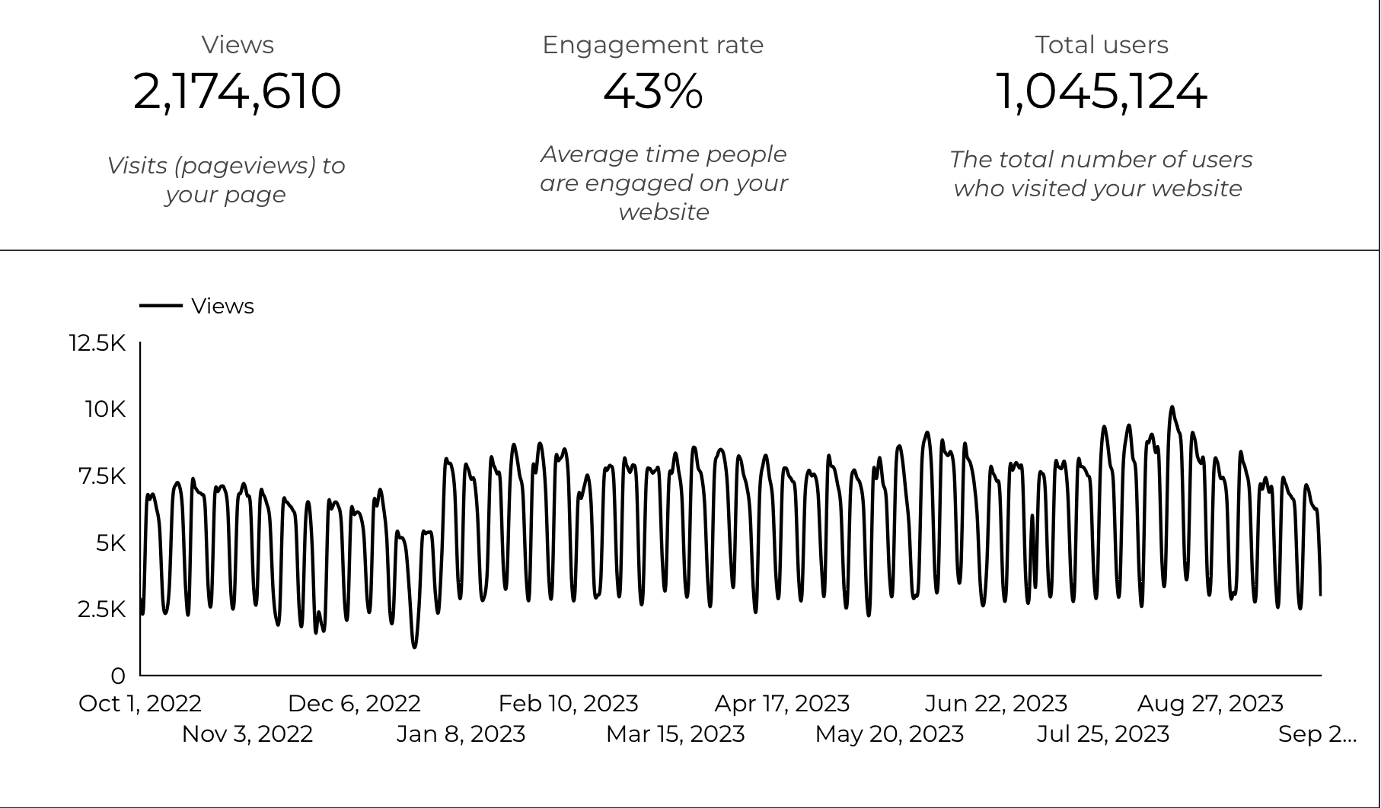
Web Analytics Summary

Slide 3
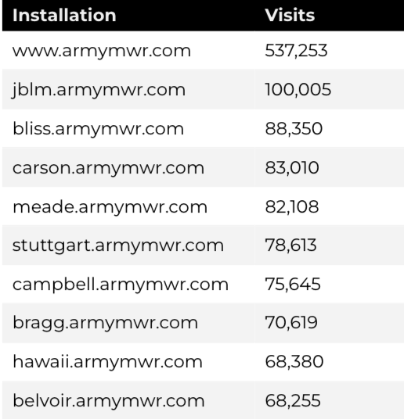
Traffic Highlights
There were a total of 2,174,610 visits, also known as pageviews, to Child and Youth Services (CYS) web pages.
On average, each user viewed 2.1 pages.

Slide 4
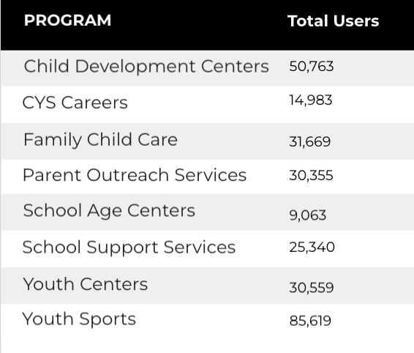
Visitor Highlights
How engaged were these visitors within the website?
There are 1,045,124 total users on the CYS site.
The average visit duration is 2 minutes and 31 seconds.
A total of 789,626 visitors were new to the website.
76% of all visitors were new.

Slide 5
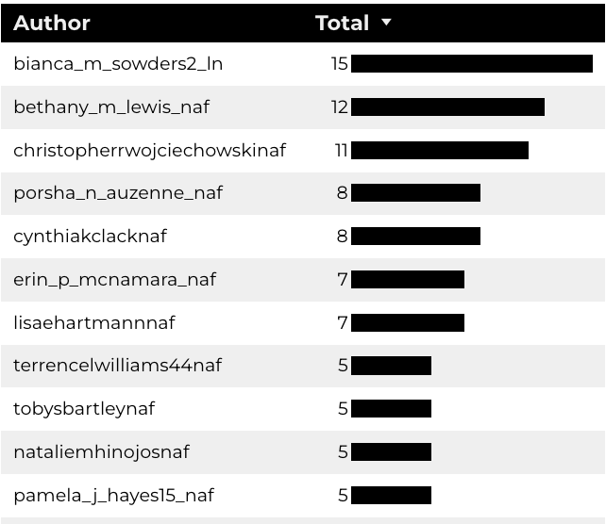
Top 10 CYS Content Creators

Slide 6

New Pages
Web managers created 281 new CYS pages, program pages, and happenings on EPW last year. (Data from EPW Page Report)

Slide 7
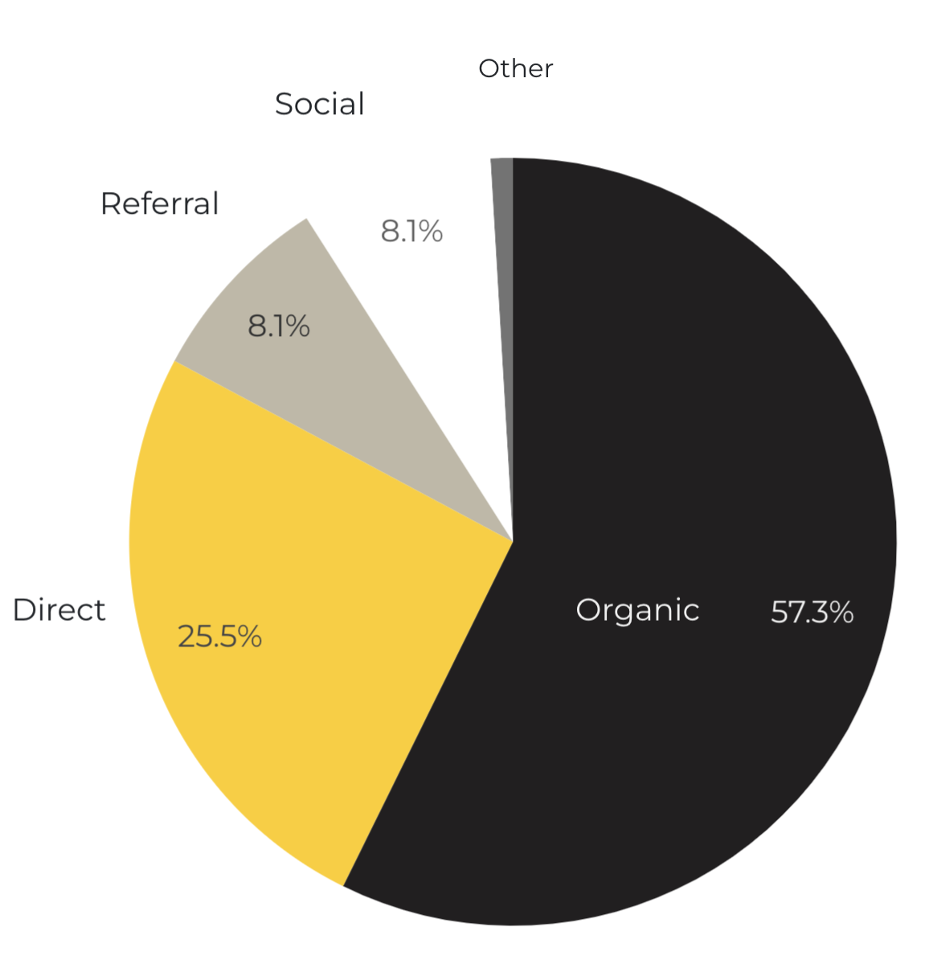
Marketing Reach
57.3% of visitors came from online search engines.
25.5% came directly to the site (by typing in the address, using bookmarks, or email links).
8.1% of visitors came from referrals.
8.1% of visitors came from social media.
1% Other (traffic that has an acquisition source Google doesn’t know how to classify).
9.2%
63.8%

Slide 8
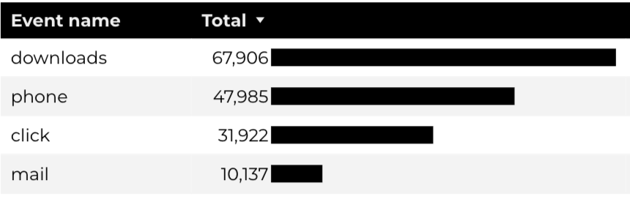
Engagement Insights & Highlights
Last quarter there were a total of 422,003 interactions on the CYS pages, which included downloads, email clicks, phone number clicks, and outbound links.

Slide 9
CYS Careers
6,666 people looking for employment took action and clicked on USAJOBS.gov.
2019 downloads of the CYS Career Guide.
240 Rack Card downloads.

Slide 10
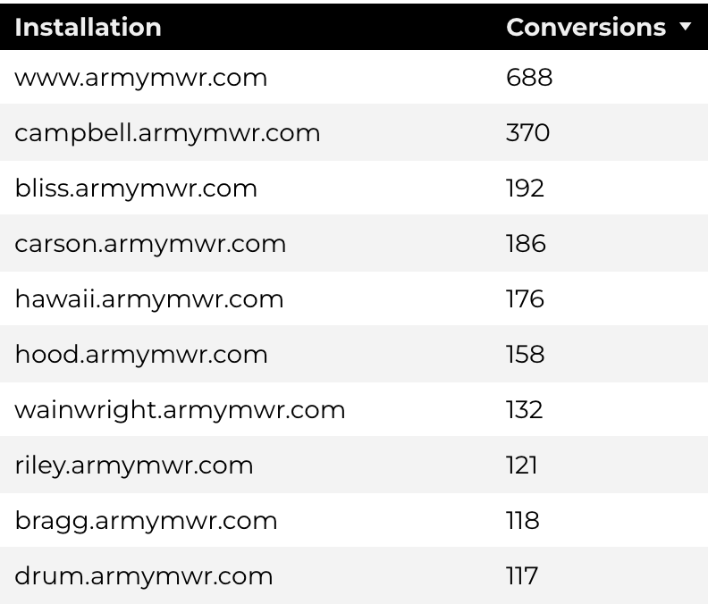
Family Child Care
53,496 visits to program pages.
31,669 users to FCC program pages.
3011 downloads of DA 5219 form!

Slide 11
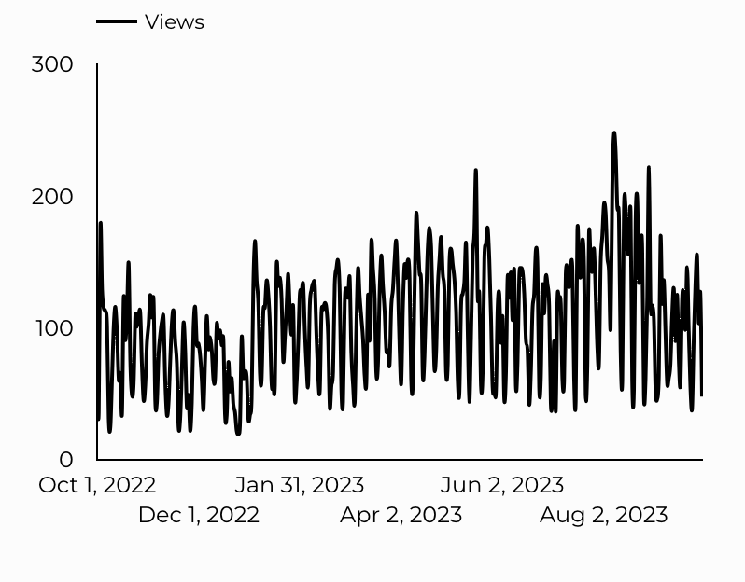
School Support Services
25,340 users made a visit to School Support Services pages.
418 people clicked to watch the 'What Is A SLO Anyway’ video.

Slide 12
Search Intent
Search intent is defined as being the underlying purpose behind an online query.
49% Searches looking to investigate brands or services and intending to complete an action or purchase.
40% Searches looking for an answer to a specific question or general information.
13% Searches intending to find a specific program, page using the onsite search.

Slide 13
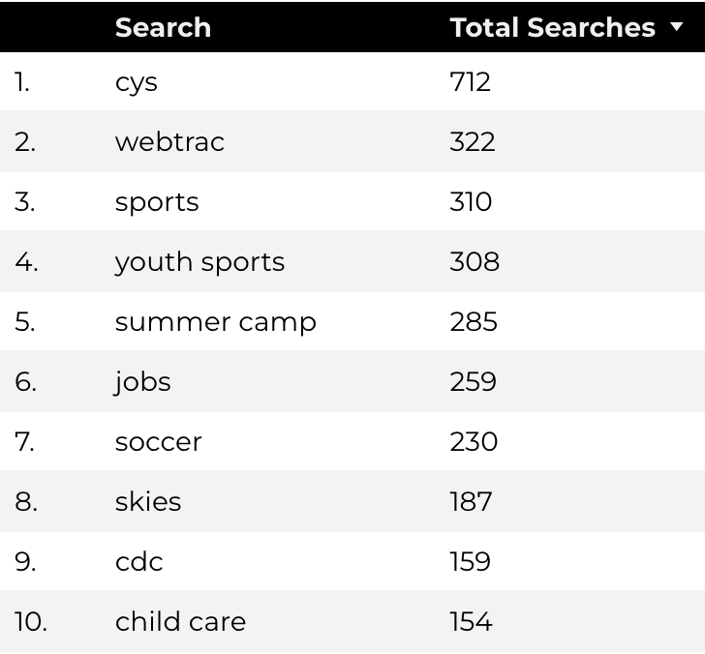
Search Insights
Top Searches
22,392 Total on-site searches on CYS pages to find more information.
95.74% of users left the site after performing a search.

Slide 14
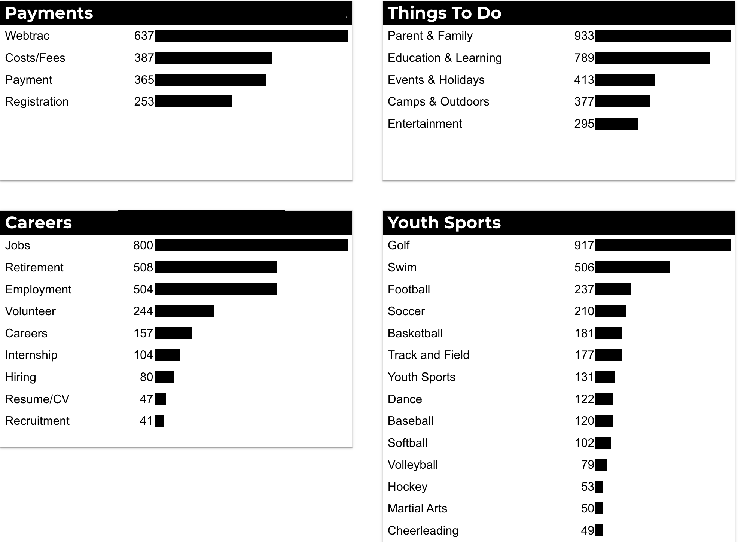
What Are The Top Search Sub-Topics?
The most popular search categories > terms within CYS.

