Slide 1
BRD Second Quarter FY24 Insights
1 JAN – 31 MAR
​

Slide 2
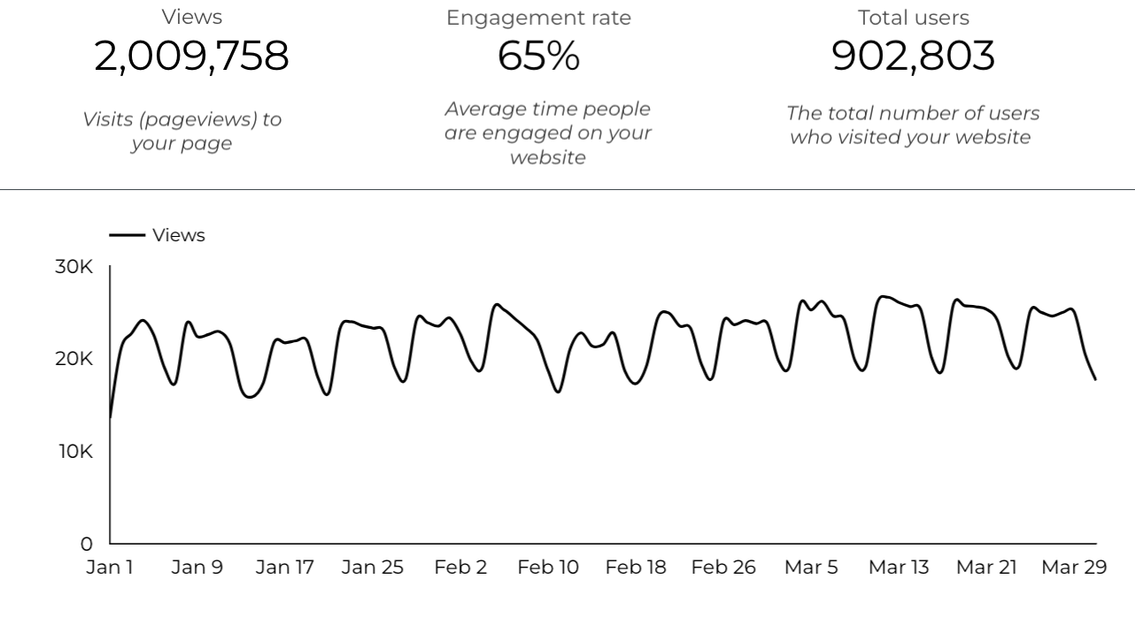
Web Analytics Summary

Slide 3
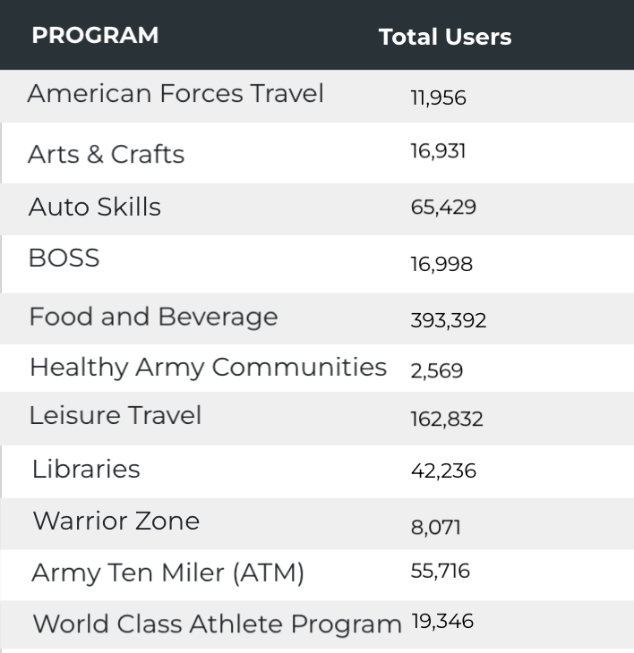

Visitor Highlights
8,761 People clicked on the Chow Now button to start an order.

Slide 4
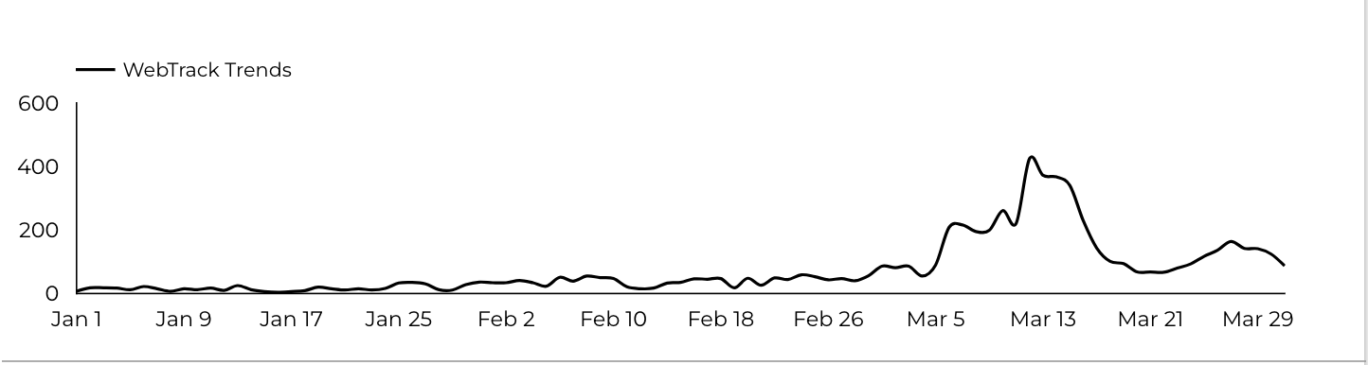
Sport and Fitness
Golf
6,711 People clicked to schedule a tee time or register for a golf clinic.

Slide 5
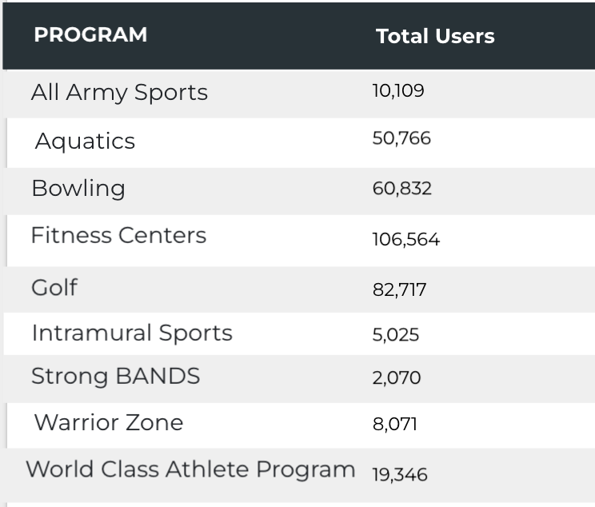
Visitor Highlights
Sports and Fitness

Slide 6
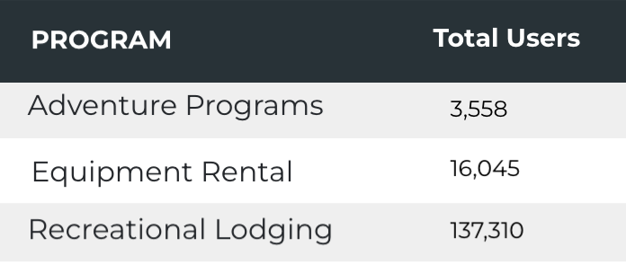
Visitor Highlights
Outdoor Rec

Slide 7
Visitor Highlights
How engaged were these visitors within the website?
On average, users visited 2.24 pages per visit.
On average, users stayed on the site for 2 minutes and 47 seconds per visit.
707,556 visitors were new to the website.
65% of visitors took action on a page!

Slide 8
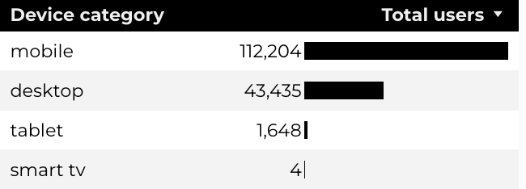
Traffic Highlights
  BRD pages received 2,009,758 visits last quarter.
  The majority of social traffic came from Facebook.
  Users by Device Category

Slide 9
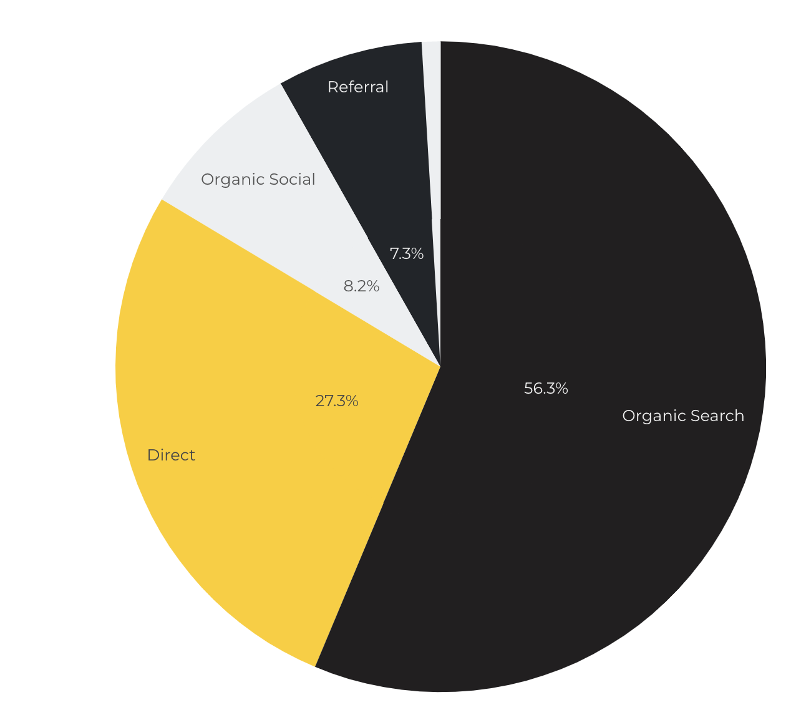
Marketing Reach
Other
|
56.3% of visitors came from online search engines.
27.3% came directly to the site (by typing in the address, using bookmarks, or email links).
8.2% of visitors came from social media.
7.3% of visitors came from referrals.
.9% Other (traffic that has an acquisition source Google doesn't know how to classify).

Slide 10
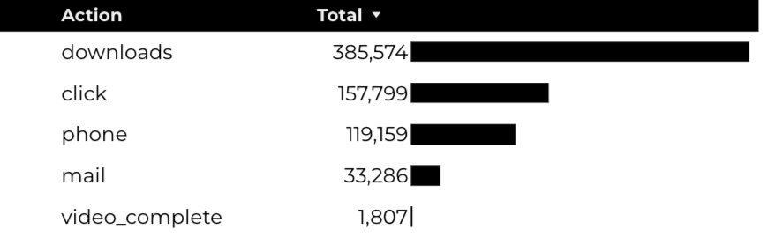
Engagement Insights & Highlights
Last quarter had a total of 697,625 interactions on the pages (including downloads, email clicks, phone number clicks, outbound links, and videos).

Slide 11
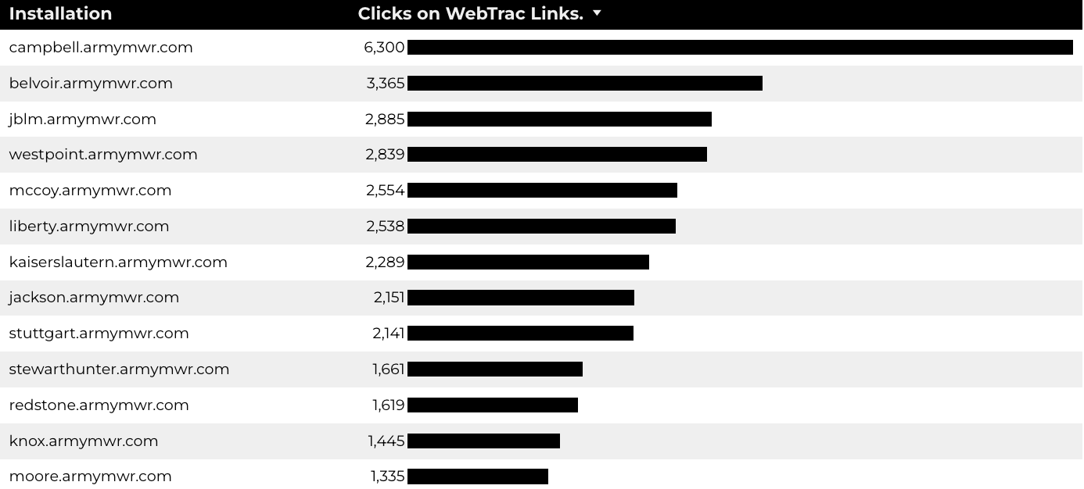
WebTrac Insights & Highlights
43,774 People clicked on a WebTrac link from a program page to register or pay for a program.

Slide 12
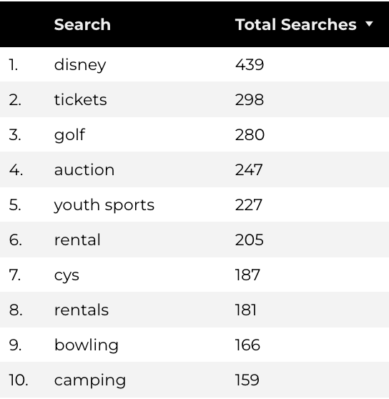
Search Insights
30,037 Total on-site searches on BRD pages to find more information.

Slide 13
Search Intent
Search intent is defined as being the underlying purpose behind an online query.
42% of searches were looking for an answer to a specific question or general information.
43% of searches were looking to investigate brands or services and intending to complete an action or purchase.
15% of searches were intending to find a specific program page using the on-site search.

Slide 14
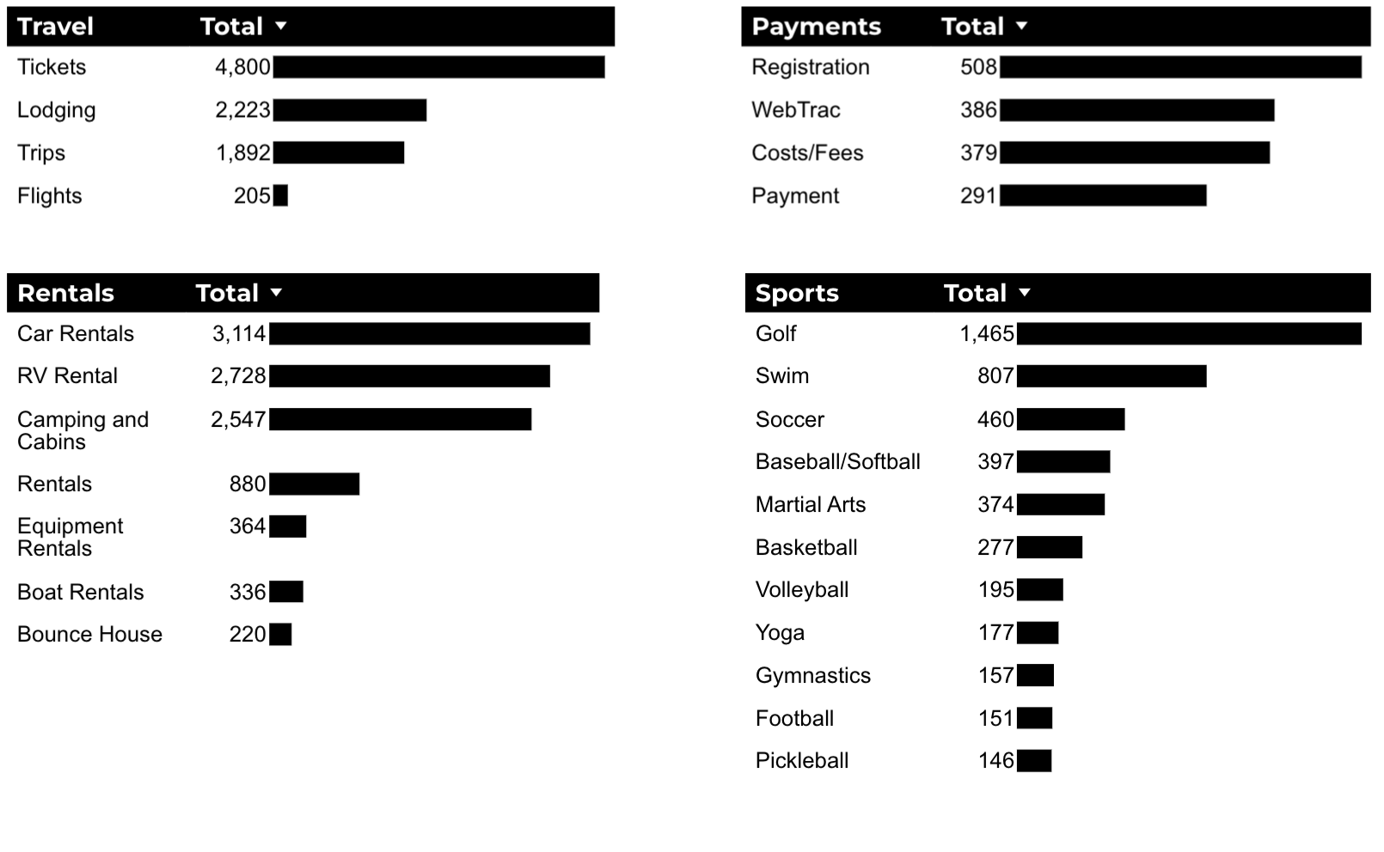
What Are The Top Search Sub-Topics?
The most popular search categories and terms within BRD

