Slide 1
BRD Third Quarter FY24 Insights

Slide 2
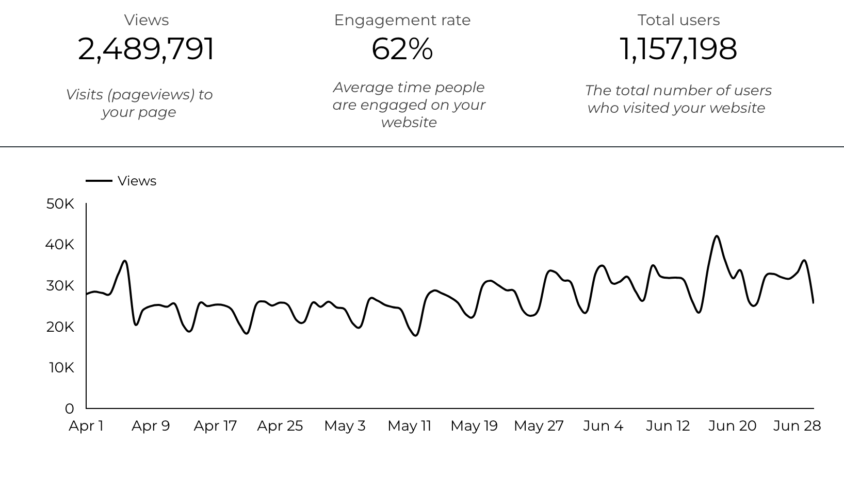
Web Analytics Summary

Slide 3
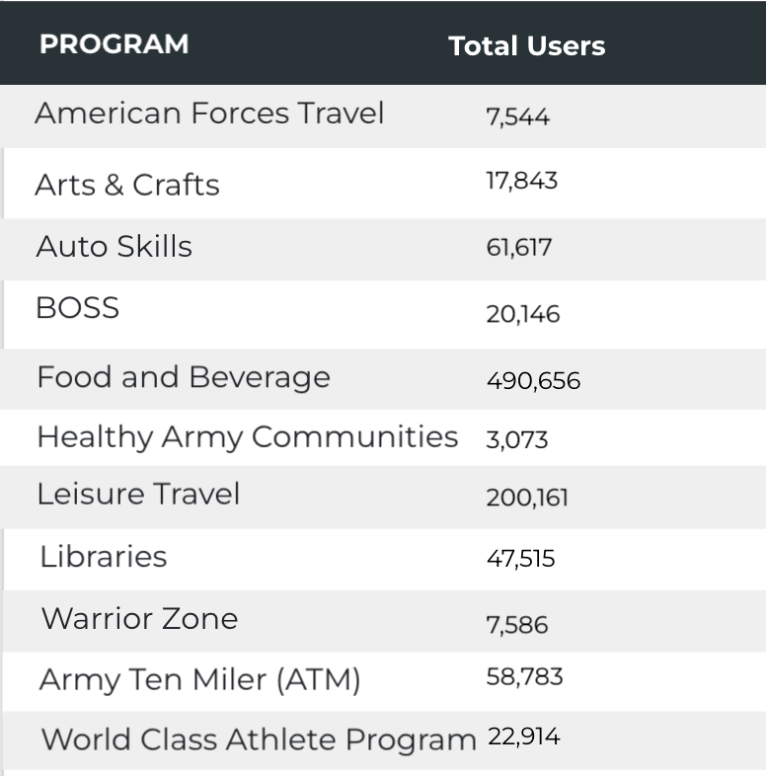

Visitor Highlights
12,025 People clicked on the Chow Now button to start an order.

Slide 4
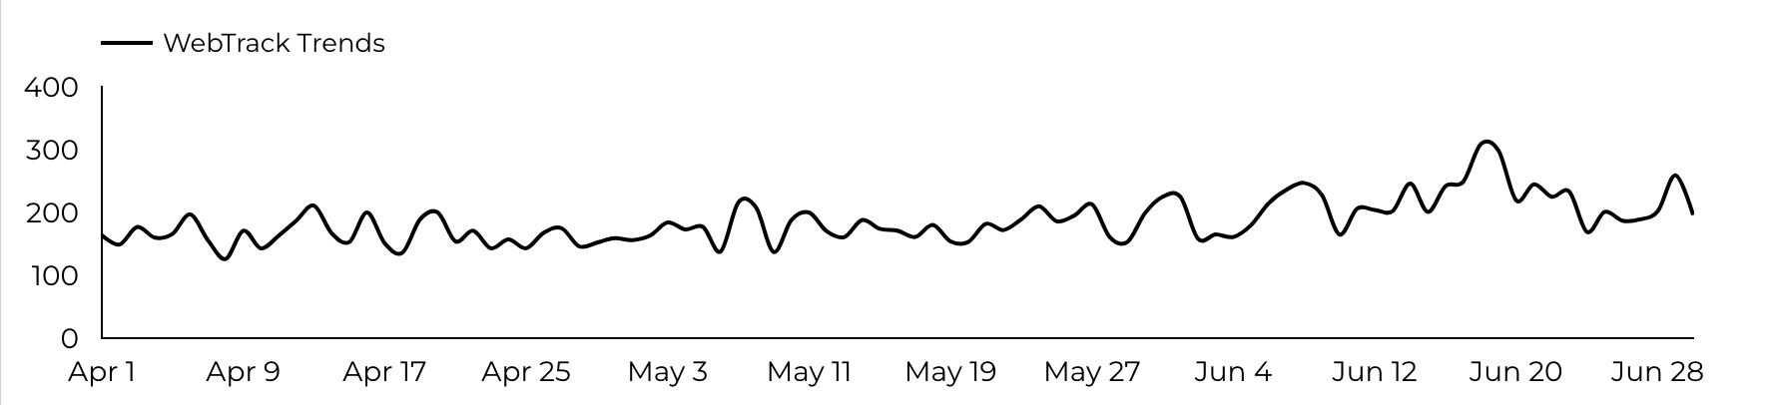
Sports and Fitness
10,271 People clicked to schedule a tee time or register for a golf clinic.

Slide 5
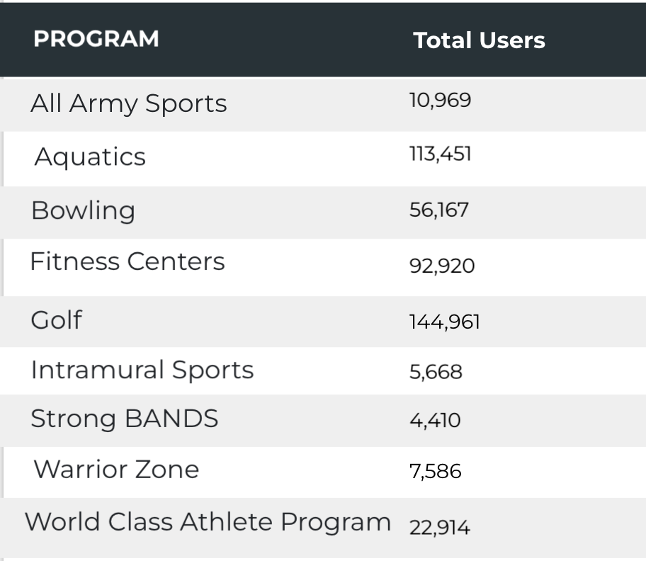
Visitor Highlights
Sports and Fitness

Slide 6
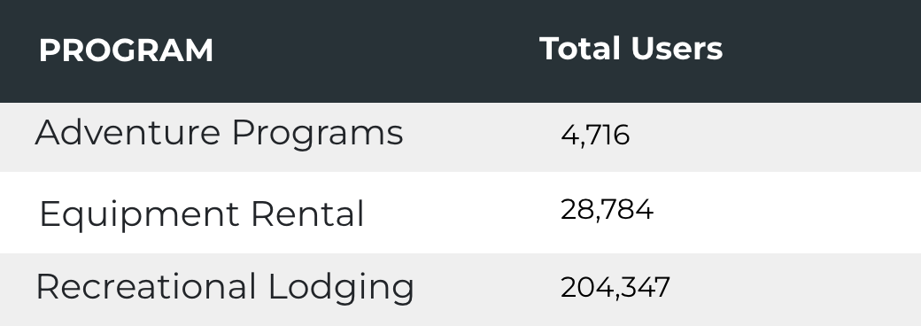
Visitor Highlights
Outdoor Rec

Slide 7
Visitor Highlights
How engaged were these visitors within the website?
On average, users visited 2.16 pages per visit.
On average, users stayed on the site for 2 minutes and 40 seconds per visit.
913,446 visitors were new to the website.
62% of visitors took action on a page!

Slide 8
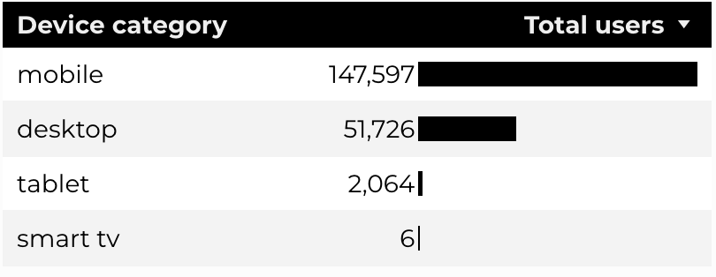
Traffic Highlights
  BRD pages received 2,489,791 visits last quarter.
  The majority of social traffic came from Facebook.
  Users by Device Category

Slide 9
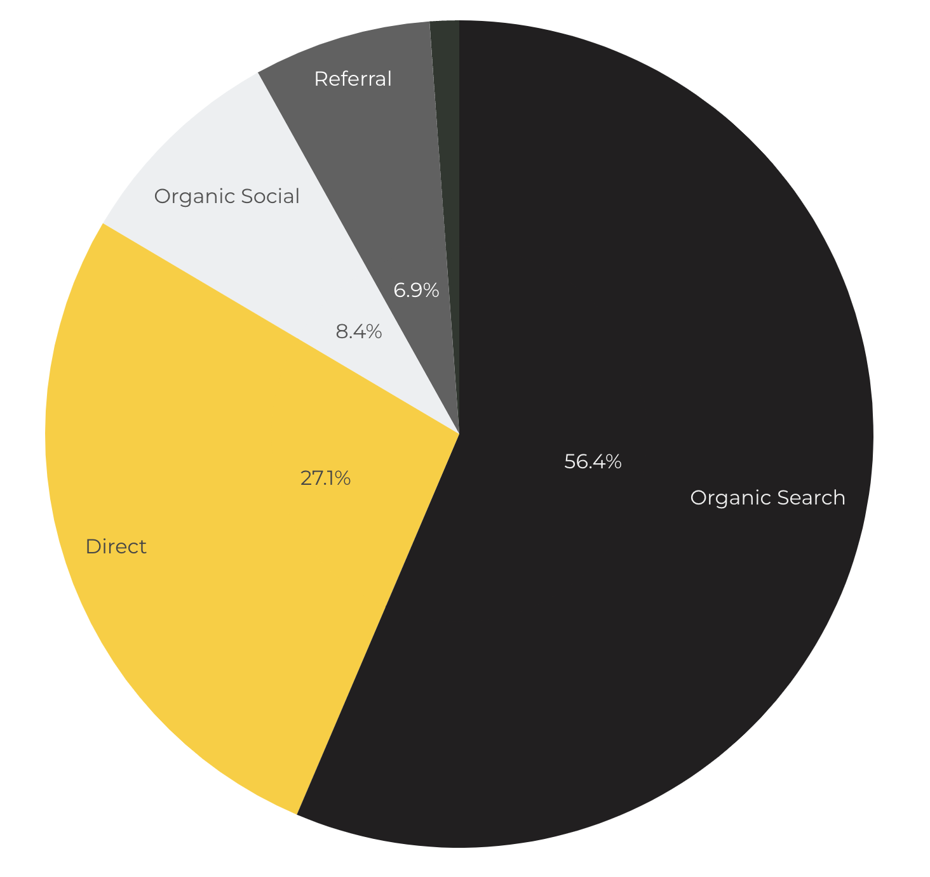
Marketing Reach
Other
|
56.4% of visitors came from online search engines.
27.1% came directly to the site (by typing in the address, using bookmarks, or email links).
8.4% of visitors came from social media.
6.9% of visitors came from referrals.
1.1% Other (traffic that has an acquisition source Google doesn't know how to classify).

Slide 10
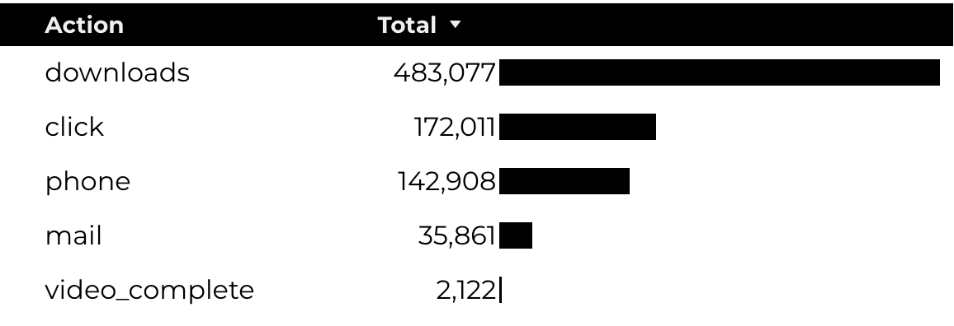
Engagement Insights & Highlights
Last quarter had a total of 835,979 interactions on the pages (including downloads, email clicks, phone number clicks, outbound links, and videos).

Slide 11
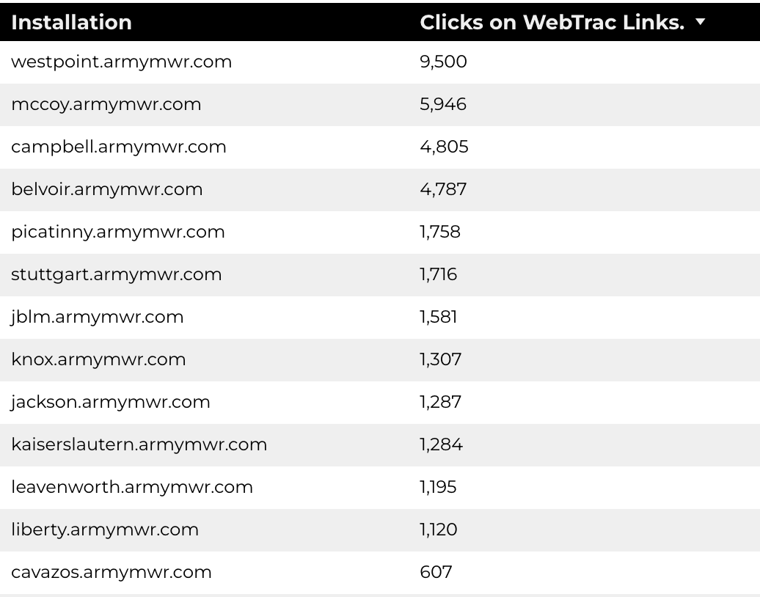
WebTrac Insights & Highlights
43,542 People clicked on a WebTrac link from a program page to register or pay for a program.

Slide 12
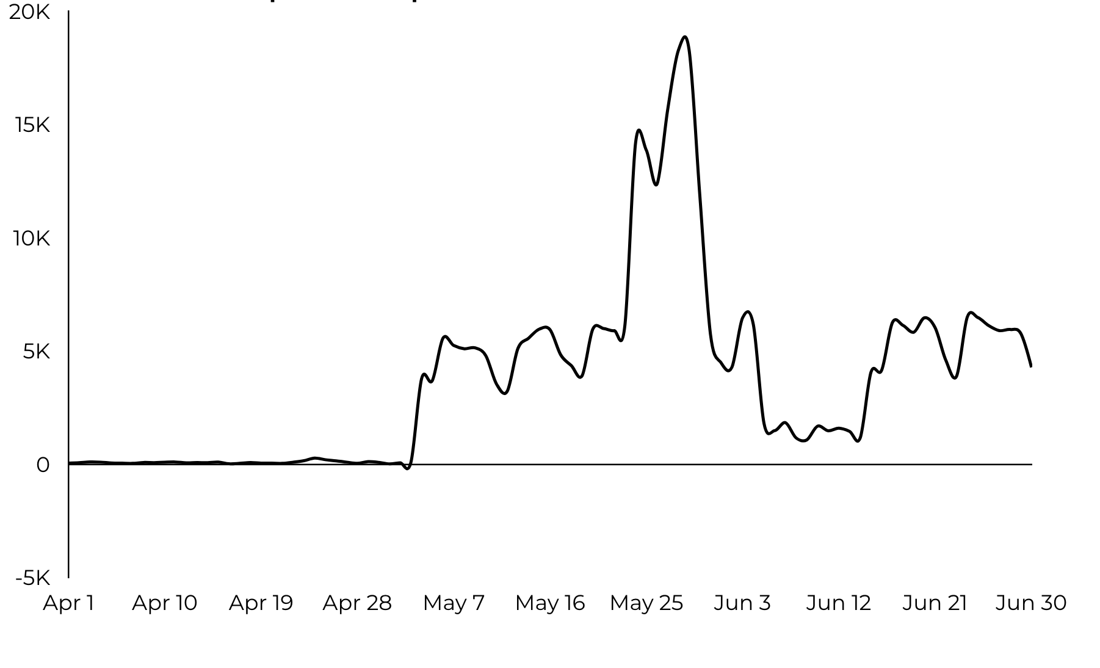
Summer Reading Program
338,369 Stripe Impressions
5,641 Clicks to Beanstack
Total Users grew 22.6% to 11,981
Stripe Impression Trends

Slide 13
Strong B.A.N.D.S.
41,422 Stripe Impressions
441 Link clicks to fitness content
New Users grew 45.4% to 1,567
Stripe Impression Trends

Slide 14
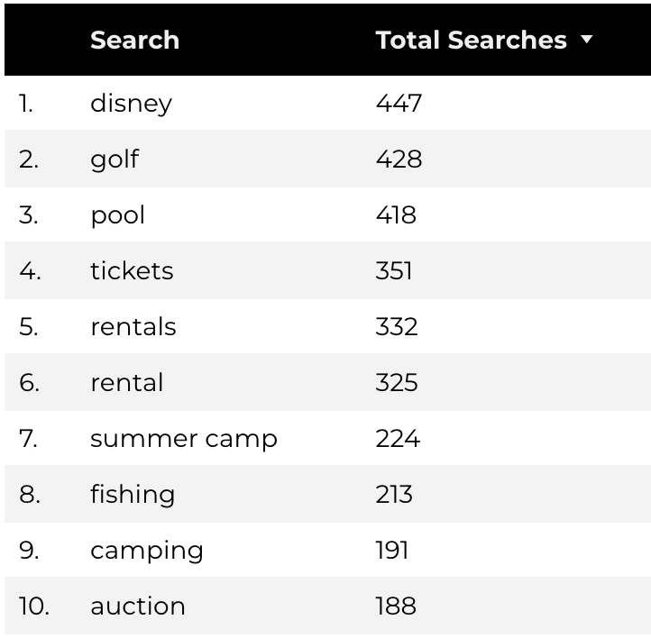
Search Insights
34,163 Total on-site searches on BRD pages to find more information.

Slide 15
Search Intent
Search intent is defined as being the underlying purpose behind an online query.
42% of searches were looking for an answer to a specific question or general information.
42% of searches were looking to investigate brands or services and intending to complete an action or purchase.
16% of searches were intending to find a specific program page using the on-site search.

Slide 16
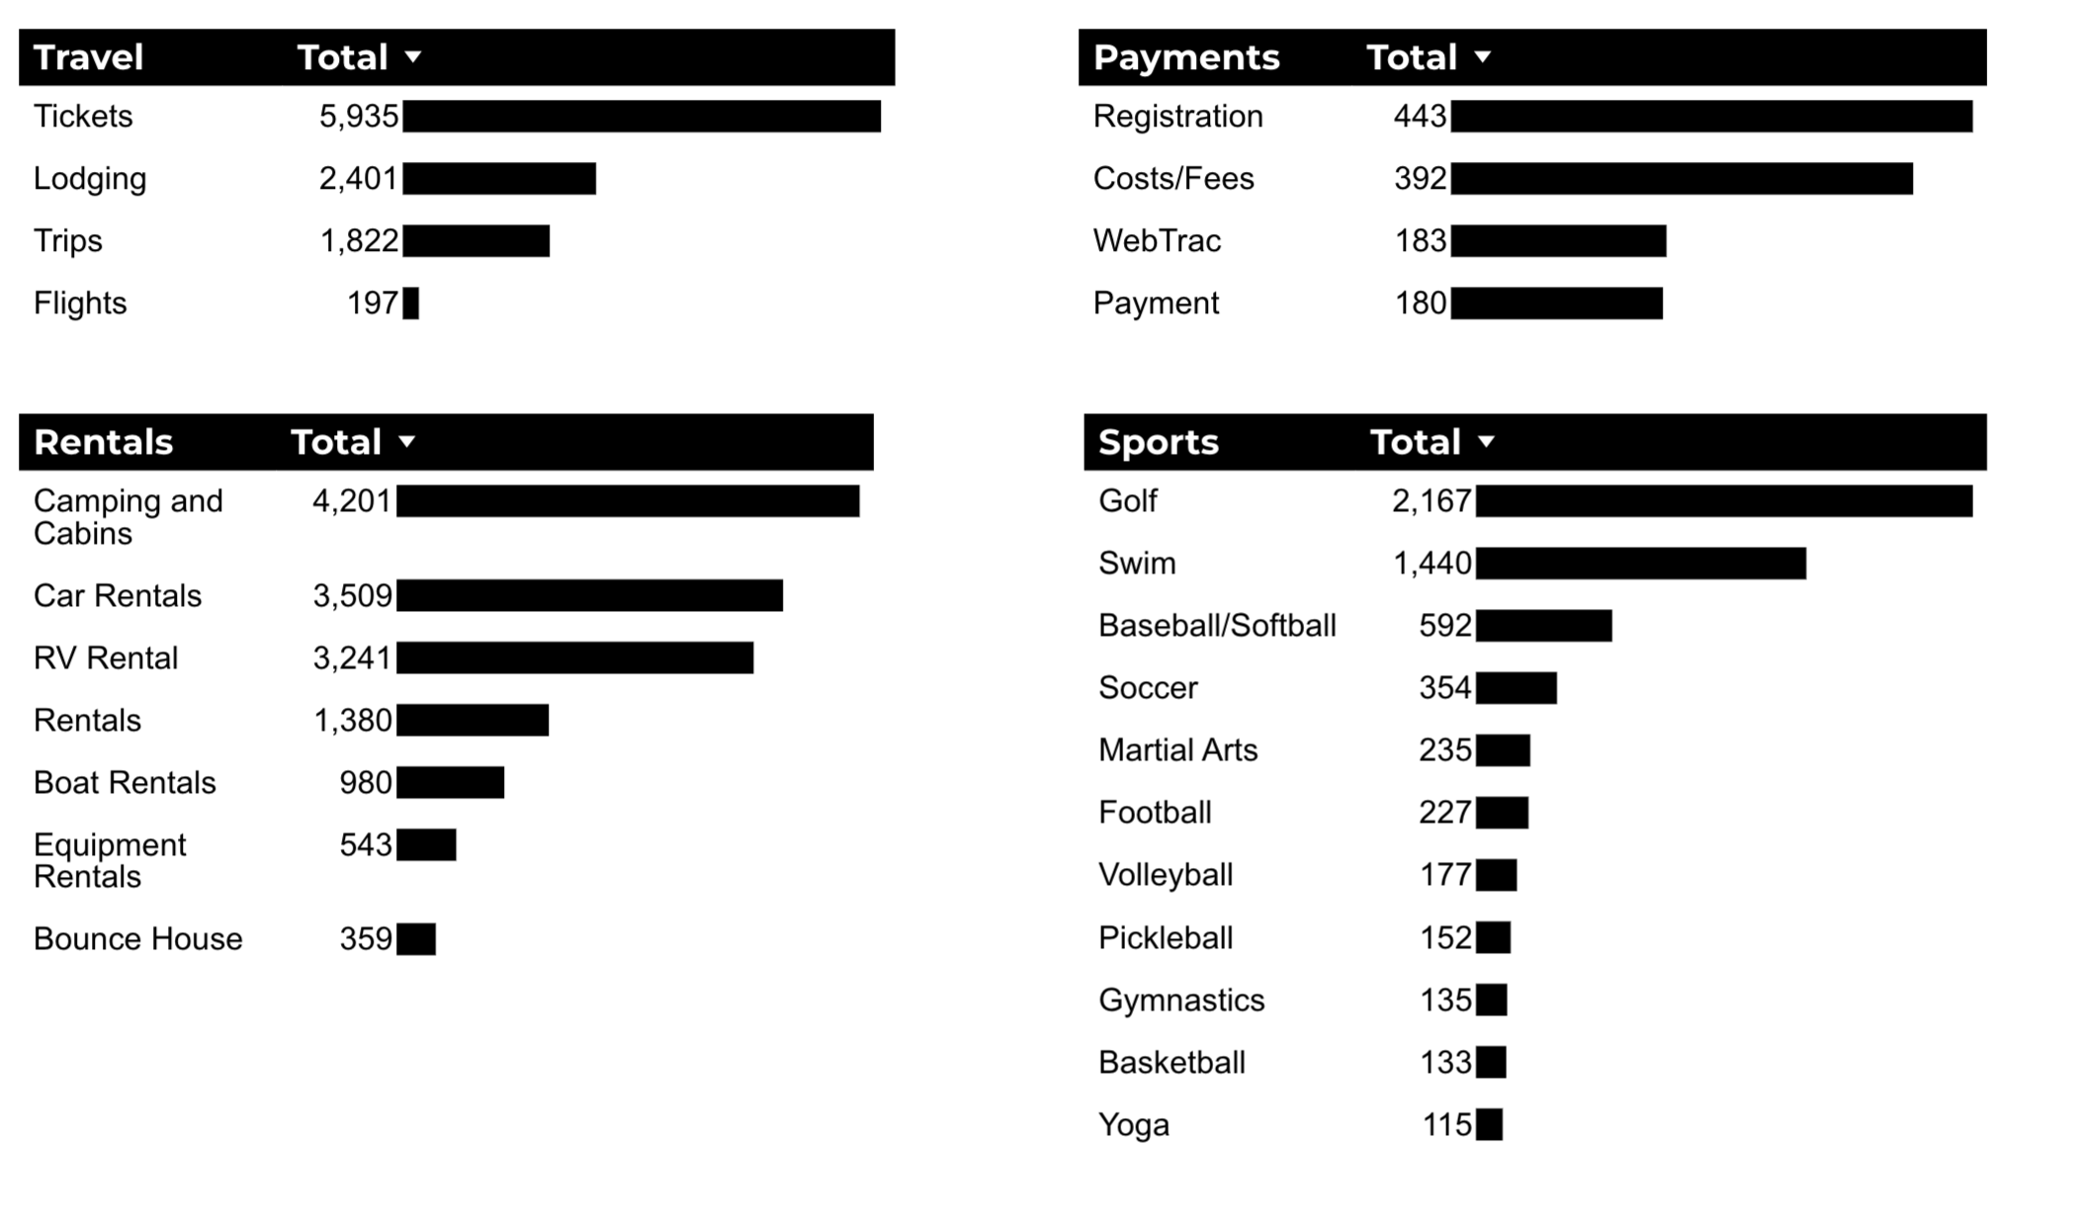
What Are The Top Search Sub-Topics?
The most popular search categories and terms within BRD

