Slide 1
Support Services First Quarter FY23 Insights
01 Oct – 31 Dec
​

Slide 2
Web Analytics Summary
Program Roll-up

Slide 3
Traffic Highlights
NAF Personnel Services
New Users increased +1.5 times from the previous year.
Mobile Traffic increased by +1.4 times from the previous year.
39.56% of visitors came from nafbenefits.com.

Slide 4
Engagement Insights & Highlights
NAF Personnel Services
There were 6,068 clicks to find more information.
1,114 people downloaded a pdf or a form.
143 people clicked an email address to get more information.
44 people needed to talk to a real person and made a phone call from the website.
Top pages (Downloads, Click Email, Phone Numbers, Outbound Links)

Slide 5
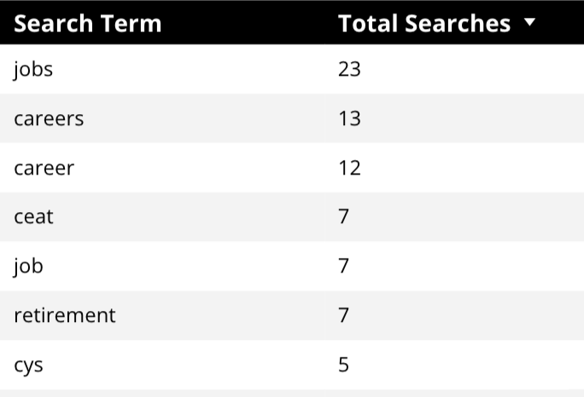
Search Insights & Highlights
NAF Personnel Services
367 Total on-site searches on NAF Personnel Services pages to find more information.
17.32% of users searched again immediately after performing a search
Top Searches

Slide 6
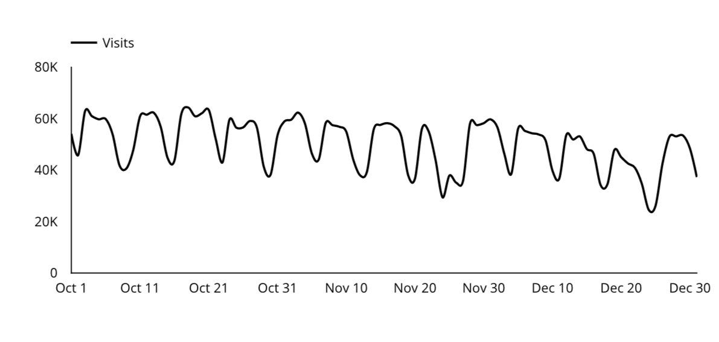
Traffic Highlights
CEAT
26,707 Visits. (pageviews to CEAT pages)
There is over 5.7% more traffic compared to the previous year!
CEAT Traffic Trends

Slide 7
Engagement Insights & Highlights
CEAT
There were 1,720 clicks to other websites to find more information.
585 people downloaded a pdf or a form.
76 people clicked an email address to get more information.

Slide 8
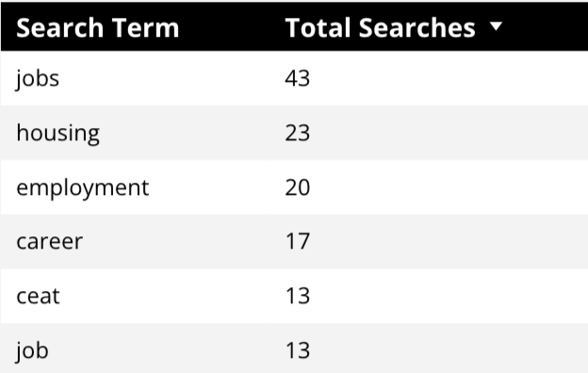
Search Insights & Highlights
CEAT
103 Total on-site searches on CEAT pages to find more information.
13.75% of users searched again immediately after performing a search.
Top Searches

Slide 9
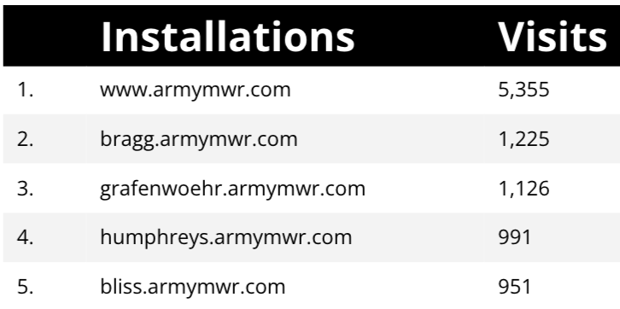
Traffic Highlights
Home Based Business (HBB)
Top Installations
22,362 Visits. (pageviews to HBB pages)
Traffic increased by 14.5% from the previous year.

Slide 10
Engagement Insights & Highlights
Home Based Business (HBB)
There were 1,605 clicks to other websites to find more information.
1,337 people downloaded a pdf or a form.
109 needed to talk to a real person.
Top installations
(Downloads, Email, Phone Numbers, Outbound Links)

Slide 11
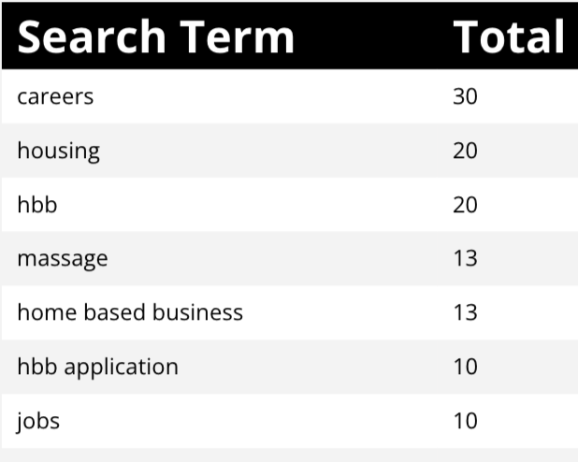
Search Insights & Highlights
Home Based Business (HBB)
733 Total on-site searches on HBB pages to find more information.
24.75% of users searched again immediately after performing a search.

