Slide 1
CYS First Quarter FY24 Insights
01 OCT – 31 DEC
​

Slide 2
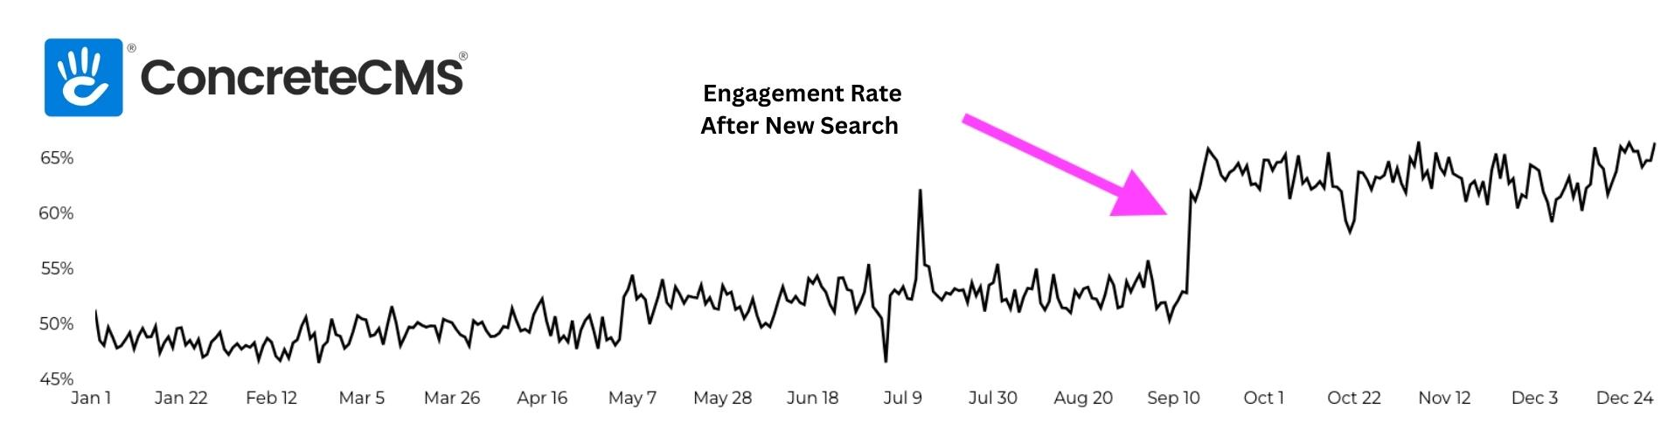
EPW Search Engagement Improvement

Slide 3
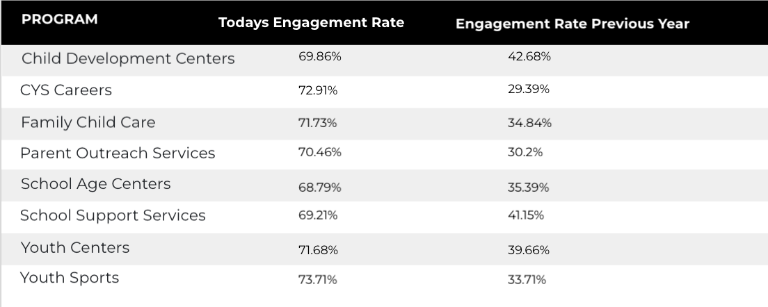
EPW Search Engagement Improvement

Slide 4
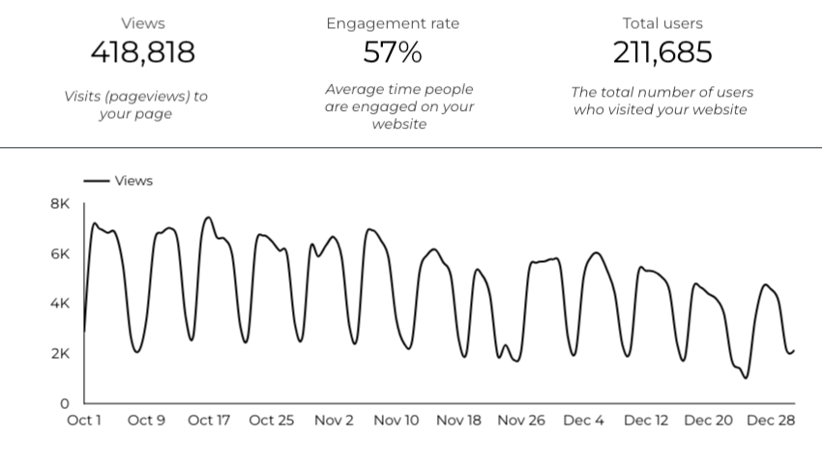
Web Analytics Summary

Slide 5
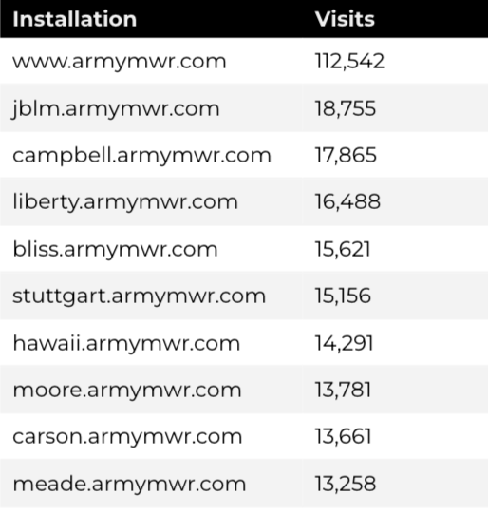
Traffic Highlights
There were a total of 418,818 visits, also known as pageviews, to Child and Youth Services (CYS) web pages.
On average, each user viewed 2 pages.

Slide 6
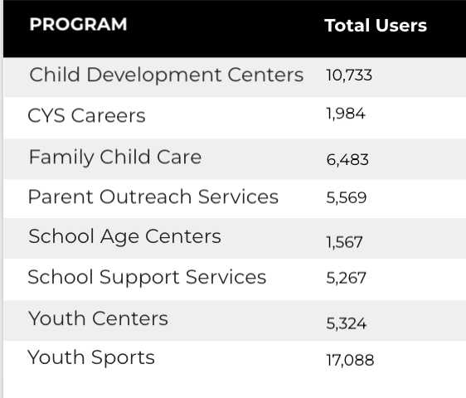
Visitor Highlights
How engaged were these visitors within the website?
There are 211,685 total users on the CYS site.
The average visit duration is 2 minutes and 37 seconds.
A total of 153,654 visitors were new to the website.
73% of all visitors were new.

Slide 7
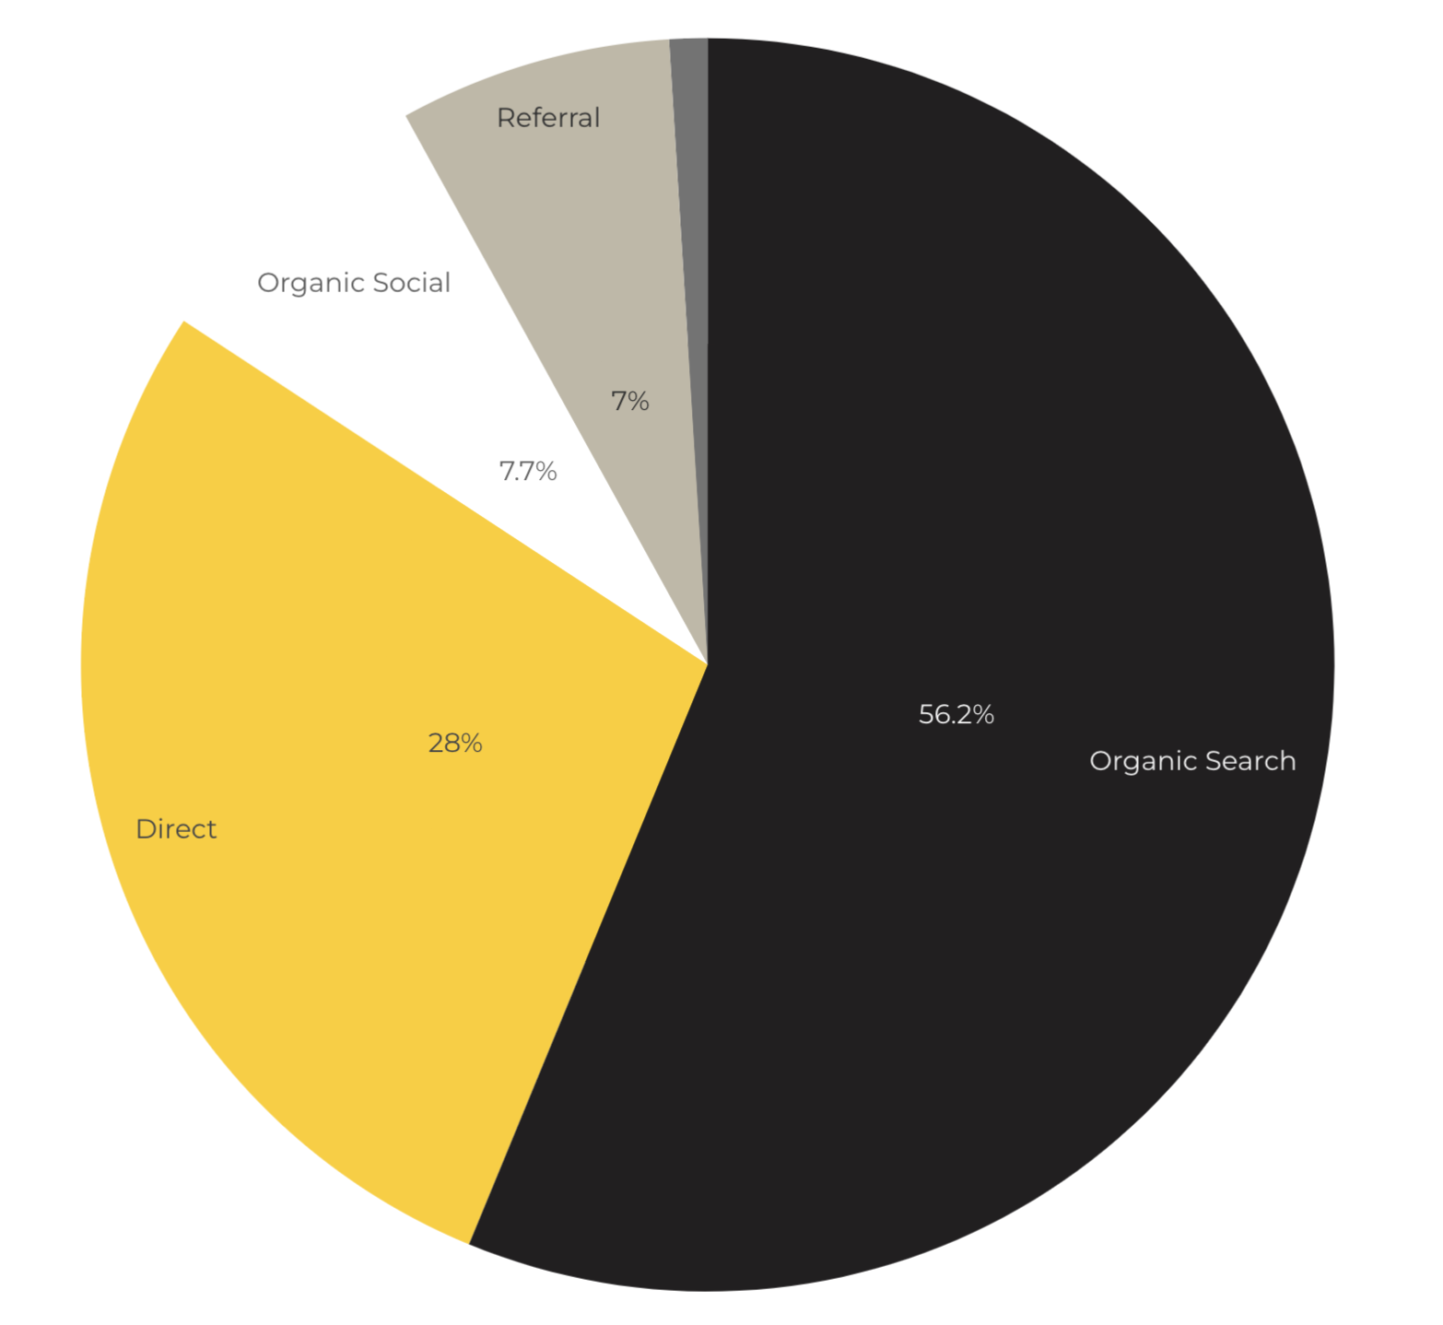
Marketing Reach
Other
|
56.2% of visitors came from online search engines.
28% came directly to the site (by typing in the address, using bookmarks, or email links).
7% of visitors came from referrals.
7.7% of visitors came from social media.
1.1% Other (traffic that has an acquisition source Google doesn’t know how to classify).
9.2%
63.8%

Slide 8
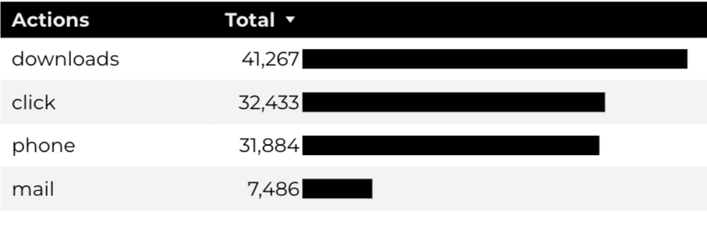
Engagement Insights & Highlights
Last quarter there were a total of 113,070 interactions on the CYS pages, which included downloads, email clicks, phone number clicks, and outbound links.

Slide 9
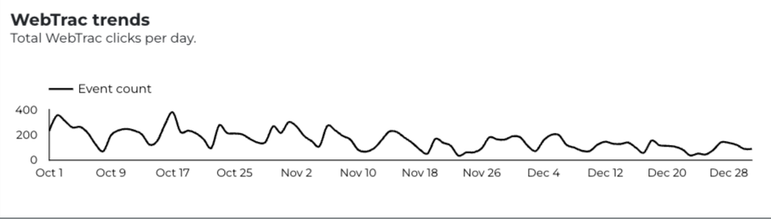
WebTrac Insights & Highlights
14,673 Parents clicked on a WebTrac link from a program page to register or pay for a CYS program.

Slide 10
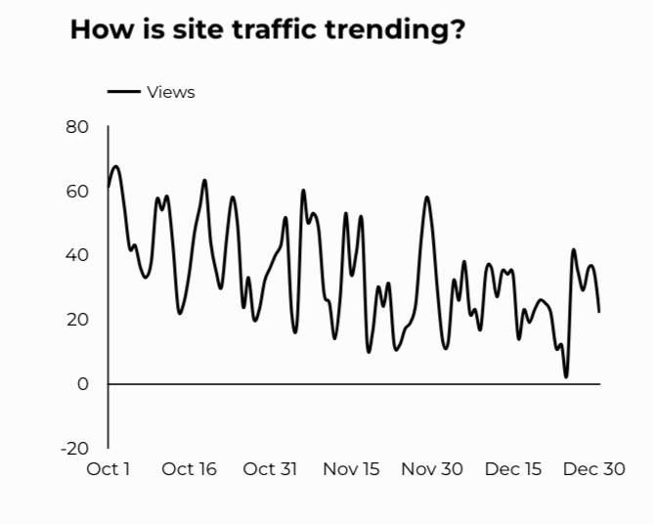
CYS Careers
988 people looking for employment took action and clicked on USAJOBS.gov.
468 downloads of the CYS Career Guide.
84 Rack Card downloads.

Slide 11
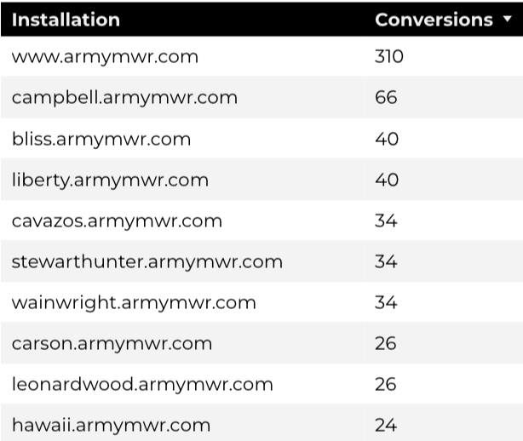
Family Child Care
10,752 visits to program pages.
6,483 users to FCC program pages.
784 downloads of DA 5219 form!

Slide 12
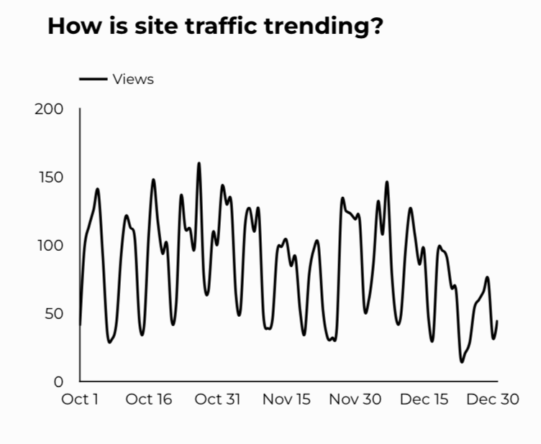
School Support Services
5,267 users made a visit to School Support Services pages.
74 people clicked to watch the 'What Is An SLO Anyway’ video.

Slide 13
Search Intent
Search intent is defined as being the underlying purpose behind an online query.
50% Searches looking to investigate brands or services and intending to complete an action or purchase.
37% Searches looking for an answer to a specific question or general information.
15% Searches intending to find a specific program, page using the onsite search.

Slide 14
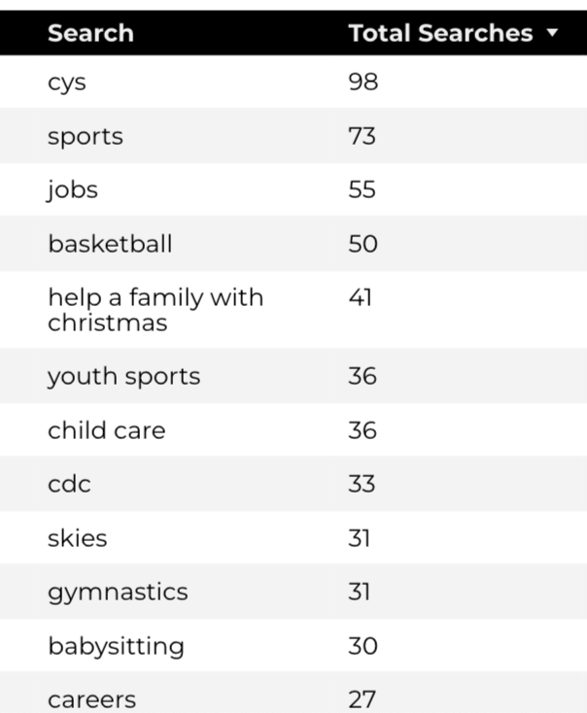
Search Insights
Top Searches
3,866 Total on-site searches on CYS pages to find more information.
2.09% of users left the site after performing a search.

Slide 15
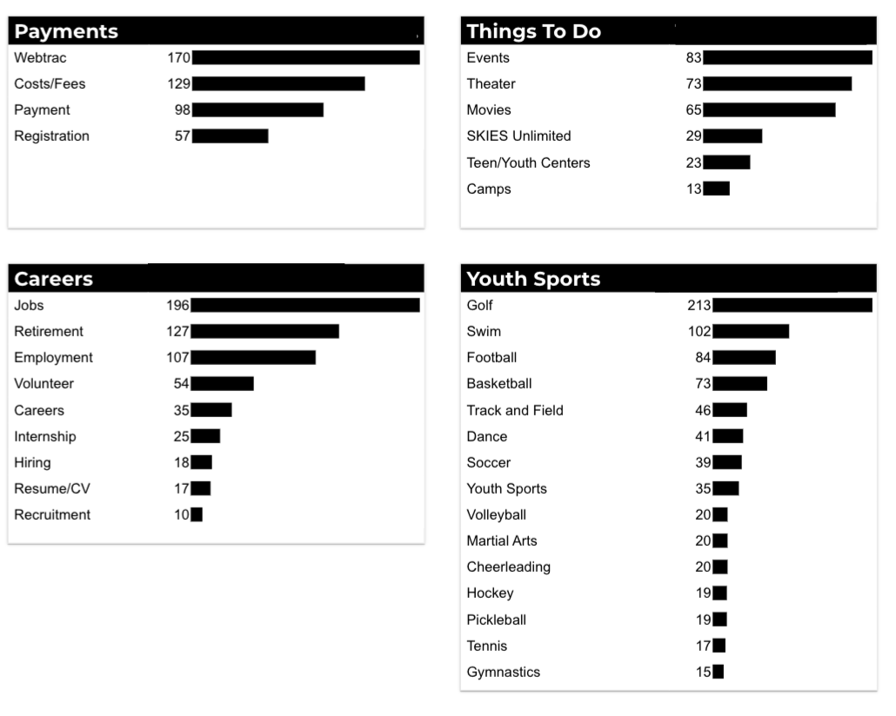
What Are The Top Search Sub-Topics?
The most popular search categories and terms within CYS

