Slide 1
BRD First Quarter FY24 Insights
01 OCT – 31 DEC
​

Slide 2
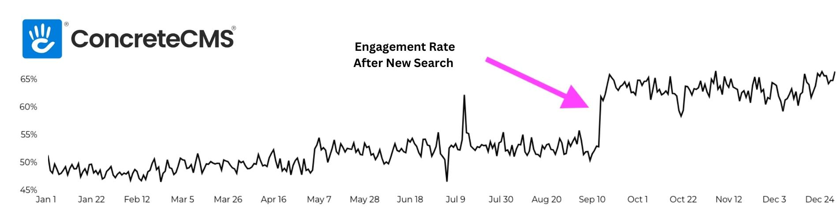
EPW Search Engagement Improvement

Slide 3
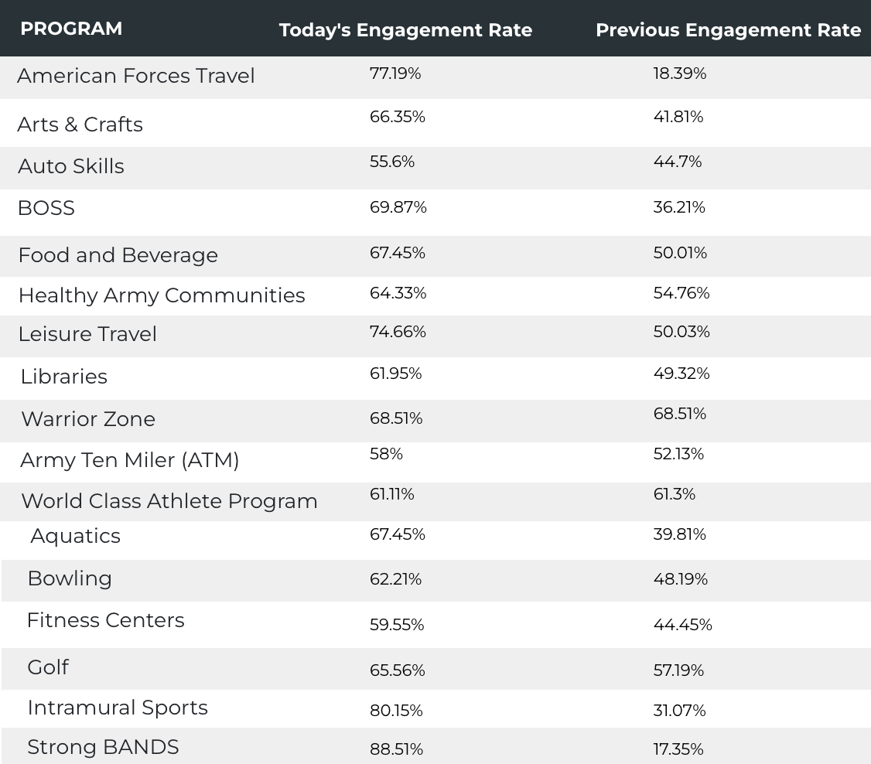
EPW Search Engagement Improvement

Slide 4
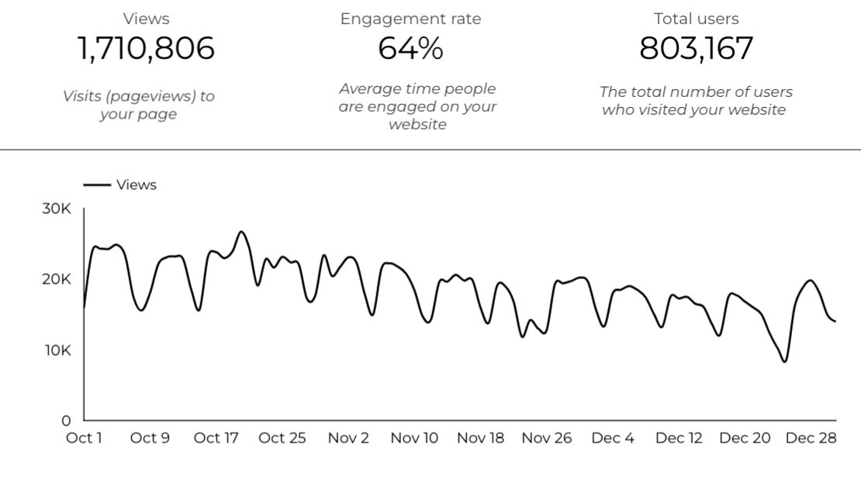
Web Analytics Summary

Slide 5
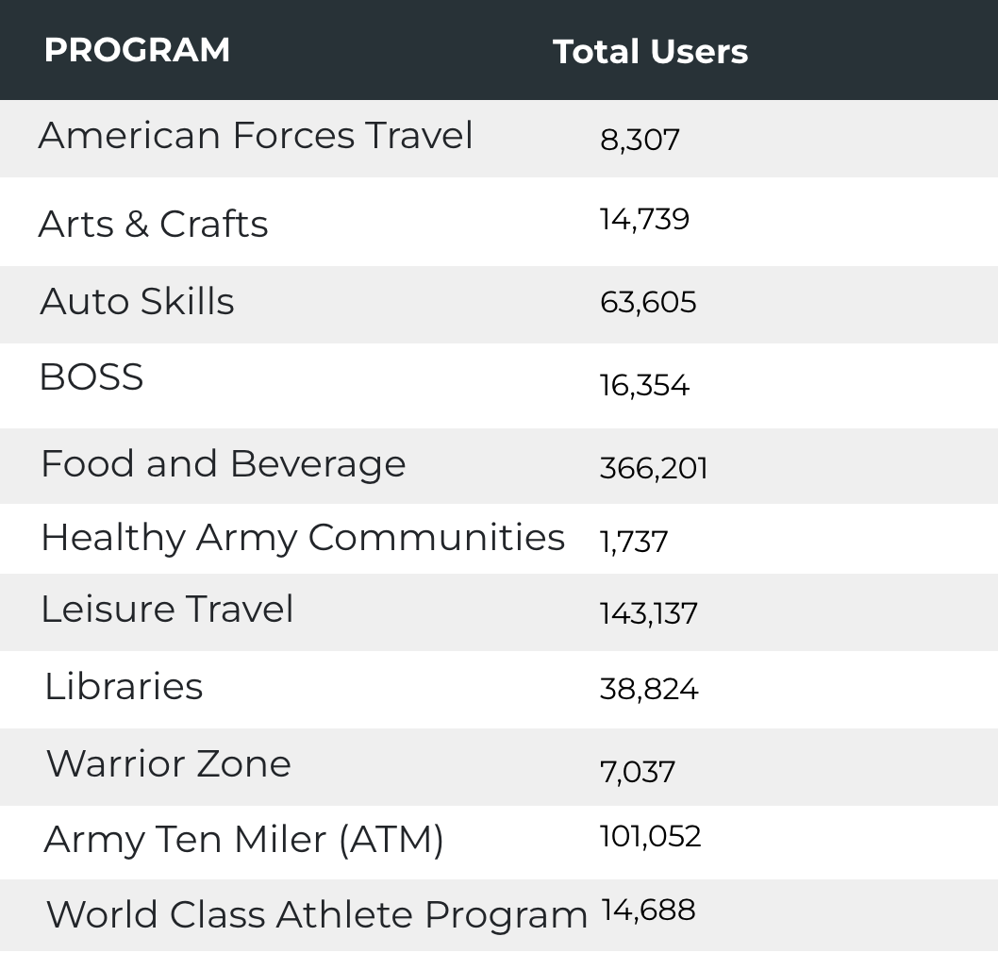

Visitor Highlights
6,876 People clicked on the Chow Now button to start an order.

Slide 6
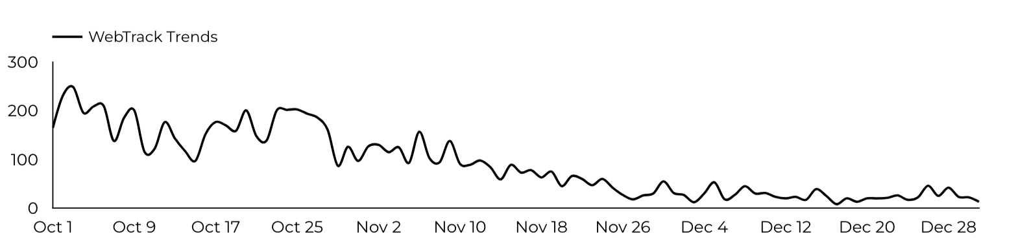
Sport and Fitness
Golf
8,307 People clicked to schedule a tee time or register for a golf clinic.

Slide 7
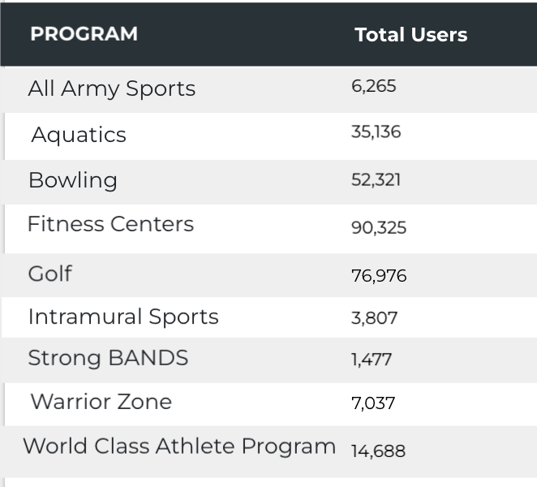
Visitor Highlights
Sports and Fitness

Slide 8
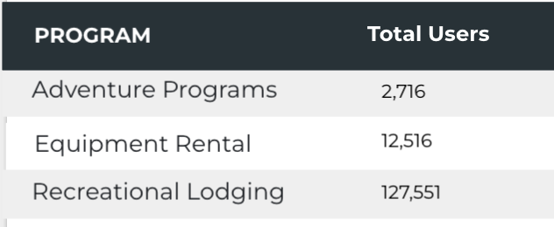
Visitor Highlights
Outdoor Rec

Slide 9
Visitor Highlights
How engaged were these visitors within the website?
On average, users visited 2.14 pages per visit.
On average, users stayed on the site for 2 minutes and 55 seconds per visit.
624,935 visitors were new to the website.
64% of visitors took action on a page!

Slide 10
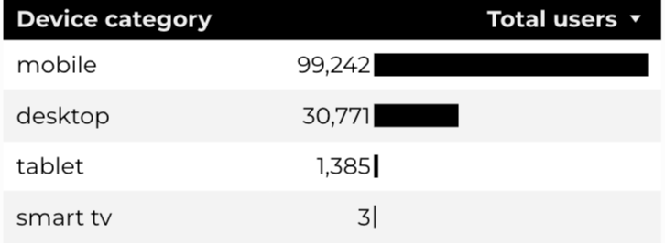
Traffic Highlights
  BRD pages received 1,710,806 visits last quarter.
  The majority of social traffic came from Facebook.
  Users by Device Category

Slide 11
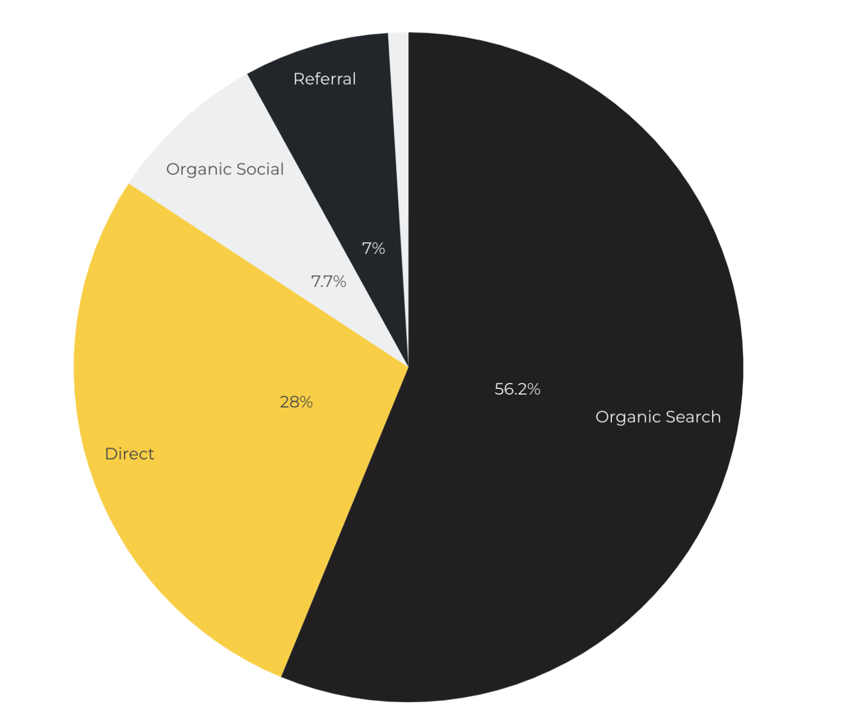
Marketing Reach
Other
|
56.2% of visitors came from online search engines.
28% came directly to the site (by typing in the address, using bookmarks, or email links).
7.7% of visitors came from social media.
7% of visitors came from referrals.
1.1% Other (traffic that has an acquisition source Google doesn't know how to classify).

Slide 12
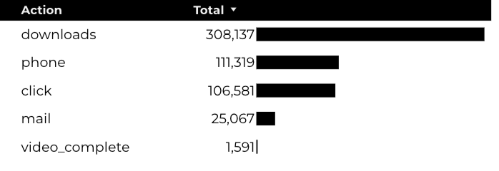
Engagement Insights & Highlights
Last quarter had a total of 552,695 interactions on the pages (including downloads, email clicks, phone number clicks, outbound links, and videos).

Slide 13
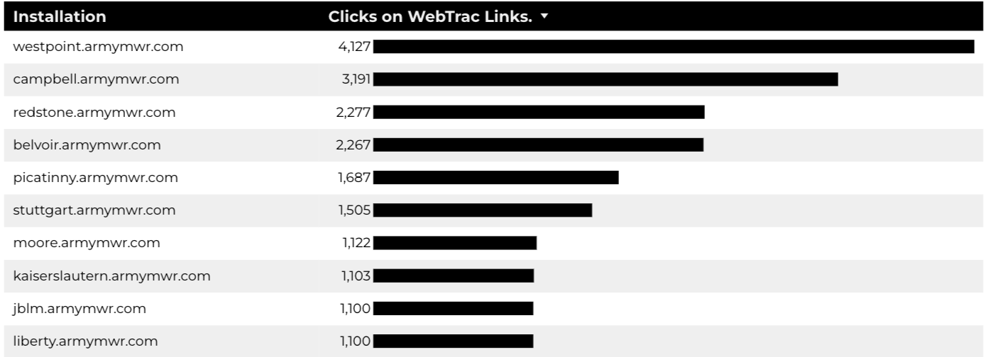
WebTrac Insights & Highlights
29,018 People clicked on a WebTrac link from a program page to register or pay for a program.

Slide 14
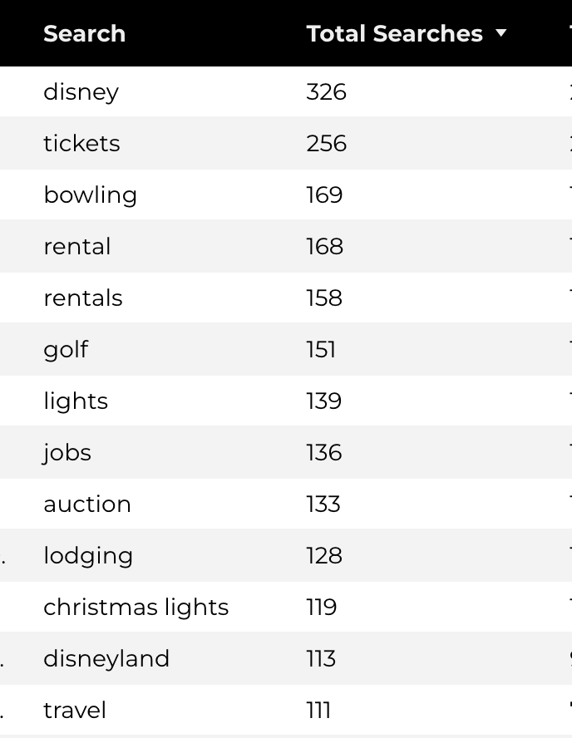
Search Insights
24,382 Total on-site searches on BRD pages to find more information.

Slide 15
Search Intent
Search intent is defined as being the underlying purpose behind an online query.
42% of searches were looking for an answer to a specific question or general information.
44% of searches were looking to investigate brands or services and intending to complete an action or purchase.
14% of searches were intending to find a specific program page using the on-site search.

Slide 16
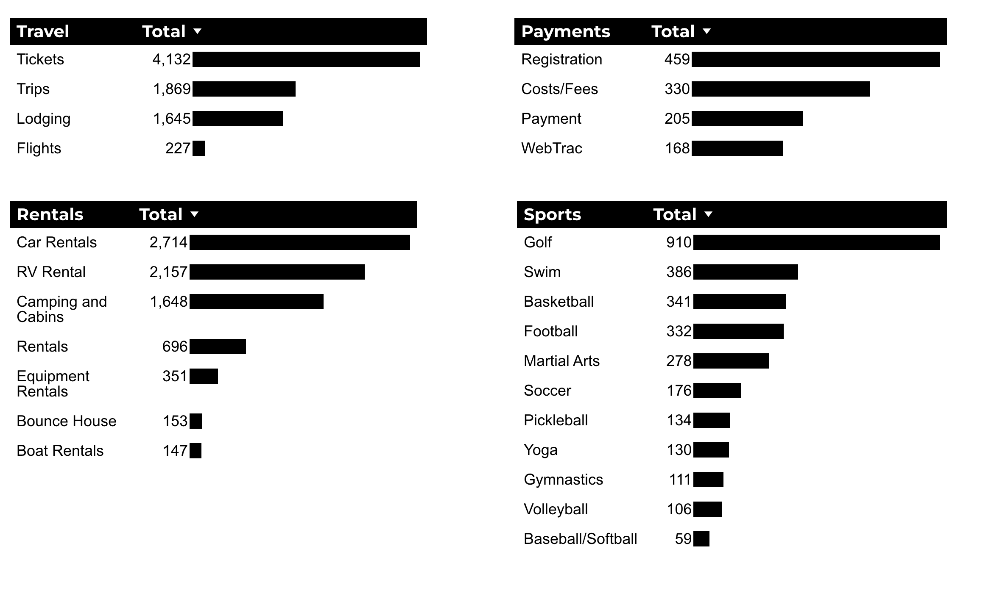
What Are The Top Search Sub-Topics?
The most popular search categories and terms within BRD

