Slide 1
ACS Second Quarter FY24 Insights
1 JAN – 31 MAR
​

Slide 2
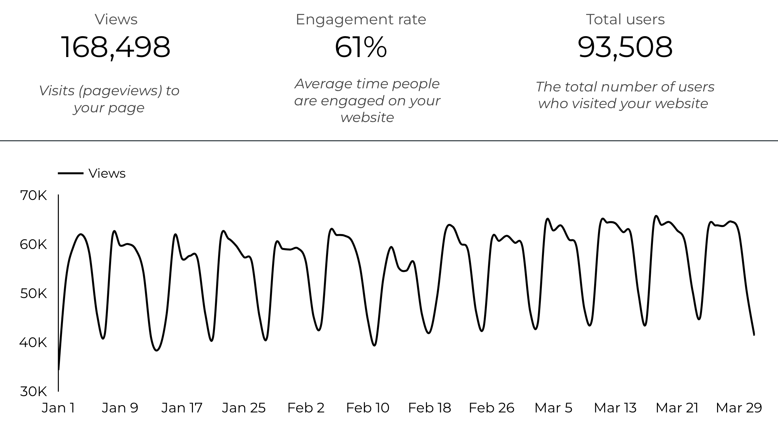
Web Analytics Summary

Slide 3
Traffic Highlights
ACS pages received 168,498 visits last quarter.
Engagement on ACS pages was 61%.
There were 93,508 total users who made a visit to ACS.
3,970 visits were directed from social media platforms.
Most of the social traffic came from Facebook.

Slide 4
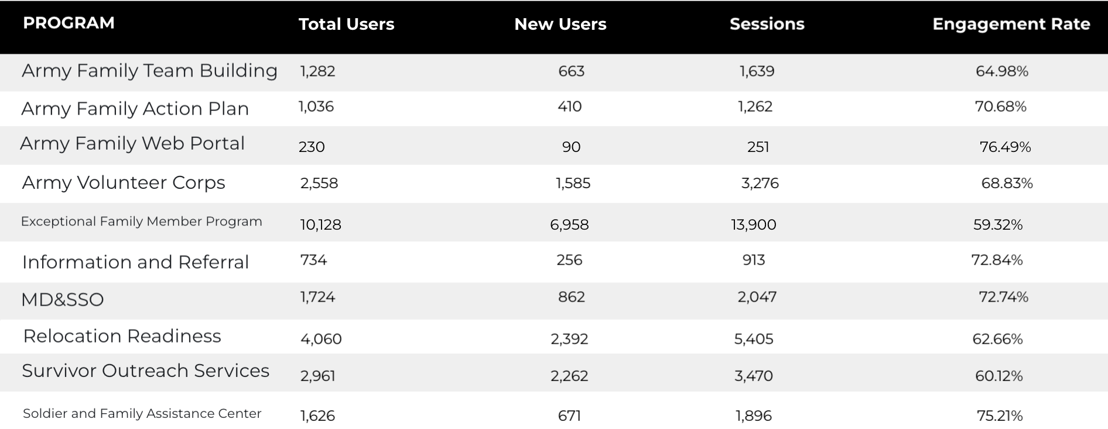
Visitor Highlights

Slide 5
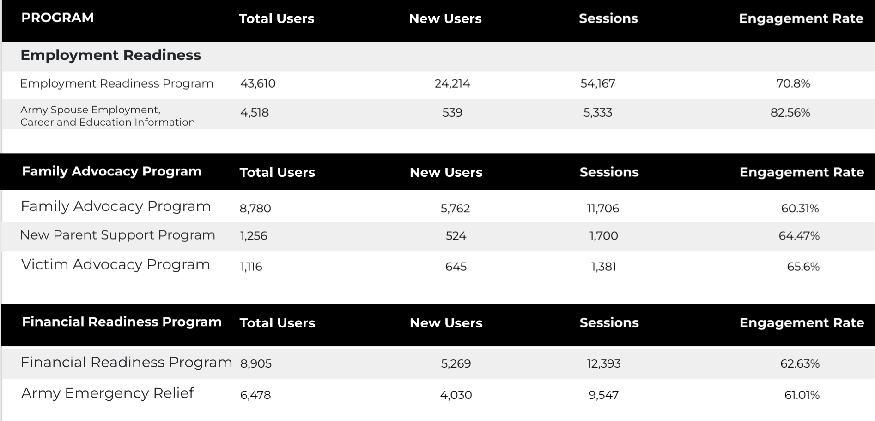
Visitor Highlights
Continued

Slide 6
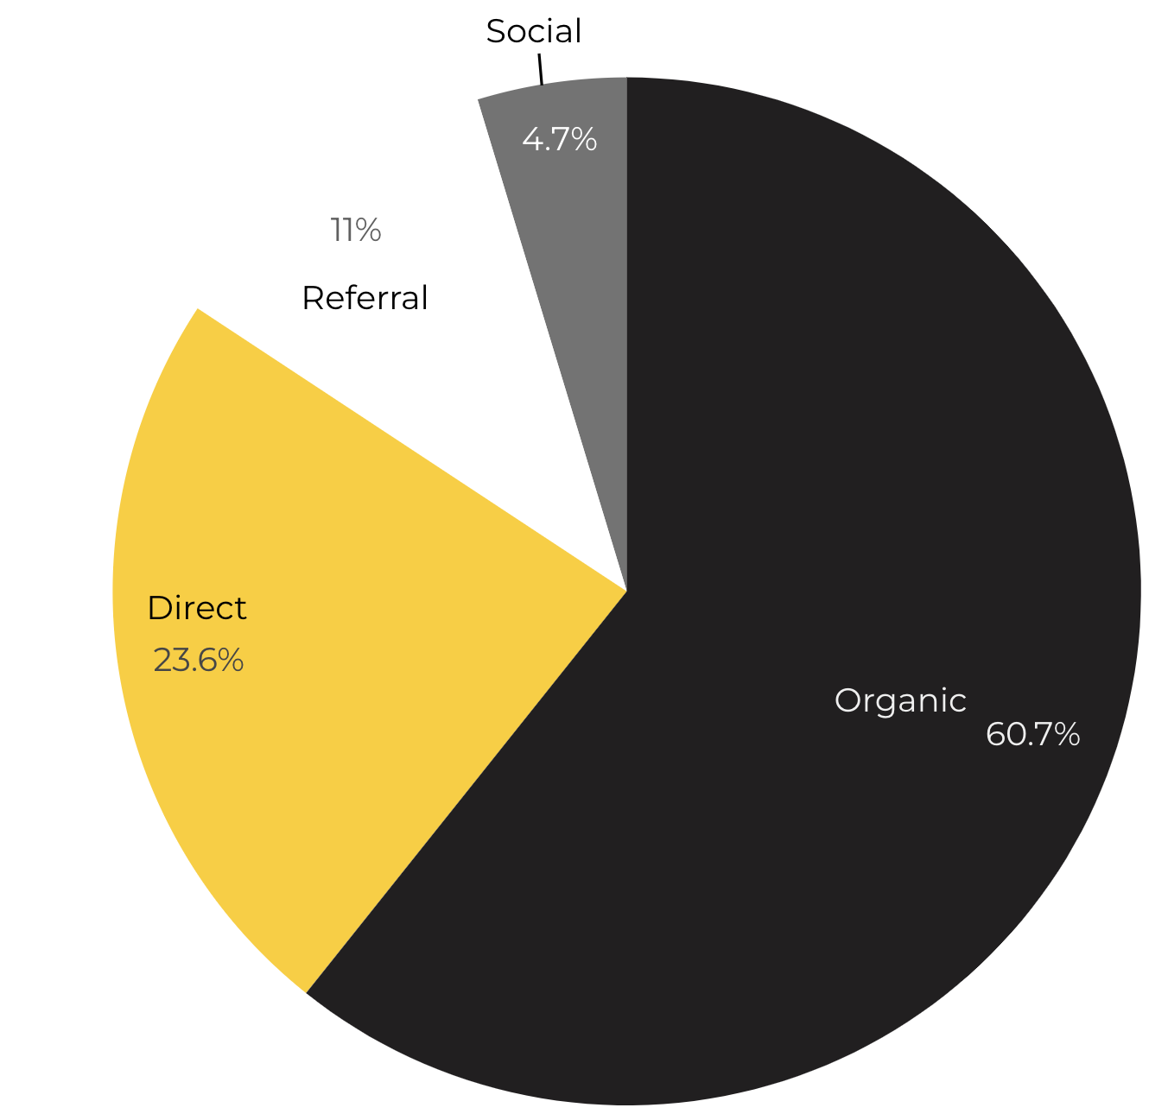
Marketing Reach
60.7% of visitors came from Organic Search engine queries.
23.6% of visitors came directly to the site (by typing in the address, using bookmarks, or email links).
11% of visitors came from Referral links on 3rd party web sites.
4.7% of visitors came from Social Media.
Organic

Slide 7
Engagement Insights & Highlights
Last quarter had a total of 145,632 interactions on the ACS pages (interactions are downloads, email clicks, phone number clicks, and outbound links).
Phone
Outbound Clicks

Slide 8
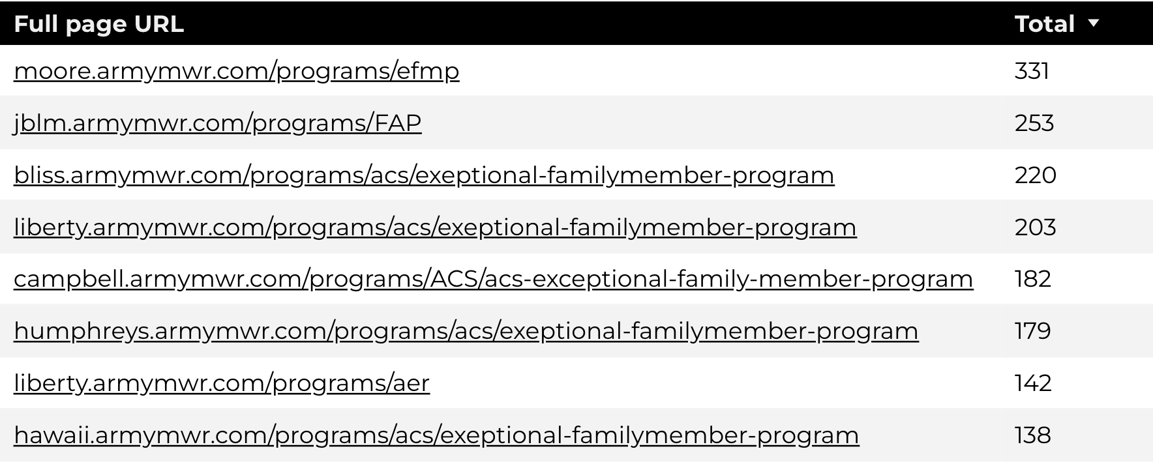
Insights & Highlights
Last quarter, 12,807 people required assistance from a live person.
Top ACS programs that received phone calls from the web.

Slide 9
Search Intent
Search intent is defined as being the underlying purpose behind an online query.
44% of searches were aimed at finding an answer to a specific question or acquiring general information.
41% of searches were conducted to explore brands or services with the intention of completing an action or making a purchase.
15% of searches were intended to locate a specific program page using the on-site search.

Slide 10
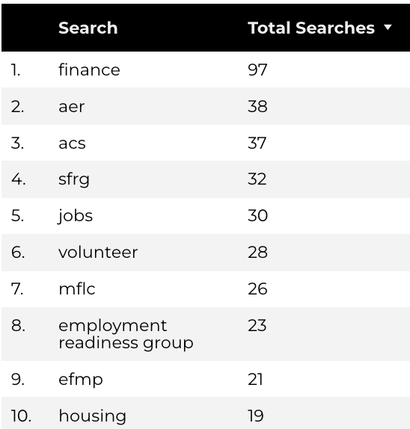
Search Insights
Top Search Terms
2,290 Total on-site searches on ACS pages to find more information.
2.18% of users left the site after performing a search.
Notes:
.

Slide 11
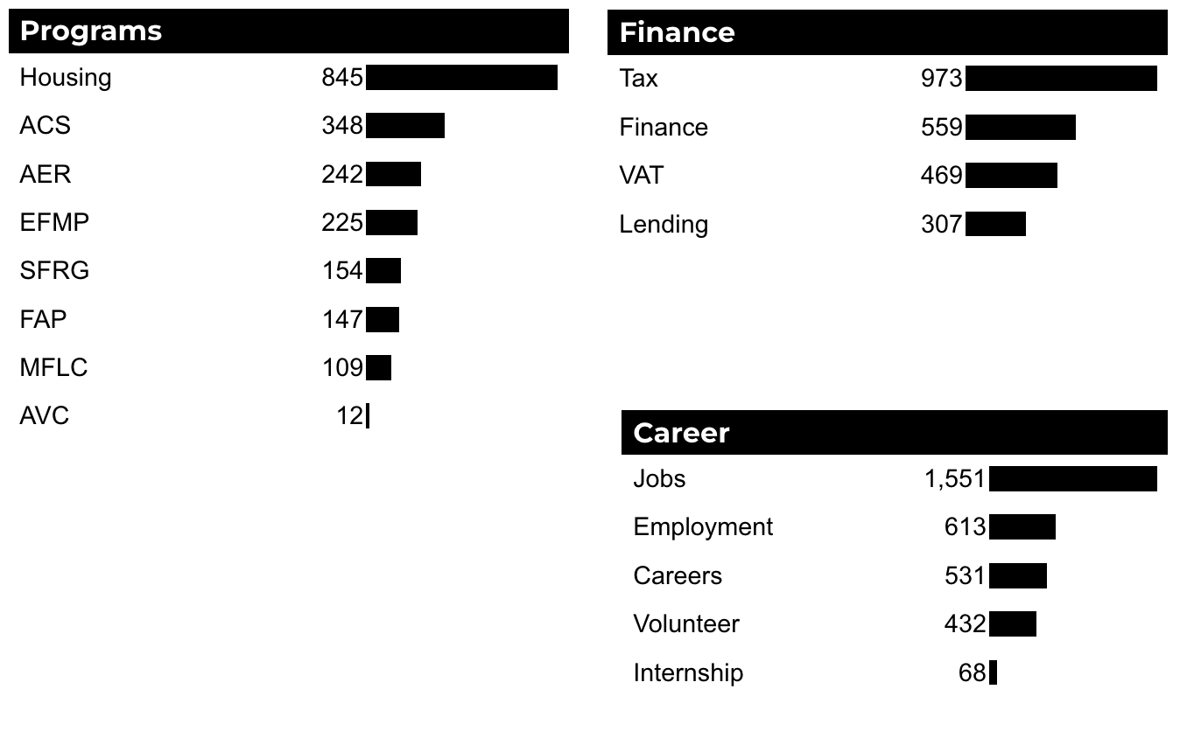
What Are The Top Search Sub-Topics?
The most popular search categories and terms within ACS.

