Slide 1
CYS First Quarter FY22 Insights
01 Oct – 31 Dec
​

Slide 2
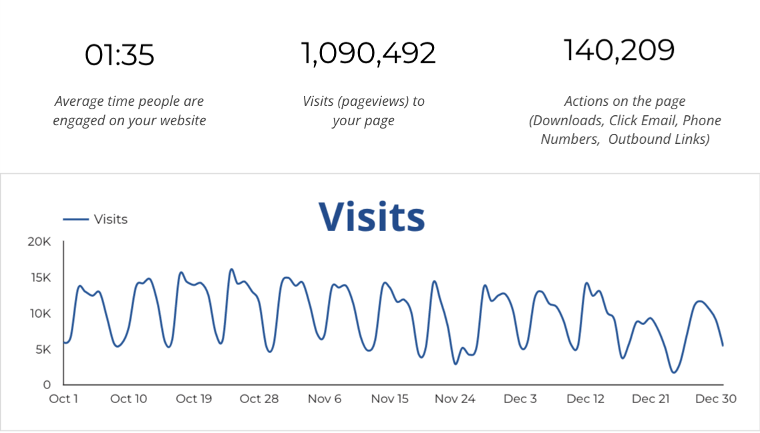
Web Analytics Summary

Slide 3
Traffic Highlights
1,090,492 Visits (pageviews to CYS pages).
Traffic to CYS increased by +8.3% from the previous year.
Social traffic is -2.4% from the previous year.

Slide 4
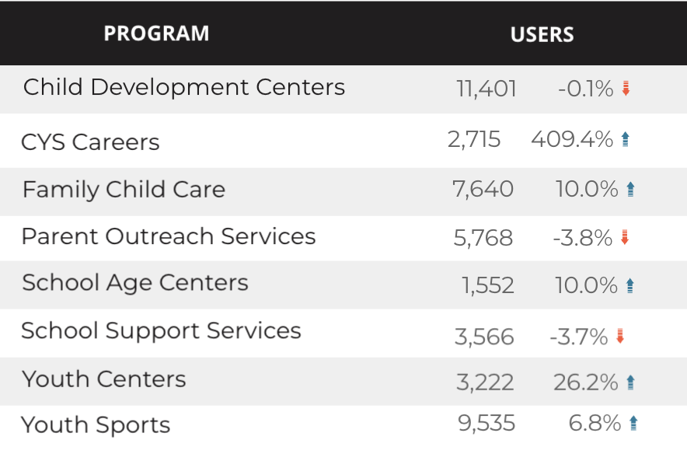
Visitor Highlights
How engaged were these visitors within the website?
On average, users visited 2.5 pages per visit.
On average, users stayed on the site for 1:36 minutes per visit.
208,696 visitors were new to the website.
New visitors increased +13.6% compared to last year!

Slide 5
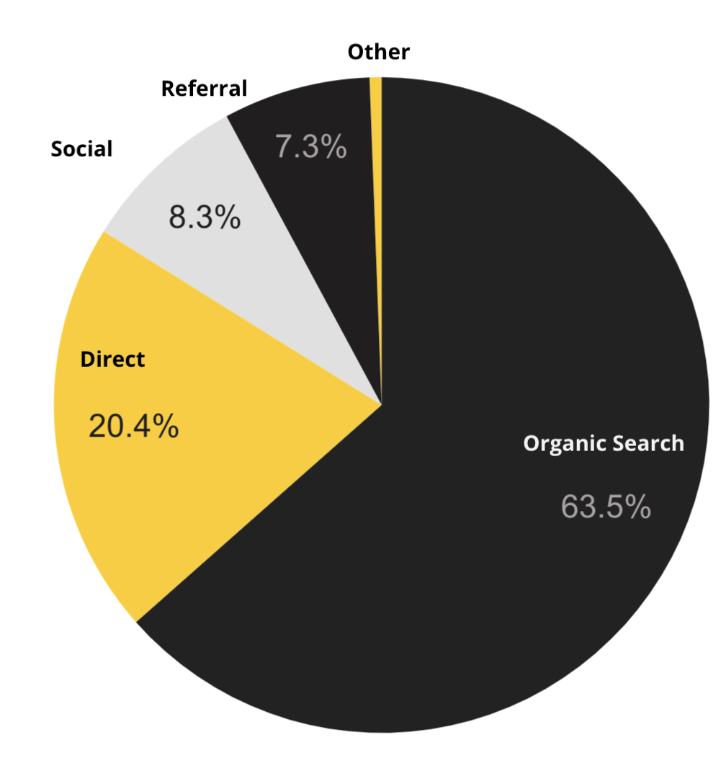
Marketing Reach
63.5% of visitors came from online search engines.
20.4% came directly to the site. (by typing in the address, using bookmarks, or email links)
8.3% of visitors came from social media.
7.3% of visitors came from referrals.
.5% Other. (traffic that has an acquisition source Google doesn’t know how to classify)
9.2%
63.8%

Slide 6
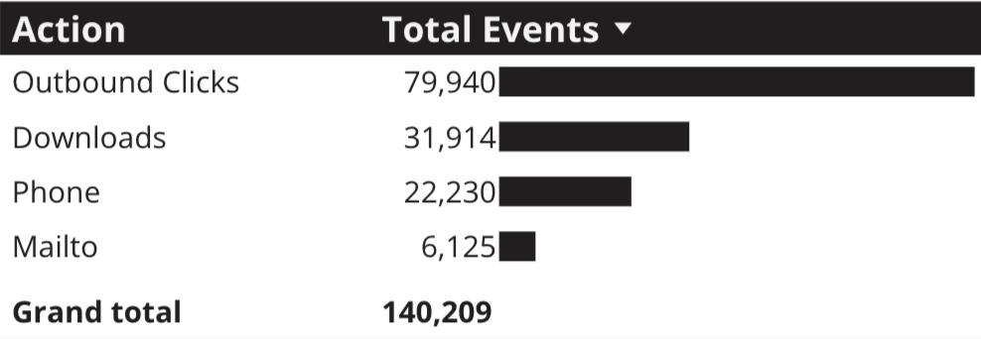
Engagement Insights & Highlights
Last quarter had a total of 140,209 interactions on the CYS pages. (interactions are downloads, email clicks, phone number clicks, and outbound links)
+4.6% from the previous year.

Slide 7
WebTrac Insights & Highlights
23,313 Parents clicked on a WebTrac link from a program page to register or pay for a CYS program.
+15.3% from the previous year.

Slide 8
Search Intent
Search intent is defined as being the underlying purpose behind an online query.
49% Searches looking to investigate brands or services and intending to complete an action or purchase.
37% Searches looking for an answer to a specific question or general information.
16% Searches intending to find a specific program, page using the onsite search.

Slide 9
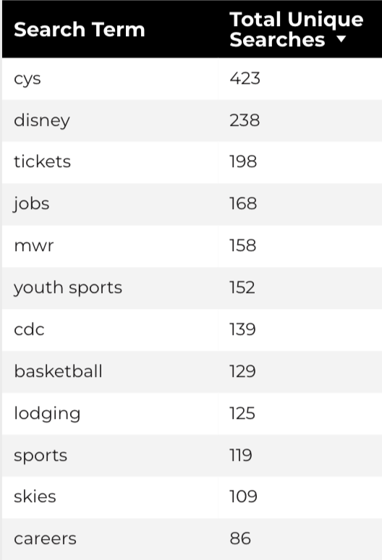
Search Insights
19,975 Total on-site searches on CYS pages to find more information.
22.38% of users searched again immediately after performing a search.

Slide 10
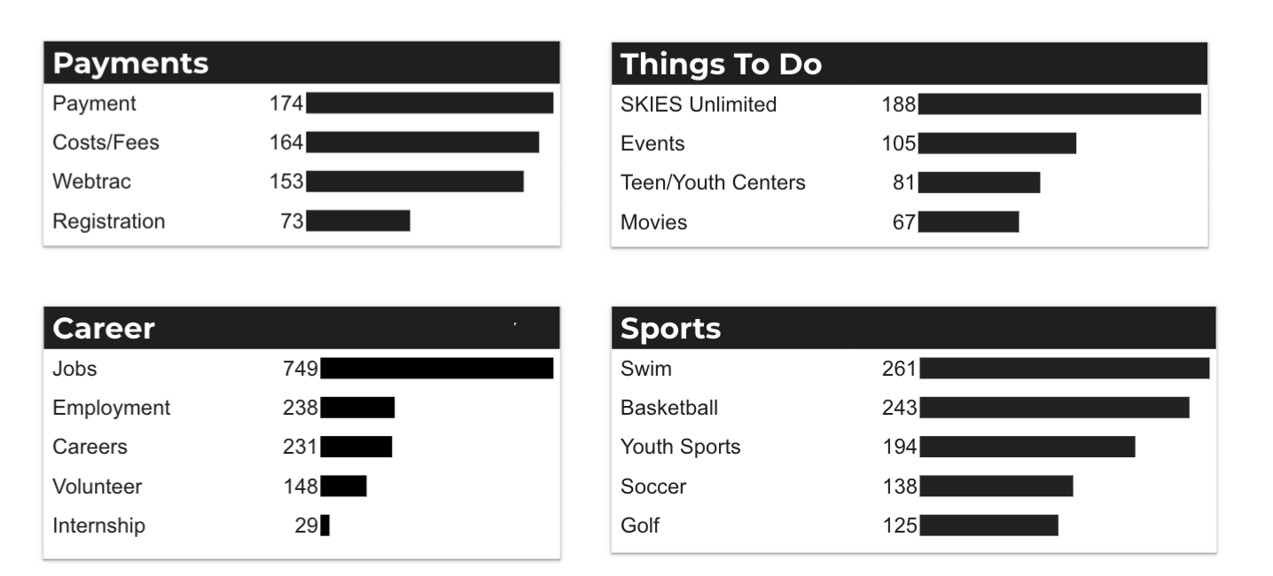
What Are The Top Search Sub-Topics?
The most popular search categories > terms within CYS.

Slide 11
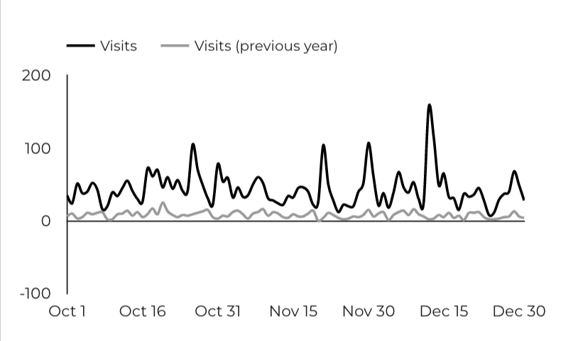
CYS Careers
1,404 people looking for employment took action and clicked on USAJOBS.gov.
198 downloads of the CYS Career Guide.
31 Rack Card downloads.
4.4x more users are visiting the career pages compared to the previous year!

Slide 12
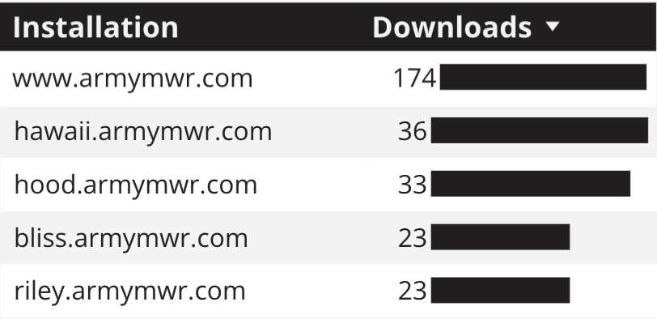
Family Child Care
34,070 visits to program pages.
+18% compared to last year.
385 DA 5219 form downloads.

Slide 13
School Support Services
17,390 visits to School Support Services pages. +19.1% compared to last year.
29 people clicked the find your SLO link.

