Slide 1
CYS Fourth Quarter FY24 Insights

Slide 2
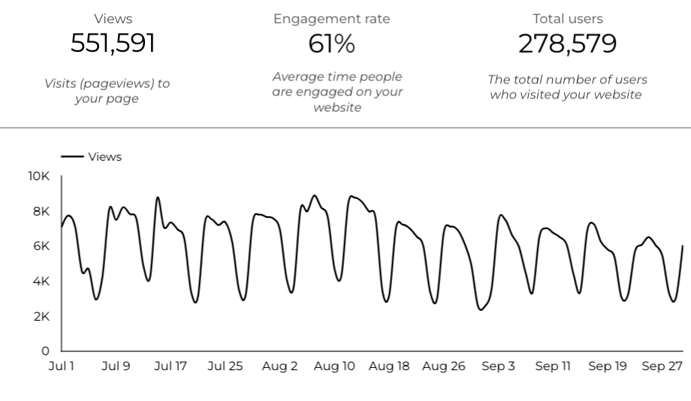
Overview

Slide 3
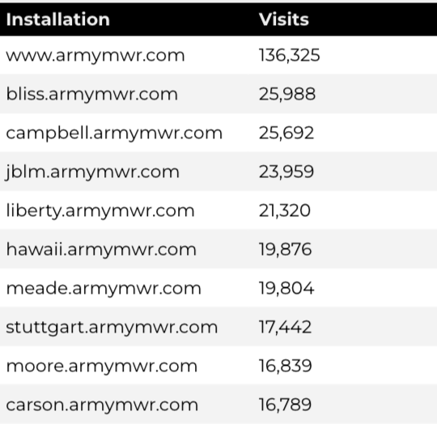
Traffic Highlights
There were a total of 551,591 visits, to Child and Youth Services (CYS) web pages.
On average, each user viewed 2 pages.
Top US Army Installations

Slide 4
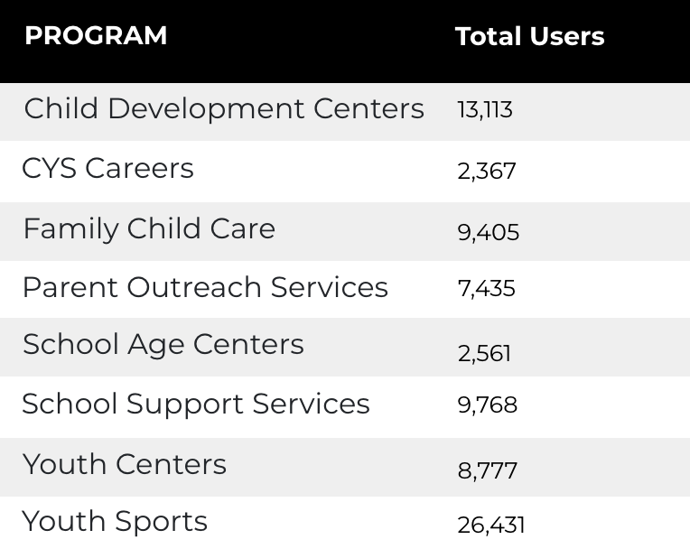
Visitor Highlights
Program Roll-Up
There are 278,579 total users on the CYS site.
The average visit duration is 2 minutes and 33 seconds.
A total of 191,287 visitors were new to the website.

Slide 5
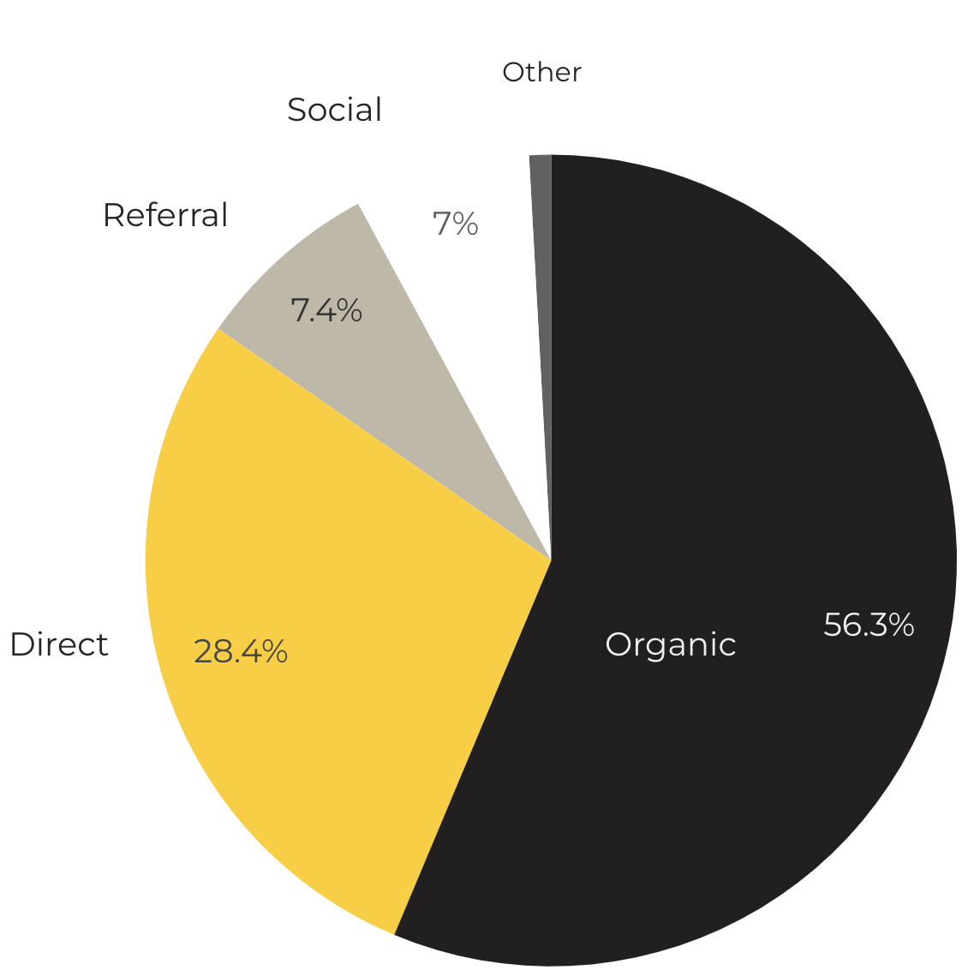
Marketing Reach
56.3% of visitors came from online search engines.
28.4% came directly to the site (by typing in the address, using bookmarks, or email links).
7.4% of visitors came from referrals.
7% of visitors came from social media.
.09% Other (traffic that has an acquisition source Google doesn’t know how to classify).
9.2%
63.8%

Slide 6
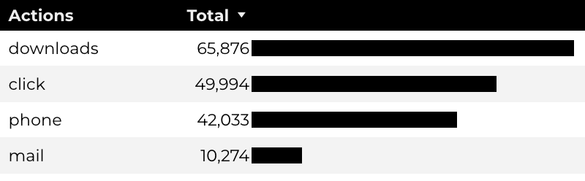
Engagement Insights & Highlights
Last quarter there were a total of 168,177 interactions on the CYS pages, which included downloads, email clicks, phone number clicks, and outbound links.

Slide 7
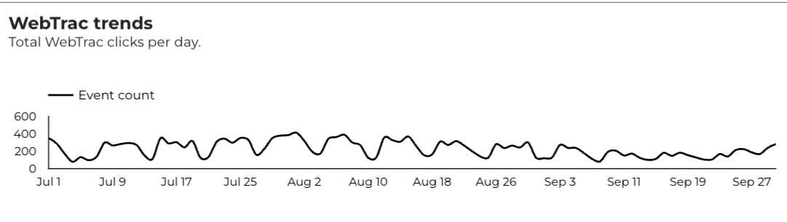
WebTrac Insights & Highlights
A total of 20,923 parents clicked on a WebTrac link from a program page to register or make a payment for a CYS program.

Slide 8
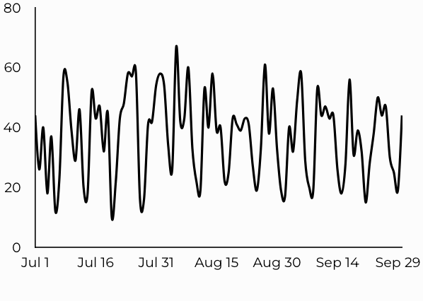
CYS Careers
CYS Career Traffic Trends
1,172 people looking for employment took action and clicked on USAJOBS.gov.
562 downloads of the CYS Career Guide.
84 Rack Card downloads.

Slide 9
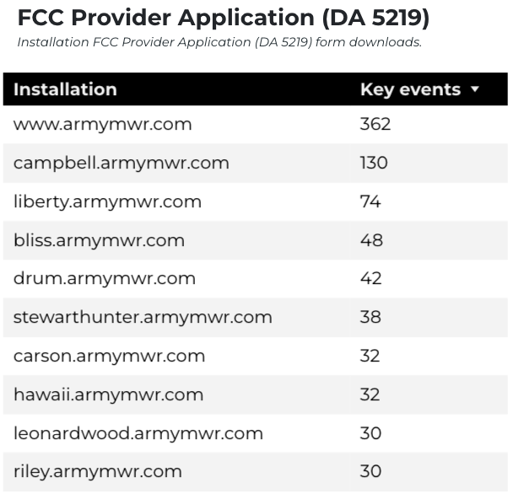
Family Child Care
17,526 visits to program pages.
8,501 users to FCC program pages.
982 downloads of DA 5219 form!

Slide 10
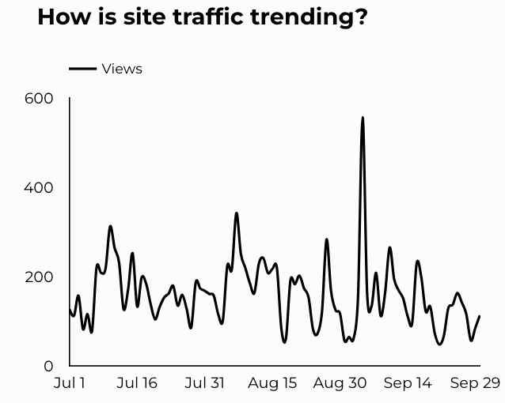
School Support Services
9,768 users made a visit to School Support Services pages.
98 people clicked to watch the 'What Is An SLO Anyway’ video.

Slide 11
Search Intent
40% Searches looking to investigate brands or services and intending to complete an action or purchase.
47% Searches looking for an answer to a specific question or general information.
13% Searches intending to find a specific program, page using the onsite search.
Search intent is defined as being the underlying purpose behind an online query.

Slide 12
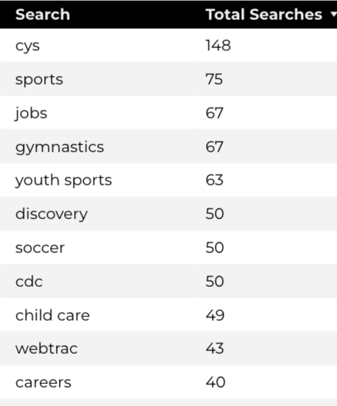
Search Insights
Top Searches
4,990 Total on-site searches on CYS pages to find more information.
2.69% of users left the site after performing a search.

Slide 13
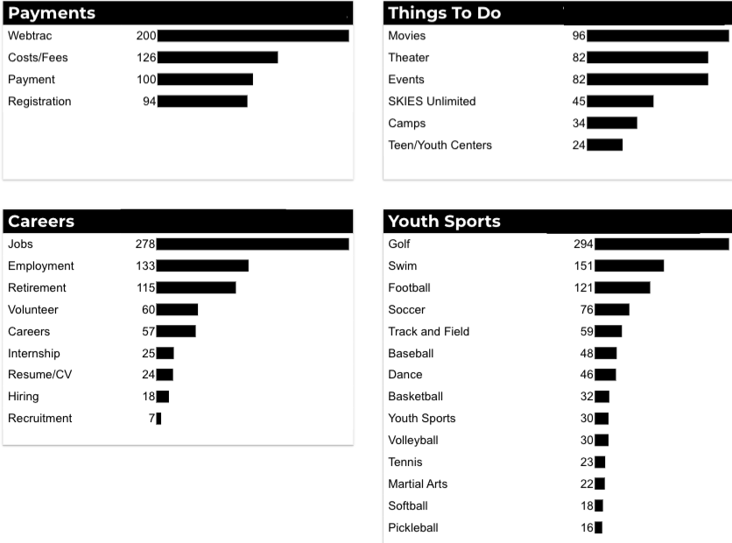
What Are The Top Search Sub-Topics?
The most popular search categories and terms within CYS

