Slide 1
Support Services Fourth Quarter FY24 Insights

Slide 2
Web Analytics Summary
Program Roll-up

Slide 3
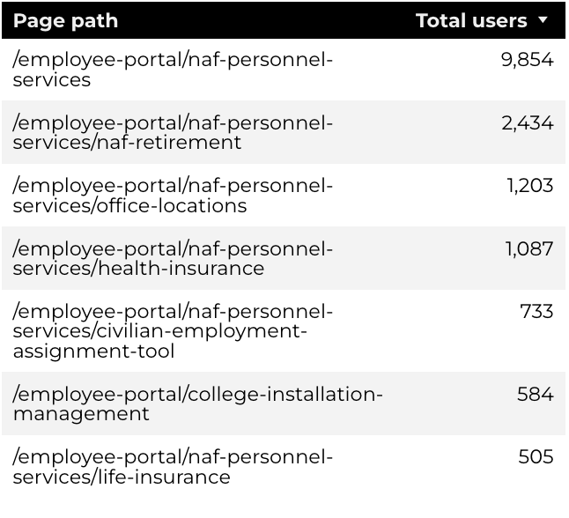
Traffic Highlights
Top Pages NAF Personnel Services
The program received 25,073 views and 16,659 sessions.
The engagement rate was at 68%.
There were a total of 14,391 users. Of those users, 10,592 were new.
NAF Personnel Services

Slide 4
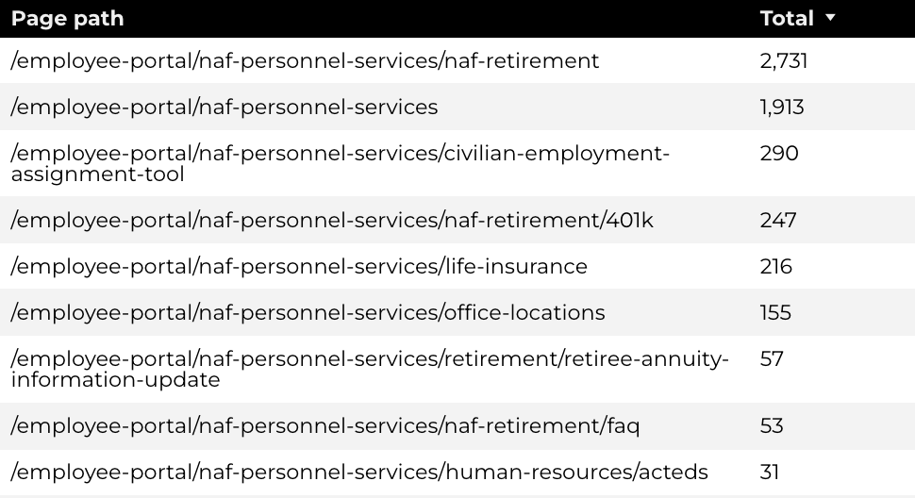
Engagement Insights & Highlights
5,353 people downloaded a PDF or a form.
417 people clicked on a link to another website to get more information.
Top pages for downloads, click-throughs on email addresses, phone numbers, and outbound links.
NAF Personnel Services

Slide 5
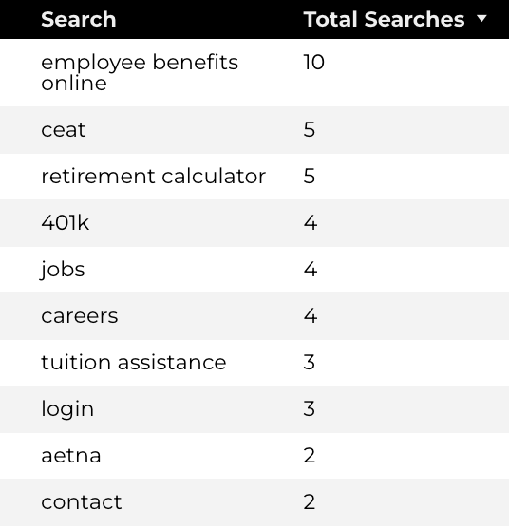
Search Insights & Highlights
Top Searches
There were 144 total on-site searches on NAF Personnel Services pages to find more information.
0.83% of users left the site after performing a search.
NAF Personnel Services

Slide 6
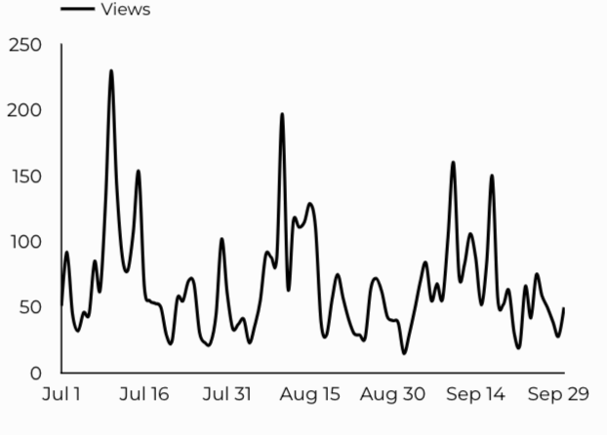
Traffic Highlights
The website received 6,201 views and 4,405 sessions.
The engagement rate was at 81%.
CEAT

Slide 7
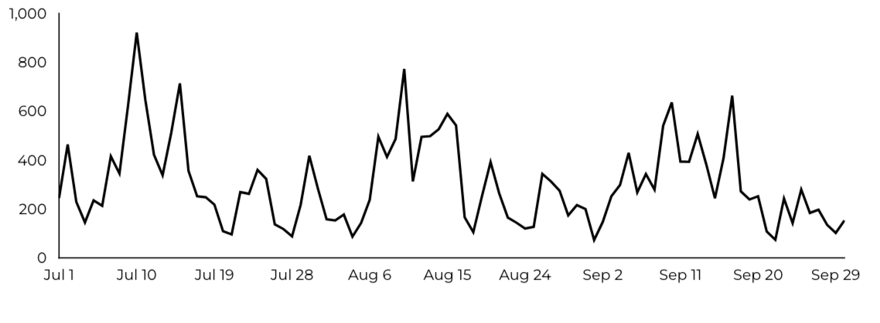
Engagement Insights & Highlights
CEAT Transfer Guide: Achieved 820 Downloads.
CEAT Transfer Guide Download Trends
CEAT

Slide 8
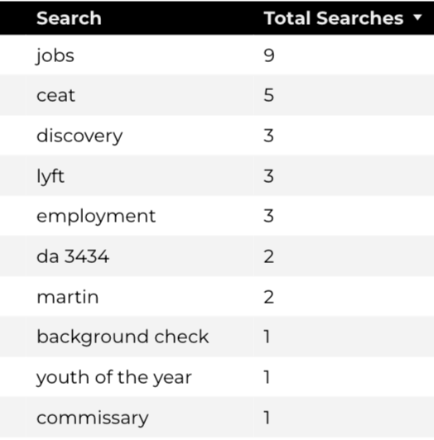
Search Insights & Highlights
52 total on-site searches on CEAT pages to find more information.
Top Searches
CEAT

Slide 9
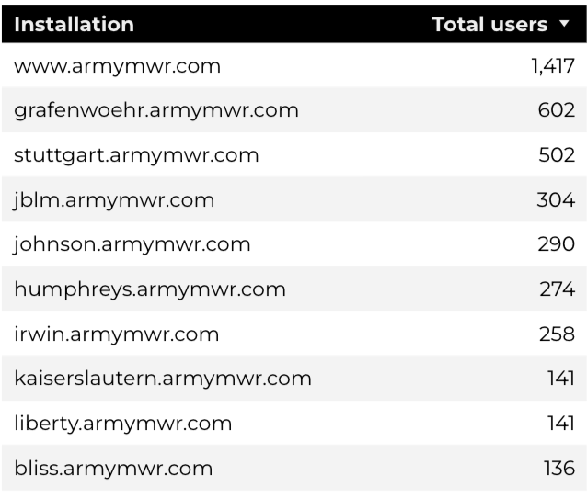
Traffic Highlights
HBB pages received 9,202 views and 7,849 sessions.
The engagement rate was at 68%.
The total number of users was 6,370, and there were 2,746 new users.
Top Installations
Home Based Business (HBB)

Slide 10
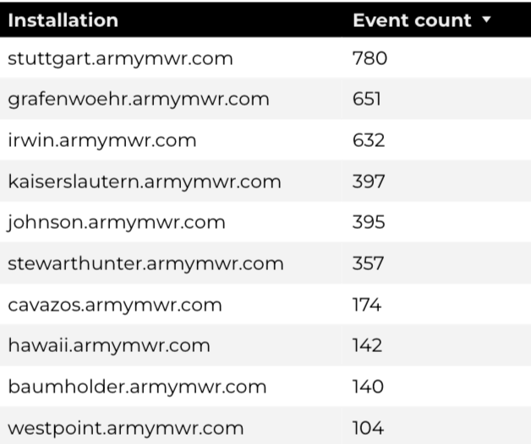
Engagement Insights & Highlights
There were 217 clicks to other websites to find more information.
3,859 people downloaded a PDF or a form.
247 people needed to talk to a real person.
Top Installations
(Downloads, Email, Phone Numbers, Outbound Links)
Home Based Business (HBB)

Slide 11
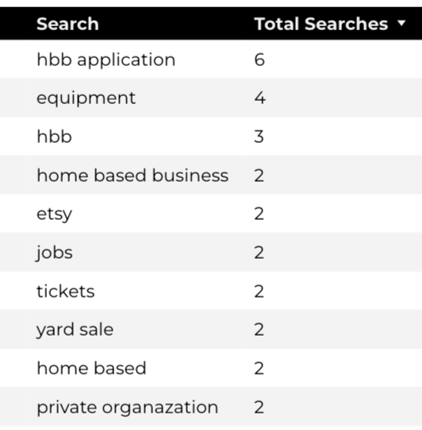
Search Insights & Highlights
73 total on-site searches on HBB pages to find more information.
8.82% of users left the site after performing a search.
Top Searches
Home Based Business (HBB)

