Slide 1
Support Services
First Second FY24 Insights
1 JAN – 31 MAR
​

Slide 2
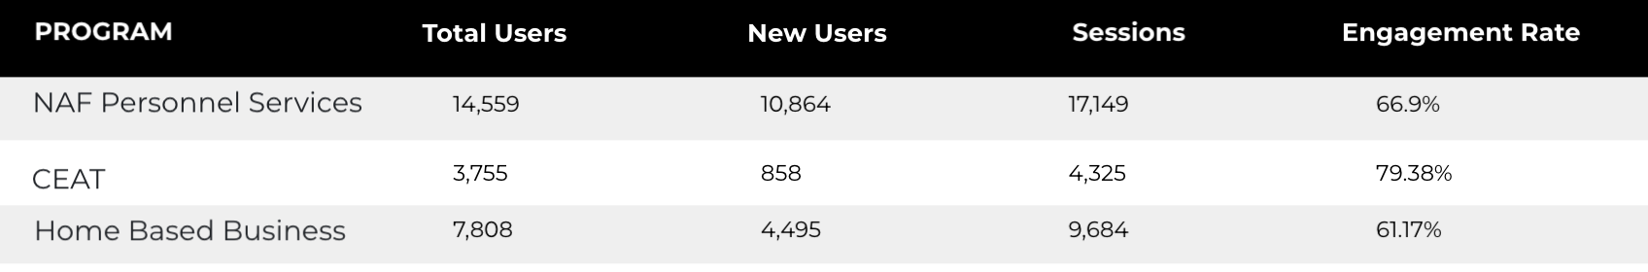
Web Analytics Summary
Program Roll-up

Slide 3
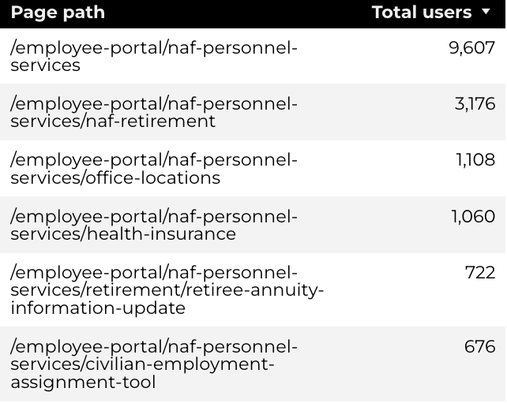
Traffic Highlights
NAF Personnel Services
Top Pages
The program received 28,282 views and 17,149 sessions.
The engagement rate was at 67%.
There were a total of 14,559 users. Of those users, 10,864 were new.

Slide 4
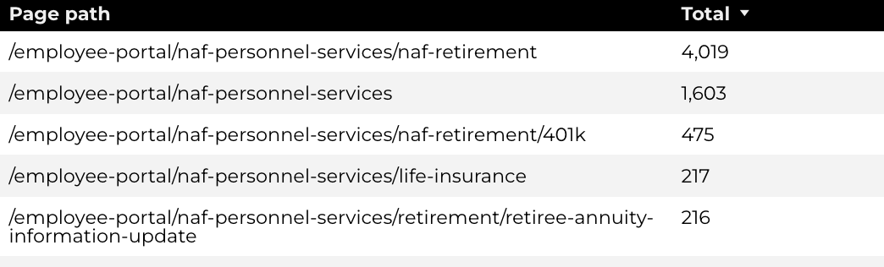
Engagement Insights & Highlights
NAF Personnel Services
6,529 people downloaded a PDF or a form.
765 people clicked on a link to another website to get more information.
Top pages for downloads, click-throughs on email addresses, phone numbers, and outbound links.

Slide 5
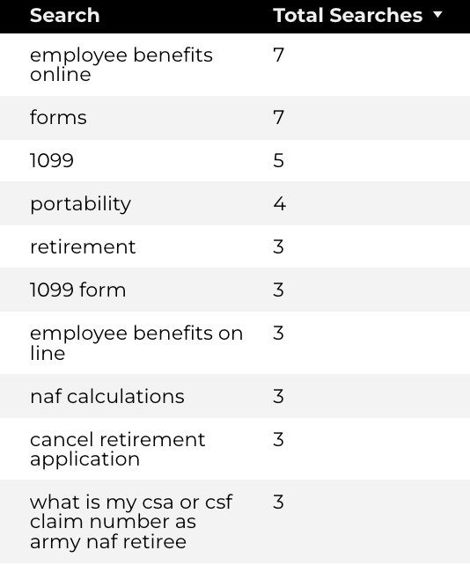
Search Insights & Highlights
NAF Personnel Services
Top Searches
There were 181 total on-site searches on NAF Personnel Services pages to find more information.
0.65% of users left the site after performing a search.

Slide 6
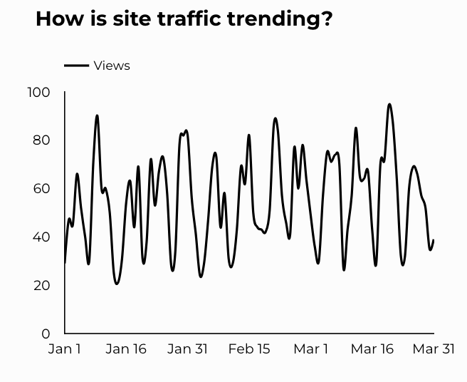
Traffic Highlights
CEAT
The website received 4,994 views and 4,325 sessions.
The engagement rate was at 79%.
There are a total of 3,755 users. Of those users 858 were new.

Slide 7
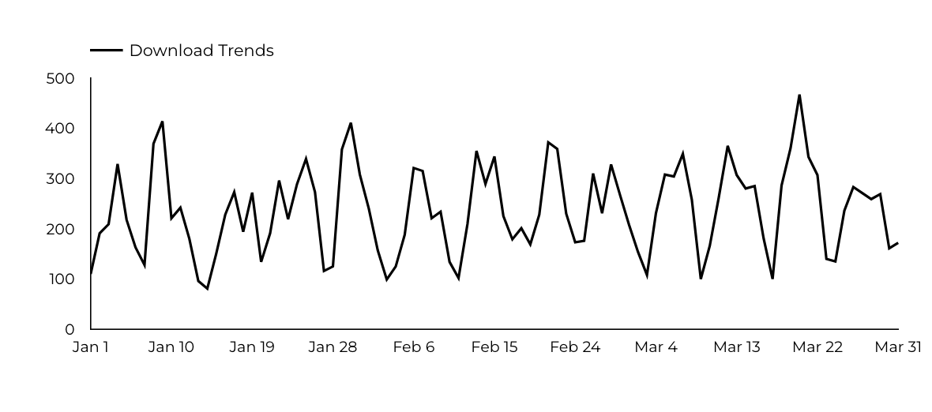
Engagement Insights & Highlights
CEAT
CEAT Transfer Guide: Achieved 730 Downloads.
CEAT Transfer Guide Download Trends

Slide 8
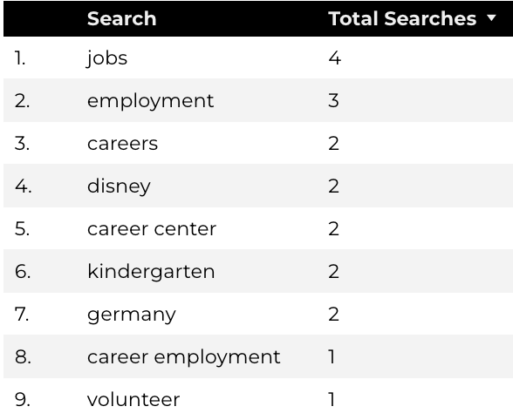
Search Insights & Highlights
CEAT
Top Searches
44 total on-site searches on CEAT pages to find more information.

Slide 9
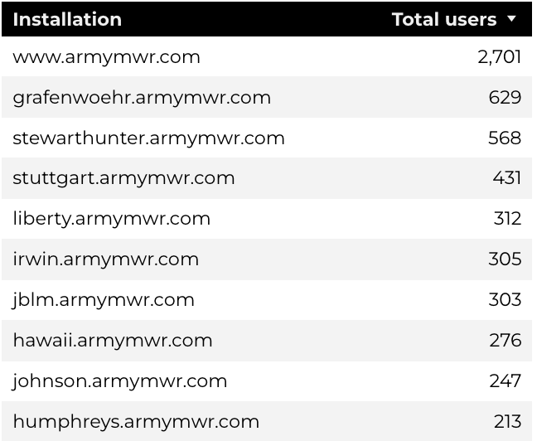
Traffic Highlights
Home Based Business (HBB)
Top Installations
HBB pages received 10,873 views and 9,684 sessions.
The engagement rate was at 61%.
The total number of users was 7,808, and there were 4,495 new users.

Slide 10
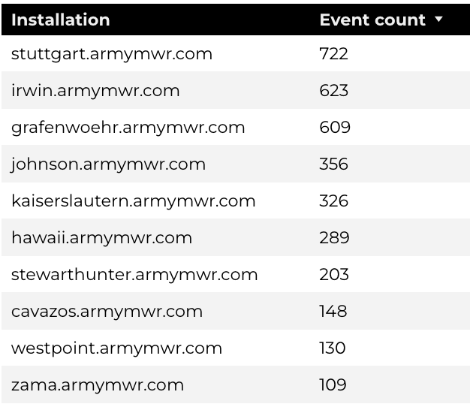
Engagement Insights & Highlights
Home Based Business (HBB)
Top Installations
(Downloads, Email, Phone Numbers, Outbound Links)
There were 340 clicks to other websites to find more information.
3,679 people downloaded a PDF or a form.
185 people needed to talk to a real person.

Slide 11
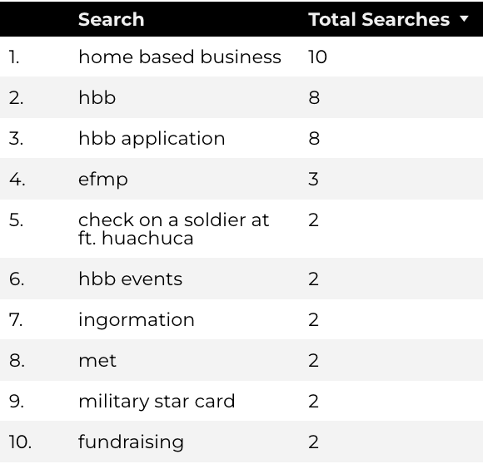
Search Insights & Highlights
Home Based Business (HBB)
Top Searches
86 total on-site searches on HBB pages to find more information.
2.7% of users left the site after performing a search.

