Slide 1
CYS Third Quarter FY24 Insights

Slide 2
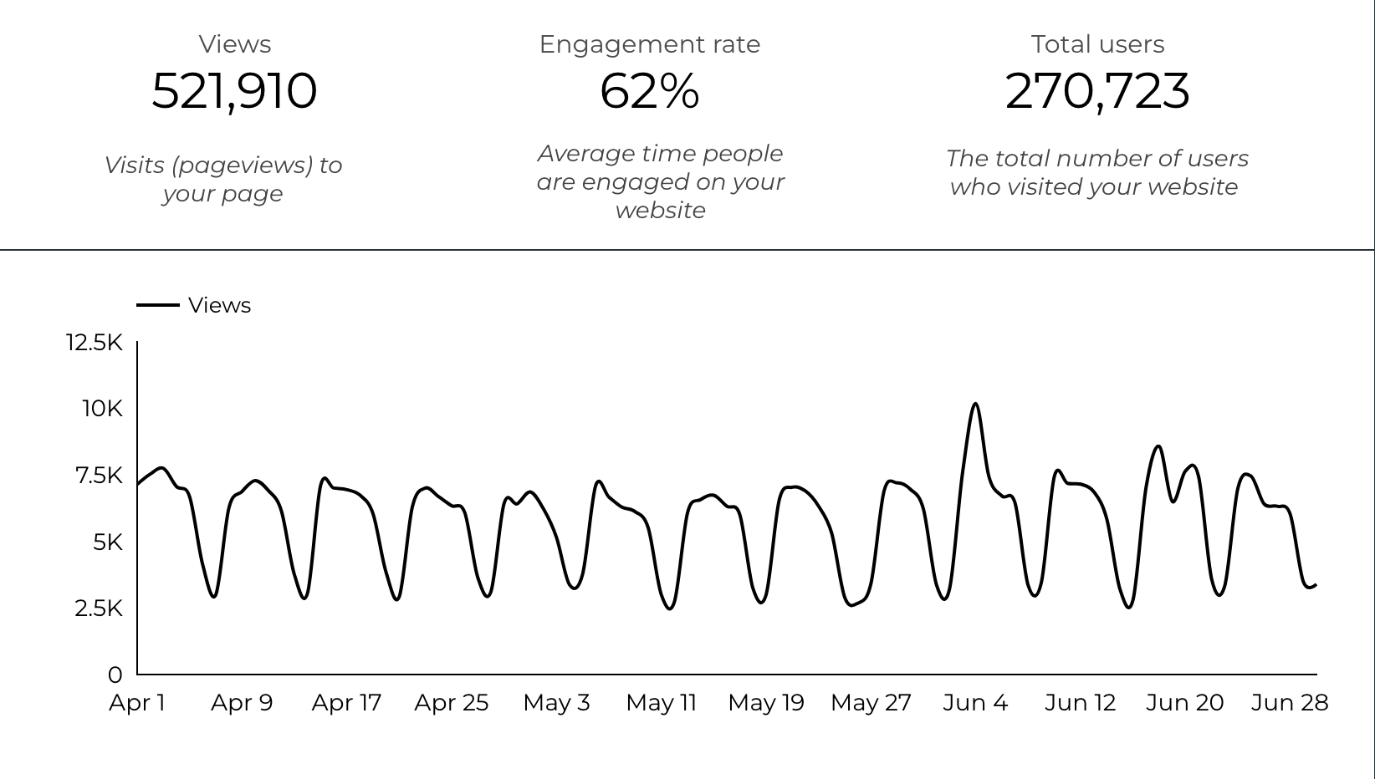
Overview

Slide 3
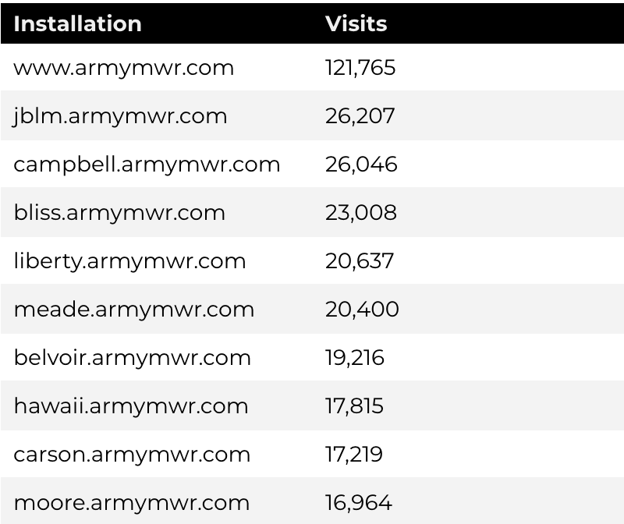
Traffic Highlights
There were a total of 521,910 visits, also known as pageviews, to Child and Youth Services (CYS) web pages.
On average, each user viewed 1.95 pages.
Top US Army Installations

Slide 4
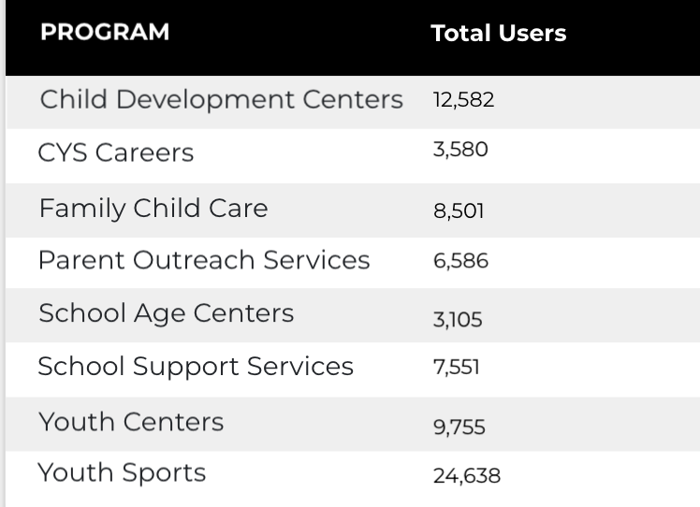
Visitor Highlights
There are 270,723 total users on the CYS site.
The average visit duration is 2 minutes and 29 seconds.
A total of 179,340 visitors were new to the website.
66% of all visitors were new.
Program Roll-Up

Slide 5
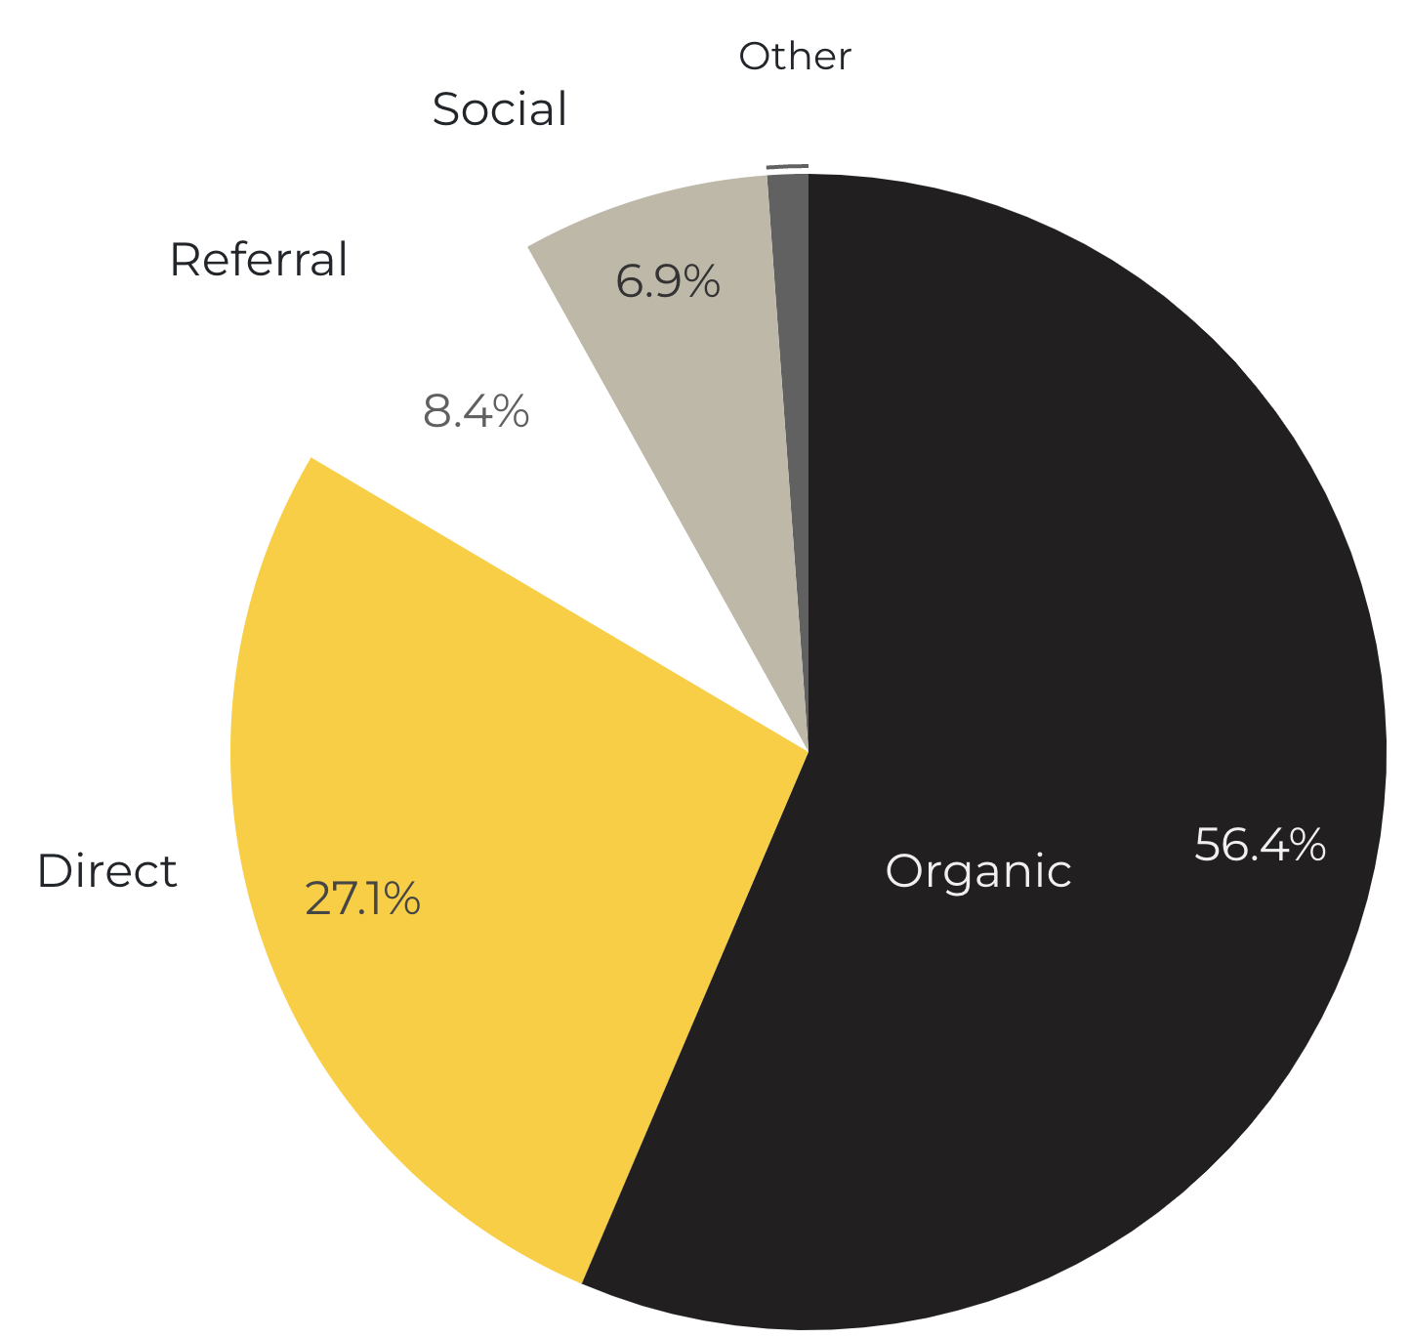
Marketing Reach
56.4% of visitors came from online search engines.
27.1% came directly to the site (by typing in the address, using bookmarks, or email links).
8.4% of visitors came from referrals.
6.9% of visitors came from social media.
1.1% Other (traffic that has an acquisition source Google doesn’t know how to classify).
9.2%
63.8%

Slide 6
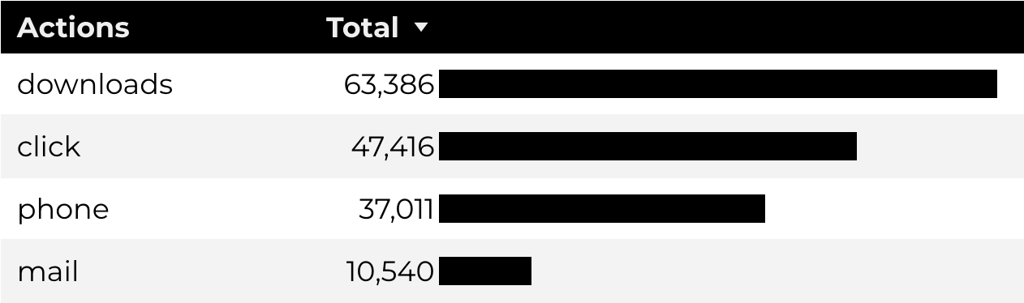
Engagement Insights & Highlights
Last quarter there were a total of 158,353 interactions on the CYS pages, which included downloads, email clicks, phone number clicks, and outbound links.

Slide 7
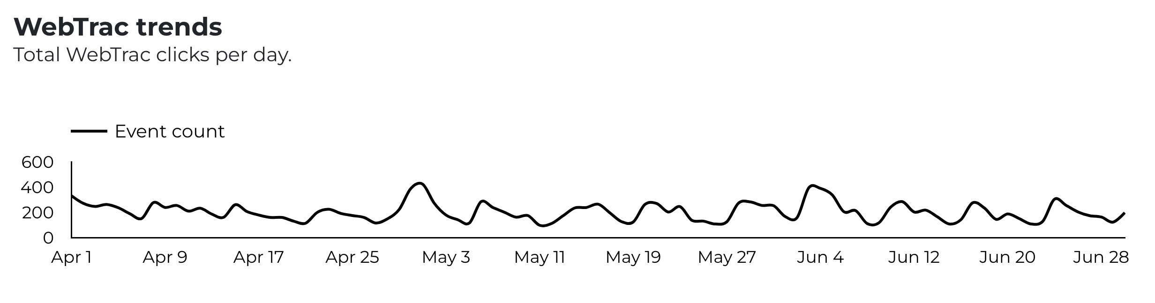
WebTrac Insights & Highlights
18,813 Parents clicked on a WebTrac link from a program page to register or pay for a CYS program.

Slide 8
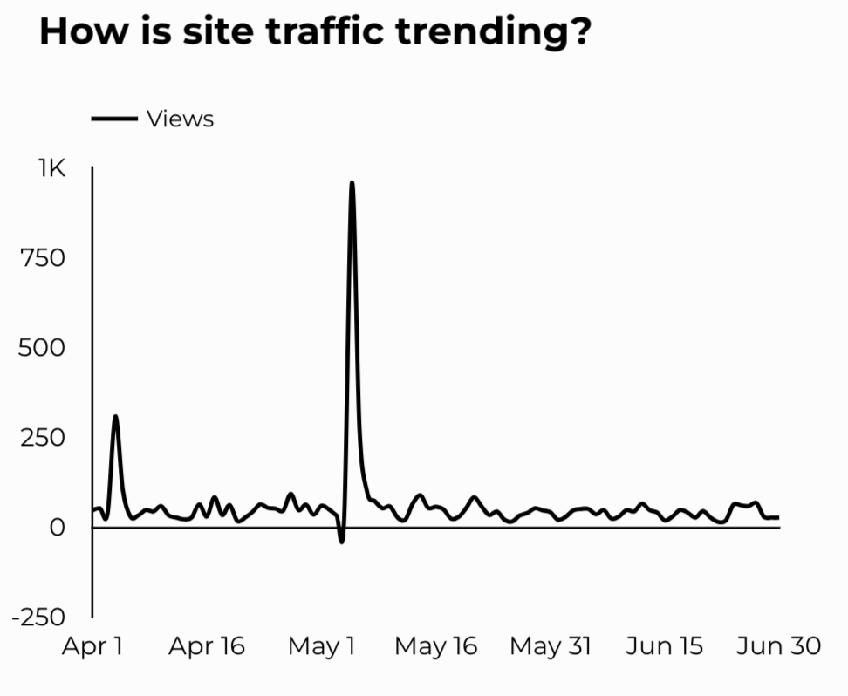
CYS Careers
1,902 people looking for employment took action and clicked on USAJOBS.gov.
584 downloads of the CYS Career Guide.
84 Rack Card downloads.

Slide 9
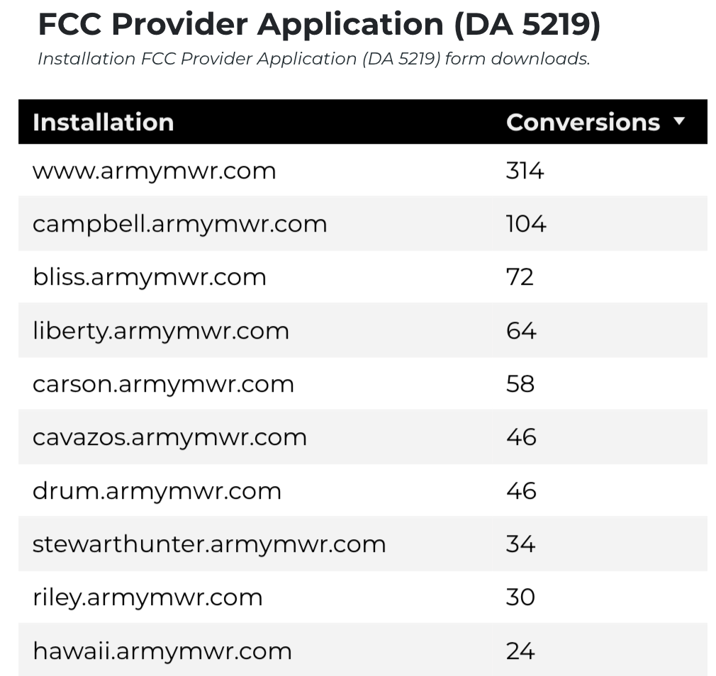
Family Child Care
14,871 visits to program pages.
8,501 users to FCC program pages.
916 downloads of DA 5219 form!

Slide 10
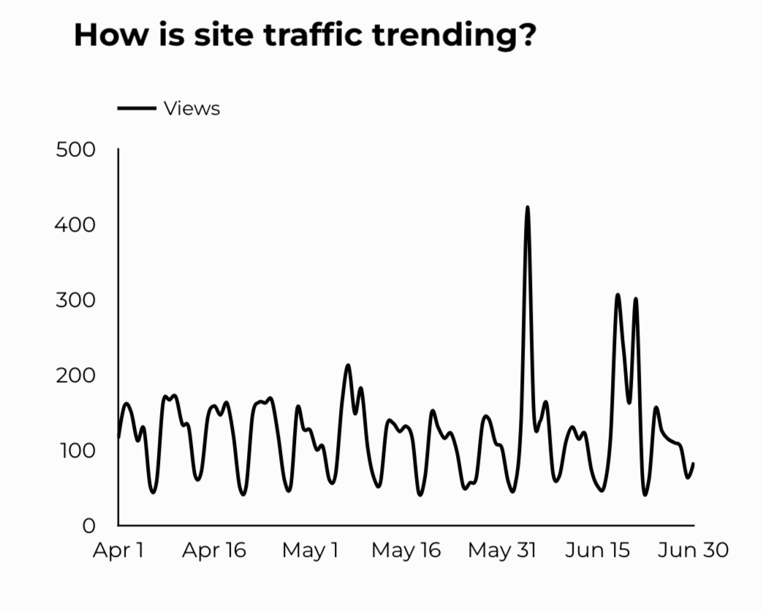
School Support Services
11,023 users made a visit to School Support Services pages.
118 people clicked to watch the 'What Is An SLO Anyway’ video.

Slide 11
Search Intent
45% Searches looking to investigate brands or services and intending to complete an action or purchase.
37% Searches looking for an answer to a specific question or general information.
18% Searches intending to find a specific program, page using the onsite search.
Search intent is defined as being the underlying purpose behind an online query.

Slide 12
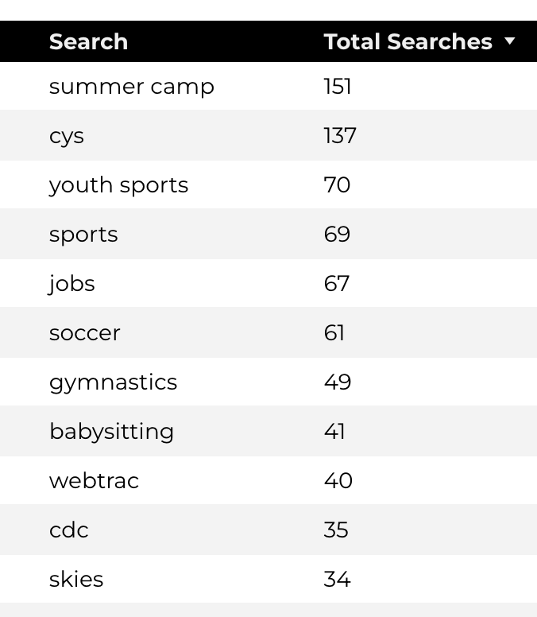
Search Insights
Top Searches
5,167 Total on-site searches on CYS pages to find more information.
2.69% of users left the site after performing a search.

Slide 13
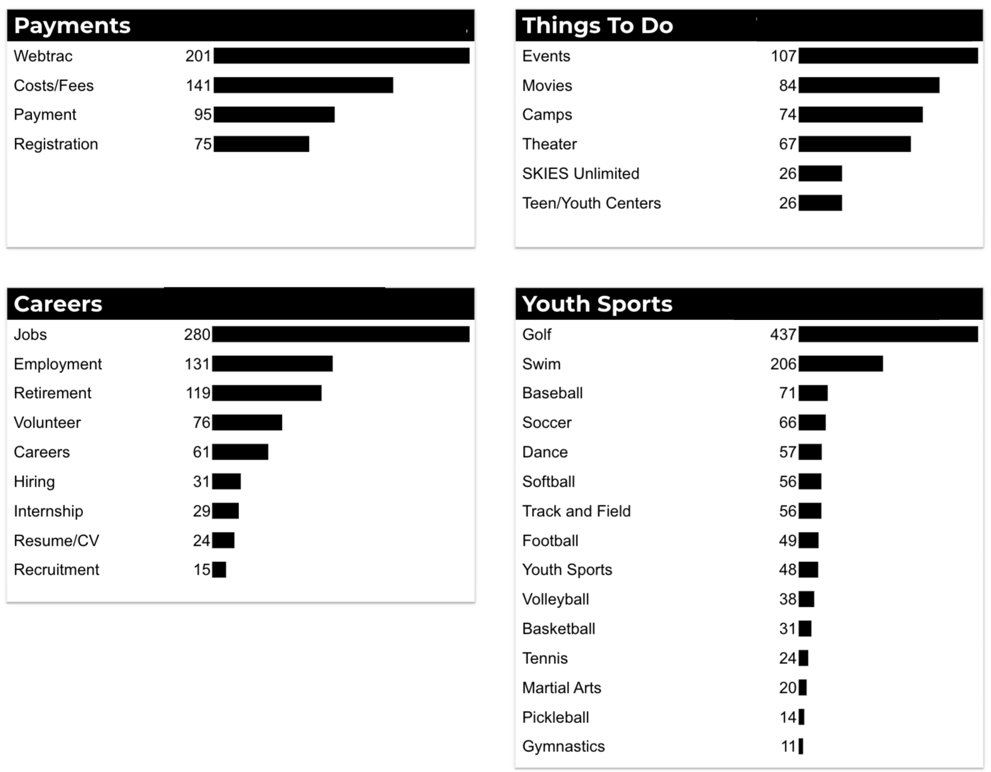
What Are The Top Search Sub-Topics?
The most popular search categories and terms within CYS

