Slide 1
ACS Annual FY23 Insights
01 Oct – 30 Sept
​

Slide 2
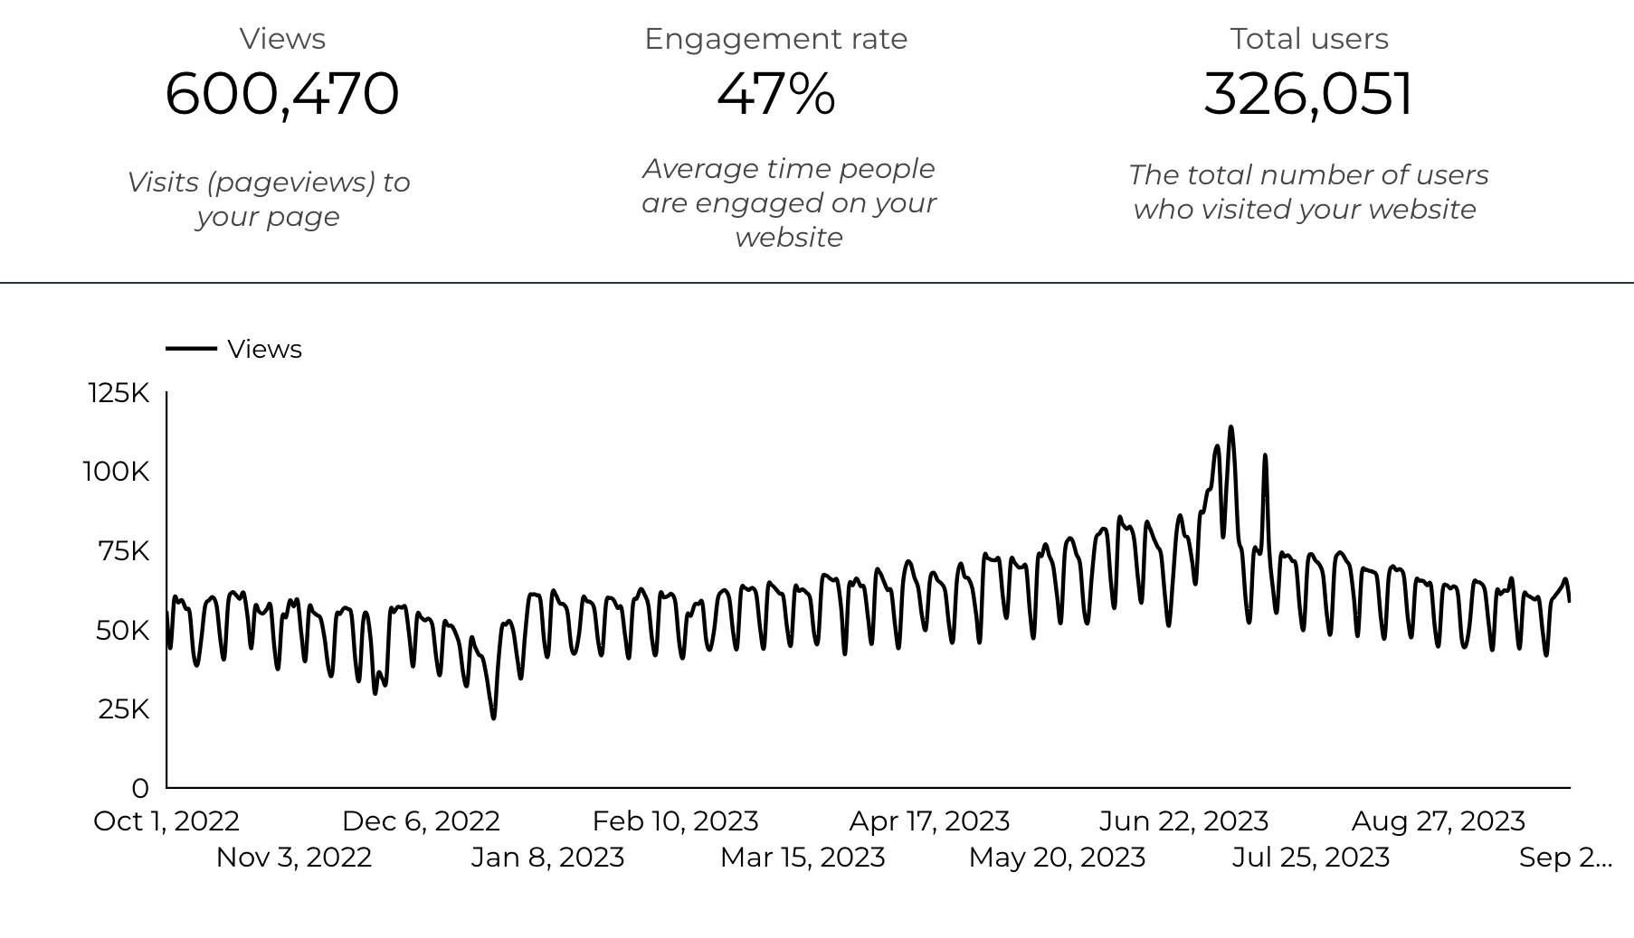
Web Analytics Summary

Slide 3
Traffic Highlights
  ACS pages received 600,470 visits in FY23.
  Engagement on ACS pages is 47%.
  There were 326,051 total users who made a visit to ACS.
  Most of the social traffic came from Facebook.

Slide 4
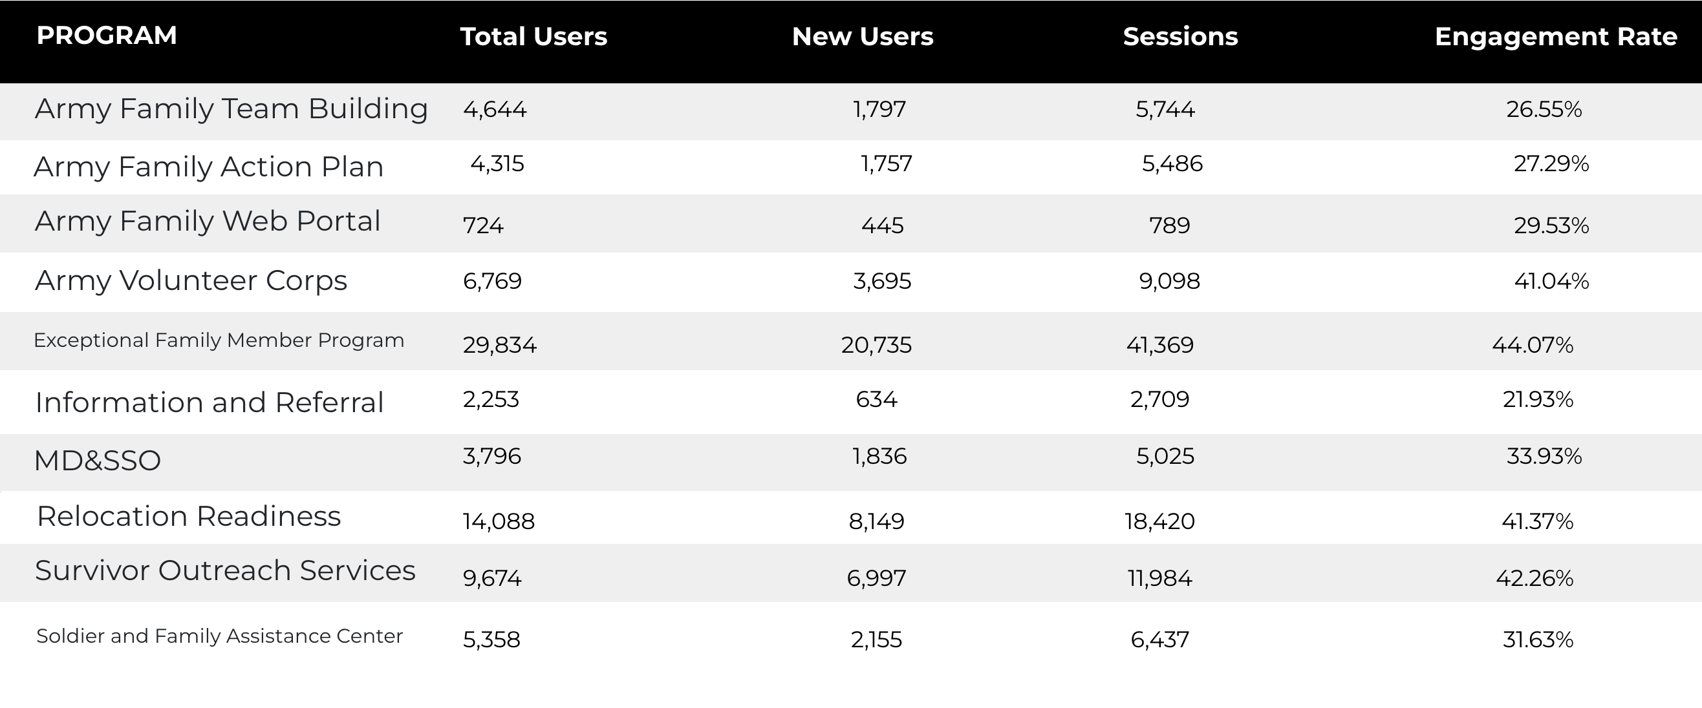
Visitor Highlights

Slide 5
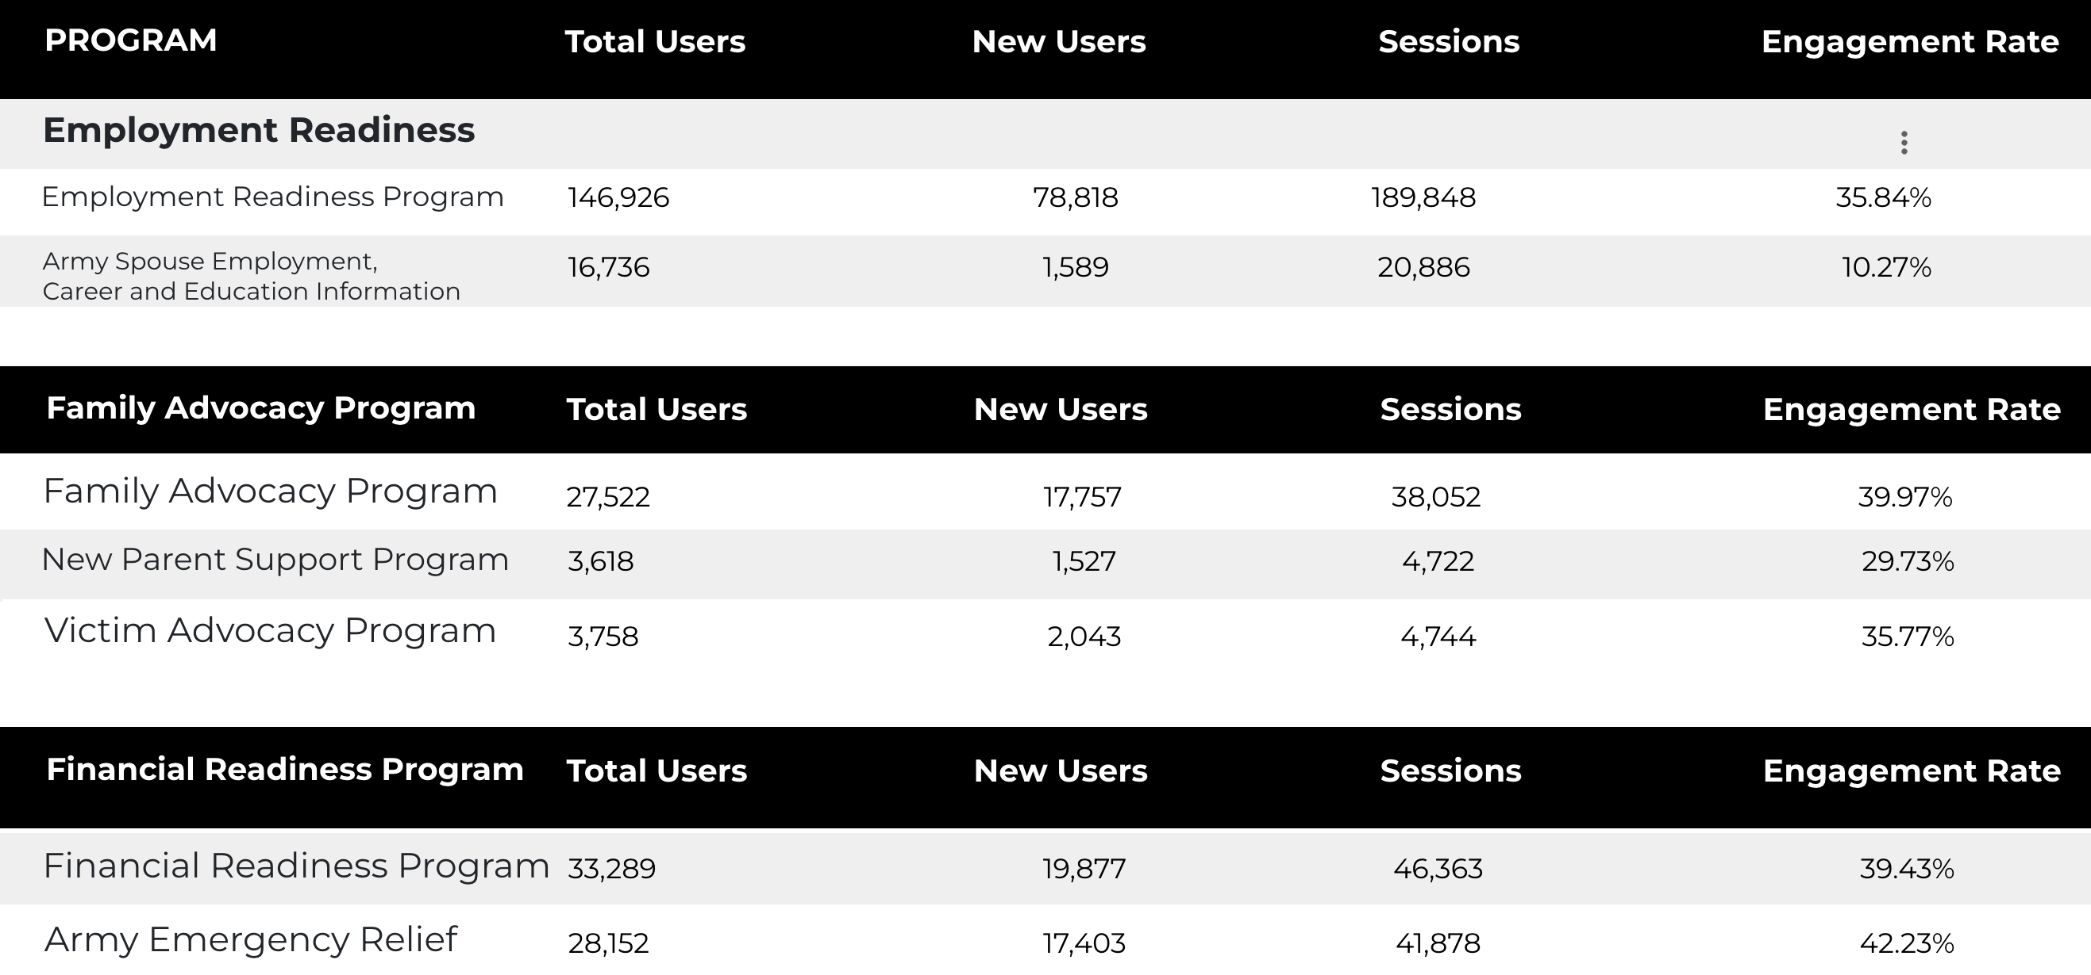
Visitor Highlights
Continued

Slide 6
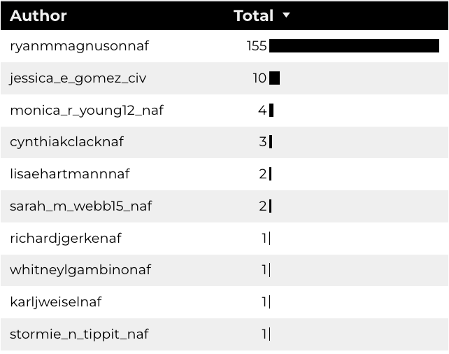
Top 10 ACS Content Creators

Slide 7
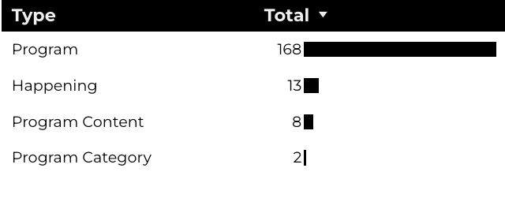
New Pages
Web managers created 191 new ACS pages, program pages, and happenings on EPW last year. (Data from EPW Page Report)

Slide 8
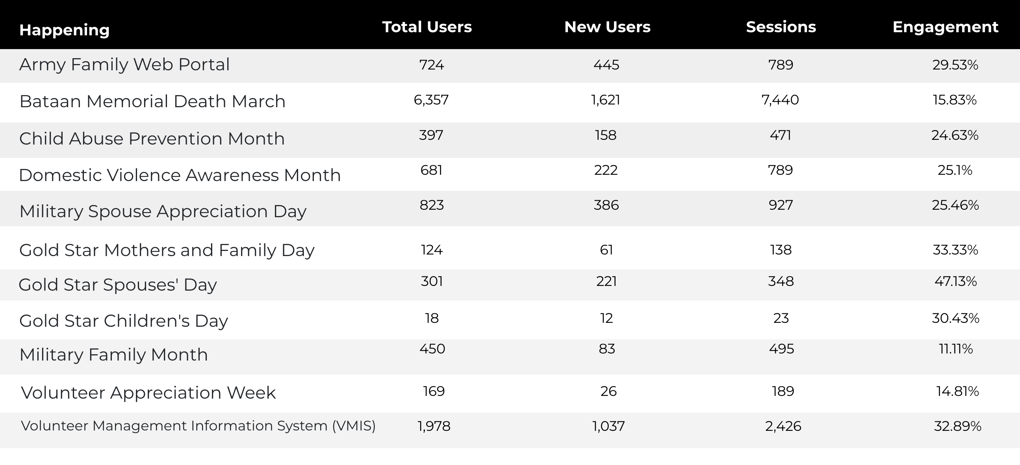
Happenings Insights & Highlights

Slide 9
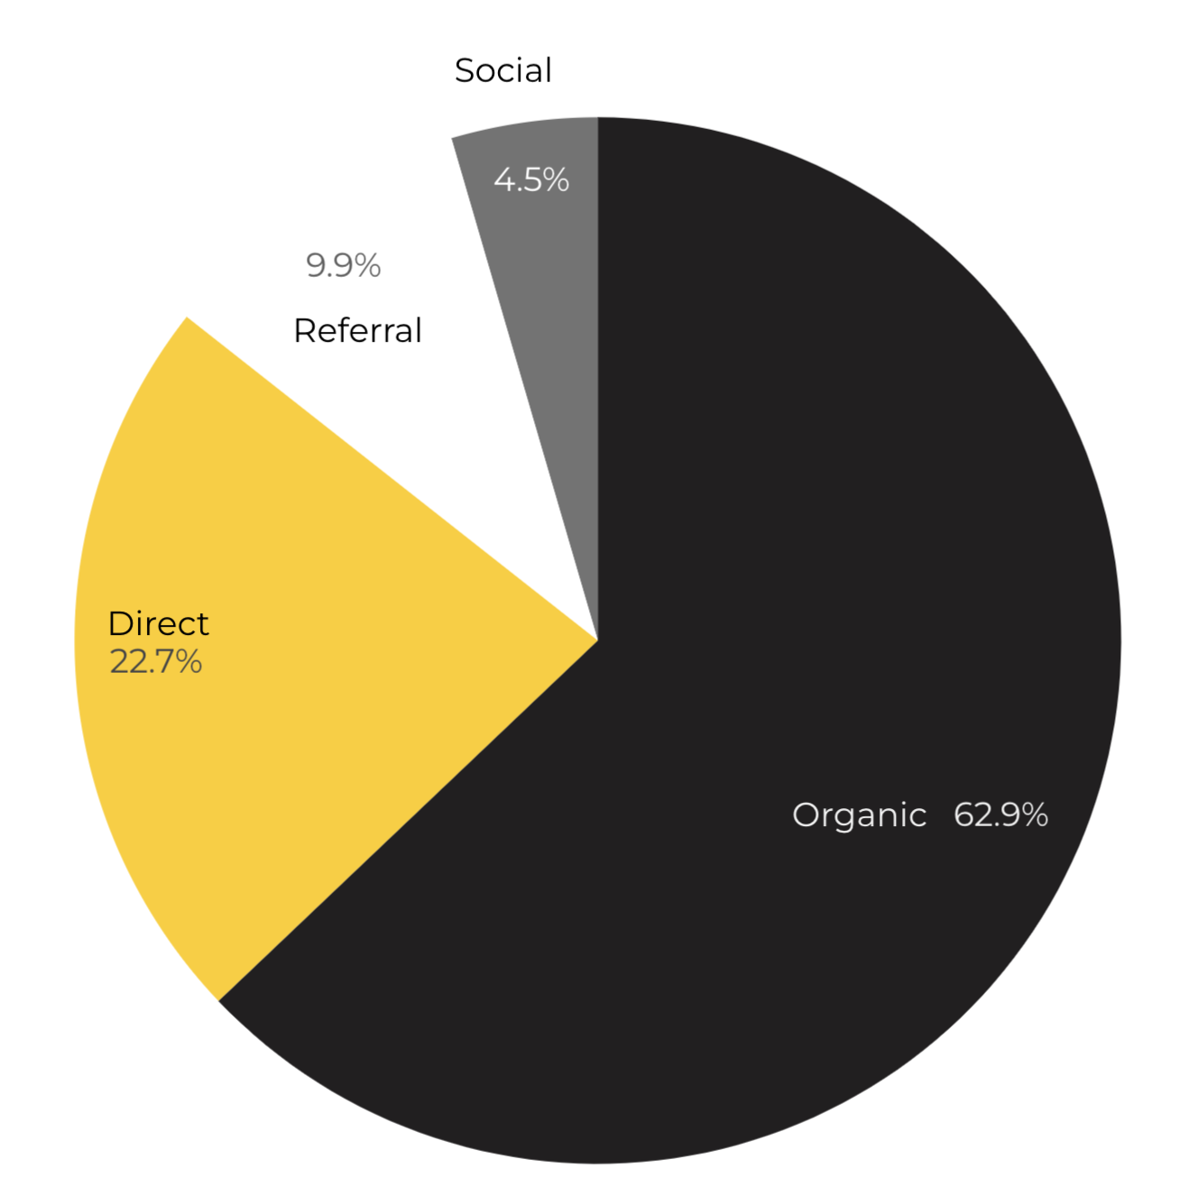
Marketing Reach
62.9% of visitors came from Organic Search Engine queries.
22.7% of visitors came directly to the site (by typing in the address, using bookmarks, or email links).
9.9% of visitors came from Referral links on 3rd party web sites.
4.5% of visitors came from Social Media.
Organic

Slide 10
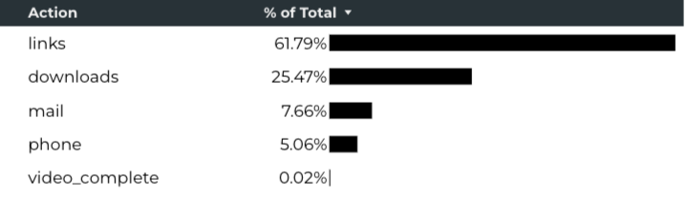
Engagement Insights & Highlights
Last FY had a total of 272,271 interactions on the ACS pages. (interactions are downloads, email clicks, phone number clicks, and outbound links).
Phone
Outbound Clicks

Slide 11
Search Intent
Search intent is defined as being the underlying purpose behind an online query.
43% of searches are looking for an answer to a specific question or general information.
42% of searches are looking to investigate brands or services and intend to complete an action or purchase.
15% of searches intend to find a specific program page using the on-site search.

Slide 12
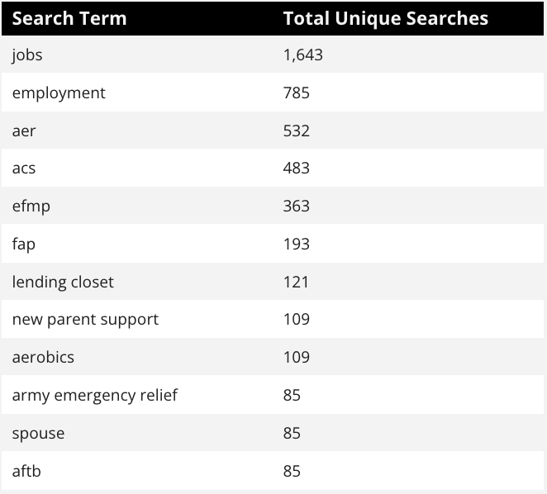
Search Insights
Top Search Terms
8,630 Total on-site searches on ACS pages to find more information.
81.58% of users left the site after performing a search.

Slide 13
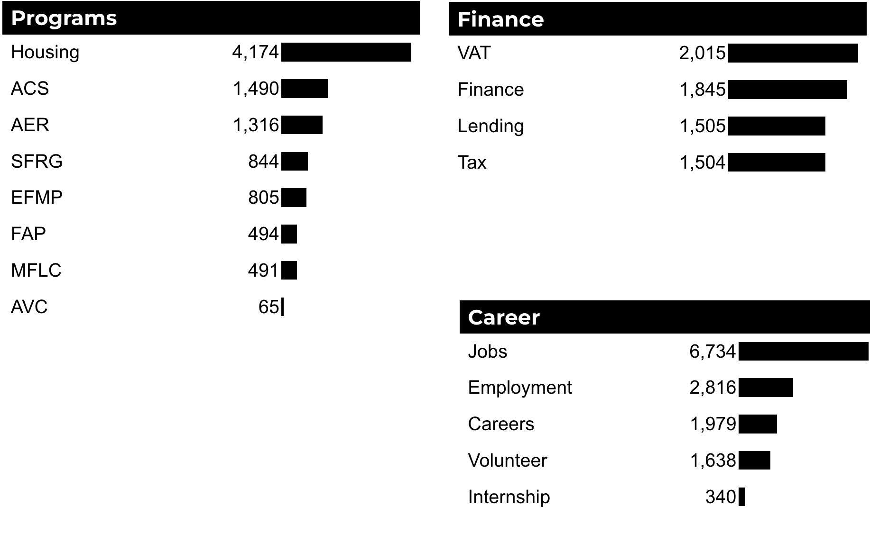
What Are The Top Search Sub-Topics?
The most popular search categories > terms within ACS.

