Slide 1
Table of Contents
Section 1 – FoodTrak Intro
  Basic Information 2
  Terms & Vocabulary 6
  System Elements 9
  Logging-In 26
  About Your System 30
  Security & Users 35

Slide 2
Table of Contents (cont.)
Section 2 – Database & System Setup
  Inventory Locations 37
  Location Groups 40
  Recipe and Product Groups 45
  General Ledger (GL) Accounts 52
  Vendors 55
  Items 60
  Invoices 62

Slide 3
Table of Contents (cont.)
Section 3 – Data Entry & Report Analysis
  Prep Items 68
  Recipes 72
  Key (sensitive) Items 76
  Inventory 79
  Shelf Order Inventory Template 89
  Waste 92
  Management Summary 101
Appendix A – Reports 103
Appendix B – How To (step by step instructions) 104

Slide 4

Food and Beverage Management Software Training
Intro
January 2013

Slide 5
What is FoodTrak?
The FoodTrak system is a comprehensive inventory accounting and control program that increases purchasing and accounting efficiencies, reduces the cost of goods, and increases security for assets such as food, beverage, supplies and retail goods.
This translates to FoodTrak is a tool that helps us track our food, prevent theft and in the end, saves us money.

Slide 6
What can FoodTrak do?
Data Management
Inventory Control
Purchasing Process
Recipe Management
Real Time Reports

Slide 7
Accounting vs Control
Accounting
Control
All about tracking $$$
Required for financial management and internal controls
Period-based
Generates no savings (profits)
All about tracking items
Required for profit maximixation and effective management
Real time-based
Generates significant savings that increase profit

Slide 8
Accounting vs Control Reports
Accounting Reports
Control Reports
Inventory extension
Cost of goods
Purchase recaps
Transfer activity
Item usage
Management summary
Perpetual Inventory
Inventory level variance
What’s Hot/What’s Not
Key item tracking (sensitive item inventory)

Slide 9
FoodTrak Acronyms and Terms
Site-Houses a database of vendors, items, recipes and transactions, The scope of the database is determined by the type of resources allocated to it.
Resources-Represent business areas within a site that need to enter transactions into FoodTrak. Ex. Profit/Cost Centers, Ordering Affiliates, Stands…
Concurrent Users-Number of users licensed to use FoodTrak at the same time
Interface-Software which enables interaction between FoodTrak and other automated systems

Slide 10
FoodTrak Acronyms and Terms (cont.)
Module-Represents specialized add-on functionality that enhances the basic functionality of the FoodTrak system
PIE-Perpetual Inventory Engine
Allocate-To assign a particular resource, module or interface for use in a specific site
Session Timeout-The duration of time which when elapsed kills a licensed session forcing a user to log back into FoodTrak. (There is a possibility of data loss when this occurs)

Slide 11
FoodTrak Acronyms and Terms (cont.)
Actual Usage = Beginning Inventory + Purchases + Transfers in – Transfers out – Ending Inventory
Ideal Usage = derived from multiplying the portion used of every item contained in recipes sold by the quantity of that recipe sold for a given period (What we should have used based on sales)
Cost of Goods Sold = Same as Actual Usage formula but expressed in dollars instead of units

Slide 12
Operational Elements
Site Administration
Database
Data Entry
Reports
Notes:
Before navigating this, have students log in

Slide 13
Site Administration
General
  Profit Center Location Assignment
  Recalculate Par Levels
  Site Information
  Undelete Items
Corporate Functions
  POS Audit Review

Slide 14
Database: Elements
G/L Accounts
Items
  Purchased
  Prep/Sub Recipes
  Saleable Recipes
Recipe Designer
Units
Vendors

Slide 15
Database: Groups
How Cooked Categories
Location Groups
Main Ingredient Categories
Product Groups
Profit Center Groups
Recipe Categories
Report Groups

Slide 16
Data Entry
Inventories
Procurement
Sales
Transfers and Requisitions

Slide 17
Data Entry: Inventories
Inventory Entry Form
  Create New Form
  Edit Existing Form
Inventory Template Manager
Link Inventory Forms
Spot Count

Slide 18
Data Entry: Procurement
Automatic Purchase Order (PO) Creation
Interactive Purchase Order (PO) Creation
Invoice Entry Form
Procurement Template Manager
Purchase Order Entry Form
Shopping List Entry Form

Slide 19
Data Entry: Sales
Sales Entry Form

Slide 20
Data Entry: Production Planning
Fabrication Input Form
Menu Planning Form
Production Input Form

Slide 21
Data Entry: Transfers and Requisitions
Automatic Requisition Creation
External Requisition Form
External Transfer Form
Interactive Requisition Creation
Internal Requisition Form
Internal Transfer Form
Waste Form

Slide 22
Reports: Accounting
Inventory
Planning
Procurement
Sales and Sales Orders
Transfers and Requisitions

Slide 23
Key Accounting Reports
Inventory Extension
Cost of Goods
Invoices
Price Exception
Transfer Activity
Waste Activity

Slide 24
Reports: Control
Forecasting
Inventory
Menu Engineering
Planning
Procurement
Sales and Sales Orders
Transfers and Requisitions

Slide 25
Key Control Reports
Item Usage
Management Summary
Perpetual Summary
Waste Control
Inventory Level Variance

Slide 26
Reports: Data Lists
Company Information
G/L Account List
Group List
Item List
Par Level Parameters
Product List
Recipe List
Security Group Settings
Stand Item List
System Message List
Vendor Item List
Vendor List

Slide 27
Reports: Input Forms
Barcode Sheets
Bid Request Form
Database Changes
Fabrication Input Form
Inventory Form
Product Input Form
Purchase Order Receiving Document
Receiving Log
Recipe Production/ Transfer Worksheet
Requisition Input Form
Requisition Pick Form
Sales Input Form
Security Worksheet
Shopping List Input Form
Waste Input Form

Slide 28
Reports: Nutrition
Item Nutrition Report
Saleable Item Nutrition Labels
Saleable Item Nutrition Report

Slide 29
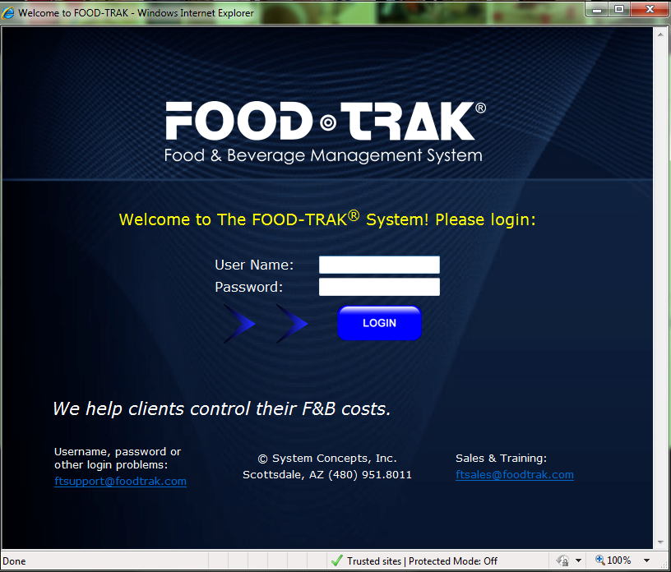
Log-In
Go to the website:
  https://www.mwrportal.army.mil/
Under the Global Applications, click on the FoodTrak link and the following window will pop-up:

Slide 30
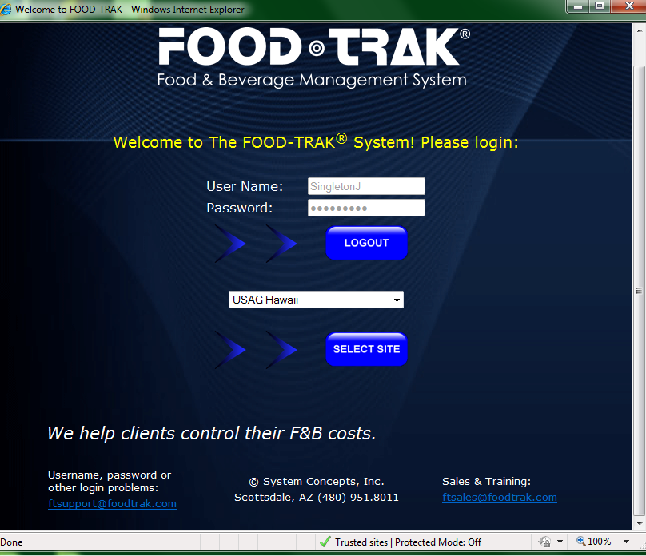
Log-In (cont.)
Type in your assigned User Name and Password, click login and the following box will popup:

Slide 31
Log-In (cont.)
From the drop down box, select your facility then click Select Site

Slide 32
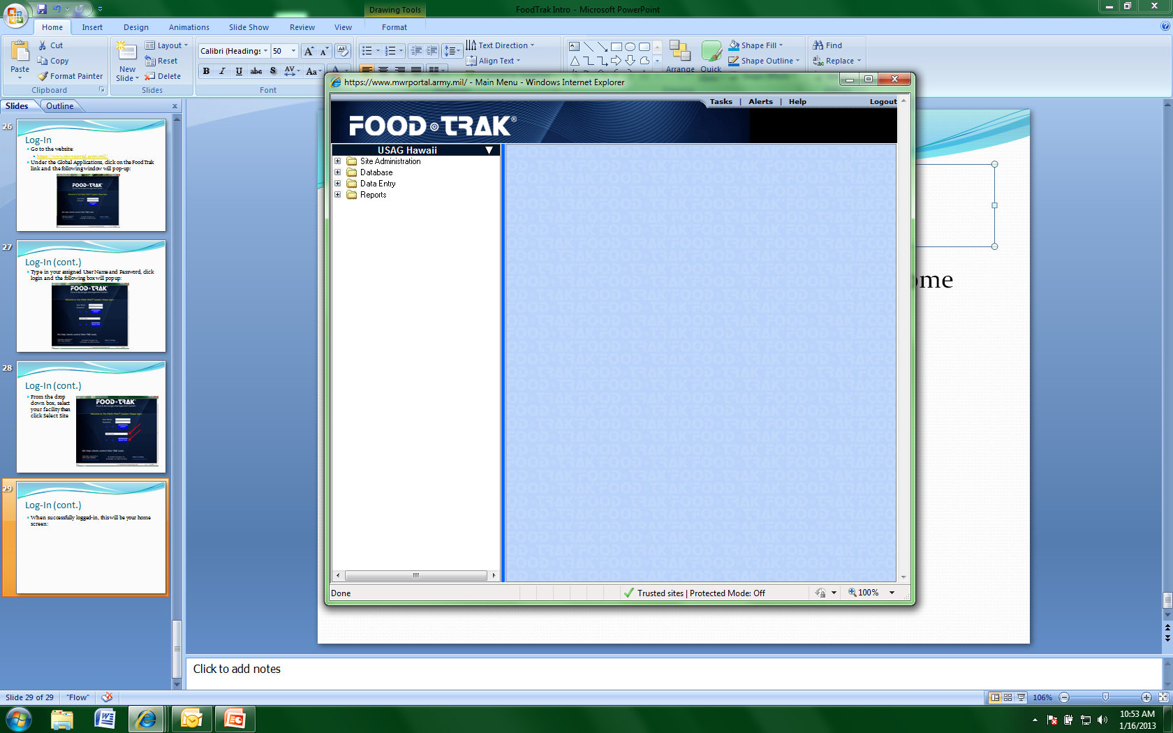
Log-In (cont.)
When successfully logged-in, this will be your home screen:

Slide 33
About Your FoodTrak System
There nay be times when you will need information regarding your system, such as:
  When requesting assistance from HQ
  The FoodTrak Technical Support Advisor or HQ subject matter expert (SME) will need to know certain information

Slide 34
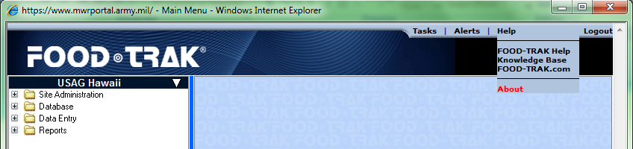
About Your FT System (cont.)
Launch and log-in to your FoodTrak system using your credentials, then go to your site. At this point, you should be on the home screen
At the top of the screen, click Help and then click About

Slide 35
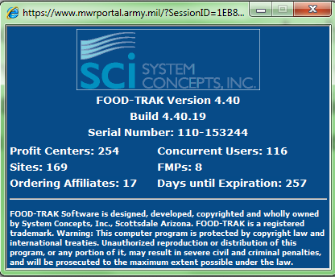
About Your FT System (cont.)
A Box will pop-up on your screen. In the example below, note where it says version and serial number as these are the two most important pieces of information that you will be asked when requesting assistance

Slide 36
About Your FT System (cont.)
The browser based version of FoodTrak will automatically ‘time-out’ a user session if there is no activity for an established period of time. Activity is defined as communicating with the FoodTrak system by saving data
Should you leave your work station while entering data and return after the allotted period of time, your screen will remain on the last page you were working on however, if the user did not save the data, it will have to be reentered

Slide 37
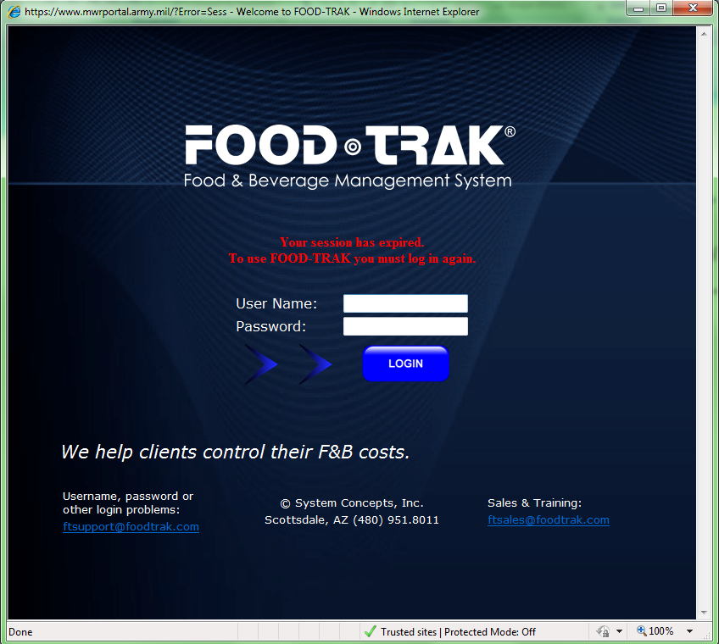
About Your FT System (cont.)
Upon returning to your workstation, no action will occur and you will be redirected to the main log-in page:

Slide 38
Security and Users
Limits the users to only the tasks that they need to do
Users can be assigned to log into and access data in specific Sites and Profit Centers only
Allows tracking of item changes and form use
  Who did what!
User groups allow similar users to access the same functions
Users who do not have permission to functions will not see them when they log-in

Slide 39
Food and Beverage Management Software Training
Part II
January 2013

Slide 40
Inventory Locations
Locations are physical areas where items are stored, produced or used
Locations are assigned to a Location Group and Cost/Profit Center
Locations function as purchase, production and inventory locations
Data entry and reporting are available by location
Option to assign inventory type as Normal, Not Inventoried or Use Last Inventory Count

Slide 41
Inventory Locations Report
To view the report that lists Inventory Locations:
  From the Main Menu; click Reports.
  Click Data Lists and click Group List name
  Choose Inventory Location option and then click Next
  Change the radio button for file format to Adobe Acrobat
  Click Submit and then Submit again
  Push the F5 key on your keyboard or click on Tasks at the top of the screen until the report status is listed as ‘Done’
  Click the name of the report after the status has updated to ‘Done’ to load the report in the browser

Slide 42
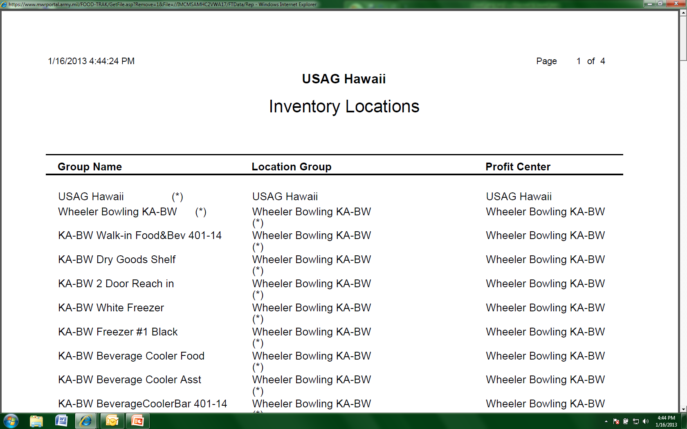
Inventory Locations Report (cont.)
The report will list all Inventory Locations within the site. Below is an example from USAGH:

Slide 43
Location Groups
Defined as a collection of locations
  Ex: Restaurant (location group)
    Storeroom (location)
    Reach-in cooler (location)
    Server station (location)
Location groups are master groups only
Items can only be assigned to locations not a location group
Reports & Templates can be generated by Location Group

Slide 44
Location Groups Report
To view the report that lists current facility Location Groups, follow the steps below:
  From the Main Menu, expand Reports. Click Data Lists and click Group List
  Choose the Location Groups option and click Next
  Change the radio button for file format to Adobe Acrobat
  Click Submit and then Submit again
  Push the F5 key on your keyboard or click on Tasks at the top of the screen until the report status is listed as ‘Done’
  Click the name of the report after the status has updated to ‘Done’ to load the report in the browser

Slide 45
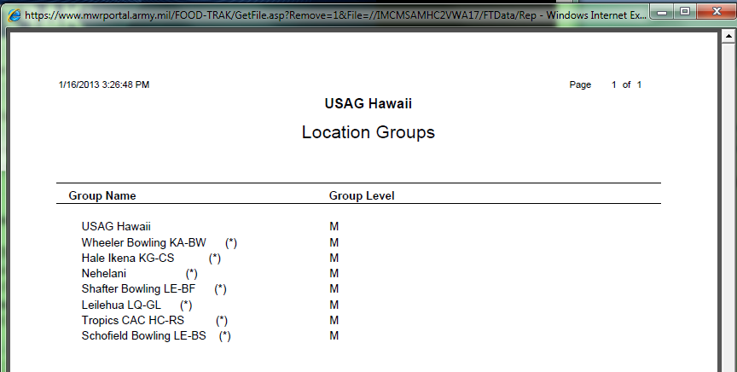
Location Groups Report (cont.)
The report will list all Location Groups within the site. Below is an example from USAGH:

Slide 46
Adding Location Groups and Locations
Locations are divided into Location Groups and Locations
Location Groups allow physical locations to be grouped together for reporting and input form/template purposes
Physical locations allow for the physical counting of stock and facilitate Profit Center reporting
Location Groups first build the reporting structure
Locations are associated with the Profit Centers to which they belong as well as to a location group
Our food and beverage items are stored in the locations

Slide 47
Adding Location Groups
How to Add New Location Groups:
  Under Database, click Groups and then click Location Groups
  Click the Add New button
  Enter the new location group name
  Use the drop down arrow and select the Profit Center associated with this physical location
  Click OK
  Those locations with the asterisk (*) next to them need to be added to the Location Group Editor
  Use the directional arrows on the right side of the group editor to move, promote, and demote groups and locations in the hierarchy

Slide 48
Adding Recipe and Product Groups
Adding recipe groups and product groups will allow the end user to easily run reports
The purpose of this function is to have the ability to section out the menu and determine sales or popularity of a specific item
Without these qualifiers, all products and recipes will fall into a general category
The category Product Groups are associated with saleable items and will reflect how we categorize the items sold on the menu

Slide 49
Recipe Groups Report
To view the report that lists Recipe Groups (categories):
  From the Main Menu, expand Reports. Click Data Lists and click Group List.
  Choose Recipe Groups option. Click Next.
  Change the radio button for file format to Adobe Acrobat
  Click Submit and then Submit again
  Push the F5 key on your keyboard or click on Tasks at the top of the screen until the report status is listed as ‘Done’
  Click the name of the report after the status has updated to ‘Done’ to load the report in the browser

Slide 50
Product Groups Report
To view the report that lists Product Groups:
  From the Main Menu, expand Reports. Click Data Lists and click Group List.
  Choose Product Groups option. Click Next.
  Change the radio button for file format to Adobe Acrobat
  Click Submit and then Submit again
  Push the F5 key on your keyboard or click on Tasks at the top of the screen until the report status is listed as ‘Done’
  Click the name of the report after the status has updated to ‘Done’ to load the report in the browser

Slide 51
Adding Recipe Groups
To add a recipe group:
  From Database, select Groups
  Click the Recipe Categories name
  Click Add New and enter the name of the recipe group to be added
  Click OK
  To designate a sub category, follow the directions above and then after added, click on the Right Arrow in the upper right hand corner of the window
  When done adding new groups, click OK to return to the main screen

Slide 52
Adding Product Groups
To add a recipe group:
  From Database, select Groups
  Click the Product Groups name
  Click Add New and enter the name of the recipe group to be added
  Click OK
  To designate a sub category, follow the directions above and then after added, click on the Right Arrow in the upper right hand corner of the window
  When done adding new groups, click OK to return to the main screen

Slide 53
Adding Inventory Locations
How to Add New Locations:
  Under Database, click Groups and then click Location Groups
  Click on the location group that you would like to create a location for to highlight it
  Click the Add New button
  Enter the new location name
  Use the drop down arrow and select the Profit Center associated with this physical location
  Click OK
  Use the directional arrows on the right side of the group editor to move, promote, and demote groups and locations in the hierarchy

Slide 54
Inventory Type for Locations
To change the Inventory Type for any Location:
  Click on the name of the location that you would like to change to highlight it
  Click the Edit button
  This will allow you to change the Inventory Type, the options are:
    Normal Inventory (default)
    Not Inventoried
    Use Last Inventory Count
  To change, click the radio button next to the option you would like to select and click OK

Slide 55
General Ledger (GL) Accounts
Automatically codes invoiced items to GL Accounts
Reports available by GL Account:
  Purchase Recap by Transaction
  Transfers by GL Account
  Invoices report-included on report
  Inventory Extension-included in Account Summary
Includes account number and a textual description
  Ex: 401 Food Purchases
  Ex: 726 Supplies

Slide 56
General Ledger (GL) Accounts Report
To view a report that lists the GL Accounts:
  From the Main Menu, expand Reports. Click Data Lists and click G/L Account List
  Choose the List G/L account by Profit Center option
  Click Next
  Choose the Include all profit centers option
  Click Next
  Change the radio button for file format to Adobe Acrobat
  Click Submit and then Submit again
  Push the F5 key on your keyboard or click on Tasks at the top of the screen until the report status is listed as ‘Done’
  Click the name of the report after the status has updated to ‘Done’ to load the report in the browser

Slide 57
Adding General Ledger Accounts
How to add new GL Accounts:
  Under Database click on Elements and then G/L Accounts
  Click Add New
  Enter the account number in the Account field and the textual name for the account in the description field
    If the G/L Account has a unique sub account number for each profit center, click the drop down arrow to select the profit center name and enter the accurate profit center G/L Account number
  Click OK to save changes to account
  Click OK to save changes to account editor window

Slide 58
Vendors
Vendors are a critical part of the FoodTrak system as all purchased items are associated with a vendor or several vendors.
General Tab
  Name and Address
  Contact Information
    Account Reps
    Customer Service Contacts
    Separate phone and fax numbers for each location
Accounting Tab
  Account and Customer Numbers
  Delivery Days
  Transferable

Slide 59
Vendor Listing Report
To view the report that lists all Vendors in the system:
  From the Main Menu, click Reports
  Click Data Lists and clicks Vendor List name
  Choose Vendors option, click Next
  Choose the Name option, click Next
  Choose All Vendors option, click Next
  Choose One-Line Summary for each Vendor option, click Next
  Change the radio button for file format to Adobe Acrobat
  Click Submit and then Submit again
  Push the F5 key on your keyboard or click on Tasks at the top of the screen until the report status is listed as ‘Done’
  Click the name of the report after the status has updated to ‘Done’ to load the report in the browser

Slide 60
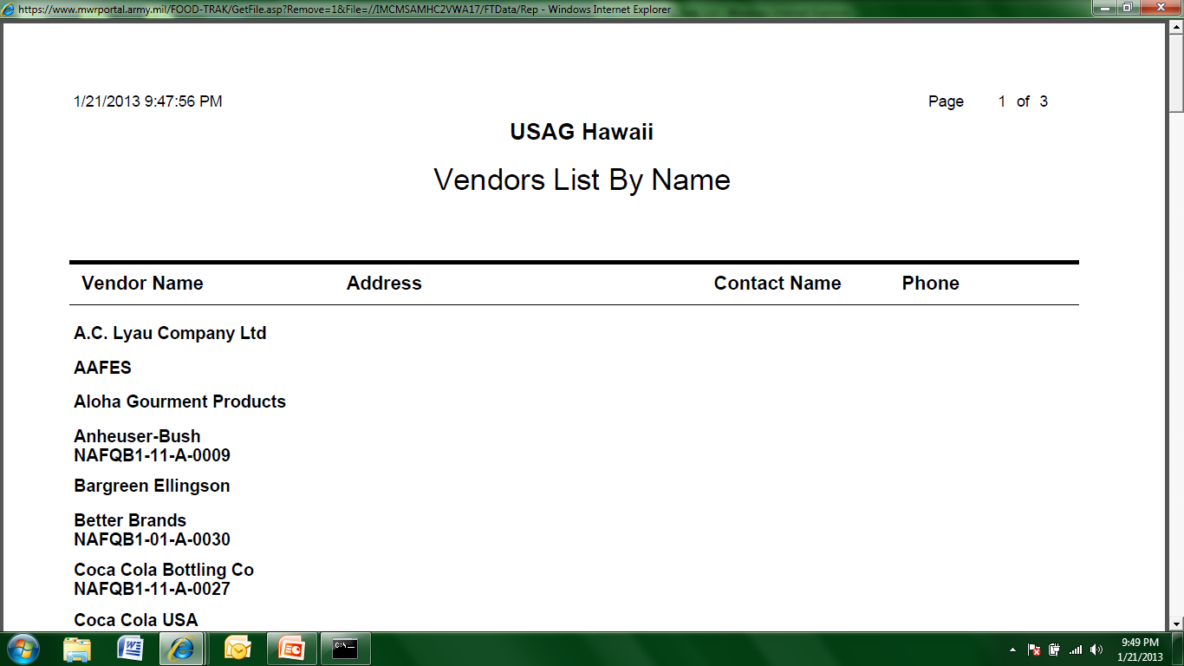
Vendor Listing Report (cont.)
The report will list all Vendors within the site. Below is an example from USAGH:

Slide 61
Adding a New Vendor
Under Database, click Elements and then click Vendors
On the tool bar, click Add New Vendor and enter the following information:
  Name, Address , City, State and Postal Code
Enter the main sales contact, click Add and enter:
  Contact name, Phone Number, Fax Number
Repeat if there are multiple contacts at a location
Click the Accounting tab
Select the Delivery Days
Ensure that the box next to Transferrable is checked
When finished, click OK

Slide 62
Modify an Existing Vendor
Click on the name of a vendor on the selection list
Make any changes necessary
Switch between the General and Accounting tabs
When finished, click the Apply button
Click OK to return back to the vendor listing

Slide 63
Adding Items to the Database
Adding items to a database is an ongoing process
Any time a substitute is sent from a vendor, or a new item is ordered, the new product must be put into the FoodTrak system
Items are generally added when invoices are input or when inventory is taken
While inputting items can be tedious, it is important to pay attention to the details or other process will be more difficult
Key information is unit input

Slide 64
Adding Items to the Database (cont.)
From the Main Menu, expand Database, then click Elements
Click Items
From the tool bar, click Add New Item
In the Item Editor, complete the item information in the General Information section and click Save
Next, complete the Unit Information section including the cost
Pay close attention to the conversion factor as well as the then click Save
Click the Inventory, Purchasing, and Vendor sections in succession for each item
After completing the information in each section, click Save
Click Close at the bottom right of the Item Editor to exit back to the Item Selection list

Slide 65
Entering Invoices
Entering invoices is a critical task in the FoodTrak system
Best practice for entering invoices is to enter them on a daily basis
We generally do not or should not have sales tax but some location may have to pay freight charges
For the purpose of this exercise, we will enter invoices manually
US Foods has an interface for uploading invoices but most other vendors do not (for more information in the US Foods interface, contact IMCOM G-9)

Slide 66
Entering Invoices (cont.)
Invoice entry for features
  Multiple search functions
  On-hand amounts automatically available
  Currency conversion
  Freight, sales tax and miscellaneous charge handling
  Distribution of purchase amounts to G/L accounts
  Reconciliation required to complete form
  Can be Profit Center specific
  Automatic transfer function

Slide 67
Entering Invoices Report
To view the report that lists invoices entered into the FoodTrak system:
  From the Main Menu, expand Reports, expand Accounting
  Click on Procurement then click on Invoices
  For the Date Range of Invoices, enter the timeframe of choice and click Next
  Select All Invoices by clicking the radio button to the left, click Next
  Select All Vendors by clicking the radio button to the left, click Next
  Select All Invoices by clicking the radio button to the left, click Next
  Deselect Sort Line Items by Report Group and ensure Include Account Distributions has a checkmark in the box to the left
  Click Submit then change the radio button for file format to Adobe Acrobat
  Click Submit and then Submit again
  Push the F5 key on your keyboard or click on Tasks at the top of the screen until the report status is listed as ‘Done’
  Click the name of the report after the status has updated to ‘Done’ to load the report in the browser

Slide 68
Manual Invoice Entry
To manually enter an invoice:
  Click Data Entry then Procurement
  Click the Invoice Entry Form
  Choose the Blank Invoice
  In the Header, select the vendor and fill in the information
  Click Details and add the items. Use the item code when possible to expedite data entry
  Add quantities and update pricing if required
  Click Complete (1 of 2)
  Check the box at the top of the screen that says Print when Completed
  If there are no Critical Issues or Warnings, click Complete (2 of 2)
  Click OK to save your changes and return to the form

Slide 69
Entering Invoices (cont.)
After entering invoices, the following reports can be run with data
  Purchase Recap by Vendor
  Purchase Recap by Report Group
  Purchase Recap by Transaction
  Purchase Recap by Purchase Ranking
  Management Summary

Slide 71
Food and Beverage Management Software Training
Part III
January 2013

Slide 72
Prep Items - Introduction
Also referred to as:
  Batch recipes
  Sub-recipes
  Food in-process
  Prep recipes
May be used as part of another recipe
May represent items at various stages of preparation
  Ex: Chili for nachos, filleted whole fish or cooked chicken breasts
Inventory as they have value!

Slide 73
Prep Items-What to Consider
Item Name: What name makes the item easily identifiable and unique?
Units: Hoe is the item produced, inventoried and used in other recipes?
Inventory: Where is the items stored and counted?
Produced: What location produces this item?
Ingredients: What ingredients are used in the item?
Yield: How much do the ingredients make after chopping, processing or cooking?

Slide 74
Prep Items – Yield Definition
The yield is expressed as the number of usable units you can get out of an unprocessed unit
  Lbs of trimmed, cooked ham vs. as purchased
  oz of cooked rice vs dry
Some yields represent no loss (100%)
  Ex: ketchup has an inventory unit of #10 can and a recipe unit of fl oz resulting in a yield of 96 fl oz per #10 can
Other yields represent processing loss (less than 100%)
  Prime rib may only yield 12 oz per raw pound after cooking (75%)
Some yields represent a gain (more than 100%)
  You get 32 oz of cooked pasta for every uncooked pound (200%)

Slide 75
How to Conduct a Yield Test
Define two units for establishing relationship
  ex: pound (lb) and ounce (oz)
Measure or weigh beginning amount (15lbs)
Process until fully useable
  ex: cook and trim meat
Measure or weigh ending about in the same unit as before (12 lbs)
Yield=Ending amount / beginning amount *100
  12/15=0.8 0.8*100=80%
  Yield = 80%

Slide 76
Defining Recipe Units
Consider every recipe that uses the item, and how that recipe calls for the item
Items can have multiple recipe units
Recipe units are more often smaller than inventory or purchase units
When entering recipes, make sure to assign default units for forms: (I) Inventory, (P) Production and (R) Recipe
These are very important because this designation will simplify or complicate other processes such as inventory

Slide 77
Entering Recipes into FoodTrak
Expand Database, click Elements
Click Recipes
In the upper left hand corner click the small box to Add New Item
This will open the Item Editor – Recipe Option
Fill in all of the information under the general tab and ensure that the Inventory and Ingredients are selected
Click Save
Fill in the information on the unit tab
  Make sure that the Assigned Units are correct
  The (I) unit is how an item will show on the Inventory sheet
Click Save

Slide 78
Entering Recipes into FoodTrak (cont.)
On the left hand side of the screen, click Inventory Information and fill in then click Save
Click Recipe Information fill in the information then, at the bottom of the screen, click Recipe Designer
Click on the icon at the top to Add Ingredient (if you are unsure which icon this is, hover over it with your mouse without clicking and the description will appear)
Fill In the information (binocular icon will assist you in searching for items already in the database)
For the prep notes, use descriptors such as chopped, drained or seedless if needed
Click Add, when done adding items, close the box using the red X at the top

Slide 79
Entering Recipes into FoodTrak (cont.)
Fill in the Procedures area at the bottom with instruction on recipe
When complete, click the disk icon to save the recipe then exit
Click Save then click Close
You will now see the new recipe on the main screen
To edit the recipe, click on the small white box between the recipe name and recipe abbreviation
To delete, check the box to the left of the recipe name then click on the black “X” on the toolbar at the top of the screen

Slide 80
Designating Key Items
Designed to be used to track inventory variance of sensitive items
Any item or recipe can be designated as a key item
Key item template maintained by system
Reporting available for key items only
Tracking can be used for Financial Management Branch inspections for Internal Controls

Slide 81
Designating Key Items
Follow the instructions to add a new item or select the item to be designated from the Database, Elements then Items
Under the Inventory Information section, check the box that says Key Item
Click Save then Close
Note: to remove an item from the Key Items, follow the same instructions above but ensure that the box is not checked

Slide 82
Key Item Inventory
To print a key (sensitive) item inventory:
  From the Main Menu, expand Reports, click on Input Forms.
  Click Inventory Form
  Use the drop down arrow and select Key Items Only. Click Next
  Select any additional settings you want by clicking the radio button to the left. Click Next.
  Do not include Barcodes is the default and is typically selected. Click Next.
  Change the radio button for file format to Adobe Acrobat
  Click Submit and then Submit again
  Push the F5 key on your keyboard or click on Tasks at the top of the screen until the report status is listed as ‘Done’
  Click the name of the report after the status has updated to ‘Done’ to load the report in the browser

Slide 83
Inventory Process
Inventory Methods
Inventory Templates
Printing Inventory Forms
Entering Inventories
FMP Introduction
Shelf Order Templates

Slide 84
Inventory
Items included in an inventory count are updated based on values entered on the physical count form
Items not included in an inventory count continue with on-hand perpetual values
Default inventory values print on inventory forms and can be overridden on any inventory count
Fixed inventory values do not print on inventory forms. The default values can be changed by modifying the item in the database.

Slide 85
Inventory Scope Definition
Full – Includes all items. A zero inventory value is assumed for any item not counted
Partial – Includes all items. For those items not counted; the perpetual inventory engine will calculate an inventory value

Slide 86
Inventory Designation Options
Site-wide – Includes items in all locations and all Profit Centers
Profit Center – Includes items in all locations within a Profit Center
Miscellaneous – Includes items in any location or Profit Center
Key Item – Includes only those items identified as Key (sensitive) Items

Slide 87
Inventory – Spot Count
Quick entry to adjust the perpetual inventory of an item in a specific location
On-hand value for that item in that location will be reset to the spot count amount
Allows for easy entry of inventory count for a single item

Slide 88
Inventory Template Options
System generated templates
  Alphabetic by location
  Alphabetic by report group
  Maintained by the system
User-sequenced templates
  Shelf Order
  Mix-and-Match alphabetic
  Built and maintained/updated by the user

Slide 89
Inventory – Printing Input Form
To print the Inventory Input Form:
  From the Main Menu, expand Reports and then click Input Form
  Click the Inventory Form
  Choose the Alphabetical by Location from the drop down menu, click Next
  Make sure the radio button for All Inventory Locations is selected, click Next
  Check the boxes for the following options: Show Cost, Show Beginning Inventory and Page Break After Each Group, then click Next
  Do not include Barcodes is the default and is typically selected. Click Next.
  Change the radio button for file format to Adobe Acrobat
  Click Submit and then Submit again
  Push the F5 key on your keyboard or click on Tasks at the top of the screen until the report status is listed as ‘Done’
  Click the name of the report after the status has updated to ‘Done’ to load the report in the browser

Slide 90
Entering an Inventory
Create a new inventory form
Select the template that was used for counting
Fill out the inventory form
  Enter counts
  Add new items/units to database as necessary
  Make and corrections as necessary
  Update the template as necessary
Use special features as necessary
  Price override function
  Designate as full inventory to facilitate closing inventory period
  Assign for, to period end date/time (23:59)
Complete or pause inventory form

Slide 91
Entering an Opening Inventory
To create a new inventory form and enter item counts:
  To begin manual entry of an inventory form, from the Main Menu, expand Data Entry and then click Inventories
  Click on Inventory Entry Form then click on the Create tab
  Click on the name Site Wide Full
  Fill in all of the information on the Inventory Form Header tab then move to the Detail tab
  Complete the inventory form by entering the quantities from the inventory sheets
  When data entry is complete, click Complete (1 of 2)
  You will get a message informing you that saving this form will set all inventory values to the levels on this form. Click OK.
  Click Complete (2 of 2). The form is saved and it will return you to the templates screen

Slide 92
Inventory Template Manager
Use to create or edit user-sequenced templates
Items can be added to templates
  Use the add function for manual entry
Items on a template can be moved up or down
If the template changes. Edit it and re-complete the template
Use this function to create a shelf order template to simplify monthly inventories

Slide 93
Create a Shelf Order Template
Why shelf order inventory?
  Inventories substantially expedited with shelf-order forms
Create a shelf order template by conducting an inventory on blank paper or use FoodTrak inventory input forms
  No missed items
  Keep track of item sequence in the inventory locations
Create new template using the shelf order rule
  Use shelf order inventory count sheet to create a shelf order template or modify existing alphabetical form and recomplete it as a new shelf order template

Slide 94
Creating a Shelf Order Template
After physically going through the facility and recording the actual location of each item create a shelf order template:
  Under Data Entry, click Inventories and click Inventory Template Manager
  Click New Template and name the template (location) Shelf Order
  Use the drop down menu for Type: and select Miscellaneous Full
  Ensure that the boxes are checked by the locations that you would like to include on your template. When finished, click Next
  For each location in the drop down list at the top of the screen use the Sort Order drop down to apply the Shelf Order rule to it
  Check Append New Items to End of Location
  Move or add the items found in each location to their respective order
  Click Finish when all are complete
  The Inventory Template Manager will now list your completed template
NOTE: If you change your shelf order (add or move an item) the change will not be reflected until the location is changed on the items page

Slide 95
Shelf Order Inventory Report
To retrieve the user defined Shelf Order Inventory Template form to print and record item quantities:
  Expand Reports
  Click Input Forms
  Click Inventory Form
  Choose a sequence for this report, use the drop down arrow to select your shelf order inventory template by name and click Next
  List items for; choose All inventory locations and click Next
  Additional settings; choose desired options, generally Show Beginning inventory, Show cost and Page break after each group then click Next
  Choose Do not include barcodes click Submit
  Change the radio button for file format to Adobe Acrobat
  Click Submit and then Submit again
  Push the F5 key on your keyboard or click on Tasks at the top of the screen until the report status is listed as ‘Done’
  Click the name of the report after the status has updated to ‘Done’ to load the report in the browser

Slide 96
Waste Control
Key element in controlling food and beverage costs
Tracking waste prevents unnecessary waste and lowers food costs
Waste can be:
  Damaged goods
  Kitchen waste
    Improper preparation
    Over production
    Emphasis on speed instead of yield
  Spoilage
  Customer Returns
  Finished Waster

Slide 97
Waste Control (cont.)
Improve food cost by:
  Identifying areas of over production
    Goods held too ling before serving (fries, coffee)
    Over-prepping of items (salads, other produce items)
  Identifying areas for kitchen training
    Improperly prepared (recipe not followed)
    Operator fails to follow customer cooking instructions
    Improper emphasis on speed
  Improved handling and storage of food in receiving, purchasing and storage areas

Slide 98
Entering a Waste Form
Waste Forms will put a value on items that are tossed and can be used for EOM Inventory, to enter a waste form:
  Under Data Entry, click Transfers and Requisitions
  Click Waste Form
  Click Blank Waste template
  Fill in the information in the Header tab
  Click on the Details tab
  Add the items to the waste form by clicking where it says Click Here to Insert an Item to the Beginning of the form
  Ensure that each item is wasted from the correct location
  When finished, click Complete (1 of 2)
  On the summary page, check the box that says Print when Completed then click Complete (2 of 2)
  To edit or reprint a form, follow the first two steps and then click on the Edit tab. Click on the waste form ID of the document to be edited and make necessary changes

Slide 99
Waste Listing Report
From the Main Menu, expand Reports, expand Accounting
Click on Transfers and Requisitions, click Next
Click the Transfer List name
Select Print Transfers to Waste by clicking the radio button to the left. Click Next
Select Date Range by clicking the radio button to the left. Click Next
Input the desired date range then click Next
Select Include transfers to all inventory locations then click Next
Select Include Prices on Report. Deselect Include Bins on Report. Click Next
Change the radio button for file format to Adobe Acrobat
Click Submit and then Submit again
Push the F5 key on your keyboard or click on Tasks at the top of the screen until the report status is listed as ‘Done’
Click the name of the report after the status has updated to ‘Done’ to load the report in the browser

Slide 100
Waste Activity Report
This report will show waste patterns for a specified timeframe:
  From the Main Menu, expand Reports, expand Accounting
  Click Transfers and Requisitions, click Next
  Click Waste Activity
  Select Date Range by clicking the radio button to the left, click Next
  Input the desired date range and click Next
  Select Include items from all report groups by clicking the radio button to the left, click Next
  Select Include transfers from all inventory groups by clicking the radio button to the left, click Next
  Select Print by report group by clicking the radio button to the left, click Next
  Change the radio button for file format to Adobe Acrobat
  Click Submit and then Submit again
  Push the F5 key on your keyboard or click on Tasks at the top of the screen until the report status is listed as ‘Done’
  Click the name of the report after the status has updated to ‘Done’ to load the report in the browser

Slide 101
External Transfers
Used for transferring goods to expense or departmental accounts such as other locations or facilities
Reduces inventory value in sending site
Cost of transders defaults to the site’s accounting method
  May be changed at time of transfer
  Protected by security key
This information can be sent as backup documentation on a Transfer Between Activities (TBA) Form DA 4080

Slide 102
Creating an External Transfer
To transfer items to chargeable accounts outside of the FoodTrak system:
  Expand Data Entry, and then click Transfers and Requisitions
  Click External Transfer Form
  Click the Blank Transfer template
  On the Header tab of the transfer, select the appropriate location from the Send To list
  Leave the date and time stamp as is or edit it to suit your needs
  Enter a reference and comment that identifies the purpose of the transfer
  Click on the Details tab, click the link to insert an item to the beginning of the form
  Enter the items that you would like to transfer
  When finished, click Complete (1 of 2)
  On the summary page, check the box that says Print when Completed then click Complete (2 of 2)
  Choose the Complete without sending option and click OK
  To edit or reprint a form, follow the first two steps and then click on the Edit tab. Click on the waste form ID of the document to be edited and make necessary changes

Slide 103
External Transfers by GL Account Report
This report displays the GL account financial data from external transfers and is obtained by:
  From the Main Menu, expand Reports, expand Accounting
  Click on Transfers and Requisitions and then click on External Transfers by GL Account
  Choose the Date Range option and then click Next
  Enter a date range and click Next
  Sort the report according to the ‘From’ account by clicking the radio button to the left, click Next
  Select Print Detail and Summary by clicking the radio button to the left, click Next
  Change the radio button for file format to Adobe Acrobat
  Click Submit and then Submit again
  Push the F5 key on your keyboard or click on Tasks at the top of the screen until the report status is listed as ‘Done’
  Click the name of the report after the status has updated to ‘Done’ to load the report in the browser

Slide 104
Transfer Activity Report
This report displays the data for all transfers:
  From the Main Menu, expand Reports, expand Accounting
  Click on Transfers and Requisitions and then click on Transfer Activity
  Choose the Date Range option and then click Next
  Enter a date range and click Next
  Select the radio button to the left of Both internal transfers and external transfers, click Next
  Select All Transfer Activity, click Next
  Select All Items, click Next
  For the primary sort order, select Report Group, click Next
  For the secondary sort order, select Transfer Date, click Next
  Select Print Detail and Summary by clicking the radio button to the left, click Next
  Change the radio button for file format to Adobe Acrobat
  Click Submit and then Submit again
  Push the F5 key on your keyboard or click on Tasks at the top of the screen until the report status is listed as ‘Done’
  Click the name of the report after the status has updated to ‘Done’ to load the report in the browser

Slide 105
FoodTrak Management Summary Report
This report provides an overview of sales, actual and ideal cost of goods, and a list of the 15 highest overuse items as well as the 5 highest underused items for the report period
Items are ranked by dollars of overuse and underuse, with the highest listed first
This report gives a quick single-page review of the operation and its major problems without burying the analyst in extensive detail
The report is customizable based on the information that the analyst would like to know

Slide 106
FoodTrak Management Summary Report
To access this report:
  From the Main Menu, expand Reports, expand Control
  Click Inventory then click Management Summary
  Generally, check the box by Group by Profit Center, click Next
  Select All Profit Centers, click Next
  At this point, the user must determine the desired information
    Enter number values into the boxes, generally 5 or 10 for the information desired
    Run the report

Slide 107
Appendix A - Reports
Inventory Locations Report……………………………………… 38
Locations Group Report…………………………………………… 41
Recipe Group Report……………………………………………….. 46
Product Group Report……………………………………………… 47
General Ledger (GL) Account Report………………………. 53
Vendor Listing Report……………………………………………… 56
Entering Invoices Report…………………………………………. 64
Shelf Order Inventory Report………………...................... 91
Waste Listing Report……………………………………………….. 95
Waste Activity Report………………………………………………. 96
External Transfers by General Ledger (GL) Report…… 99
Transfer Activity Report…………………………………………… 100
Management Summary Report………………………………… 102

Slide 108
Appendix B – How To (step by step instructions)
Log-in……………………………………………………………… 26
Find Version/Serial Number…………………………… 31
Add Location Groups …………………………………….. 44
Add Recipe Groups….......................................... 48
Add Product Groups………………………………………. 49
Add Inventory Locations………………………………… 50
Add General Ledger (GL) Accounts………………… 54
Add New Vendor……………………………………………… 58
Adding Items…………………………………………………… 60
Manual Invoice Entry ………………………………………. 65
Conduct a Yield Test………………………………………… 71
Enter Recipes…………………………………………………… 73
Designate Key (sensitive) Items………………………. 77
Run Key Item Inventory………………………………….. 78
Print Inventory Input Form…………………………….. 85
Enter Inventory……………………………………………….. 86
Create Shelf Order Inventory Template………….. 90
Enter Waste Form…………………………………………… 94
Create External Transfer…………………………………. 98

