Slide 1
CYS Second Quarter FY24 Insights
1 JAN – 31 MAR
​

Slide 2
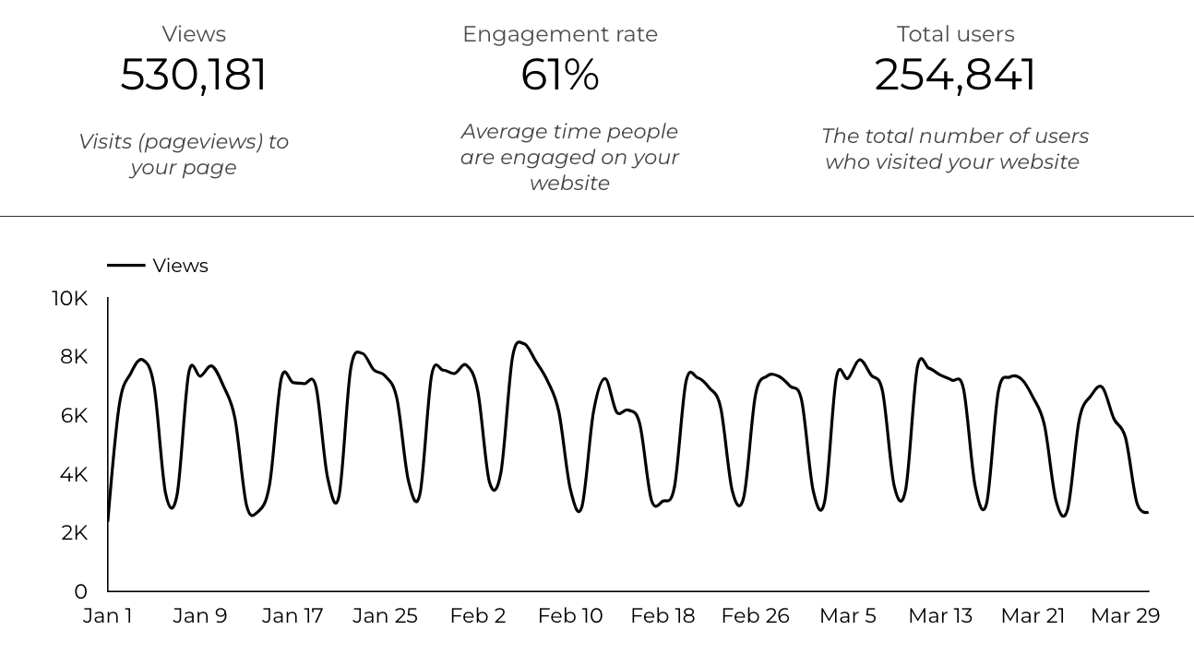
Web Analytics Summary

Slide 3
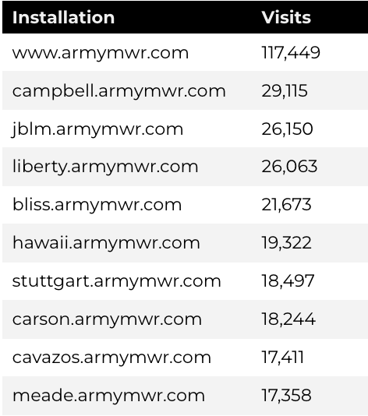
Traffic Highlights
There were a total of 530,181 visits, also known as pageviews, to Child and Youth Services (CYS) web pages.
On average, each user viewed 2.1 pages.

Slide 4
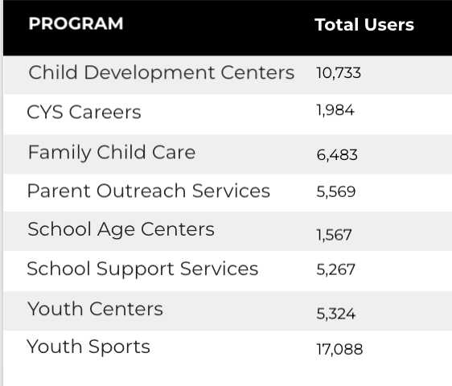
Visitor Highlights
How engaged were these visitors within the website?
There are 254,841 total users on the CYS site.
The average visit duration is 2 minutes and 35 seconds.
A total of 181,152 visitors were new to the website.
71% of all visitors were new.

Slide 5
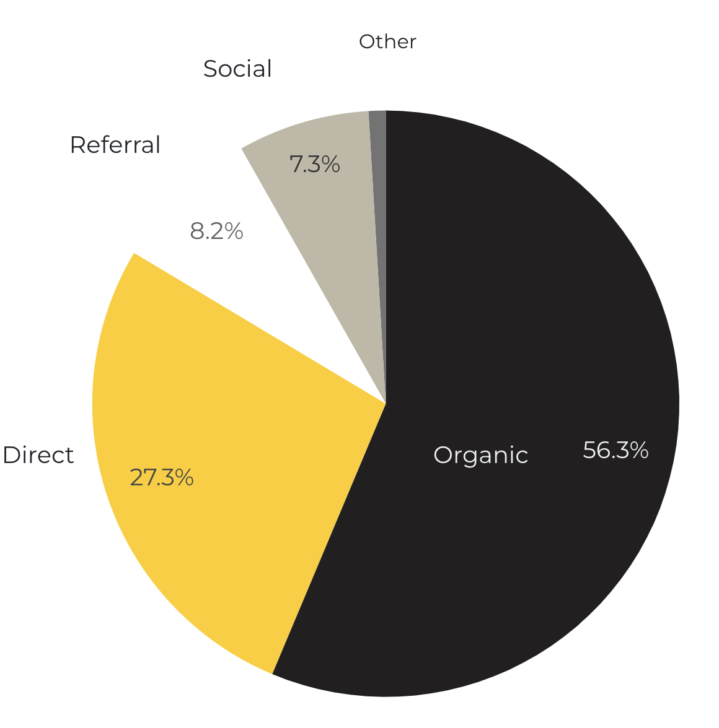
Marketing Reach
56.3% of visitors came from online search engines.
27.3% came directly to the site (by typing in the address, using bookmarks, or email links).
8.2% of visitors came from referrals.
7.3% of visitors came from social media.
0.9% Other (traffic that has an acquisition source Google doesn’t know how to classify).
9.2%
63.8%

Slide 6
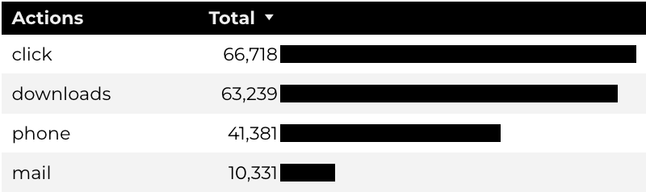
Engagement Insights & Highlights
Last quarter there were a total of 181,669 interactions on the CYS pages, which included downloads, email clicks, phone number clicks, and outbound links.

Slide 7
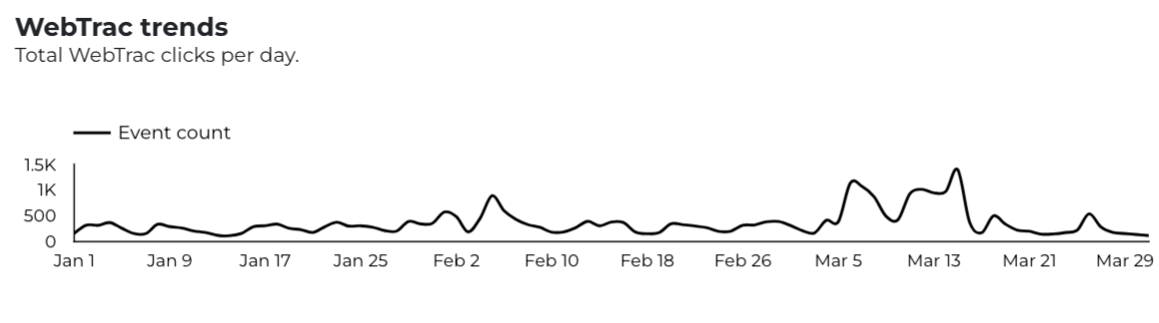
WebTrac Insights & Highlights
32,641 Parents clicked on a WebTrac link from a program page to register or pay for a CYS program.

Slide 8
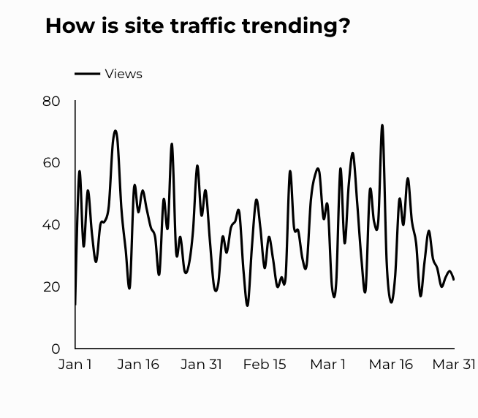
CYS Careers
1,099 people looking for employment took action and clicked on USAJOBS.gov.
621 downloads of the CYS Career Guide.
73 Rack Card downloads.

Slide 9
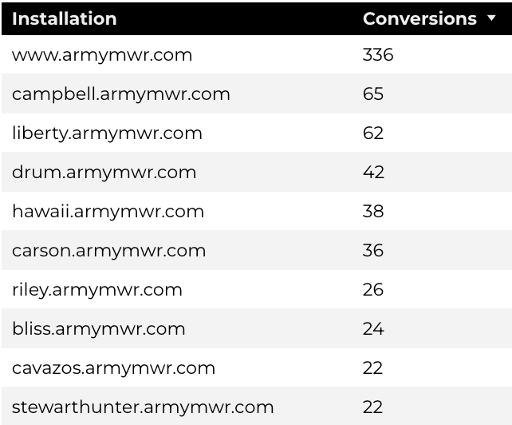
Family Child Care
13,492 visits to program pages.
8,519 users to FCC program pages.
825 downloads of DA 5219 form!

Slide 10
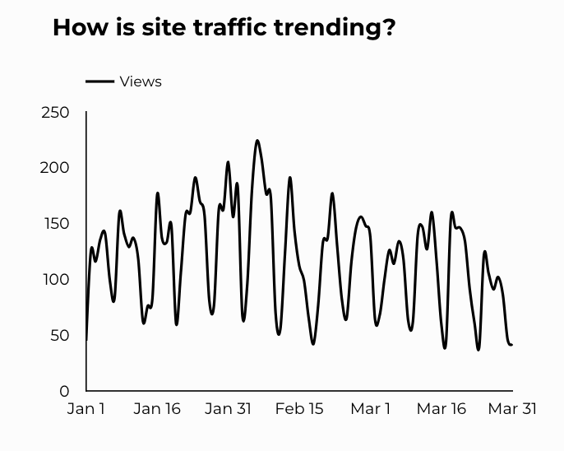
School Support Services
7,104 users made a visit to School Support Services pages.
120 people clicked to watch the 'What Is An SLO Anyway’ video.

Slide 11
Search Intent
Search intent is defined as being the underlying purpose behind an online query.
50% Searches looking to investigate brands or services and intending to complete an action or purchase.
37% Searches looking for an answer to a specific question or general information.
13% Searches intending to find a specific program, page using the onsite search.

Slide 12
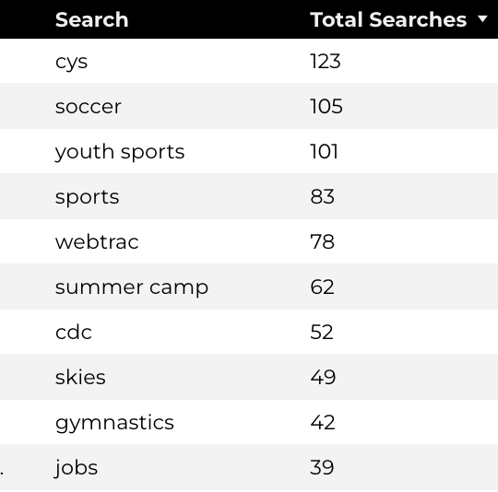
Search Insights
Top Searches
5,273 Total on-site searches on CYS pages to find more information.
2.64% of users left the site after performing a search.

Slide 13
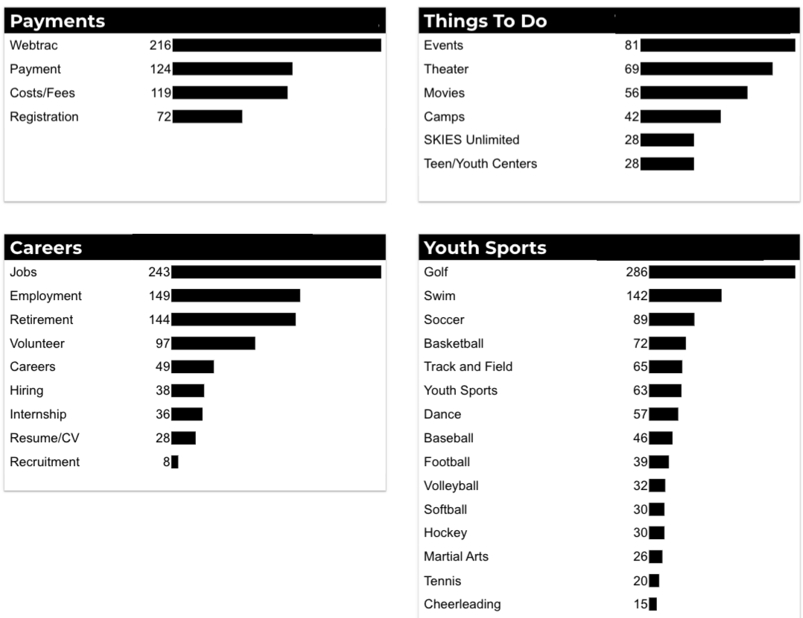
What Are The Top Search Sub-Topics?
The most popular search categories and terms within CYS

