Slide 1
ACS First Quarter FY23 Insights
01 Oct – 31 Dec
​

Slide 2
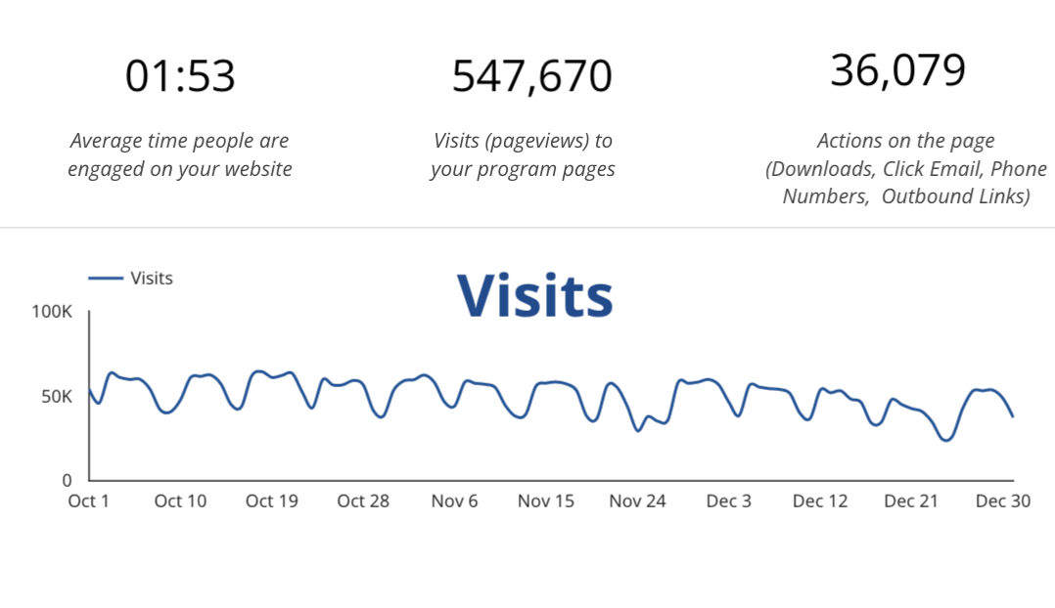
Web Analytics Summary

Slide 3
Traffic Highlights
547,670 Visits to ACS pages last quarter.
Traffic to ACS increased by 8.7% from the previous year.
Traffic to ACS decreased by 14.2% from the previous quarter.
11.4K visits came from Social Media. Social traffic is primarily from Facebook.

Slide 4
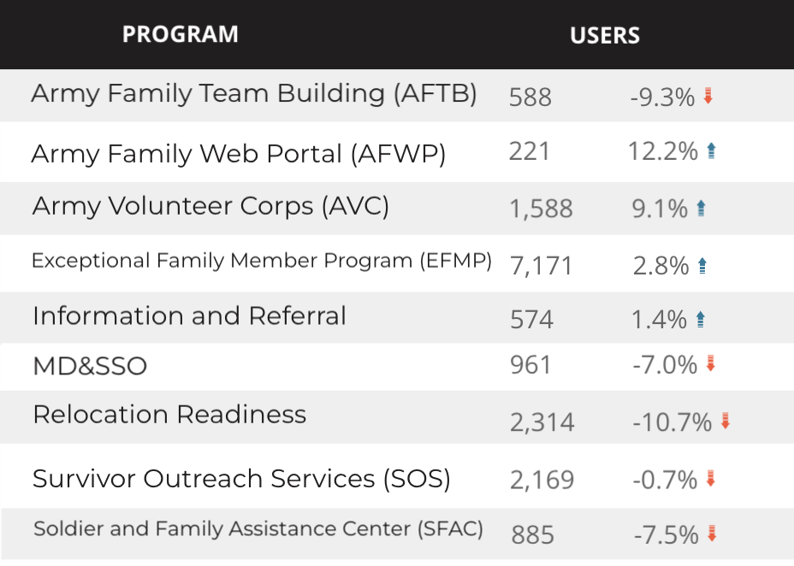
Visitor Highlights

Slide 5
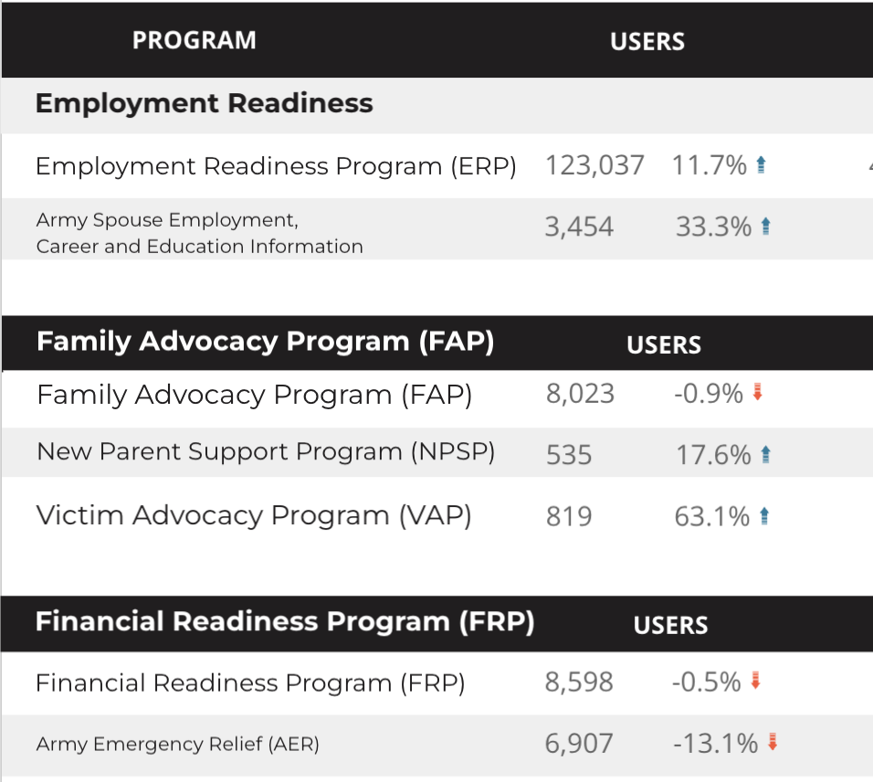
Visitor Highlights
Continued

Slide 6
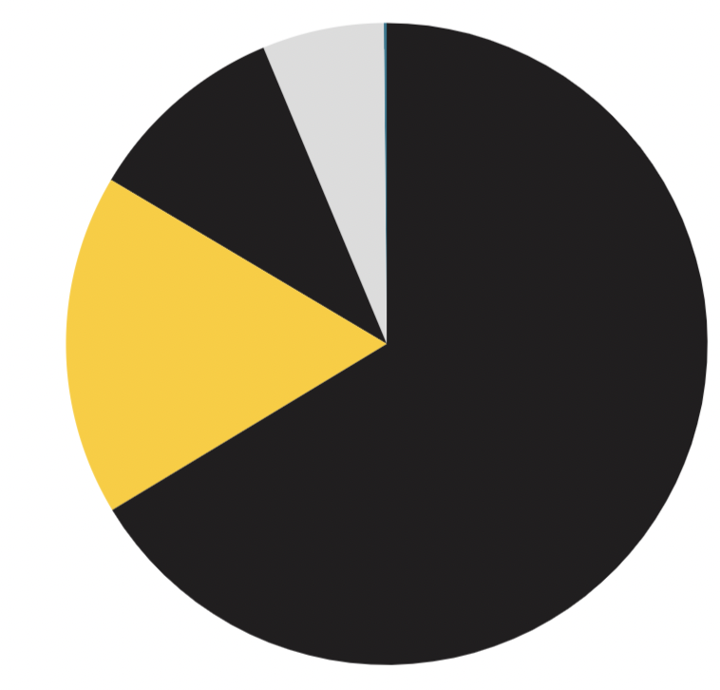
Marketing Reach
8.3 % Social
9 %
Referral
62.1% of visitors came from Organic Search engine queries.
20.4% of visitors came directly to the site (by typing in the address, using bookmarks, or email links).
9% of visitors came from Referral links on 3rd party web sites.
8.3% of visitors came from Social Media.
0.2% Other (traffic that has an acquisition source Google doesn’t know how to classify).
20.4%
Direct
62.1 %
Organic Search

Slide 7
Engagement Insights & Highlights
Last quarter had a total of 36,079 interactions on the ACS pages (interactions are downloads, email clicks, phone number clicks, and outbound links).
Phone
Outbound Clicks

Slide 8
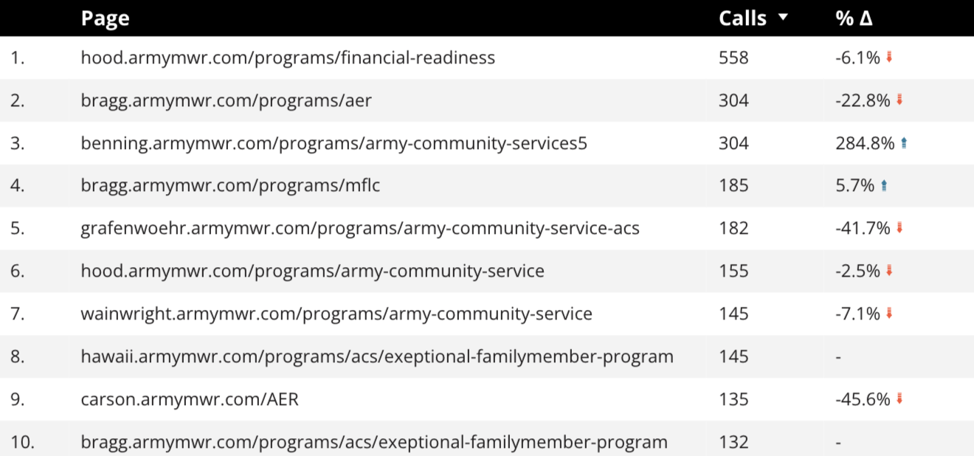
Insights & Highlights
9,770 People needed to talk to a real person last quarter.
-17.2% from the previous year.
Top ACS programs that received phone calls from the web.

Slide 9
Search Intent
Search intent is defined as being the underlying purpose behind an online query.
46% Searches looking for an answer to a specific question or general information.
39% Searches looking to investigate brands or services and intending to complete an action or purchase.
15% Searches intending to find a specific program page using the on-site search.

Slide 10
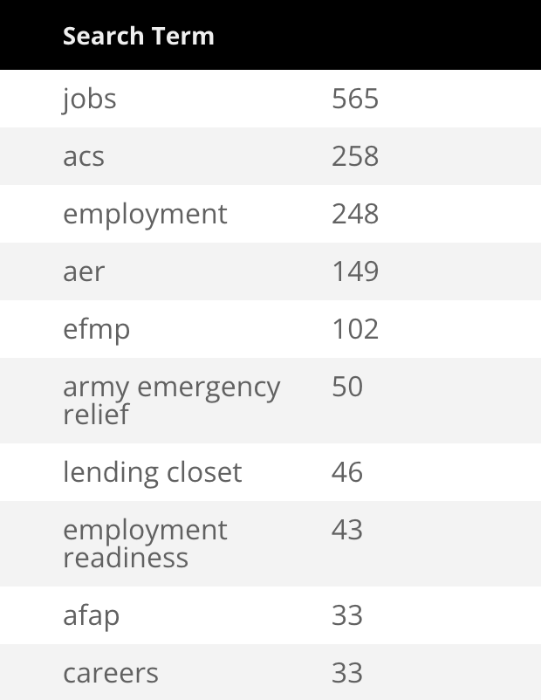
Search Insights
Top Search Terms
2,721 Total on-site searches on ACS pages to find more information.
22.75% of users searched again immediately after performing a search.

Slide 11
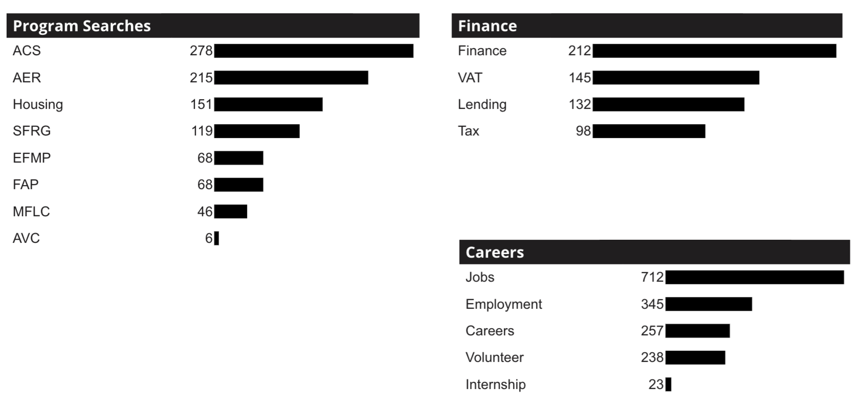
What Are The Top Search Sub-Topics?
The most popular search categories > terms within ACS

