Slide 1
ACS Fourth Quarter FY26 Insights
​

Slide 2
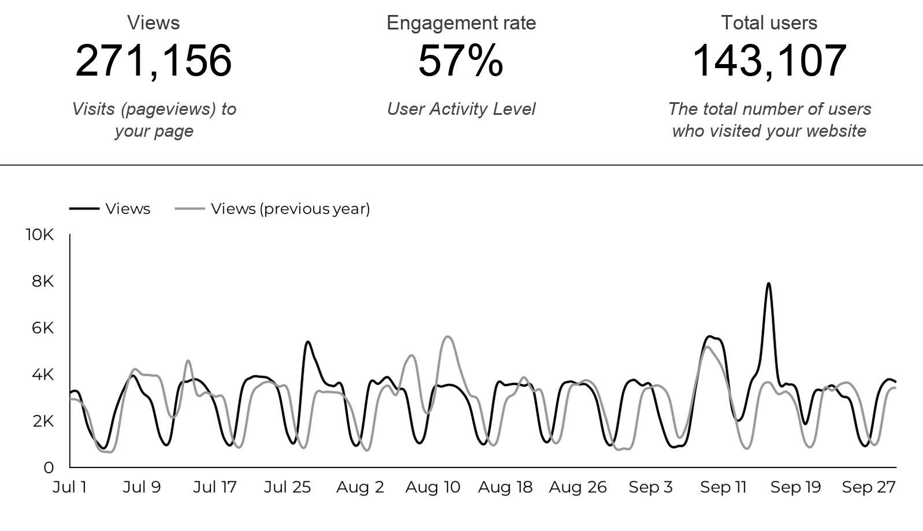
Web Analytics Summary

Slide 3
Traffic Highlights
  ACS pages received 271,156 visits last quarter.
    +5.3% YoY
  Engagement on ACS pages was 57%.
  There were 143,107 total users who made a visit to ACS.
  2,949 visits were directed from social media platforms.
  Most of the social traffic came from Facebook.

Slide 4
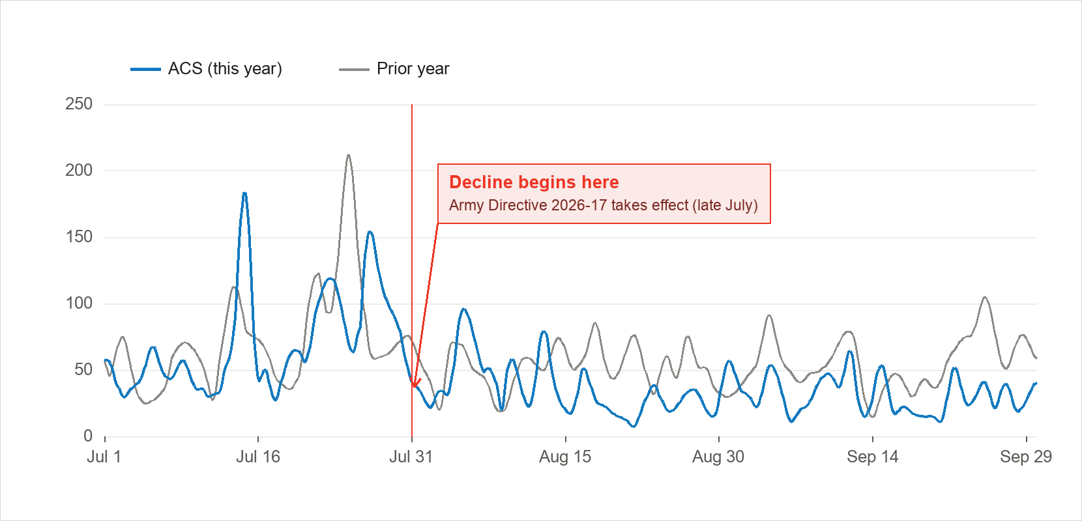
Social Media
  2,949 visits came from social media platforms.
    -31.3% YoY
  Facebook drove 72% of social visits; X was second.
  From August 1, after Army Directive 2026-17, social views fell 37.4%; expect social traffic to run roughly 35% to 40% below last year.

Slide 5
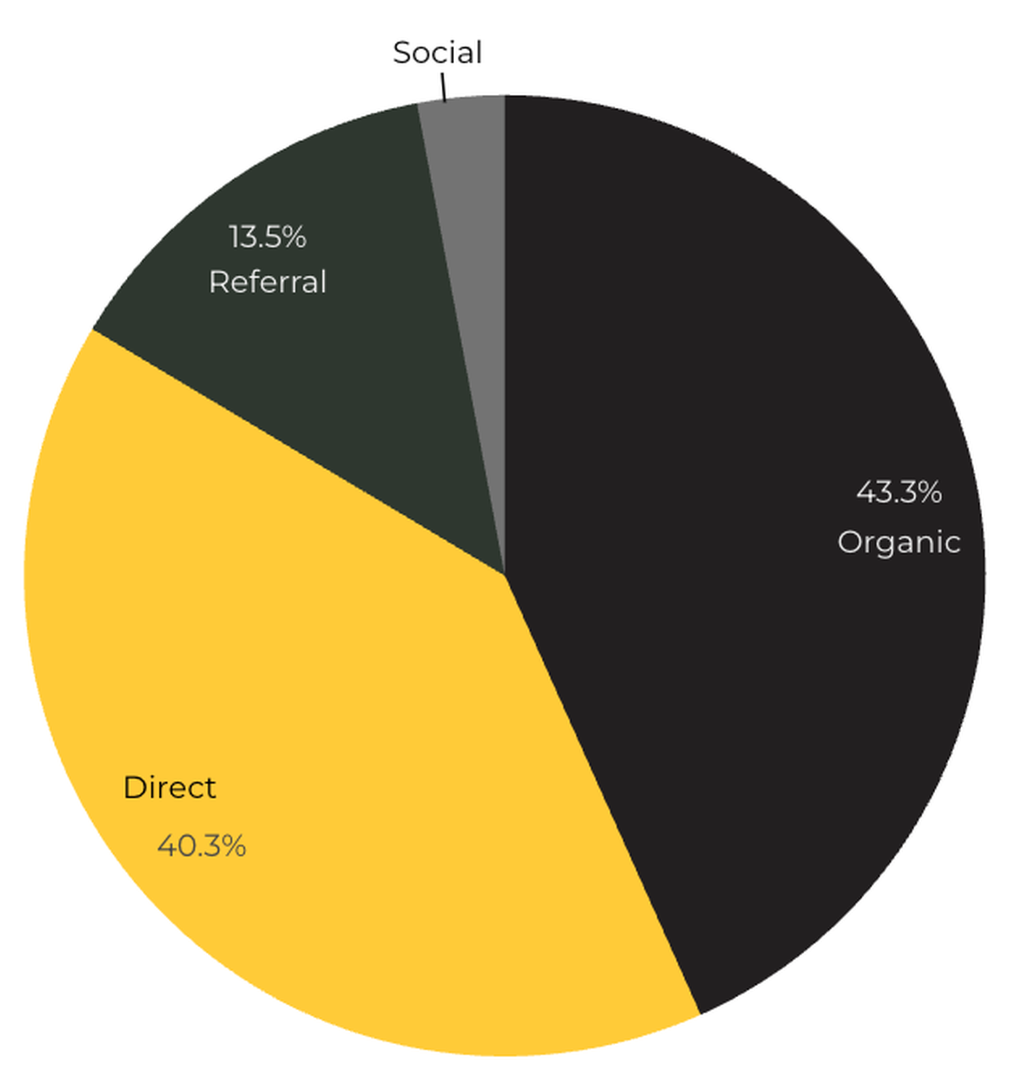
Marketing Reach
43.3% of visitors came from Organic Search engine queries.
40.3% of visitors came directly to the site (by typing in the address, using bookmarks, or email links).
13.5% of visitors came from Referral links on 3rd party web sites.
3% of visitors came from Social Media.

Slide 6
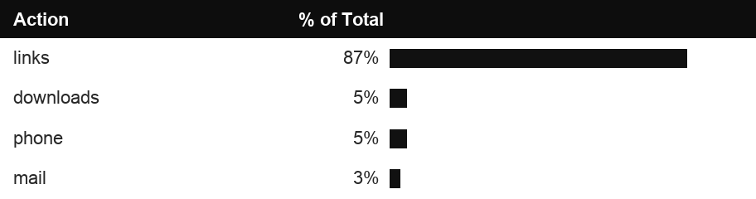
Engagement Insights & Highlights
Last quarter had a total of 221,461 interactions on the ACS pages (interactions are downloads, email clicks, phone number clicks, and outbound links).
Phone
Outbound Clicks

Slide 7
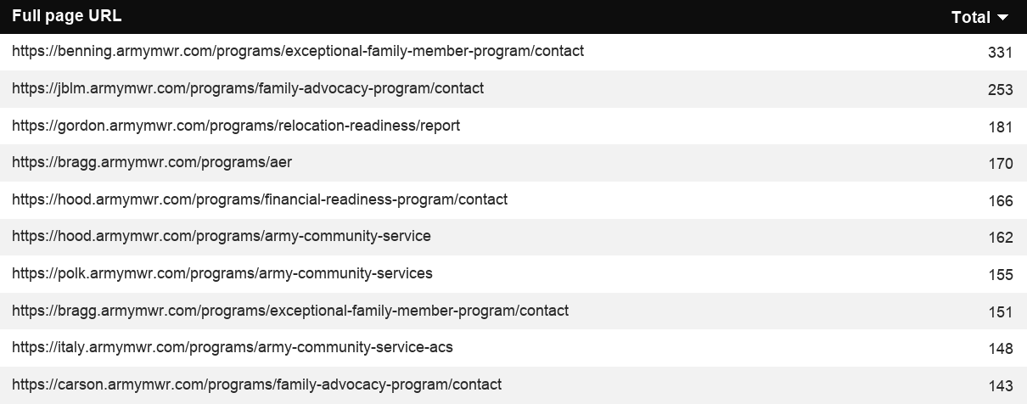
Insights & Highlights
Last quarter, 11,291 people required assistance from a live person.
Top ACS programs that received phone calls from the web.

Slide 8
Search Intent
Search intent is defined as being the underlying purpose behind an online query.
42% of searches were aimed at finding an answer to a specific question or acquiring general information.
45% of searches were conducted to explore brands or services with the intention of completing an action or making a purchase.
13% of searches were intended to locate a specific program page using the on-site search.

Slide 9
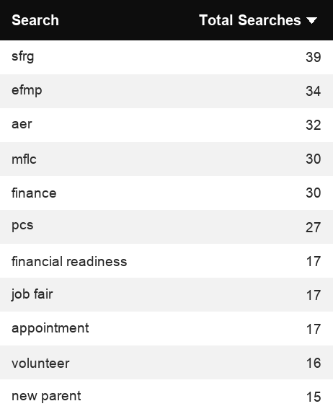
Search Insights
Top Search Terms
2,153 Total on-site searches on ACS pages to find more information.
2.39% of users left the site after performing a search.
Notes:
.

Slide 10
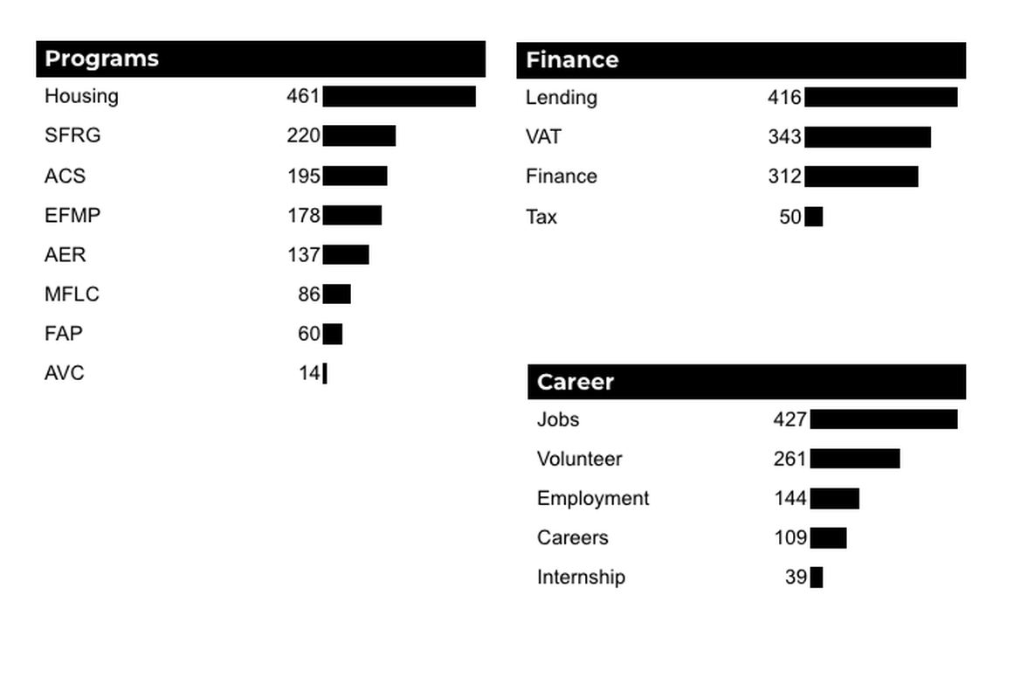
What Are The Top Search Sub-Topics?
The most popular search categories and terms within ACS.

