Slide 1
BRD Fourth Quarter FY26 Insights

Slide 2
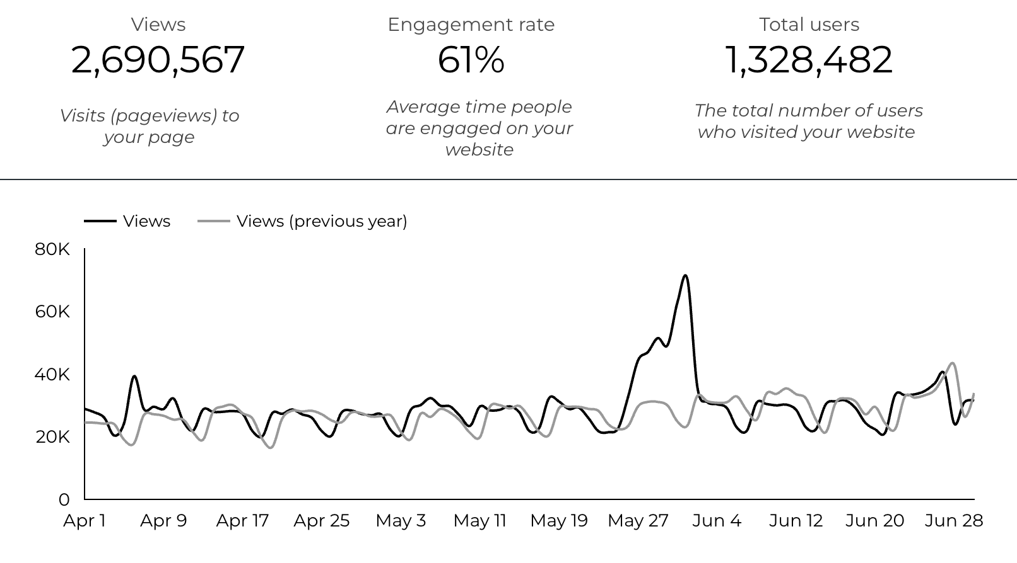
Web Analytics Summary

Slide 3
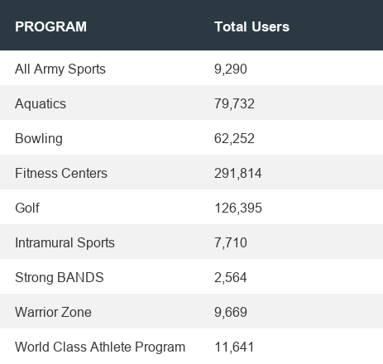

Visitor Highlights
21,695 People clicked on the Chow Now button to start an order.
  +36.0%

Slide 4
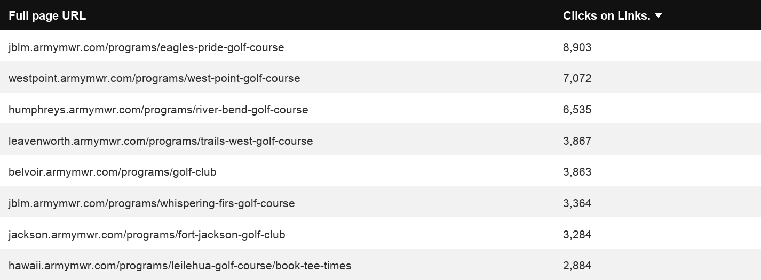
Sports and Fitness
127,003 People clicked to schedule a tee, register for a golf clinic, or find more information.

Slide 5
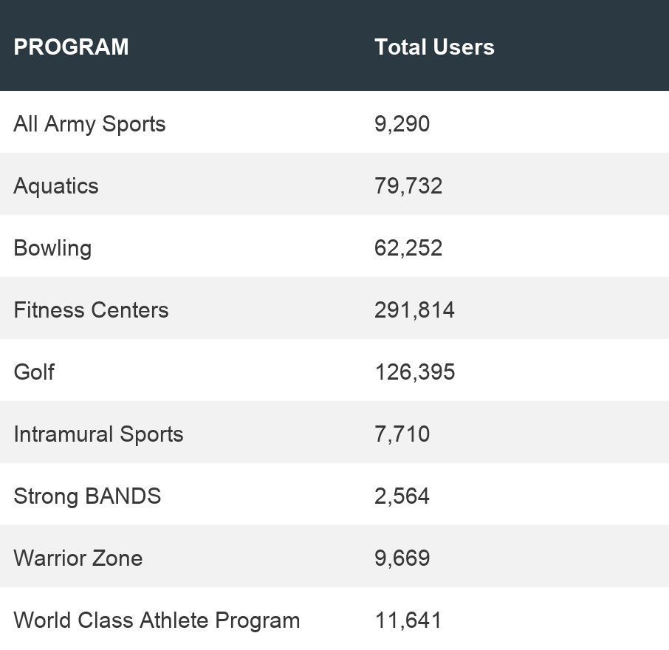
Sports and Fitness
Sports and Fitness

Slide 6
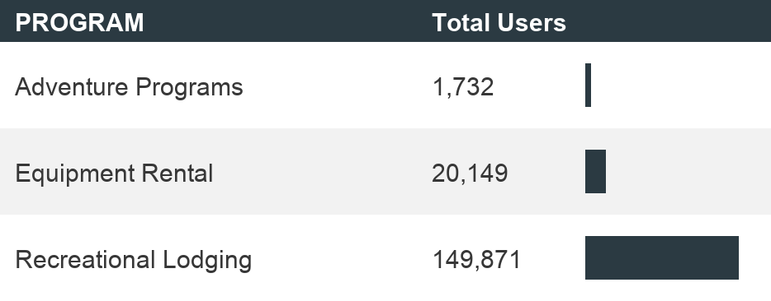
Outdoor Rec Programs
Outdoor Rec

Slide 7
Visitor Highlights
How engaged were these visitors within the website?
On average, users visited 1.4 pages per visit.
On average, users stayed on the site for 2 minutes and 10 seconds per visit.
1,397,907 visitors were new to the website.
  +82.3%
62% of visitors took action on a page!

Slide 8
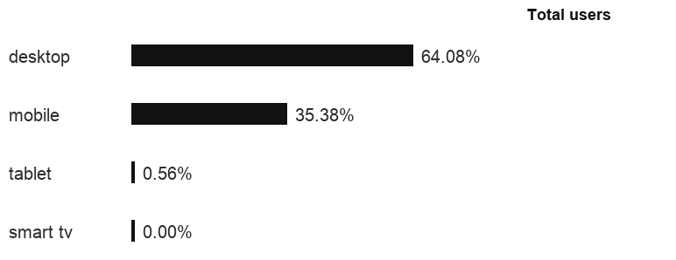
Traffic Highlights
  BRD pages received 2,859,846 visits last quarter.
  Most of the social traffic came from Facebook.
  Users by Device Category

Slide 9
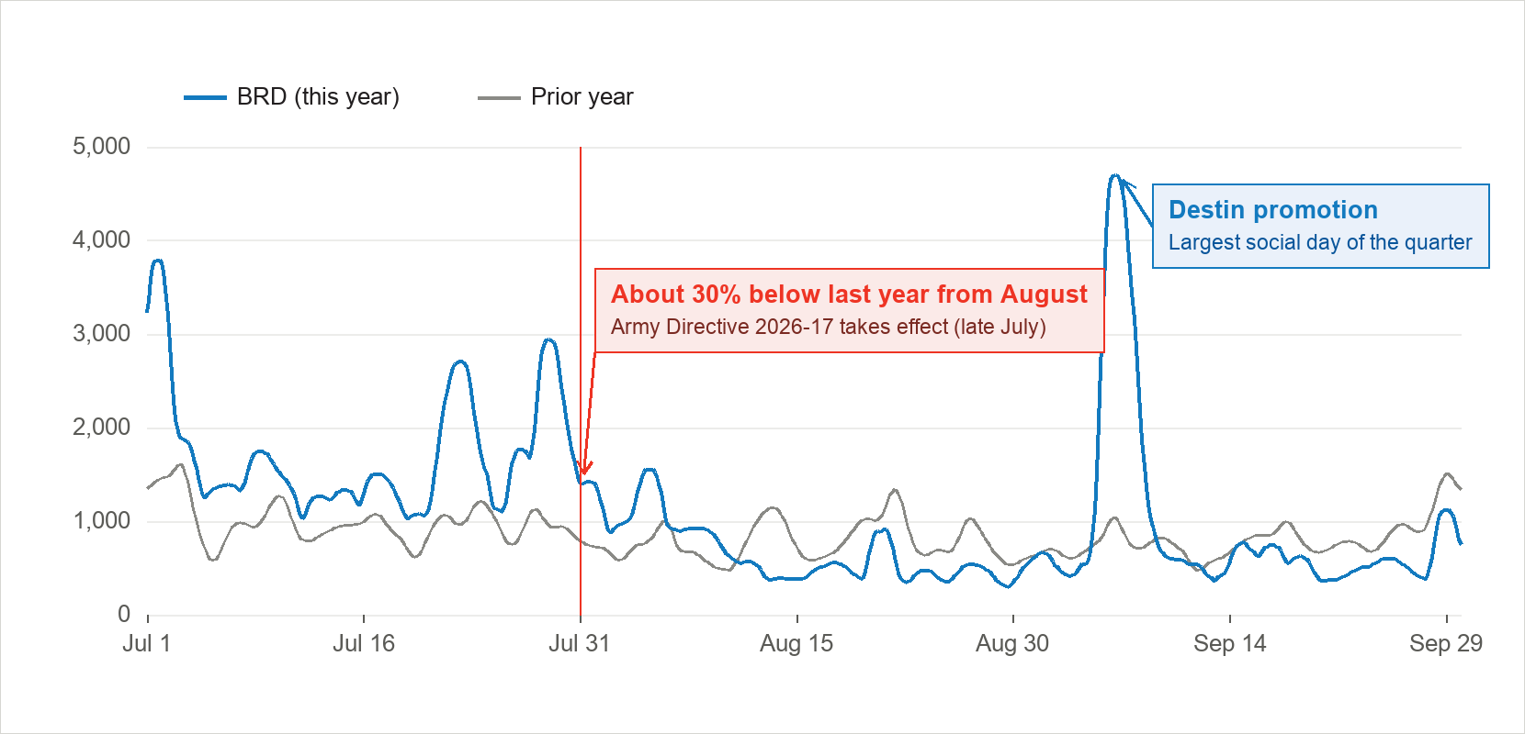
Social Media
  93,334 views came from social media platforms.
    +17.8% YoY
  A Destin promotion in early September drove the quarter’s biggest social day.
  Excluding Destin, social views fell 33.3% from August 1 after Army Directive 2026-17; expect roughly a 30% decline going forward.

Slide 10
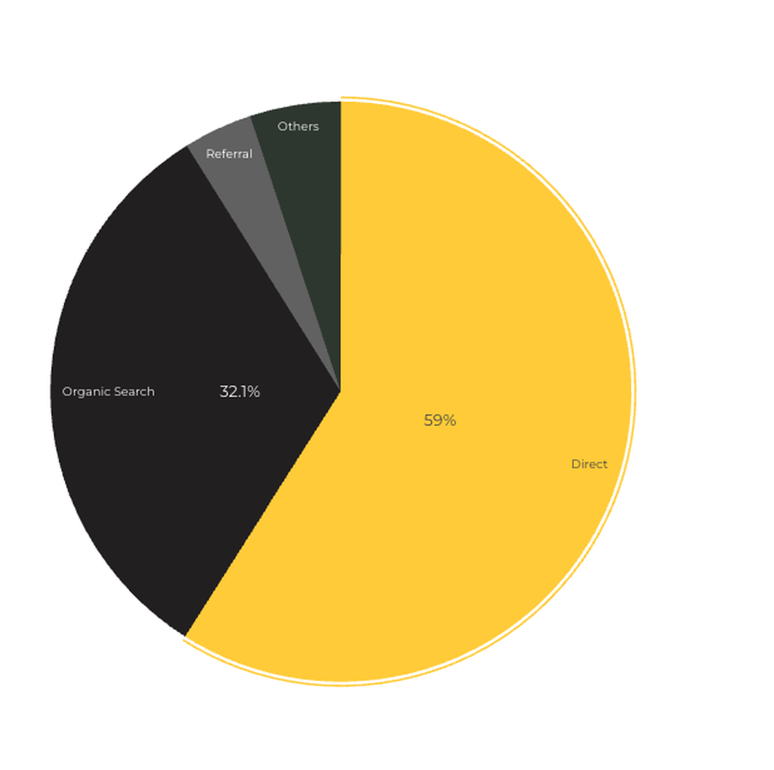
Marketing Reach
Other
|
32.1% of visitors came from online search engines.
59% came directly to the site (by typing in the address, using bookmarks, or email links).
3.7% of visitors came from social media.
3.9% of visitors came from referrals.
0.7 % Other (traffic that has an acquisition source Google doesn't know how to classify).

Slide 11
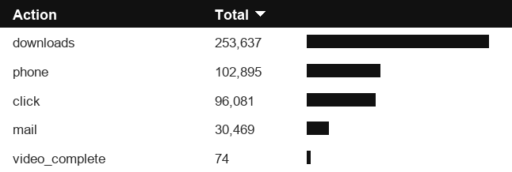
Engagement Insights & Highlights
Last quarter had a total of 483,156 interactions on the pages (including downloads, email clicks, phone number clicks, outbound links, and videos).

Slide 12
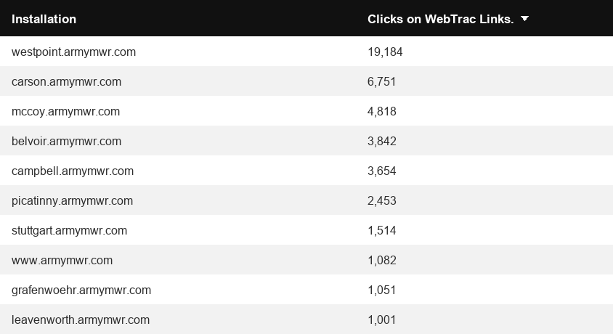
WebTrac Insights & Highlights
A total of 54,697 individuals clicked on a WebTrac link from a program page.
Top installations with the highest number of WebTrac link clicks on pages.

Slide 13

Happenings
American Forces Travel
7,209 users made a visit to an AFT page.
2,938 Users are new
75% Engagement Rate

Slide 14
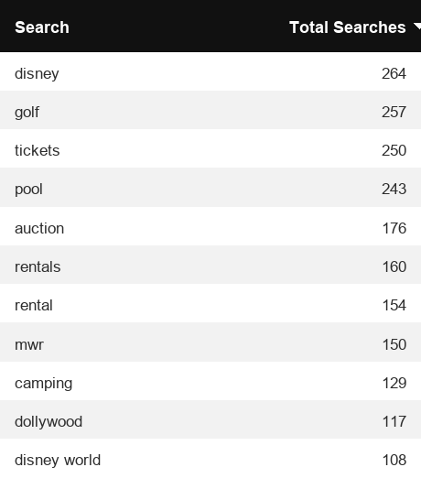
Search Insights
22,703 Total on-site searches on BRD pages to find more information.

Slide 15
Search Intent
Search intent is defined as being the underlying purpose behind an online query.
42% of searches were looking for an answer to a specific question or general information.
43% of searches were looking to investigate brands or services and intending to complete an action or purchase.
15% of searches were intending to find a specific program page using the on-site search.

Slide 16
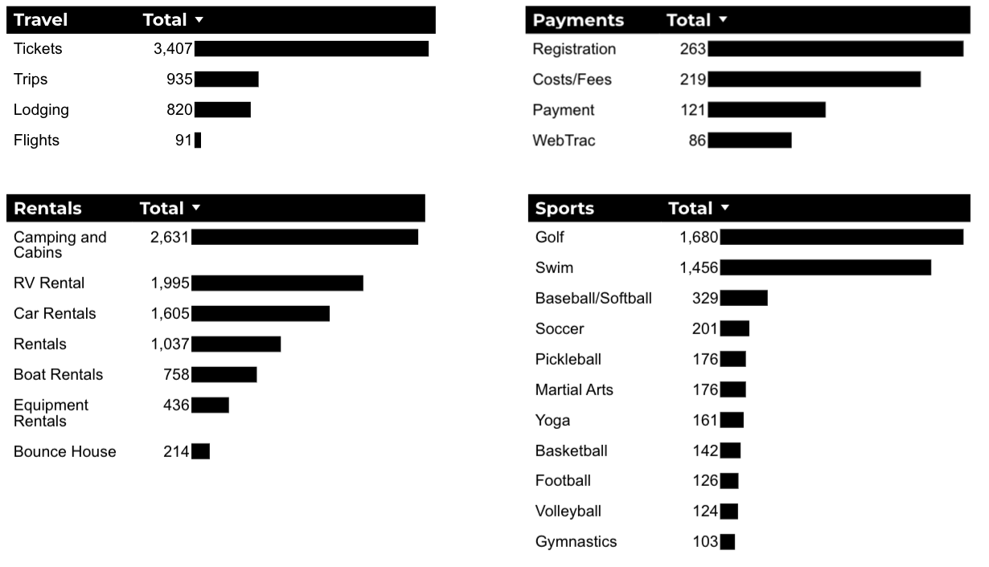
What Are The Top Search Sub-Topics?
The most popular search categories and terms within BRD

