Slide 1
CYS Fourth Quarter FY26 Insights

Slide 2
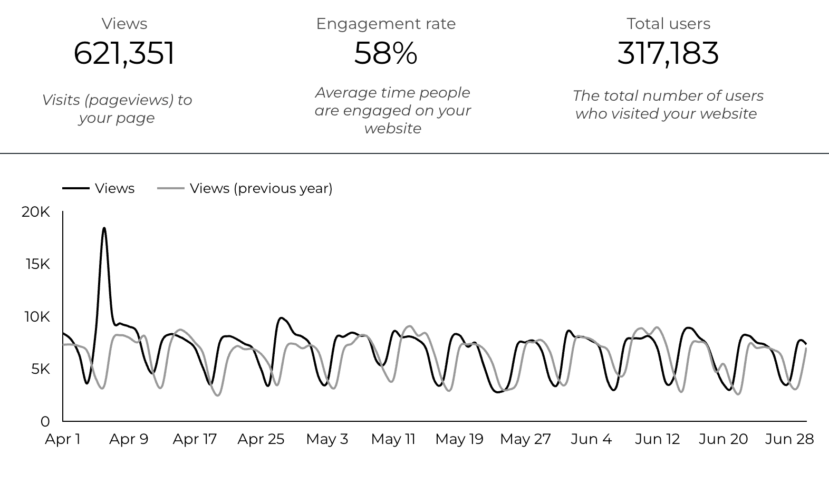
Overview

Slide 3
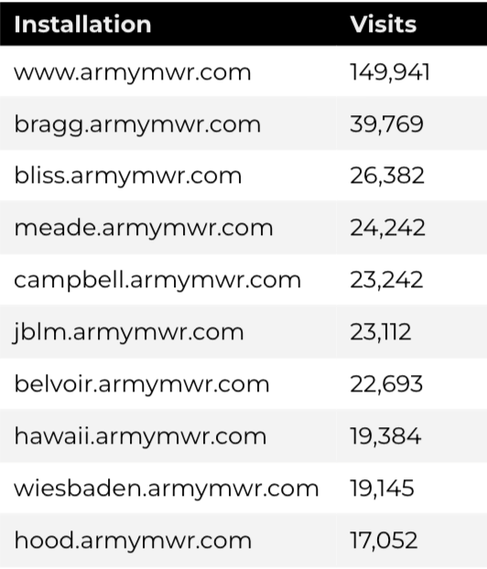
Traffic Highlights
There were a total of 292,432 users, to Child and Youth Services (CYS) web pages.
On average, each user viewed 2.13 pages.
59% of users engaged with a CYS page
Top US Army Installations

Slide 4
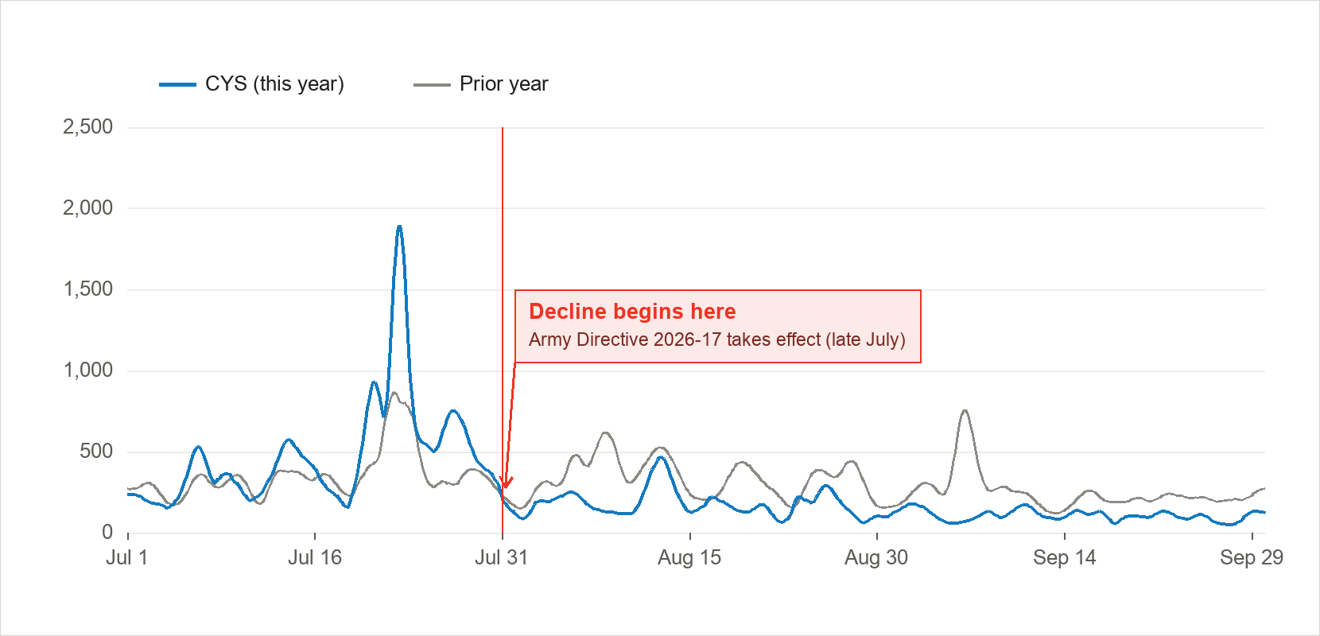
Social Media
  22,922 views came from social media platforms.
    -16.5% YoY
  Facebook drove nearly 90% of social visits; X was second.
  From August 1, after Army Directive 2026-17, social views fell 52.8%; expect roughly half of last year’s social traffic going forward.

Slide 5
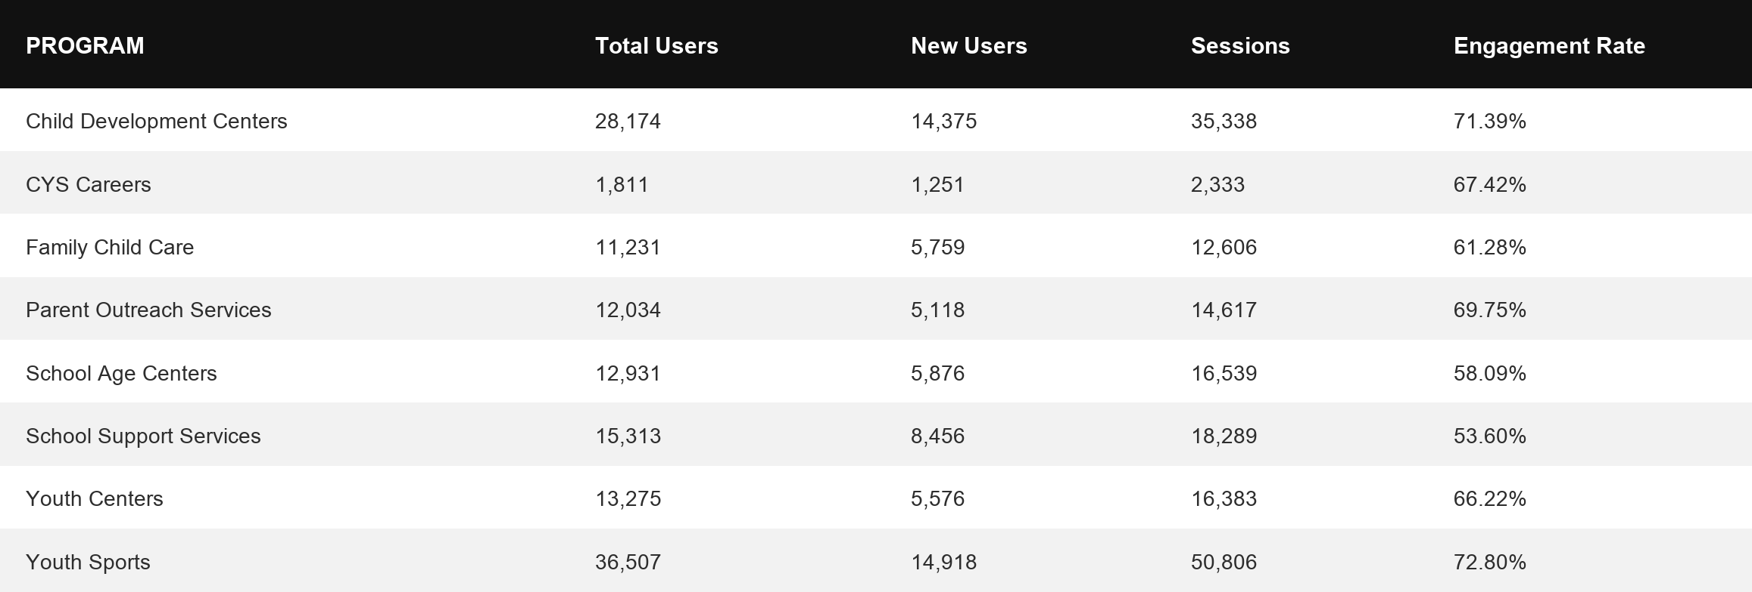
Visitor Highlights
Program Roll-Up

Slide 6
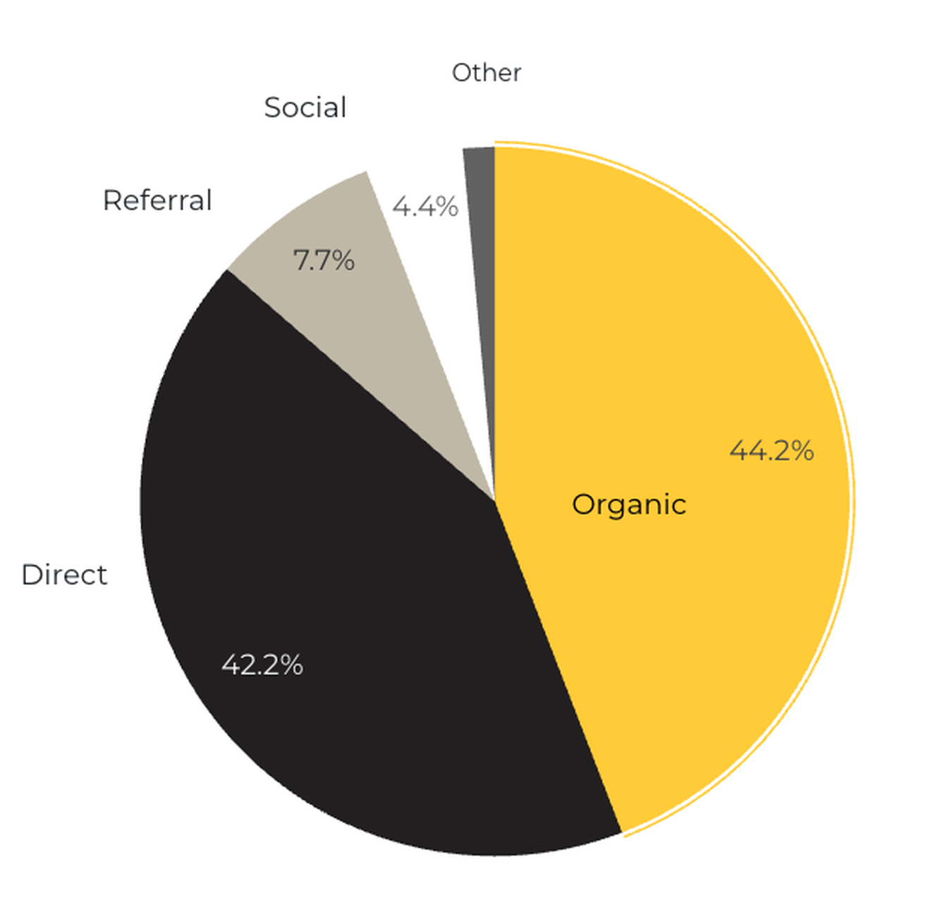
Marketing Reach
44.2% of visitors came from online search engines.
42.2% came directly to the site (by typing in the address, using bookmarks, or email links).
7.7% of visitors came from referrals.
1.5% of visitors came from social media.
4.4% Other (traffic that has an acquisition source Google doesn’t know how to classify).
9.2%
63.8%

Slide 7
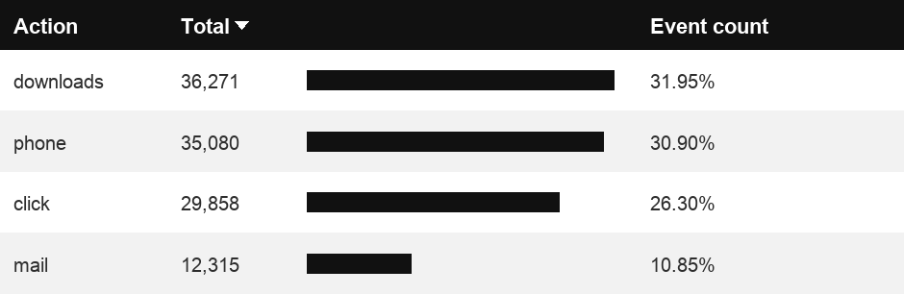
Engagement Insights & Highlights
Last quarter there were a total of 113,524 interactions on the CYS pages, which included downloads, email clicks, phone number clicks, and outbound links.

Slide 8
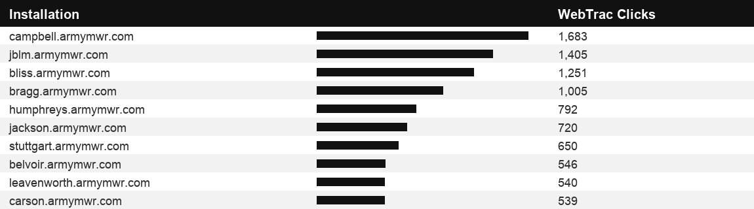
WebTrac Insights & Highlights
A total of 18,347 parents clicked on a WebTrac link from a program page to register or make a payment for a CYS program.

Slide 9
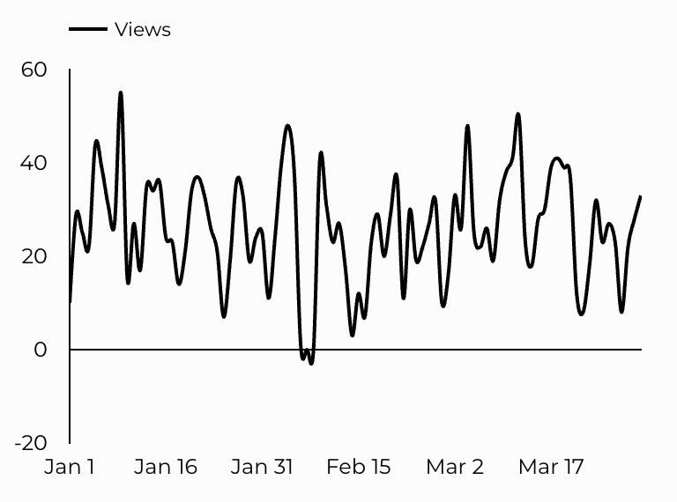
CYS Careers
CYS Career Traffic Trends
805 people looking for employment acted and clicked on USAJOBS.gov.
226 downloads of the CYS Career Guide.
24 Rack Card downloads.

Slide 10
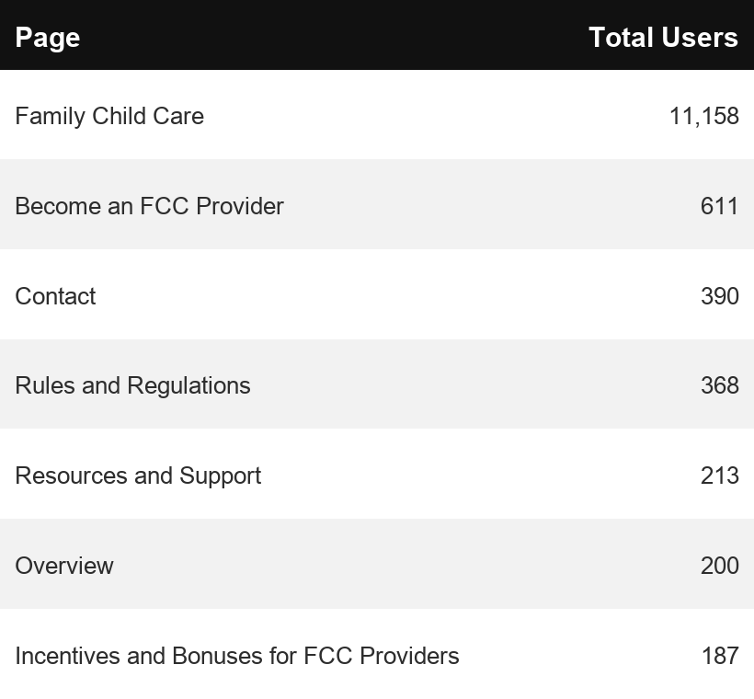
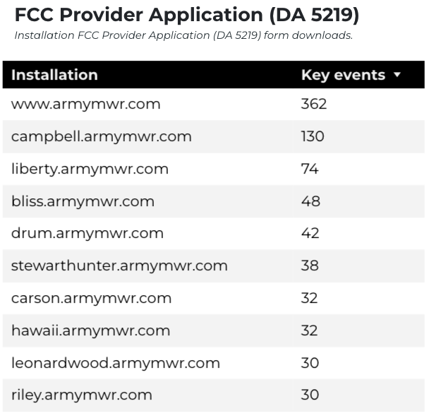
Family Child Care
12,606 visits to program pages.
11,231 users to FCC program pages.
5,759 new users with a 61% engagement rate.

Slide 11
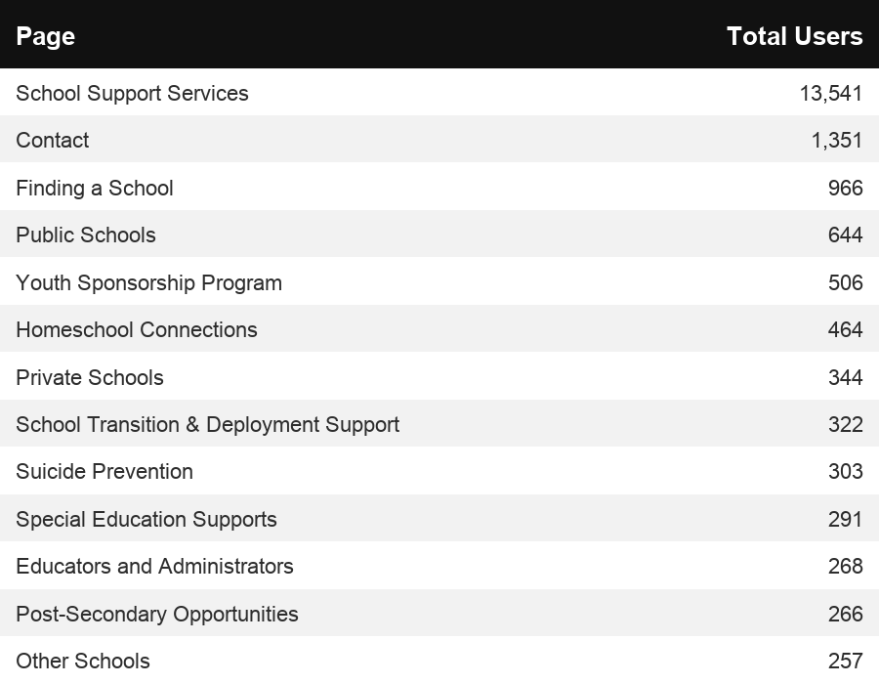
School Support Services
23,435 visits to program pages.
15,313 users made a visit to School Support Services pages, with 8,456 new users and a 54% engagement rate.

Slide 12
Search Intent
42% Searches looking to investigate brands or services and intending to complete an action or purchase.
45% Searches looking for an answer to a specific question or general information.
13% Searches intending to find a specific program, page using the onsite search.
Search intent is defined as being the purpose behind an online query.

Slide 13
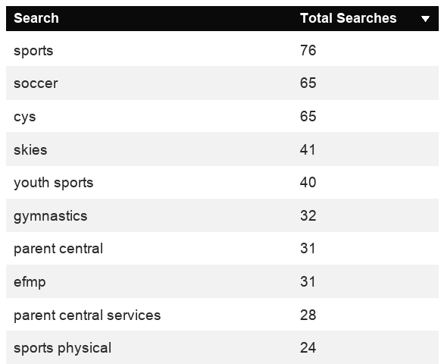
Search Insights
Top Searches
3,505 Total on-site searches on CYS pages to find more information.
Bounce rates on the top 10 search terms stayed under 5%.

Slide 14
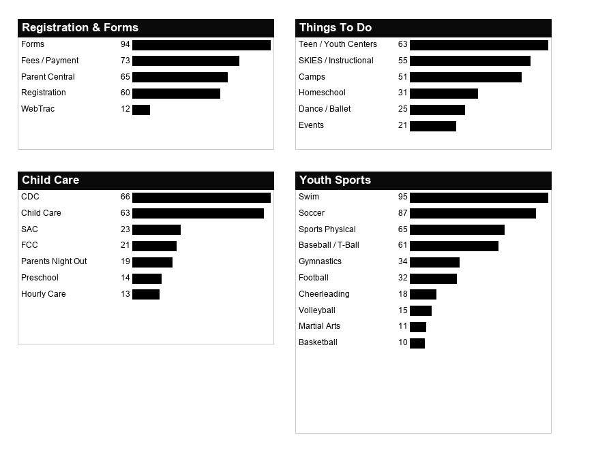
What Are The Top Search Sub-Topics?
The most popular search categories and terms within CYS

