Slide 1
BRD First Quarter FY26 Insights

Slide 2
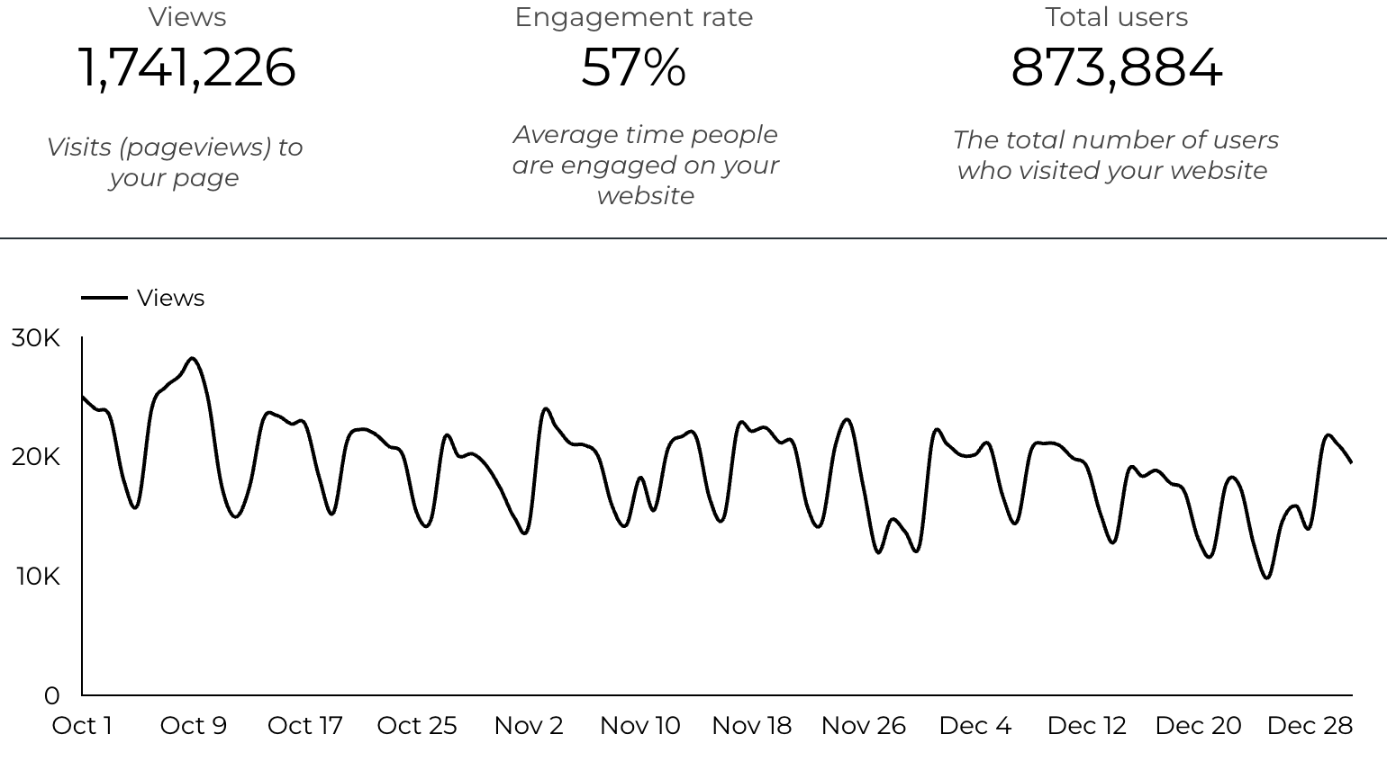
Web Analytics Summary

Slide 3
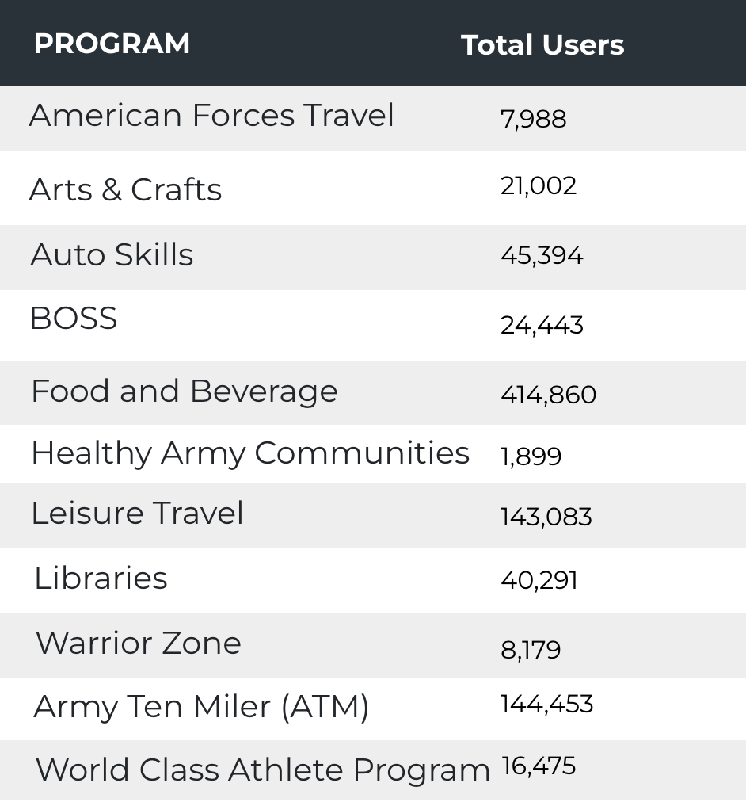

Visitor Highlights
10,554 People clicked on the Chow Now button to start an order.

Slide 4
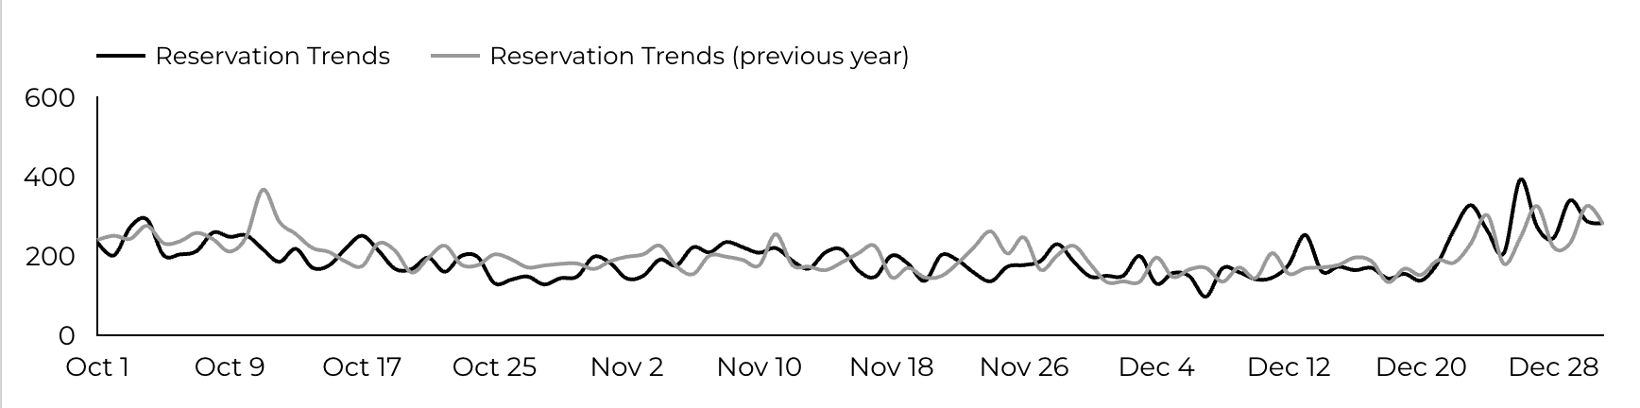
Sports and Fitness
17,955 People clicked to schedule a tee time or register for a golf clinic.

Slide 5
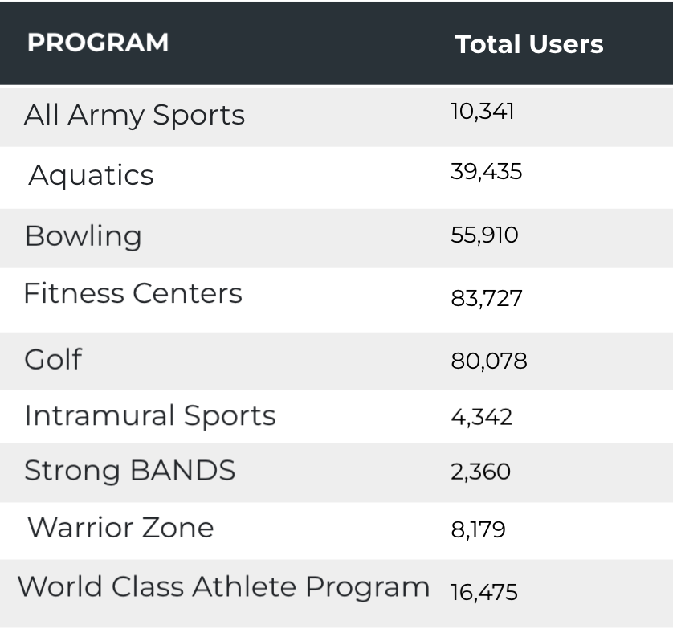
Sports and Fitness
Sports and Fitness

Slide 6
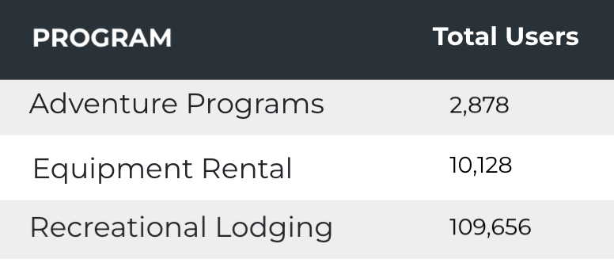
Outdoor Rec Programs
Outdoor Rec

Slide 7
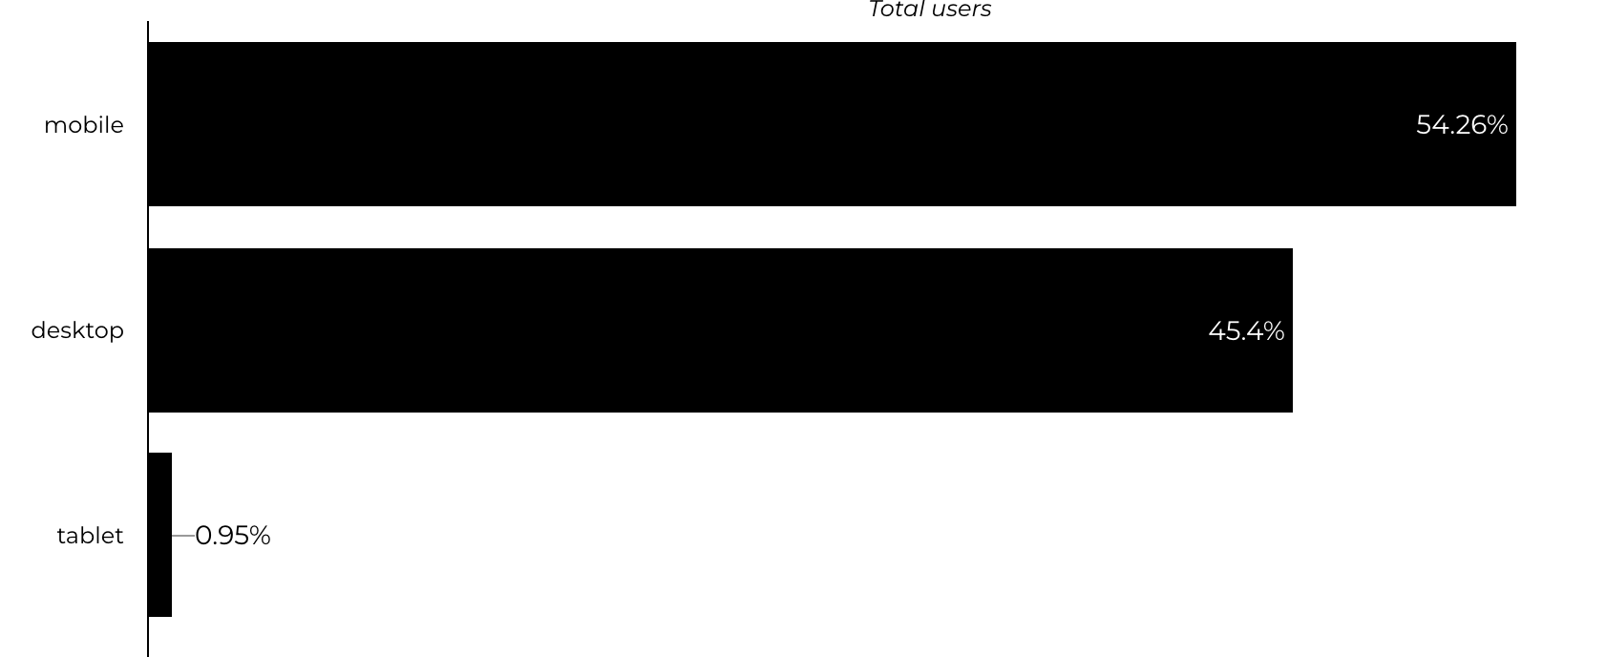
Traffic Highlights
  BRD pages received 1,741,226 visits last quarter.
  Most of the social traffic came from Facebook.
  Users by Device Category

Slide 8
Visitor Highlights
How engaged were these visitors within the website?
On average, users visited 2.01 pages per visit.
On average, users stayed on the site for 3 minutes and 06 seconds per visit.
642,223 visitors were new to the website.
57% of visitors took action on a page!

Slide 9
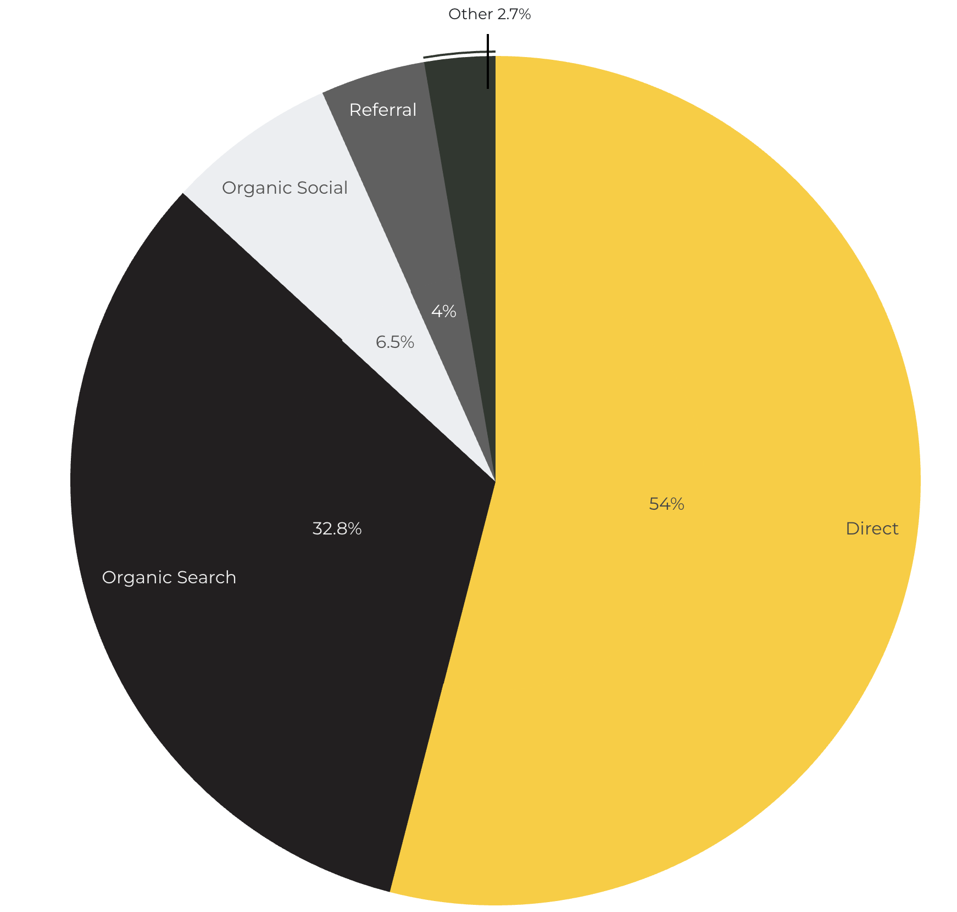
Marketing Reach
Other
|
32.8% of visitors came from online search engines.
54% came directly to the site (by typing in the address, using bookmarks, or email links).
6.5% of visitors came from social media.
4% of visitors came from referrals.
2.7% Other (traffic that has an acquisition source Google doesn't know how to classify).

Slide 10
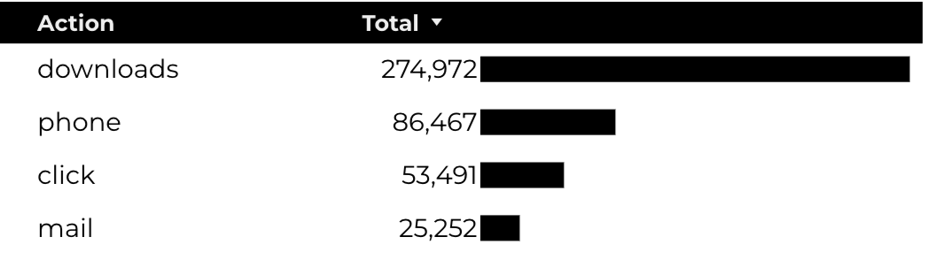
Engagement Insights & Highlights
Last quarter had a total of 441,425 interactions on the pages (including downloads, email clicks, phone number clicks, outbound links, and videos).

Slide 11
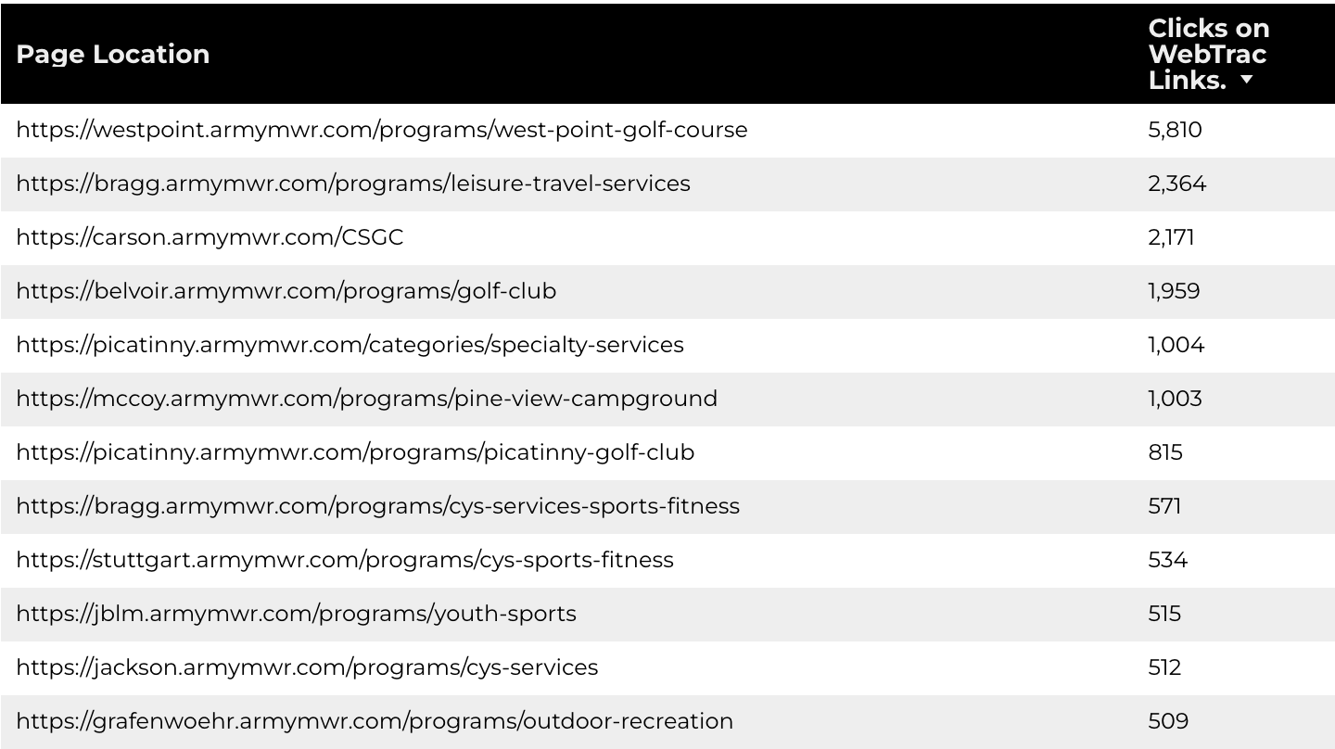
WebTrac Insights & Highlights
A total of 31,278 individuals clicked on a WebTrac link from a program page.
Top installations with the highest number of WebTrac link clicks on pages.

Slide 12

Happenings
American Forces Travel
7,988 users made a visit to an AFT page.
3,251 Users are new
76% Engagement Rate

Slide 13
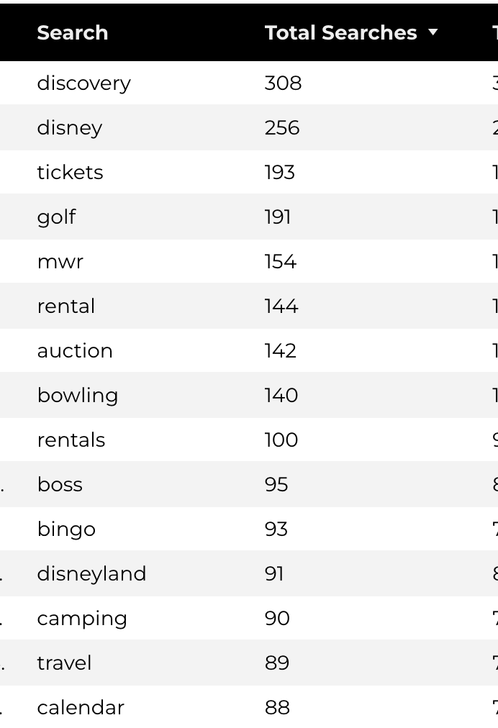
Search Insights
17,804 Total on-site searches on BRD pages to find more information.

Slide 14
Search Intent
Search intent is defined as being the underlying purpose behind an online query.
41% of searches were looking for an answer to a specific question or general information.
45% of searches were looking to investigate brands or services and intending to complete an action or purchase.
14% of searches were intending to find a specific program page using the on-site search.

Slide 15
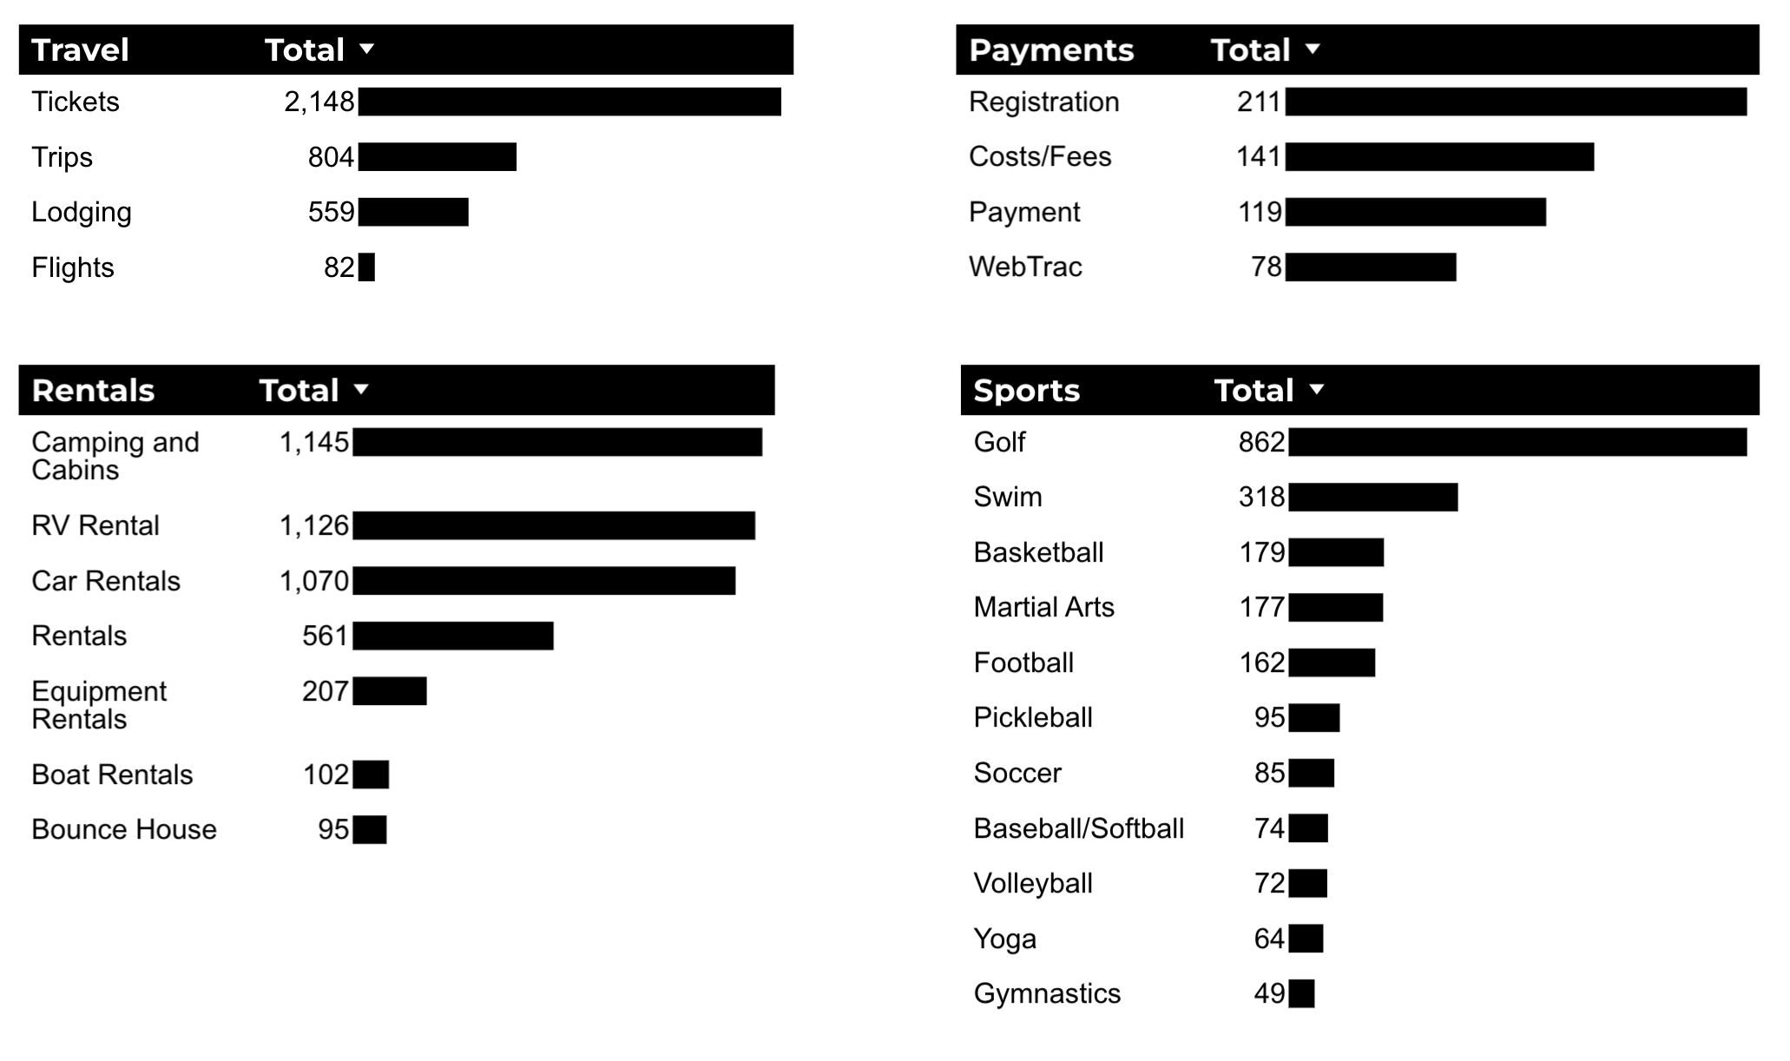
What Are The Top Search Sub-Topics?
The most popular search categories and terms within BRD

