Slide 1
BRD Third Quarter FY25 Insights

Slide 2
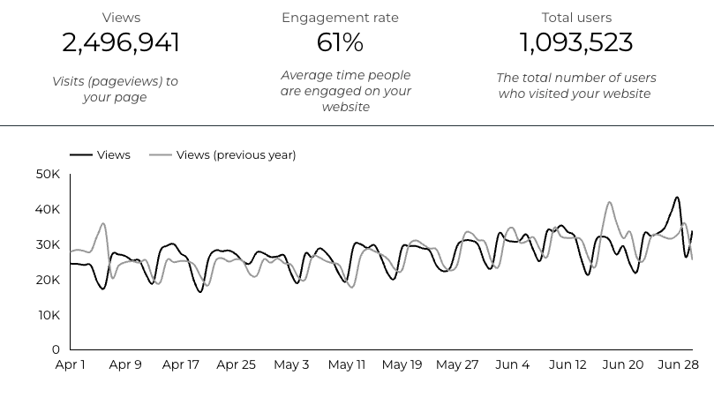
Web Analytics Summary

Slide 3
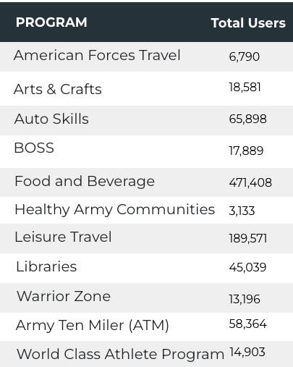
Visitor Highlights
14, 843 People clicked on the Chow Now button to start an order.

Slide 4
Sports and Fitness
25,796 People clicked to schedule a tee time or register for a golf clinic.

Slide 5
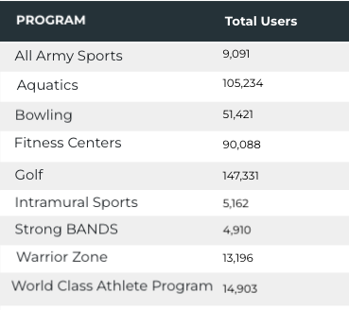
Sports and Fitness
Sports and Fitness

Slide 6
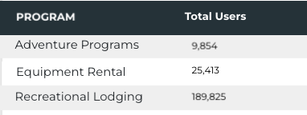
Outdoor Rec Programs
Outdoor Rec

Slide 7
Visitor Highlights
How engaged were these visitors within the website?
On average, users visited 2.31 pages per visit.
On average, users stayed on the site for 3 minutes and 14 seconds per visit.
819,686 visitors were new to the website.
61% of visitors took action on a page!

Slide 8
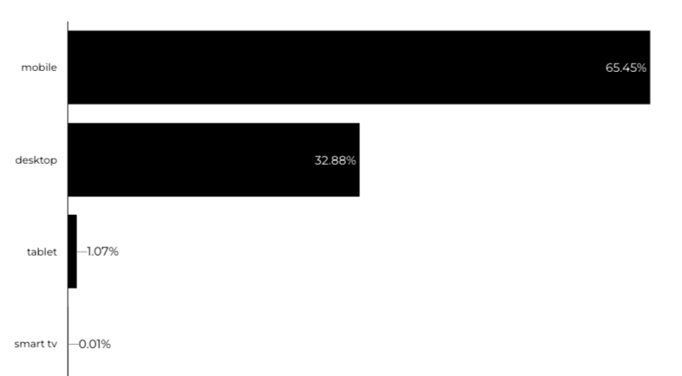
Traffic Highlights
BRD pages received 2,496,941 visits last quarter.
Most of the social traffic came from Facebook.
Users by Device Category

Slide 9
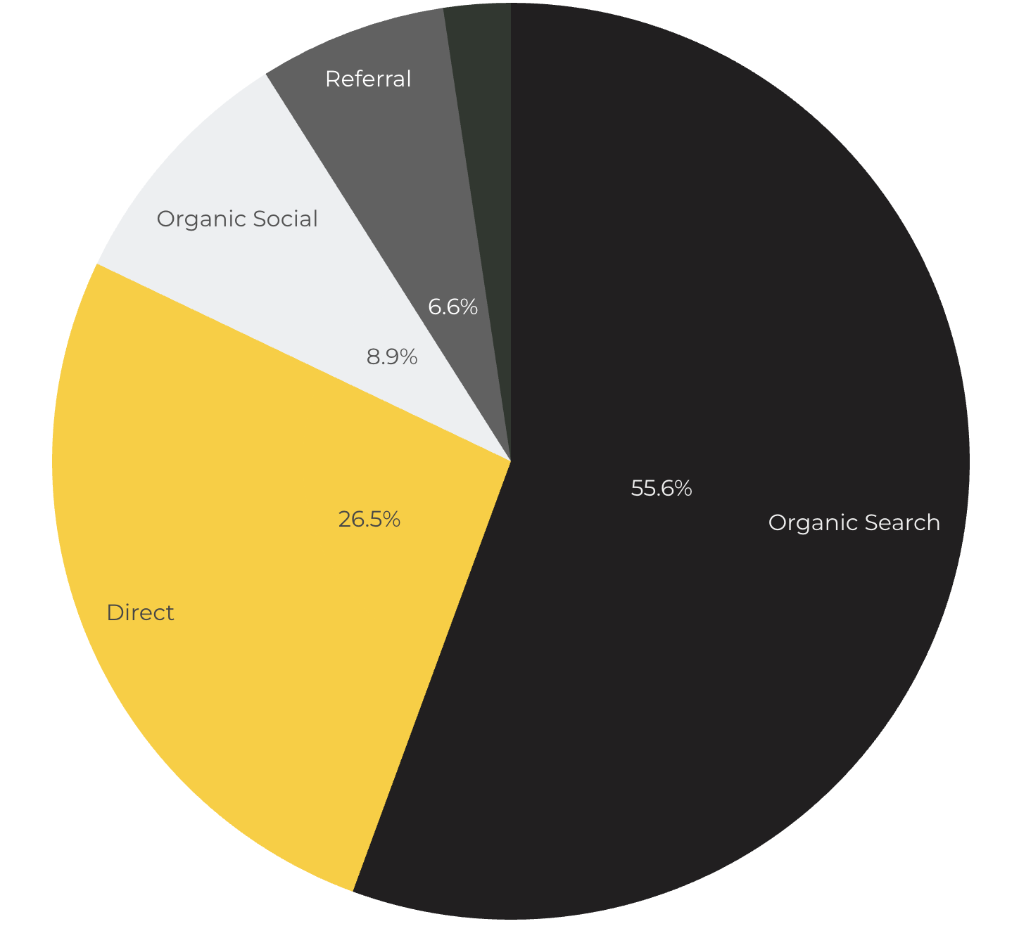
Marketing Reach
Other
|
55.6% of visitors came from online search engines.
26.5% came directly to the site (by typing in the address, using bookmarks, or email links).
8.9% of visitors came from social media.
6.6% of visitors came from referrals.
4.4% Other (traffic that has an acquisition source Google doesn't know how to classify).

Slide 10
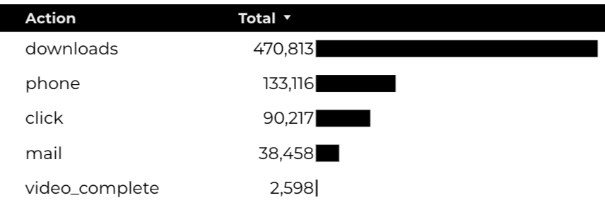
Engagement Insights & Highlights
Last quarter had a total of 735,202 interactions on the pages (including downloads, email clicks, phone number clicks, outbound links, and videos).

Slide 11
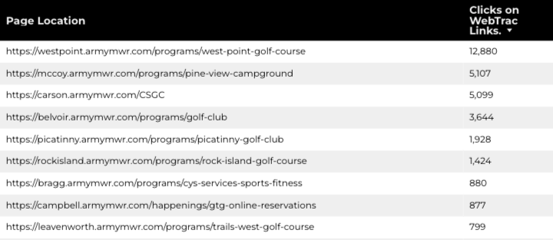
WebTrac Insights & Highlights
A total of 53,702 individuals clicked on a WebTrac link from a program page.
Top installations with the highest number of WebTrac link clicks on pages.

Slide 12
Happenings
American Forces Travel
9,048 users made a visit to an AFT page.
1,595 Users are new
82% Engagement Rate

Slide 13
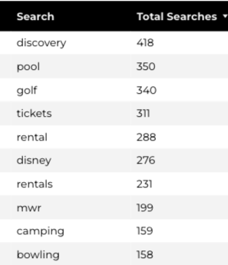
Search Insights
24,393 Total on-site searches on BRD pages to find more information.

Slide 14
Search Intent
Search intent is defined as being the underlying purpose behind an online query.
44% of searches were looking for an answer to a specific question or general information.
44% of searches were looking to investigate brands or services and intending to complete an action or purchase.
12% of searches were intending to find a specific program page using the on-site search.

Slide 15
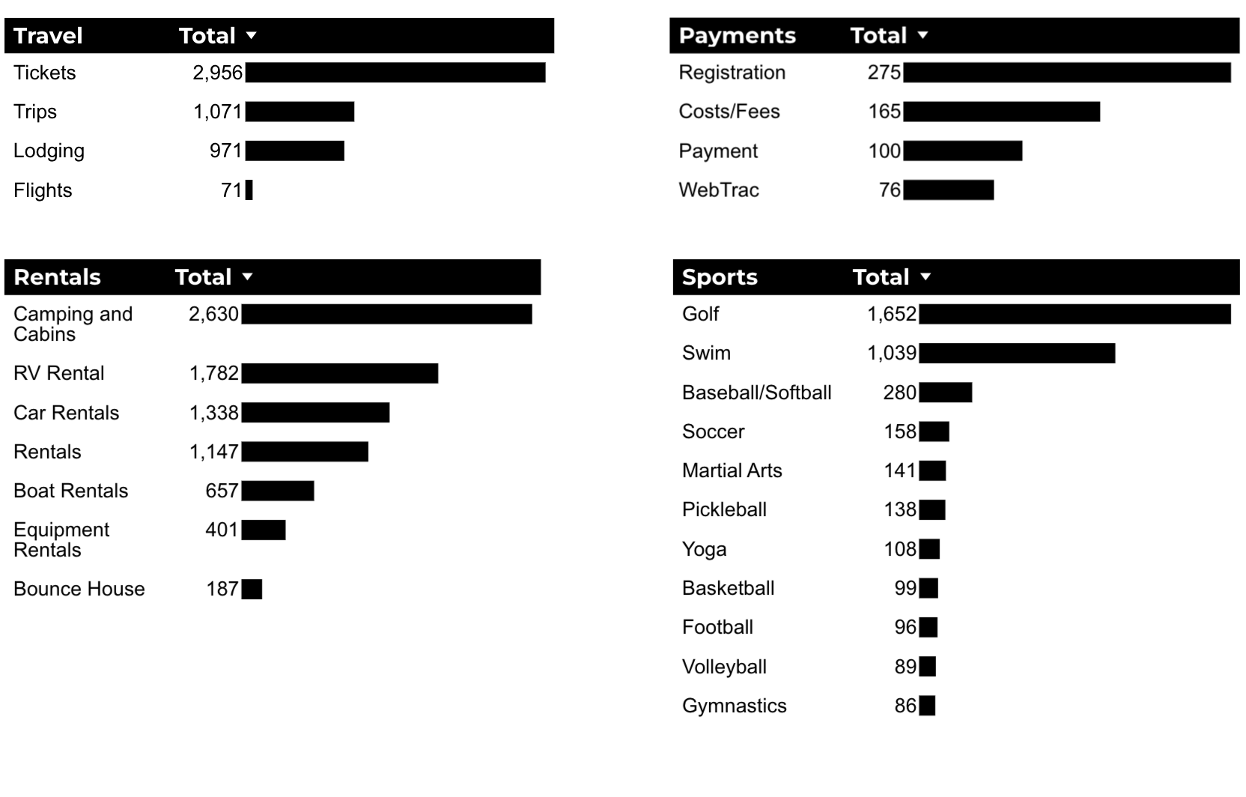
What Are The Top Search Sub-Topics?
The most popular search categories and terms within BRD

