Slide 1
CYS Third Quarter FY26 Insights

Slide 2
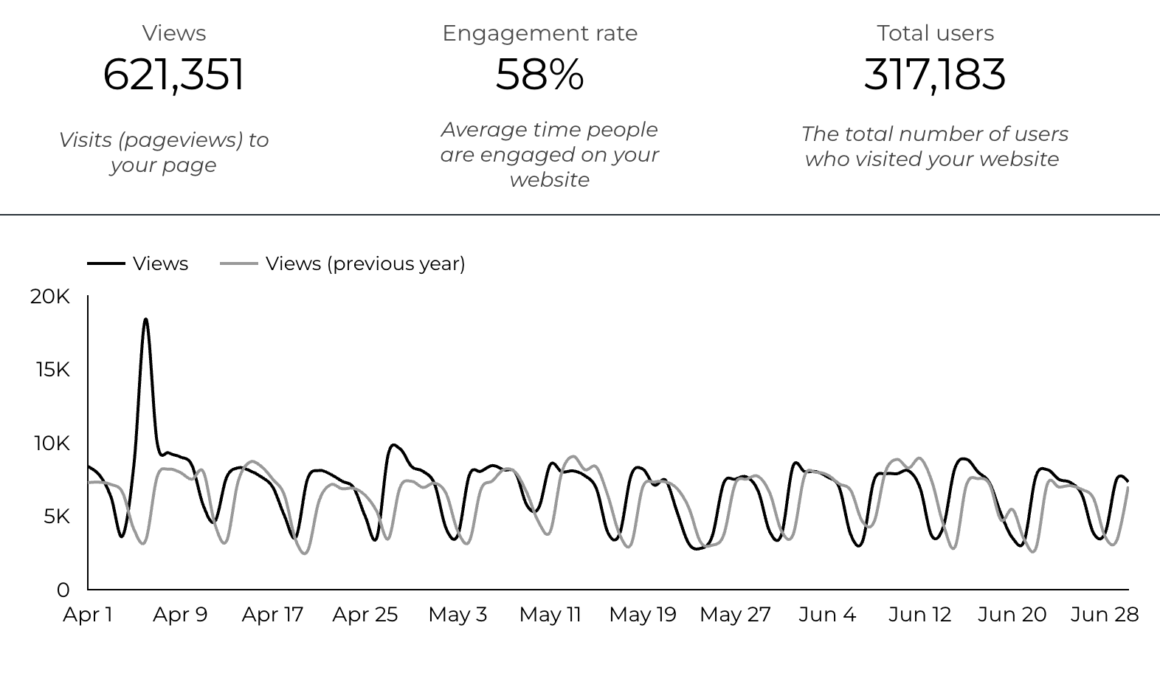
Overview

Slide 3
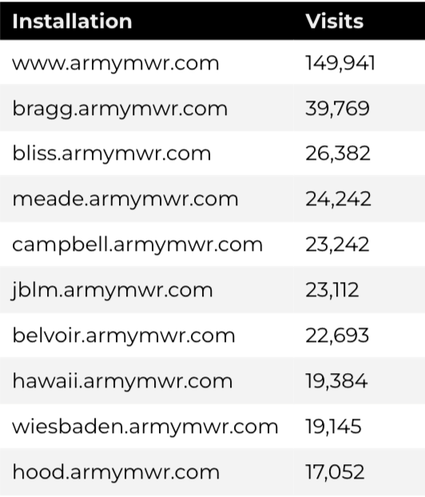
Traffic Highlights
There were a total of 317,183 users, to Child and Youth Services (CYS) web pages.
On average, each user viewed 1.99 pages.
58% of users engaged with a CYS page
Top US Army Installations

Slide 4
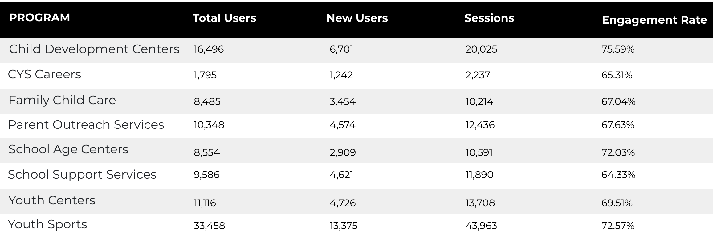
Visitor Highlights
Program Roll-Up

Slide 5
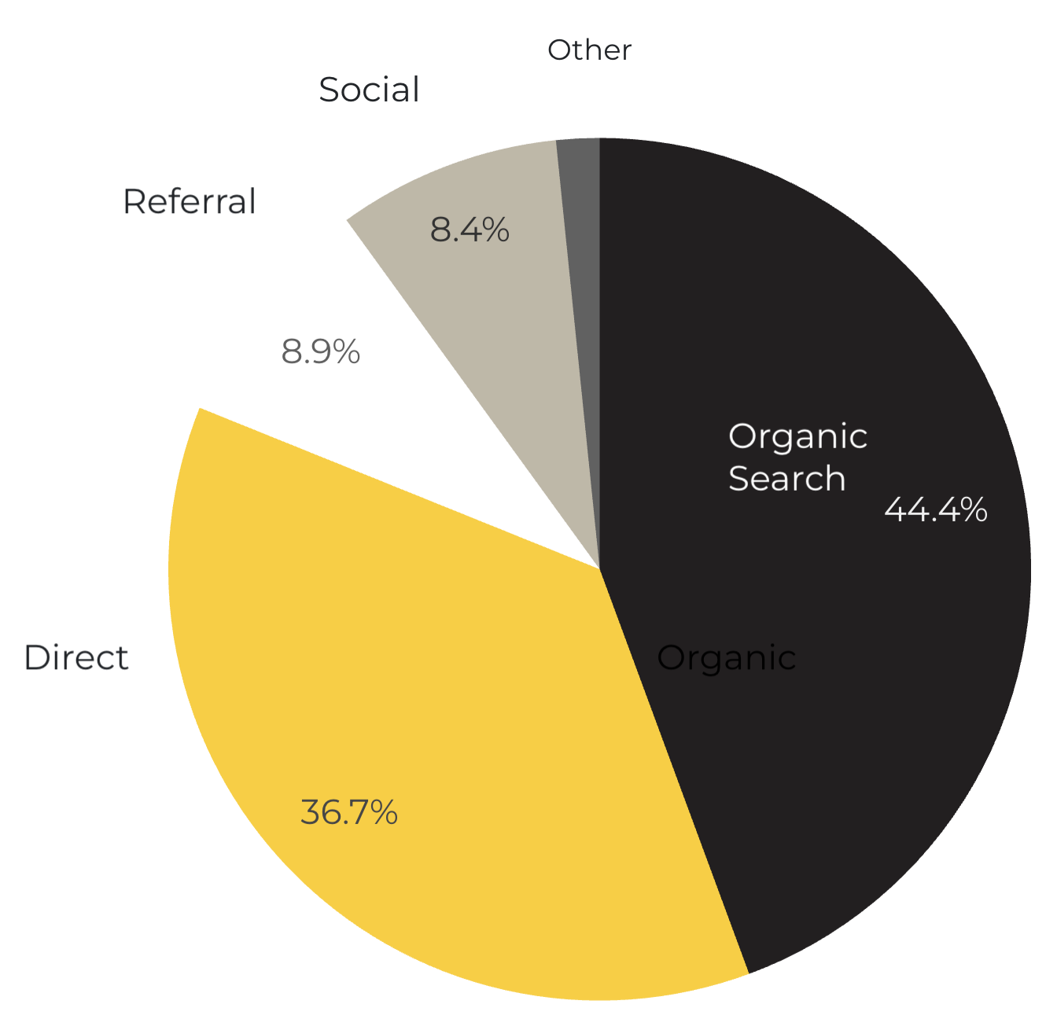
Marketing Reach
44.4% of visitors came from online search engines.
36.7% came directly to the site (by typing in the address, using bookmarks, or email links).
8.9% of visitors came from referrals.
8.4% of visitors came from social media.
1.6% Other (traffic that has an acquisition source Google doesn’t know how to classify).
9.2%
63.8%

Slide 6
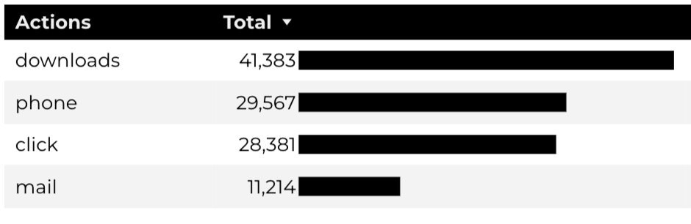
Engagement Insights & Highlights
Last quarter there were a total of 110,545 interactions on the CYS pages, which included downloads, email clicks, phone number clicks, and outbound links.

Slide 7
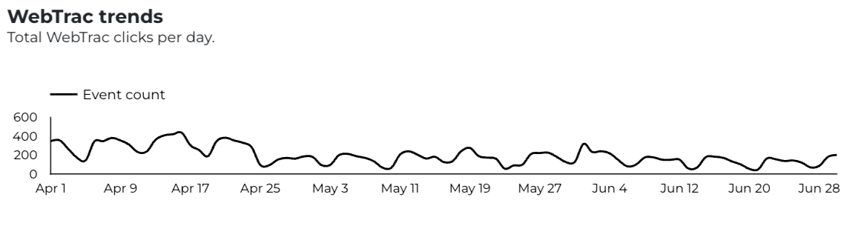
WebTrac Insights & Highlights
A total of 17,855 parents clicked on a WebTrac link from a program page to register or make a payment for a CYS program.

Slide 8
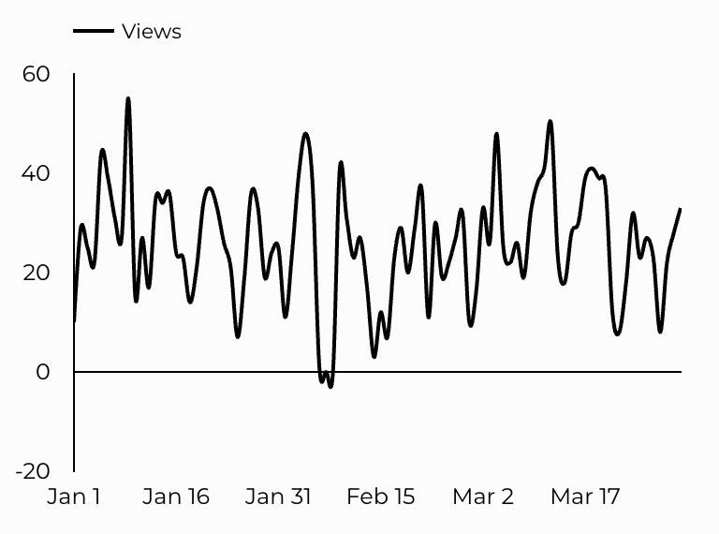
CYS Careers
CYS Career Traffic Trends
747 people looking for employment acted and clicked on USAJOBS.gov.
241 downloads of the CYS Career Guide.
49 Rack Card downloads.

Slide 9
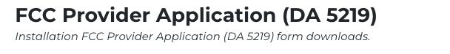
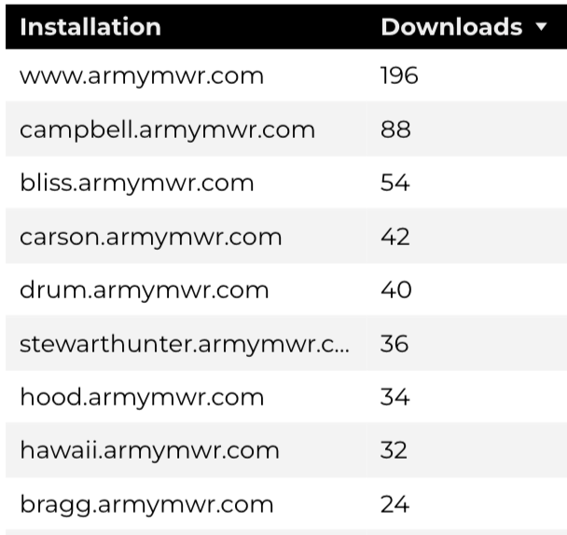
Family Child Care
14,075 visits to program pages.
8,485 users to FCC program pages.
666 downloads of DA 5219 form!

Slide 10
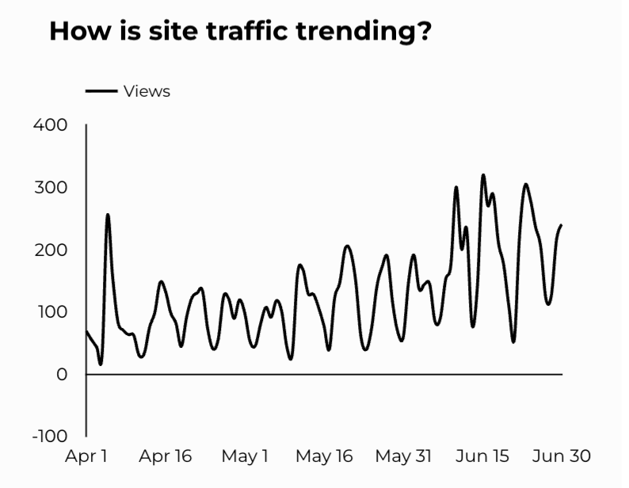
School Support Services
14,087 visits to program pages.
9,586 users made a visit to School Support Services pages.

Slide 11
Search Intent
42% Searches looking to investigate brands or services and intending to complete an action or purchase.
45% Searches looking for an answer to a specific question or general information.
13% Searches intending to find a specific program, page using the onsite search.
Search intent is defined as being the purpose behind an online query.

Slide 12
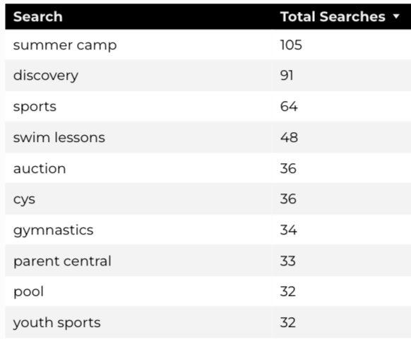
Search Insights
Top Searches
3,822 Total on-site searches on CYS pages to find more information.
3.52% of users left the site after performing a search.

Slide 13
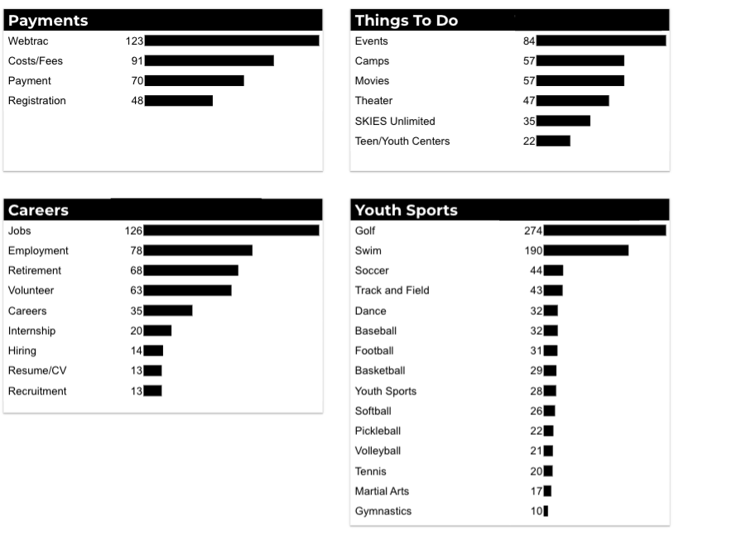
What Are The Top Search Sub-Topics?
The most popular search categories and terms within CYS

