Slide 1
CYS First Quarter FY26 Insights

Slide 2
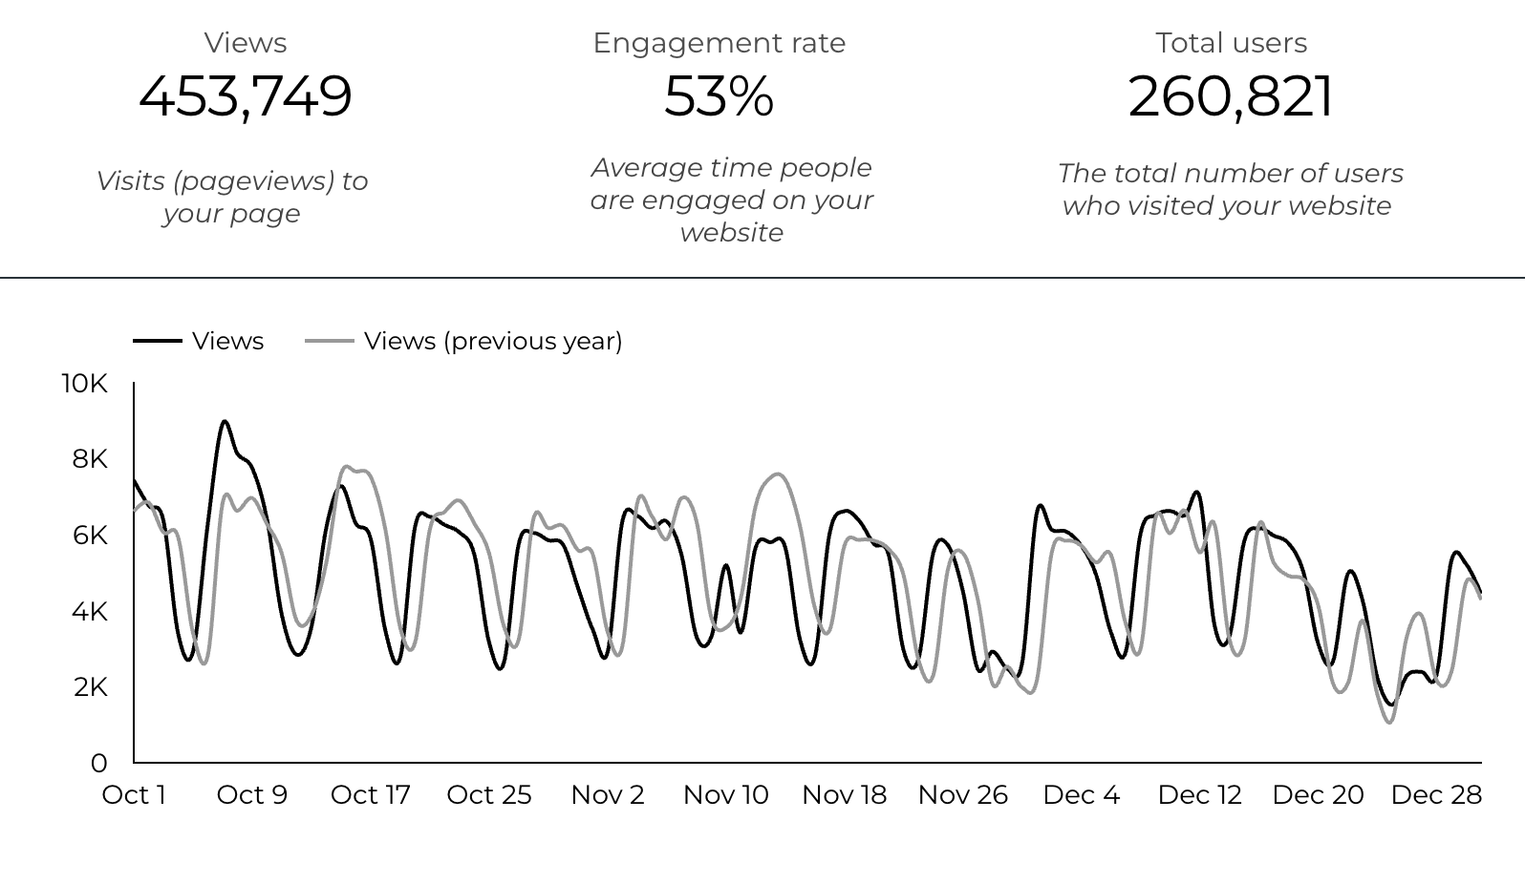
Overview

Slide 3
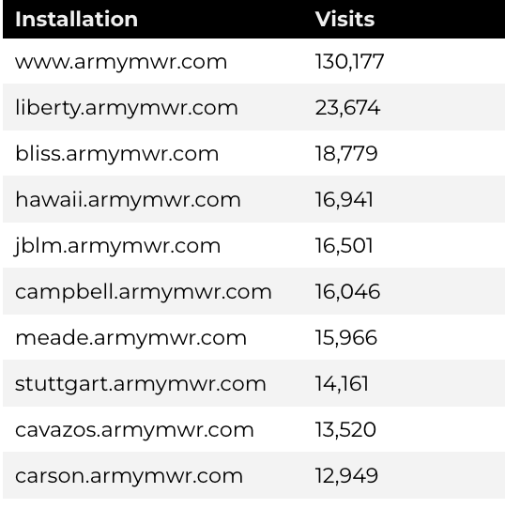
Traffic Highlights
There were a total of 260,821 users, to Child and Youth Services (CYS) web pages.
On average, each user viewed 1.77 pages.
53% of users engaged with a CYS page
Top US Army Installations

Slide 4
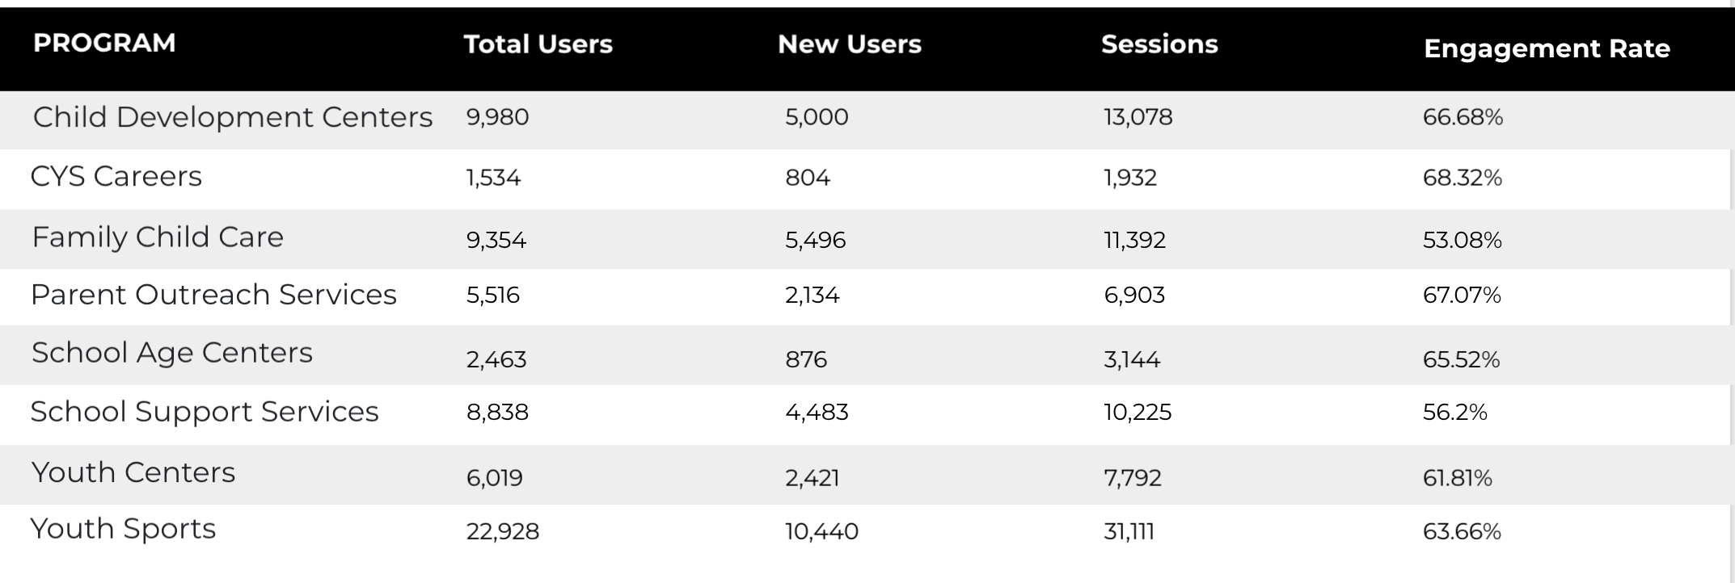
Visitor Highlights
Program Roll-Up

Slide 5
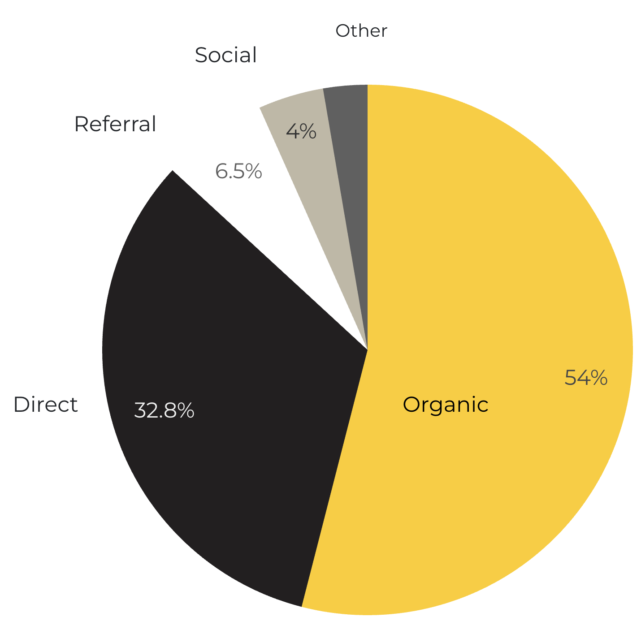
Marketing Reach
54% of visitors came from online search engines.
32.8% came directly to the site (by typing in the address, using bookmarks, or email links).
6.5% of visitors came from referrals.
4% of visitors came from social media.
2.7% Other (traffic that has an acquisition source Google doesn’t know how to classify).
9.2%
63.8%

Slide 6
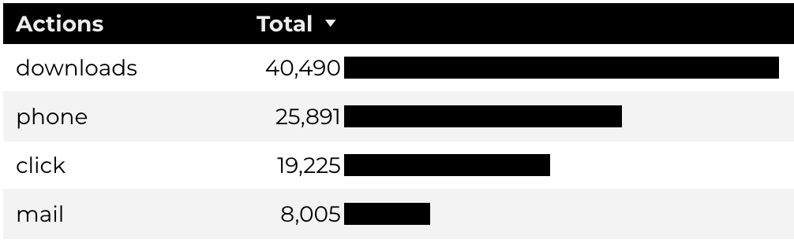
Engagement Insights & Highlights
Last quarter there were a total of 93,611 interactions on the CYS pages, which included downloads, email clicks, phone number clicks, and outbound links.

Slide 7
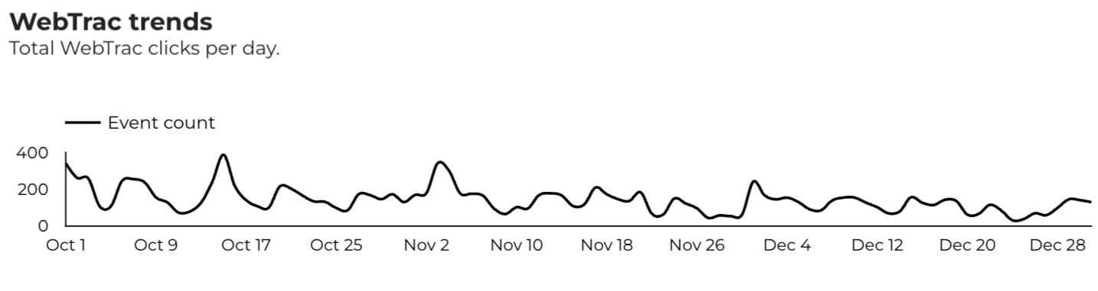
WebTrac Insights & Highlights
A total of 13,137 parents clicked on a WebTrac link from a program page to register or make a payment for a CYS program.

Slide 8
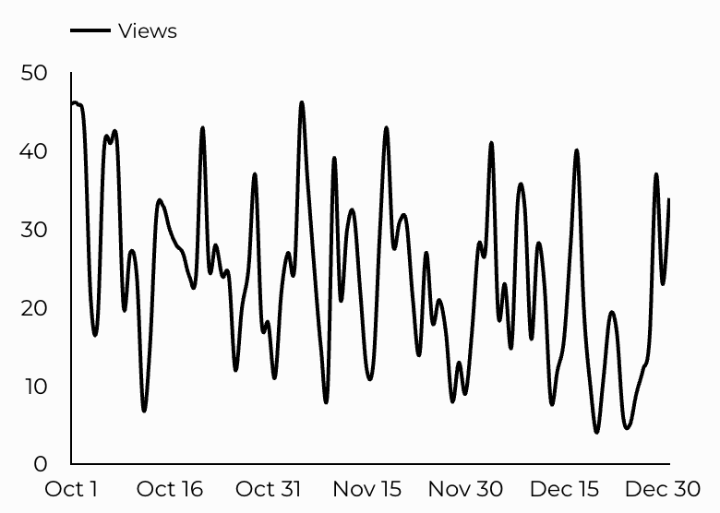
CYS Careers
CYS Career Traffic Trends
881 people looking for employment acted and clicked on USAJOBS.gov.
247 downloads of the CYS Career Guide.
33 Rack Card downloads.

Slide 9
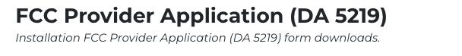
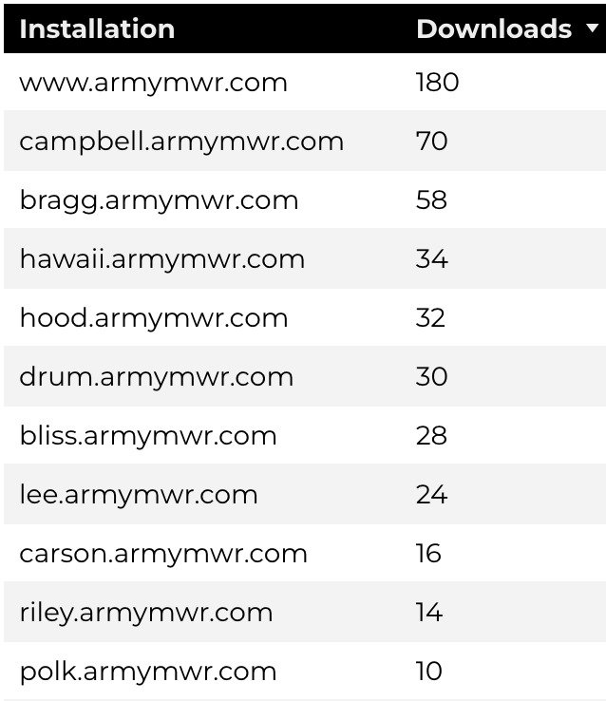
Family Child Care
14,097 visits to program pages.
5,496 users to FCC program pages.
578 downloads of DA 5219 form!

Slide 10
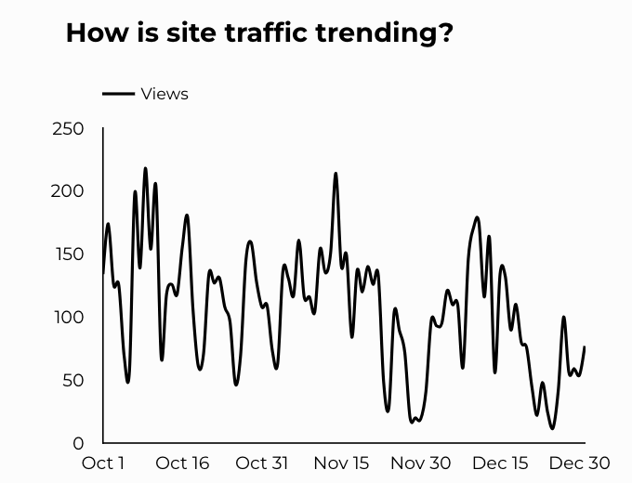
School Support Services
8,838 users made a visit to School Support Services pages.
69 people clicked to watch the 'What Is An SLO Anyway’ video.

Slide 11
Search Intent
41% Searches looking to investigate brands or services and intending to complete an action or purchase.
46% Searches looking for an answer to a specific question or general information.
13% Searches intending to find a specific program, page using the onsite search.
Search intent is defined as being the purpose behind an online query.

Slide 12
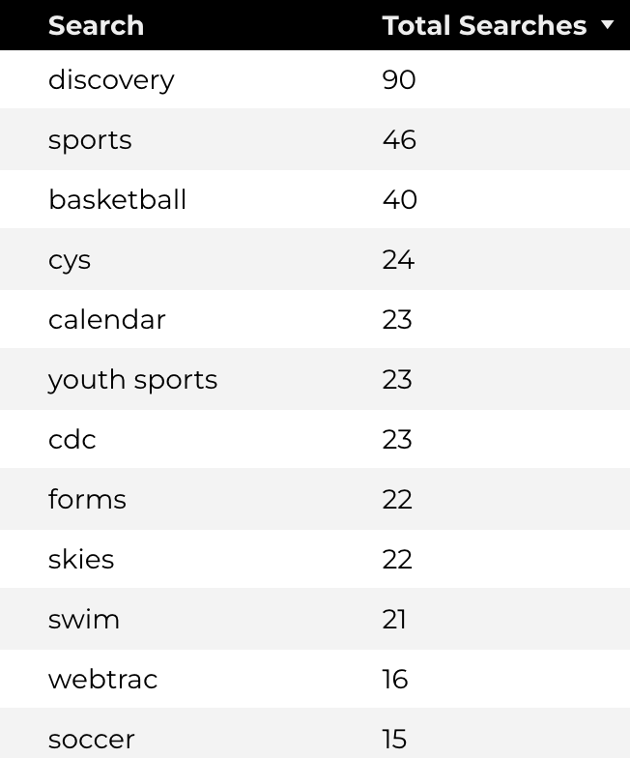
Search Insights
Top Searches
2,608 Total on-site searches on CYS pages to find more information.
2.27% of users left the site after performing a search.

Slide 13
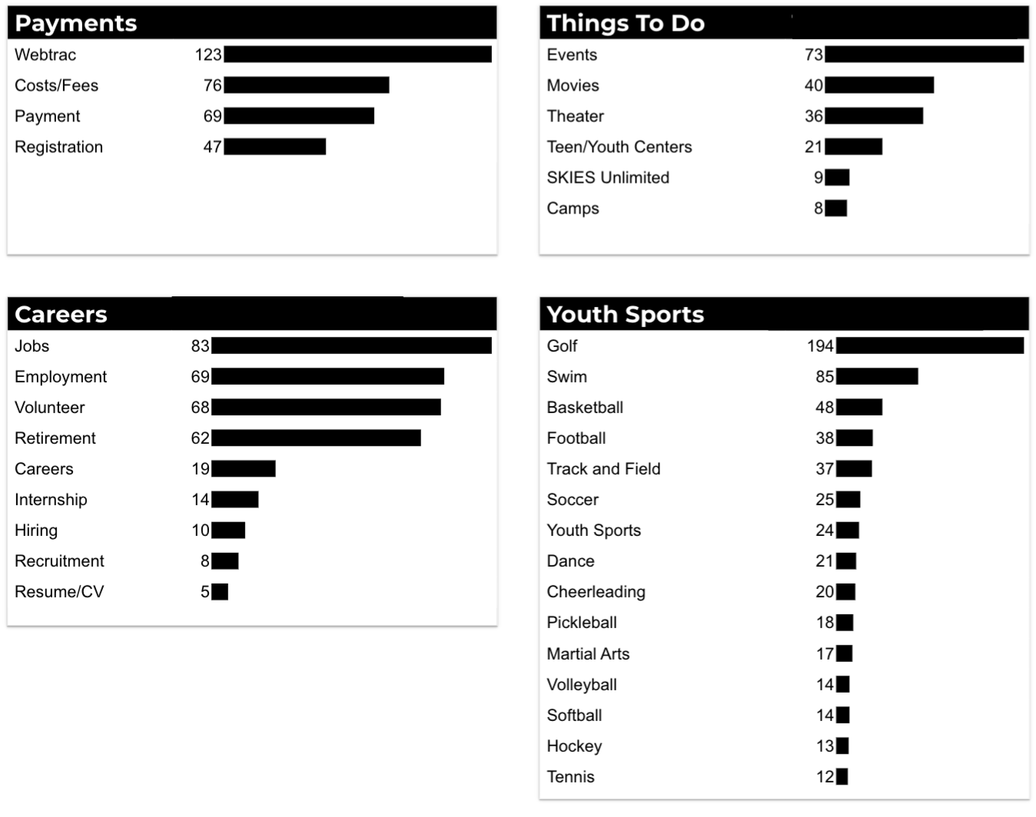
What Are The Top Search Sub-Topics?
The most popular search categories and terms within CYS

