Slide 1
WEB 3.0 BY THE NUMBERS
20 PROGRAMS | UNITS A & B COMBINED
BEFORE
Hard to find programs and services
Outdated, inconsistent information
No clear next step for Soldiers and Families
Looked different at every installation
Missing hours, contact, and location info
AFTER
20 programs fully updated and live
Soldiers and Families find what they need fast
Current, accurate information on every page
Same professional look at every installation
Hours, contact, and location on every page
→

Slide 2
WEB 3.0 BY THE NUMBERS
20 PROGRAMS | UNITS A & B COMBINED
490K+
Total Users
Across all 20 programs
22%
Avg User Growth
Unit A year over year
54%
Avg User Growth
Unit B year over year
1.2M+
Total Views
Units A & B combined
275%
Aquatics Centers
Growth year over year
69%
More first-time visitors
to Employment Readiness
DATA SOURCE: GOOGLE ANALYTICS
COMPARED YEAR OVER YEAR
FY26 | UNIT A: 1 MAR – 31 MAY | UNIT B: 11 JUN – 6 JUL

Slide 3

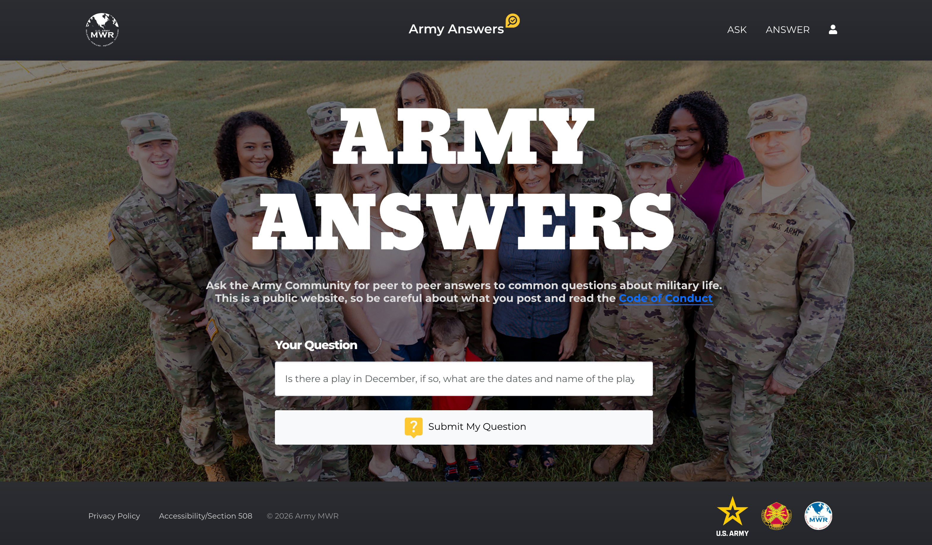
Army Answers: Real Help for the Army Community
Actual exchanges - real people, real needs, pointed in the right direction.
Answers.ArmyMWR.com
THE NEED
ANSWERED
1
“Im a future soldier going to basic at Benning […] I need to register my wife and son for EFMP beforehand […] my wife requires ERT (Enzyme replacement therapy) every other week.”
Yes, you should definitely coordinate that beforehand. […] I would call the Ft. Benning EFMP office directly so they can […] get everything dialed in ASAP […] (762) 408-2423 […] I would definitely call, since it's such a timely matter.
THE NEED
ANSWERED
2
“I am the former spouse of a retired CW4 who passed away […] I can hardly see due to a stroke […] I need assistance in claiming survivor benefits. Where can I get this?”
[…] contact USAG Rheinland-Pfalz ACS or Post-Retirement Services and ask for Survivor Outreach or Casualty Assistance […]. Also contact DFAS Retired & Annuitant Pay/SBP to start or check the claim. Be sure to mention that you have low vision and need help with forms.
THE NEED
ANSWERED
3
“I have been married to a vietnam vet for 25 years […] my husband never added me to his military record as a dependent or wife […] what do I do when I can't work any longer […] im scared.”
Reach out to a Veterans Service Officer (VSO) - they help spouses for free. […] You can also reach out to ACS […] ask for the Survivor Outreach Services (SOS) or Financial Readiness program. […] Hope that helps.
Notes:
TALKING POINTS
• Payoff line: "…and we sent them in the right direction within 48 hours." DATA FLAG: the 48-hour figure is NOT verified — pull real response timestamps from the platform before saying it aloud or adding a response-time chip to each card.
• Community angle (say only if asked): ideally this is "the community helped each other." We know that part is under-promoted and not properly positioned yet — that's the next workstream.
• Quoting: wording is the askers'/answerers' own; only trimmed with […]. Minor proper-noun capitalization and one typo were normalized for readability. No paraphrasing.
• Card 3 (25-yr marriage) is the emotional centerpiece. Easy swap if a lighter third is preferred: the Fort Bliss on-base lodging exchange (retiree, daughter's surgery).

