Slide 1
Support Services Annual FY25 Insights

Slide 2
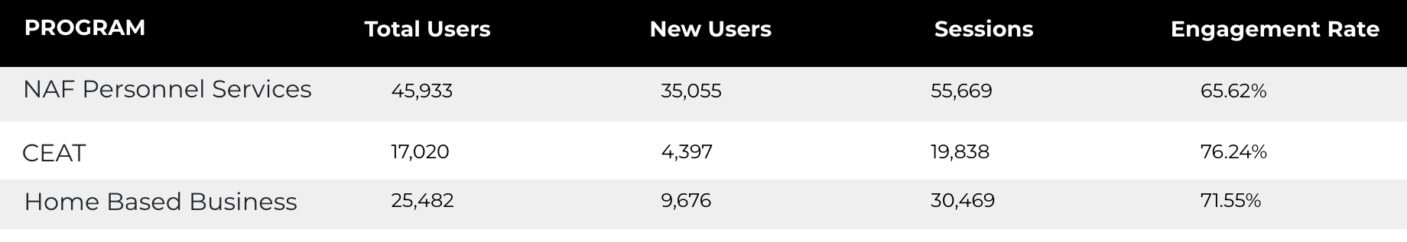
Web Analytics Summary
Program Roll-up

Slide 3
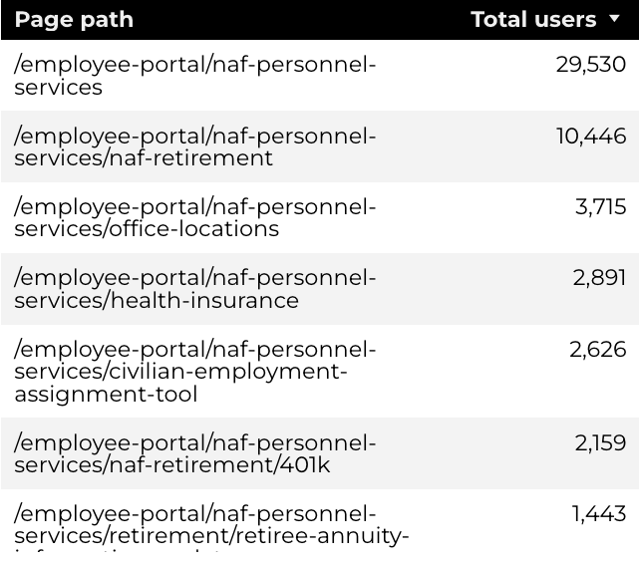
Traffic Highlights
Top Pages NAF Personnel Services
The program received 83,002 views and 55,669 sessions.
The engagement rate was at 66%.
There were a total of 45,933 users. Of those users, 35,055 were new.
NAF Personnel Services

Slide 4
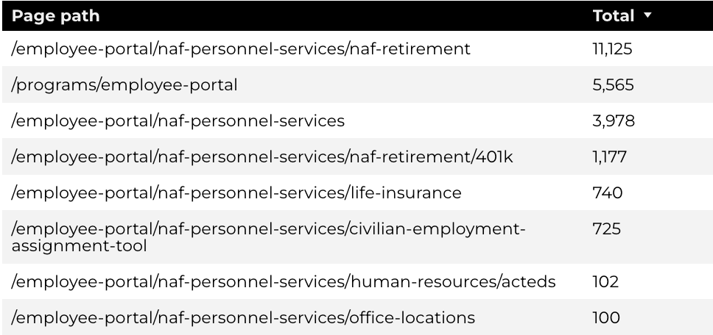
Engagement Insights & Highlights
23,307 people downloaded a PDF or a form.
Top pages for downloads, click-throughs on email addresses, phone numbers, and outbound links.
NAF Personnel Services

Slide 5
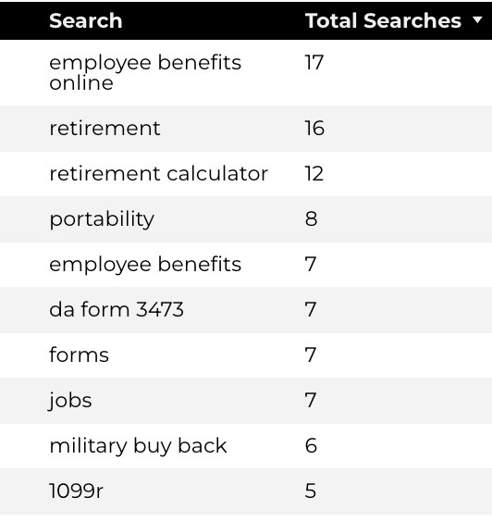
Search Insights & Highlights
Top Searches
There were 539 total on-site searches on NAF Personnel Services pages to find more information.
1.71% of users left the site after performing a search.
NAF Personnel Services

Slide 6
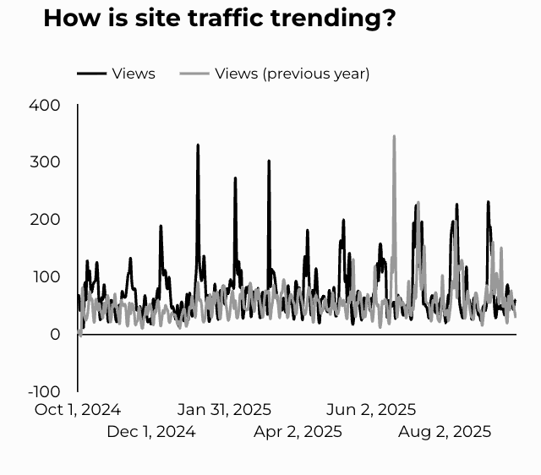
Traffic Highlights
The website received 26,305 views and 19,838 sessions.
The engagement rate was at 76%.
CEAT

Slide 7
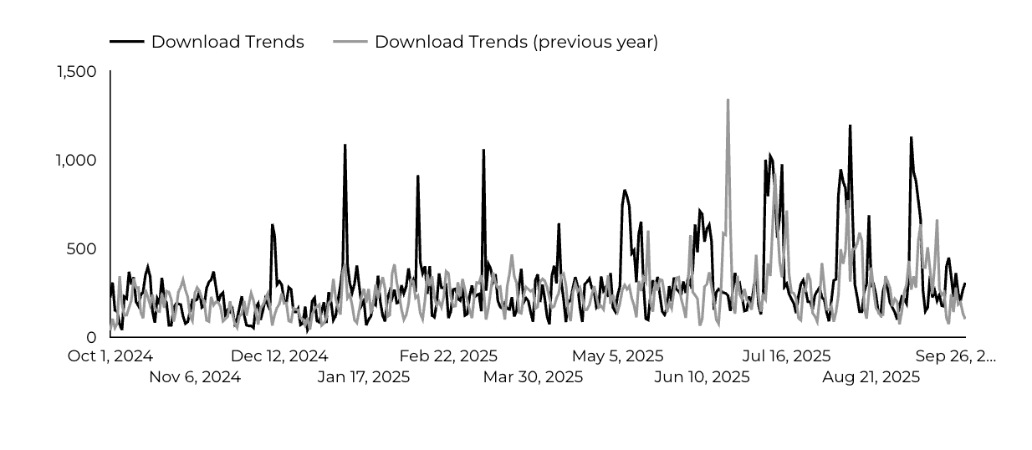
Engagement Insights & Highlights
CEAT Transfer Guide Achieved 3,135 Downloads.
CEAT Transfer Guide Download Trends
CEAT

Slide 8
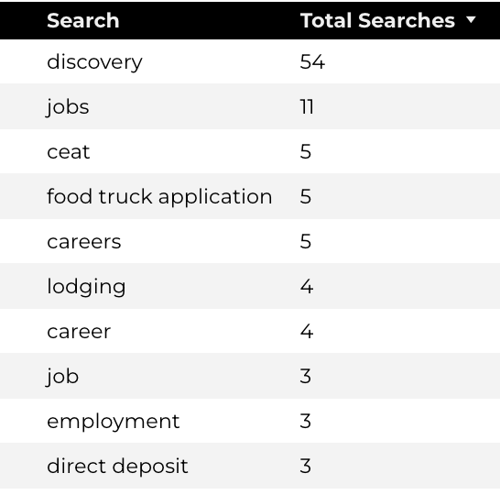
Search Insights & Highlights
223 total on-site searches on CEAT pages to find more information.
Top Searches
CEAT

Slide 9
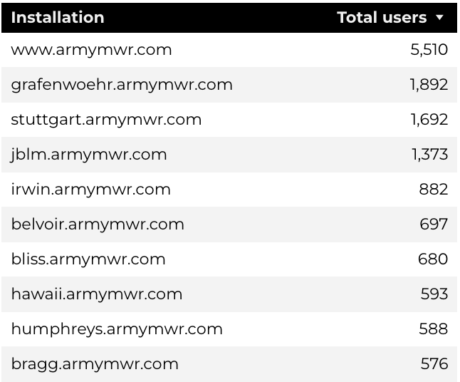
Traffic Highlights
HBB pages received 37,333 views and 30,469 sessions.
The engagement rate was at 72%.
The total number of users was 25,482, and there were 9,676 new users.
Top Installations
Home Based Business (HBB)

Slide 10
Engagement Insights & Highlights
There were 722 clicks to other websites to find more information.
11,043 people downloaded a PDF or a form.
563 people needed to talk to a real person.
Home Based Business (HBB)

Slide 11
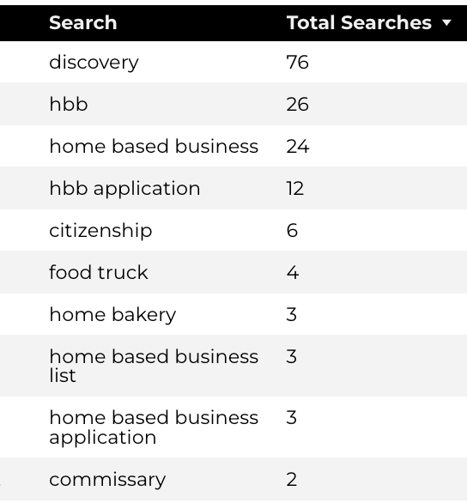
Search Insights & Highlights
357 total on-site searches on HBB pages to find more information.
2.46% of users left the site after performing a search.
Top Searches
Home Based Business (HBB)

