Slide 1
Support Services First Quarter FY26 Insights

Slide 2
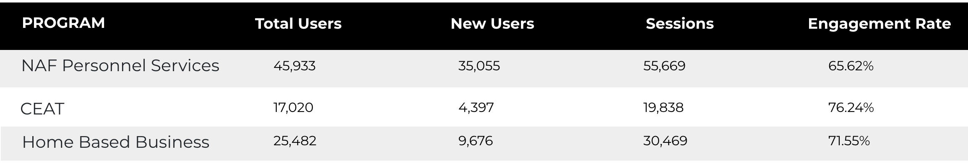
Web Analytics Summary
Program Roll-up

Slide 3
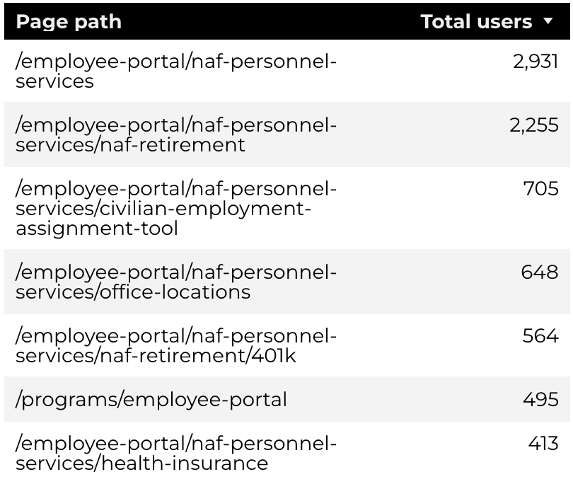
Traffic Highlights
Top Pages NAF Personnel Services
The program received 13,068 views and 9,123 sessions.
The engagement rate was at 62%.
There were a total of 7,054 users.
NAF Personnel Services

Slide 4
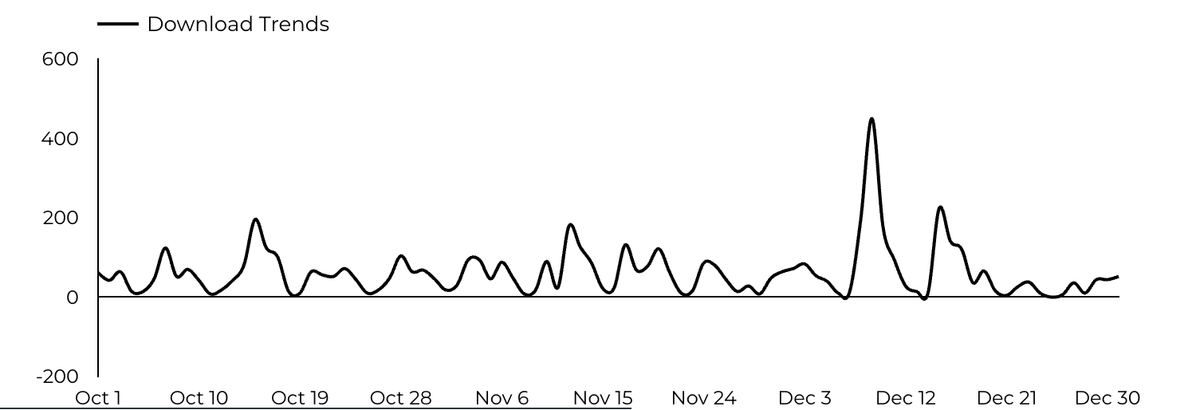
Engagement Insights & Highlights
5,733 people downloaded a PDF or a form.
68 people clicked on a link to another website to get more information.
NAF Personnel Services

Slide 5
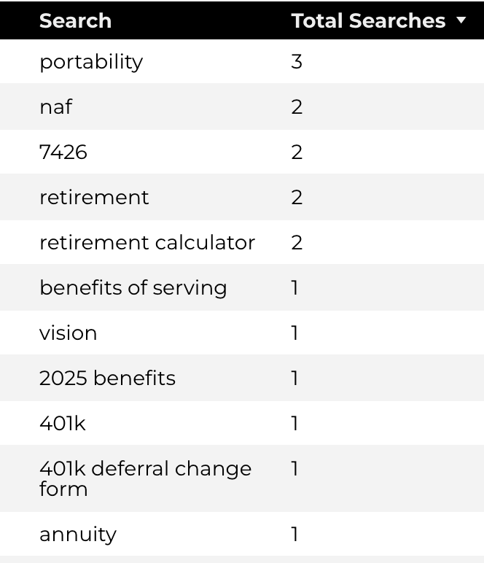
Search Insights & Highlights
Top Searches
There were 71 total on-site searches on NAF Personnel Services pages to find more information.
NAF Personnel Services

Slide 6
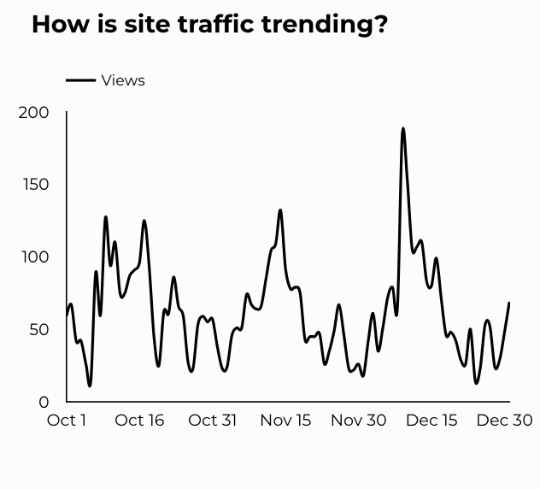
Traffic Highlights
The website received 6,346 views and 5,447 sessions.
The engagement rate was at 55%.
CEAT

Slide 7
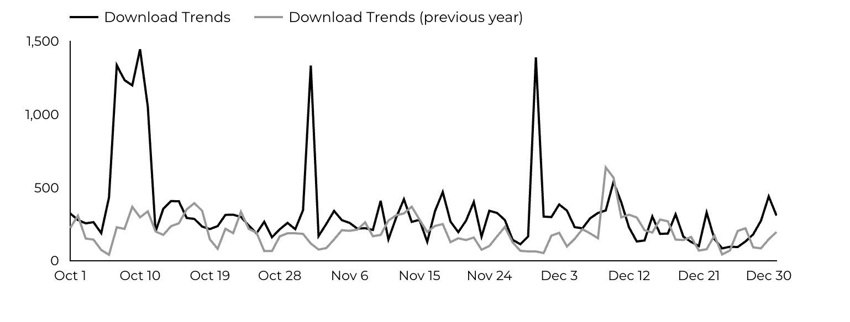
Engagement Insights & Highlights
CEAT Transfer Guide: Achieved 620 Downloads.
CEAT Transfer Guide Download Trends
CEAT

Slide 8
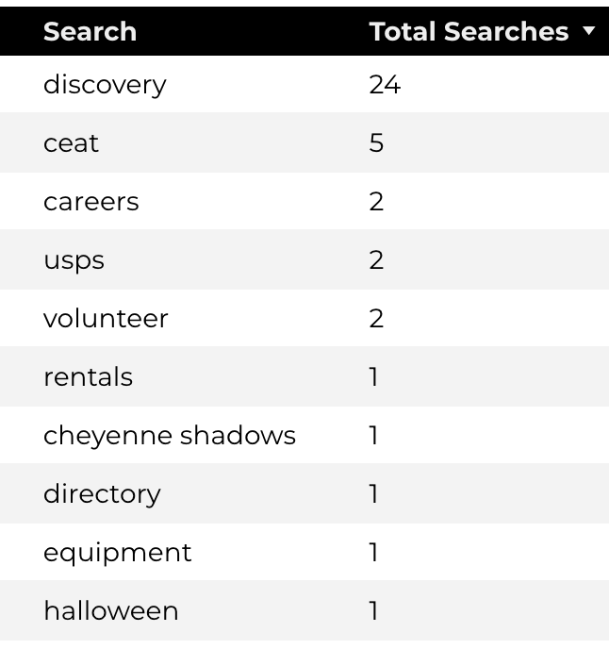
Search Insights & Highlights
Top Searches
58 total on-site searches on CEAT pages to find more information.
CEAT

Slide 9
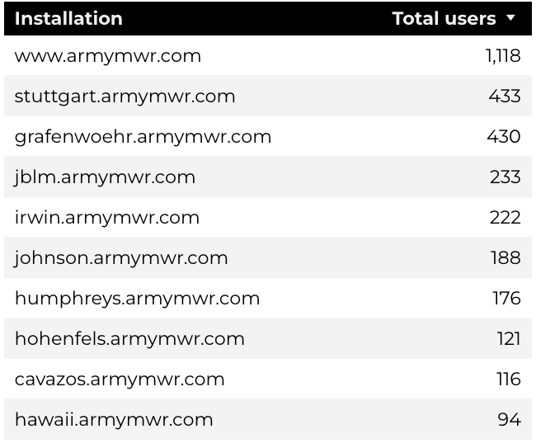
Traffic Highlights
Top Installations
HBB pages received 8,853 views and 7,263 sessions.
The engagement rate was at 61%.
The total number of users was 7,263 and there were 2,820 new users.
Home Based Business (HBB)

Slide 10
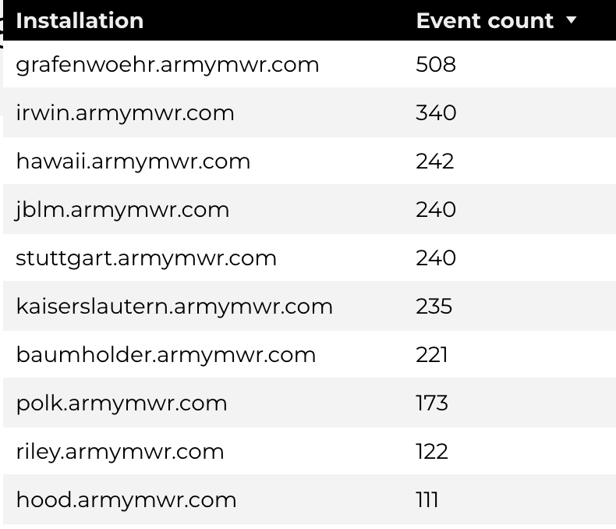
Engagement Insights & Highlights
There were 238 clicks to other websites to find more information.
2,843 people downloaded a PDF or a form.
123 people needed to talk to a real person.
Top Installations
(Downloads, Email, Phone Numbers, Outbound Links)
Home Based Business (HBB)

Slide 11
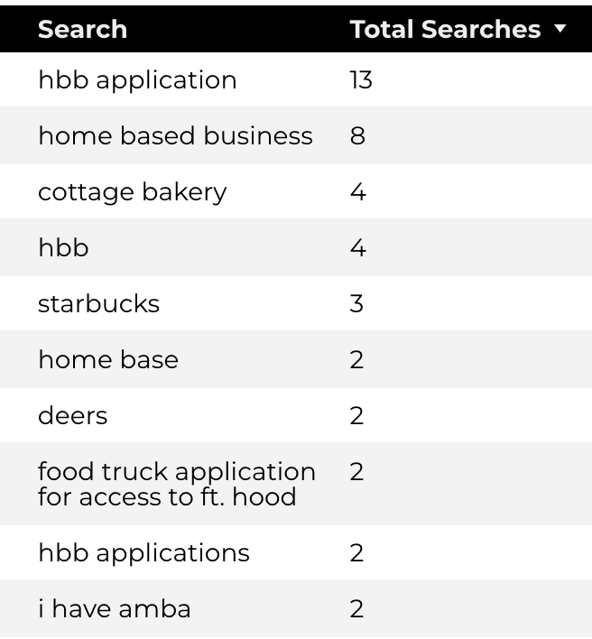
Search Insights & Highlights
90 total on-site searches on HBB pages to find more information.
7.79% of users left the site after performing a search.
Top Searches
Home Based Business (HBB)

