Slide 1
CYS Annual FY25 Insights

Slide 2
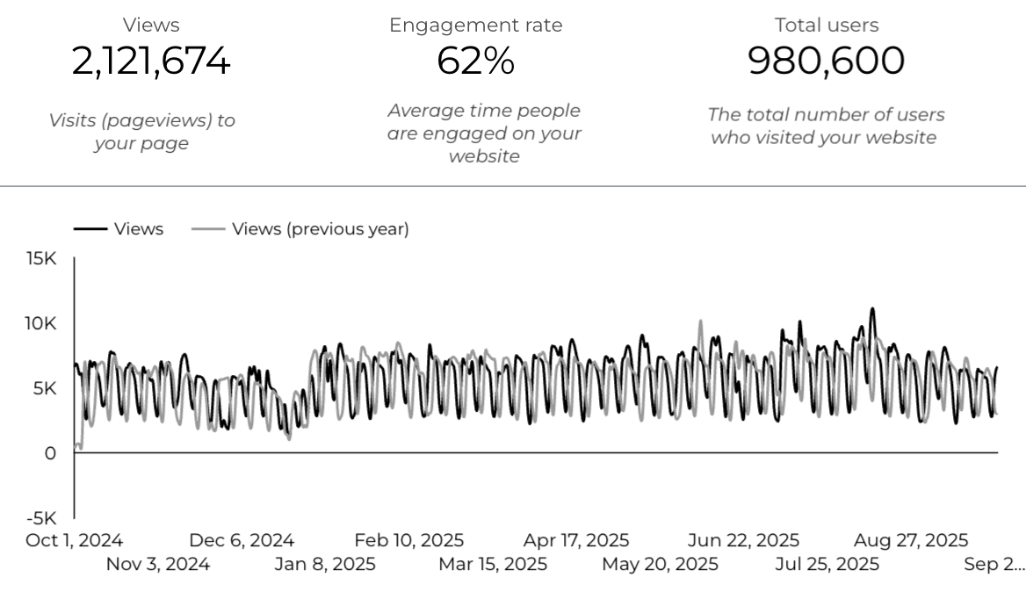
Overview

Slide 3
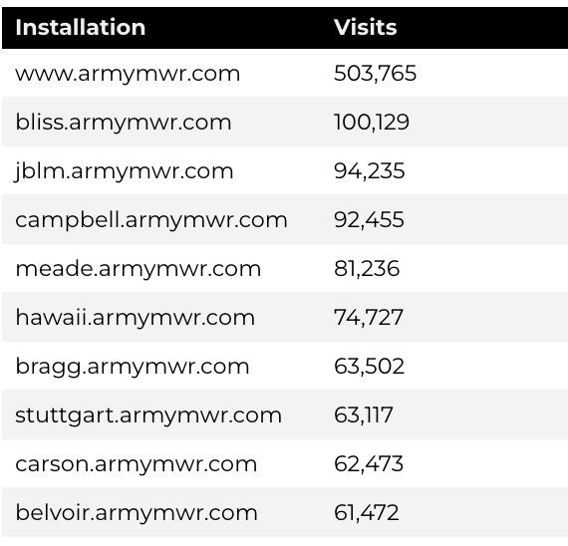
Traffic Highlights
There were a total of 2,121,674 visits, to Child and Youth Services (CYS) web pages.
On average, each user viewed 2.19 pages.
Top US Army Installations

Slide 4
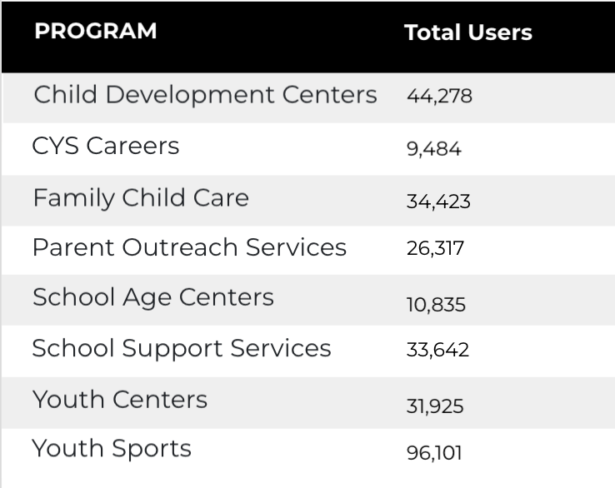
Visitor Highlights
Program Roll-Up
There are 980,600 total users on the CYS site.
The average visit duration is 2 minutes and 19 seconds.

Slide 5
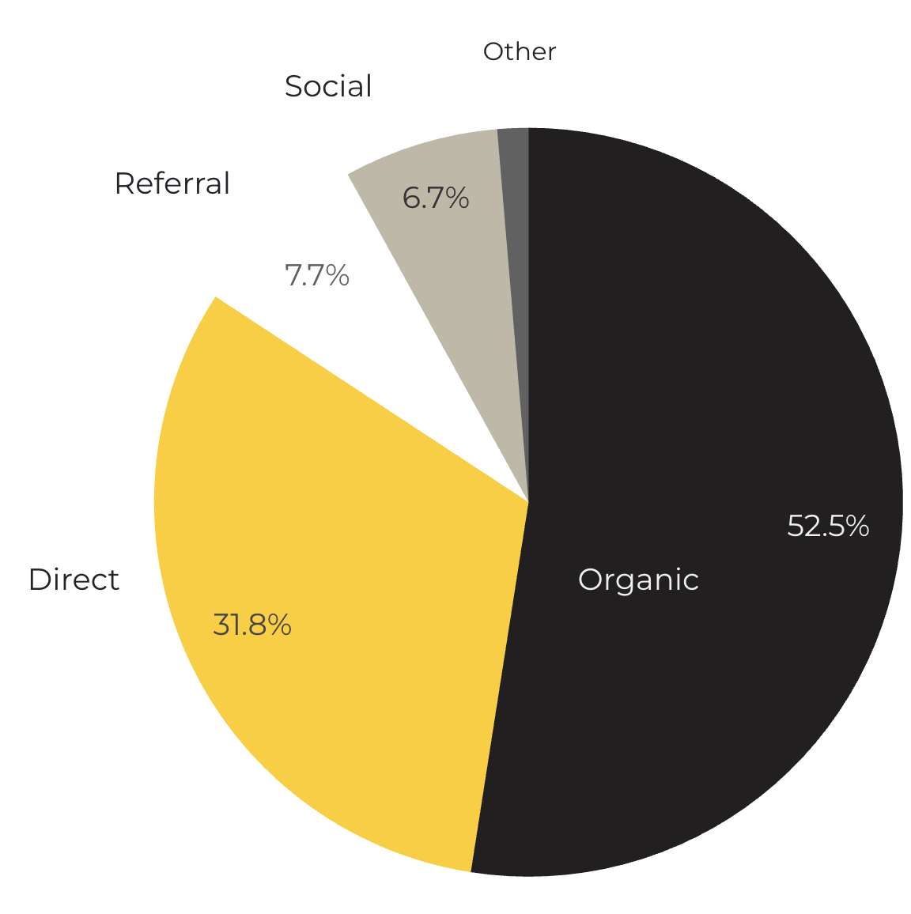
Marketing Reach
52.5% of visitors came from online search engines.
31.8% came directly to the site (by typing in the address, using bookmarks, or email links).
7.7% of visitors came from referrals.
6.7% of visitors came from social media.
1.3% Other (traffic that has an acquisition source Google doesn’t know how to classify).
9.2%
63.8%

Slide 6
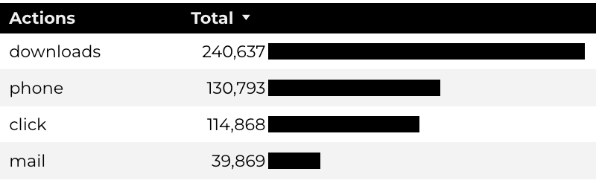
Engagement Insights & Highlights
Last year there were a total of 526,167 interactions on the CYS pages, which included downloads, email clicks, phone number clicks, and outbound links.

Slide 7
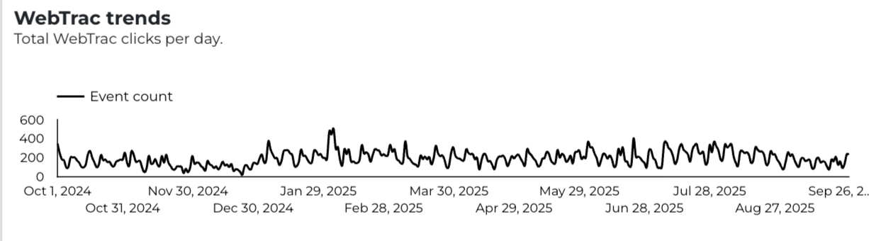
WebTrac Insights & Highlights
A total of 70,579 parents clicked on a WebTrac link from a program page to register or make a payment for a CYS program.

Slide 8
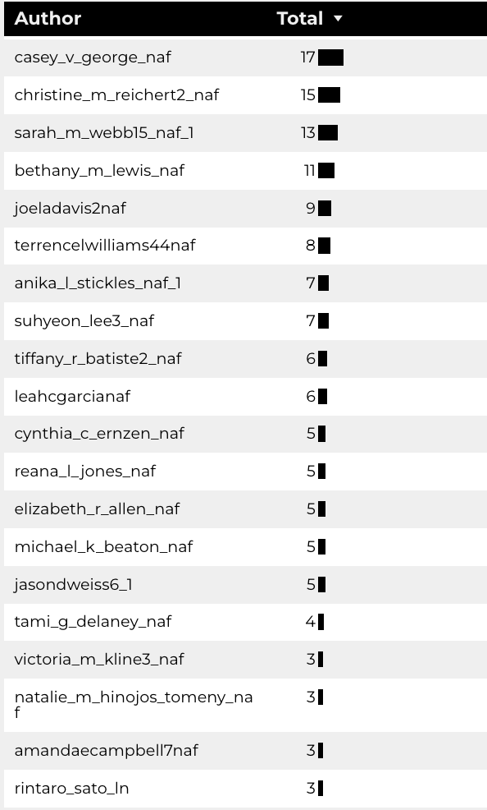
Top Content Creators
469 new pages were added to CYS.

Slide 9
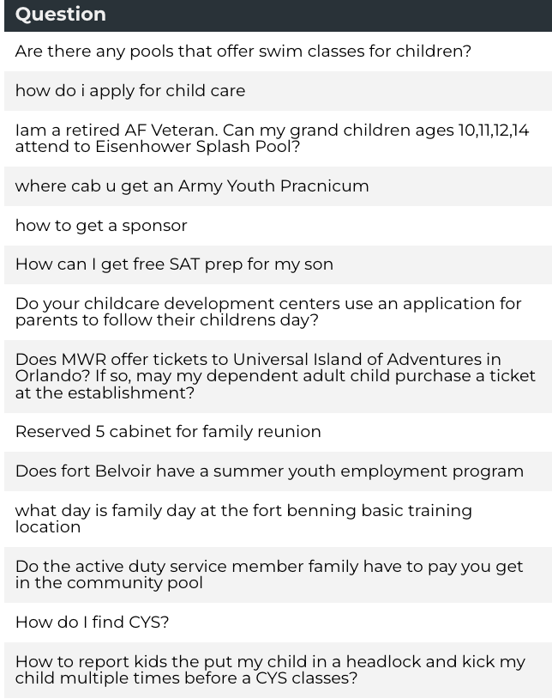
Army Answers
50 new questions added to Army Answers

Slide 10
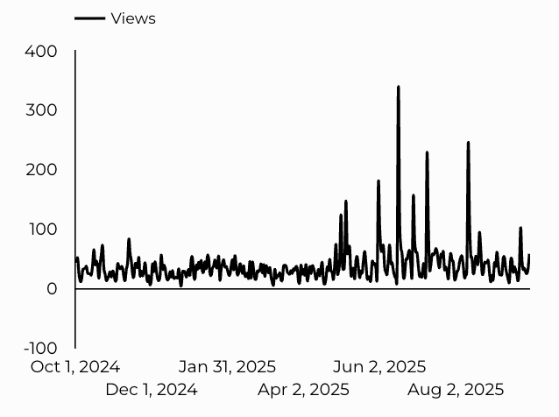
CYS Careers
CYS Career Traffic Trends
4,759 people looking for employment took action and clicked on USAJOBS.gov.
1,634 downloads of the CYS Career Guide.
217 Rack Card downloads.

Slide 11
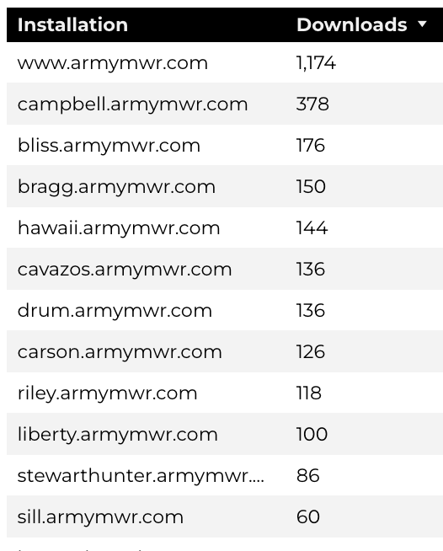
Family Child Care
FCC Provider Application (DA 5219)
form downloads.
6,1548 visits to program pages.
3,362 downloads of DA 5219 form!

Slide 12
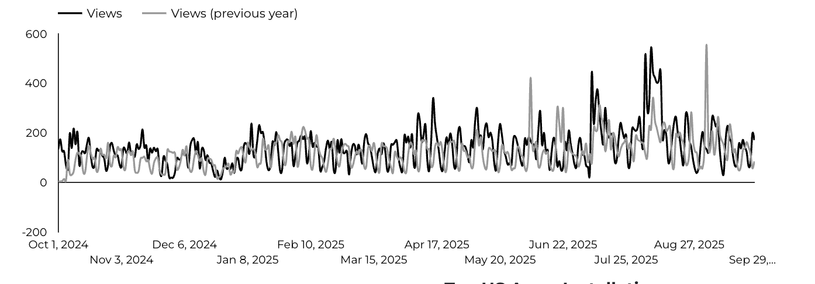
School Support Services
33,642 users made a visit to School Support Services pages.
471 people clicked to watch the 'What Is An SLO Anyway’ video.

Slide 13
Search Intent
40% Searches looking to investigate brands or services and intending to complete an action or purchase.
48% Searches looking for an answer to a specific question or general information.
12% Searches intending to find a specific program, page using the onsite search.
Search intent is defined as being the underlying purpose behind an online query.

Slide 14
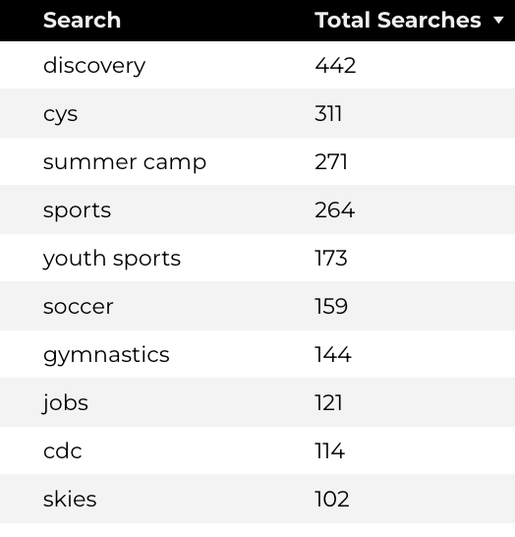
Search Insights
Top Searches
16,231 Total on-site searches on CYS pages to find more information.
2.78% of users left the site after performing a search.

Slide 15
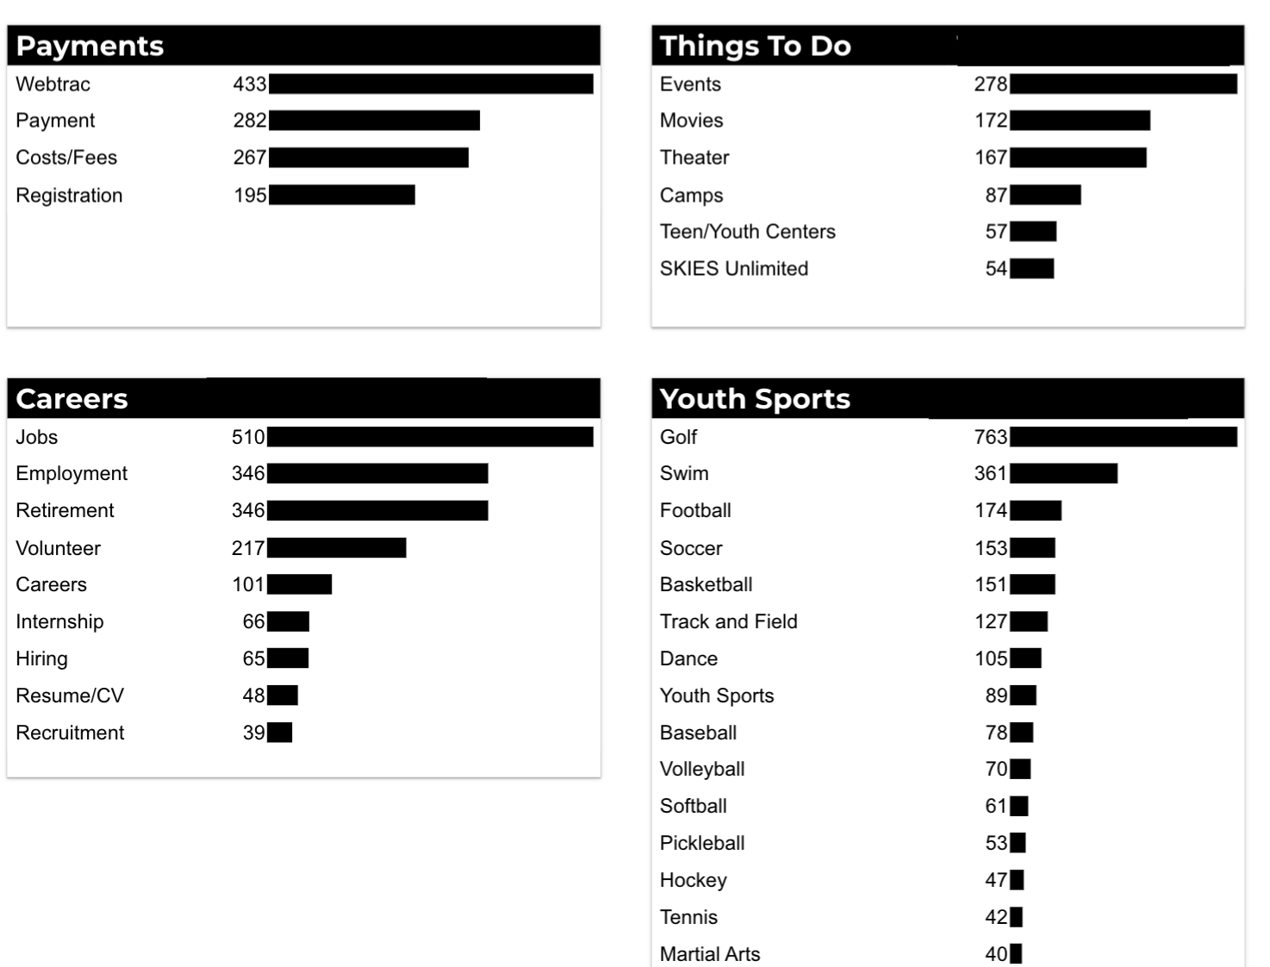
What Are The Top Search Sub-Topics?
The most popular search categories and terms within CYS

