Slide 1
BRD Annual FY25 Insights

Slide 2
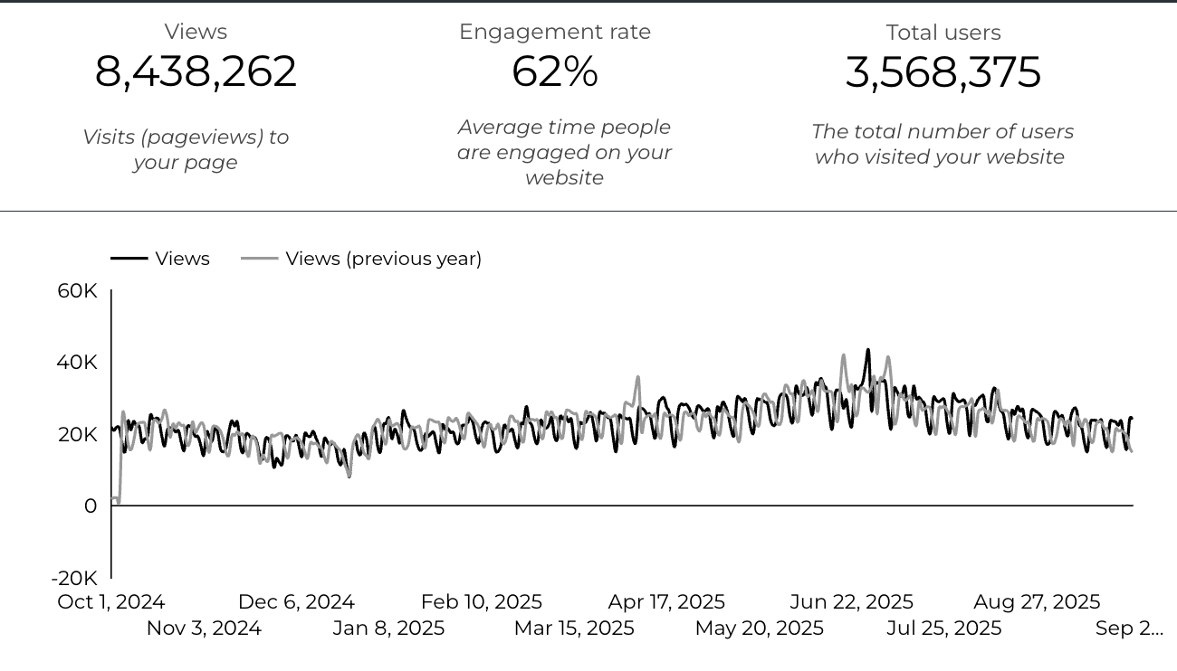
Web Analytics Summary

Slide 3
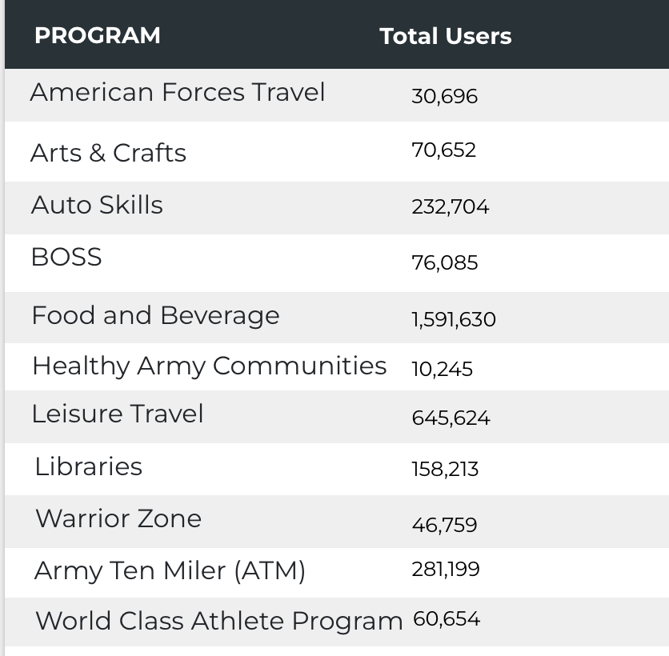

Visitor Highlights
48,022 People clicked on the Chow Now button to start an order.

Slide 4

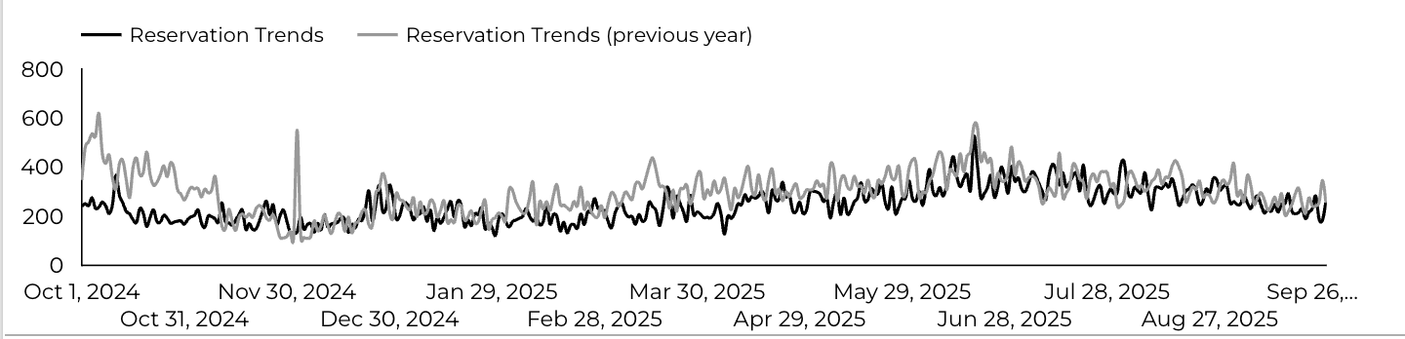
Sports and Fitness
89,760 People clicked to schedule a tee time or register for a golf clinic.

Slide 5
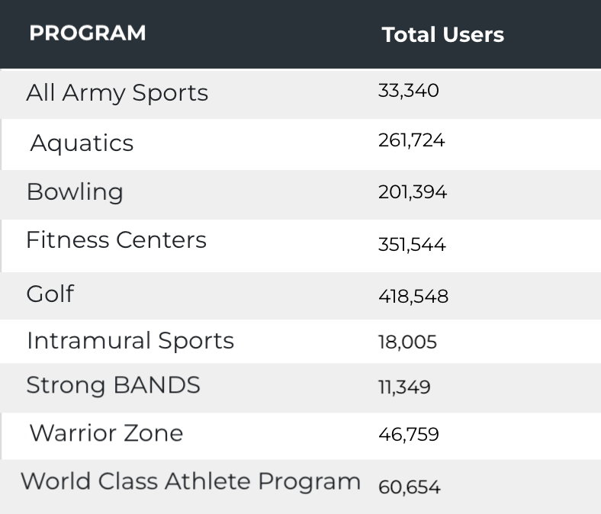
Visitor Highlights
Sports and Fitness

Slide 6
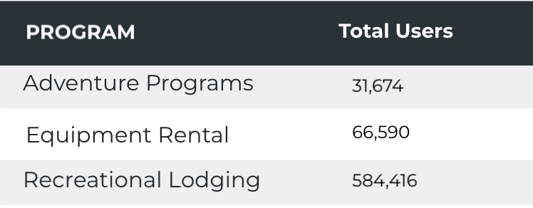
Visitor Highlights
Outdoor Rec

Slide 7
Visitor Highlights
How engaged were these visitors within the website?
On average, users visited 2.38 pages per visit.
On average, users stayed on the site for 3 minutes and 2 seconds per visit.
2,818,059 visitors were new to the website.
62% of visitors took action on a page!

Slide 8
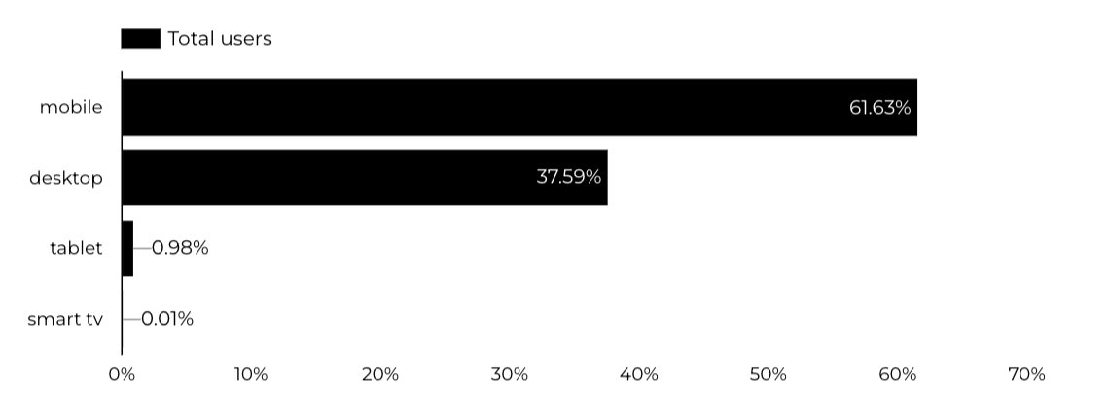
Traffic Highlights
  BRD pages received 8,438,262 visits.
  The majority of social traffic came from Facebook.
  Users by Device Category

Slide 9
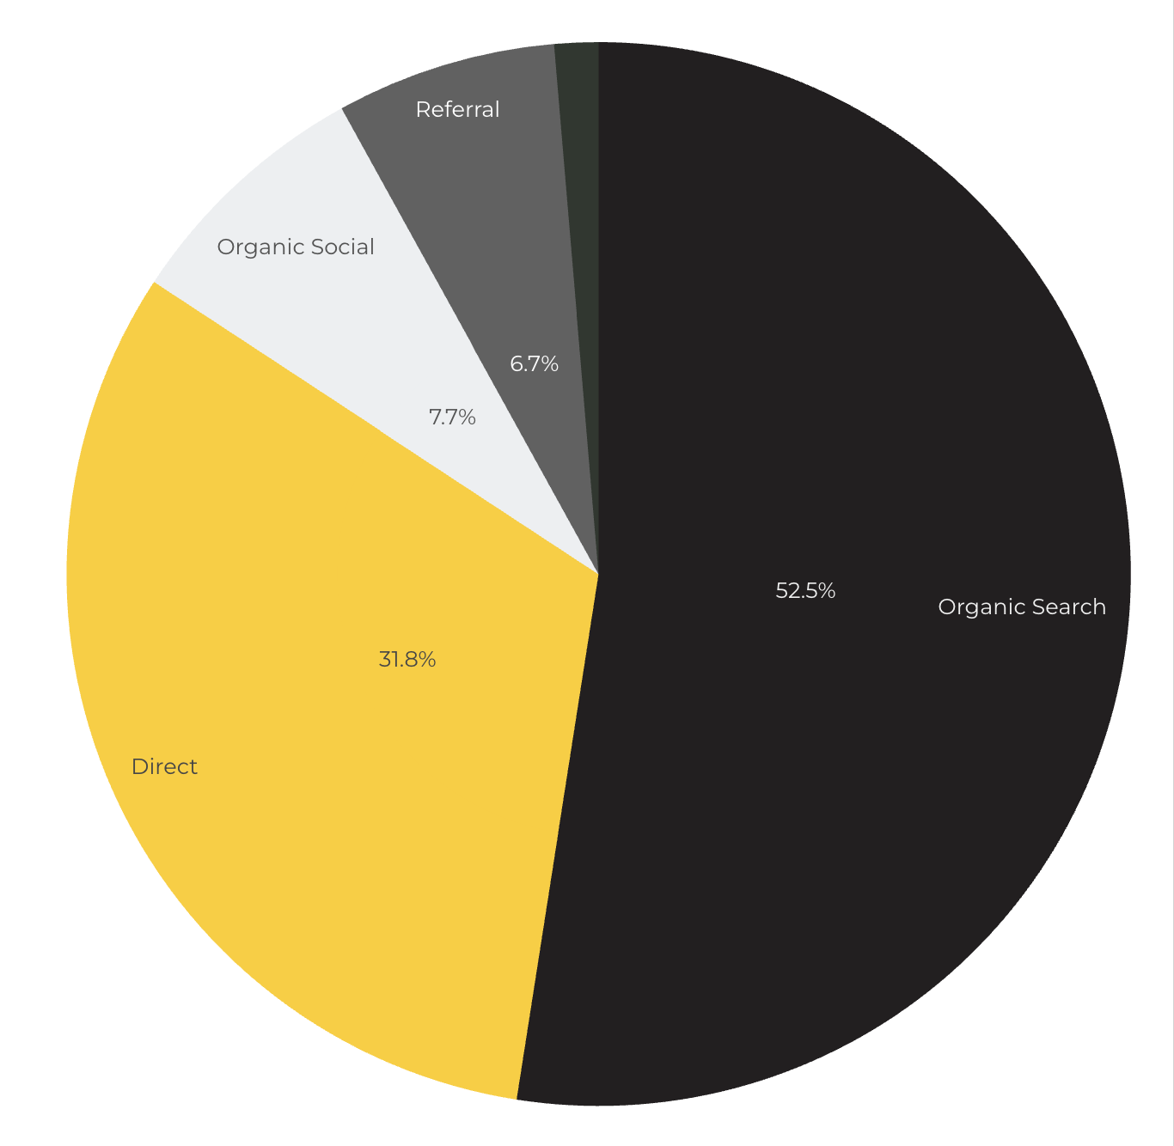
Marketing Reach
Other
|
52.5% of visitors came from online search engines.
31.8% came directly to the site (by typing in the address, using bookmarks, or email links).
7.7% of visitors came from social media.
6.7% of visitors came from referrals.
1.3% Other (traffic that has an acquisition source Google doesn't know how to classify).

Slide 10

Engagement Insights & Highlights
Last year had a total of 2,460,096 interactions on the pages (including downloads, email clicks, phone number clicks, outbound links, and videos).

Slide 11
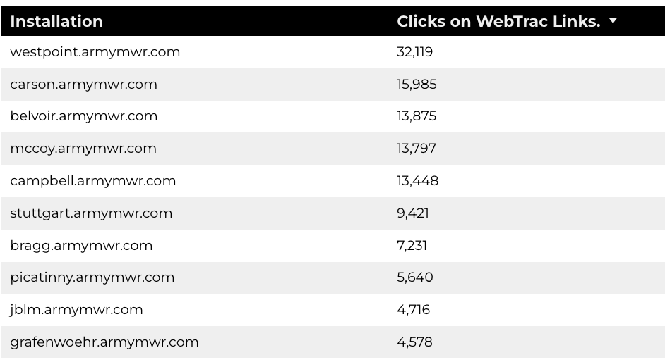
WebTrac Insights & Highlights
A total of 165,936 individuals clicked on a WebTrac link from a program page.
Top installations with the highest number of WebTrac link clicks on pages.

Slide 12

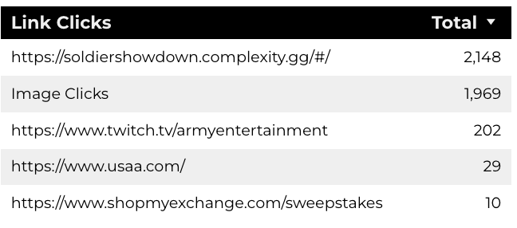
ESPORTS
14,074 Users made a visit.
55% of Visitors Take Action on a Page.
397,211 Stripe Impressions.

Slide 13

Summer Reading Program
472,312 Users made a visit.
64% of Visitors Take Action on a Page.
397,021 Stripe Impressions.
6,593 Clicks on AT&T Sponsor.
7,756 Clicks to beanstack

Slide 14

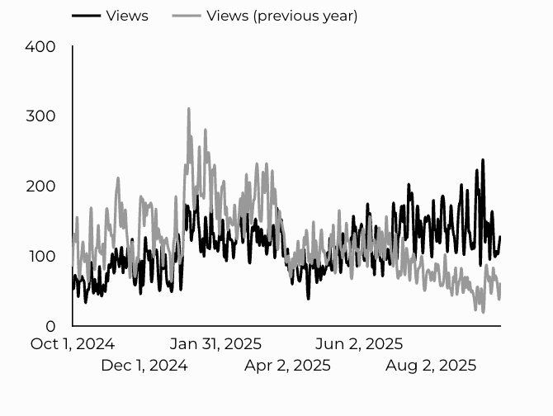
Armed Forces Travel
41,292 Users made a visit.
83% of Visitors Take Action on a Page.
Traffic trends compared y-o-y

Slide 15

Water Safety
3,557 Users made a visit.
80% of Visitors take action on a page.

Slide 16
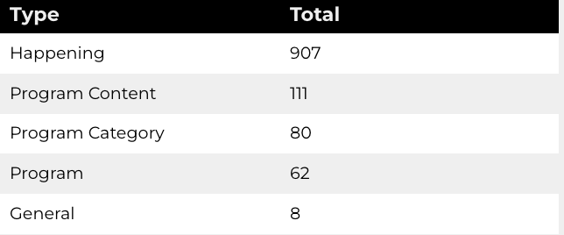
New Pages
Web managers created 1,168 new ACS pages, program pages, and happenings on EPW last year. (Data from EPW Page Report)
Total page types

Slide 17
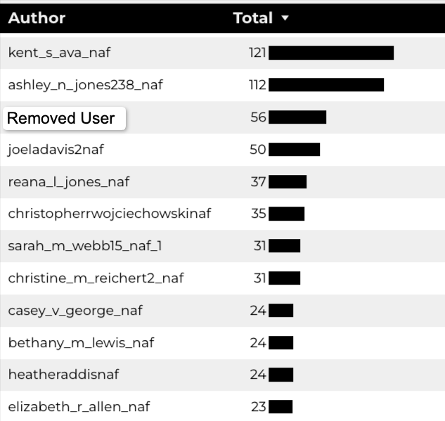
Top Content Creators

Slide 18
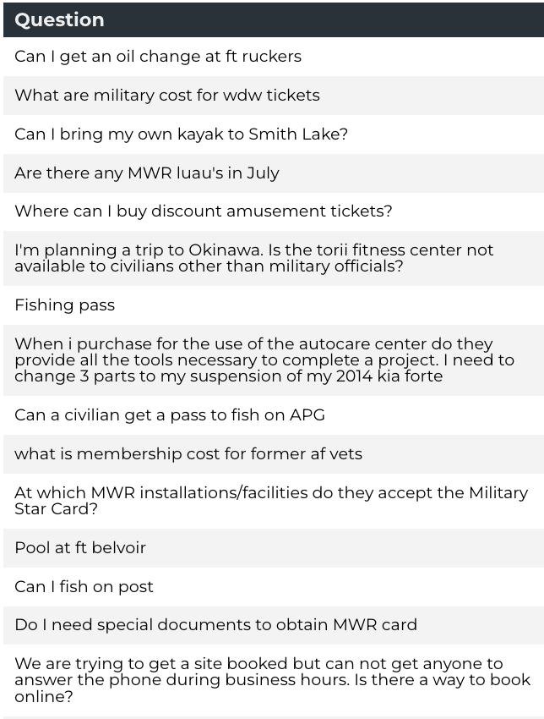
Army Answers
280 new questions added to Army Answers

Slide 19
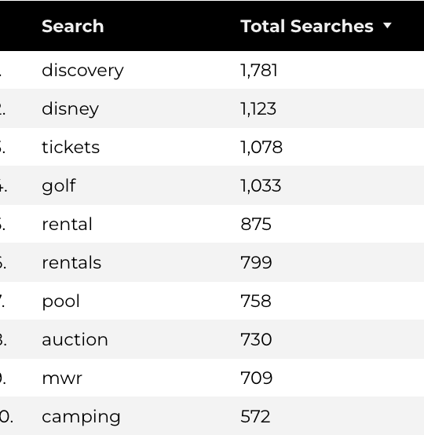
Search Insights
97,853 Total on-site searches on BRD pages to find more information.

Slide 20
Search Intent
Search intent is defined as being the underlying purpose behind an online query.
41% of searches were looking for an answer to a specific question or general information.
45% of searches were looking to investigate brands or services and intending to complete an action or purchase.
14% of searches were intending to find a specific program page using the on-site search.

Slide 21
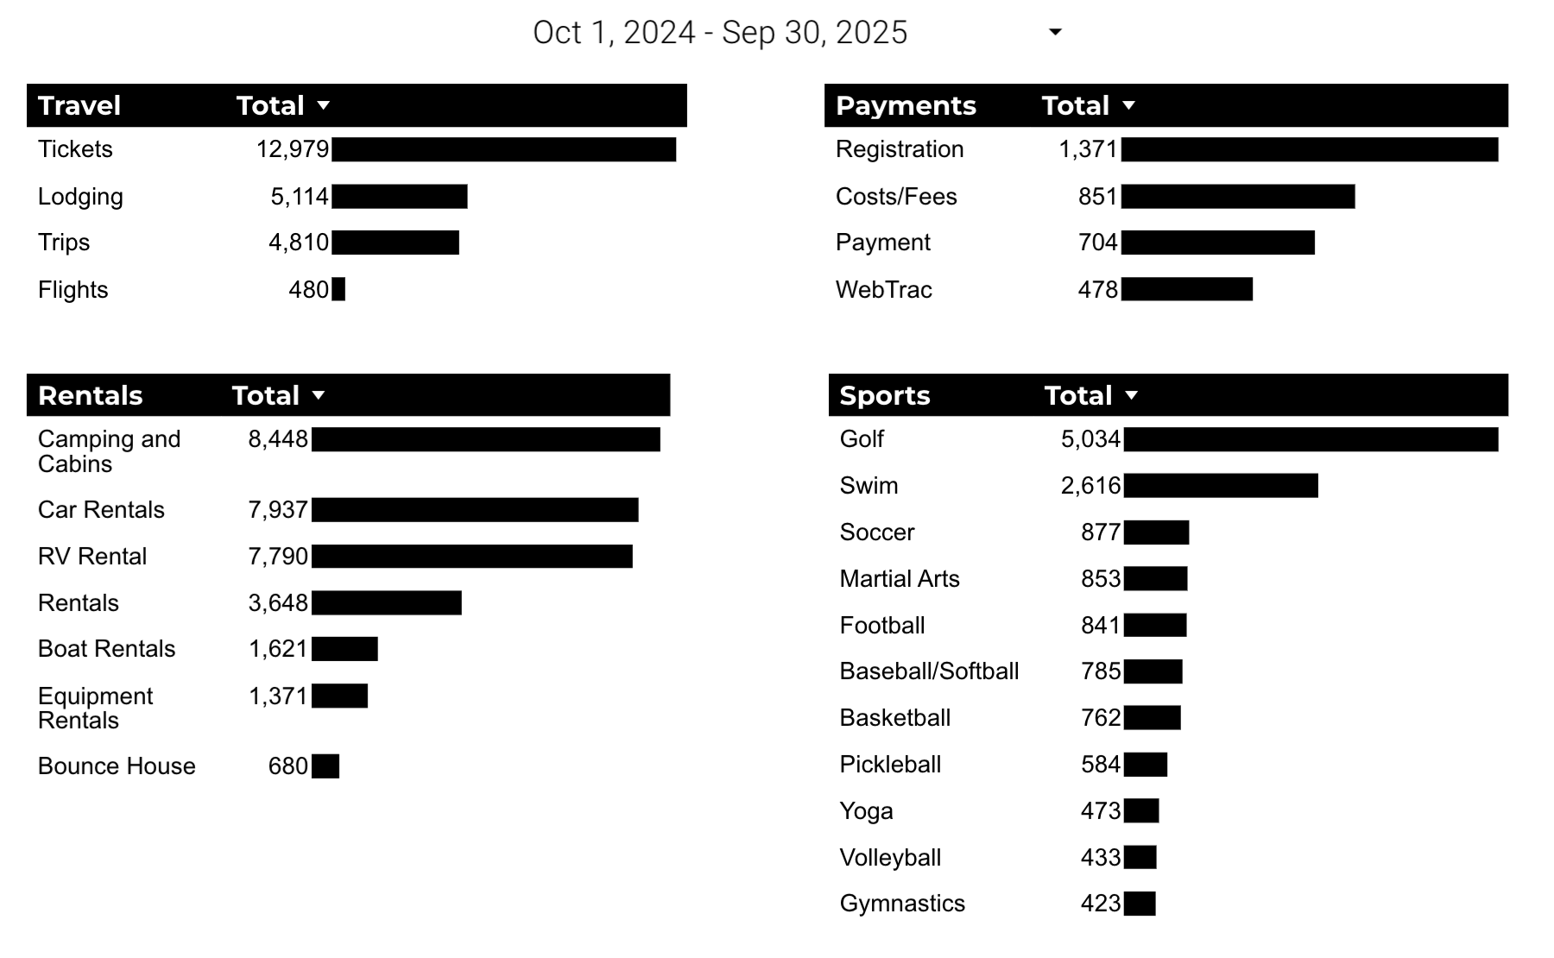
What Are The Top Search Sub-Topics?
The most popular search categories and terms within BRD

