Slide 1
Support Services Second Quarter FY26 Insights

Slide 2
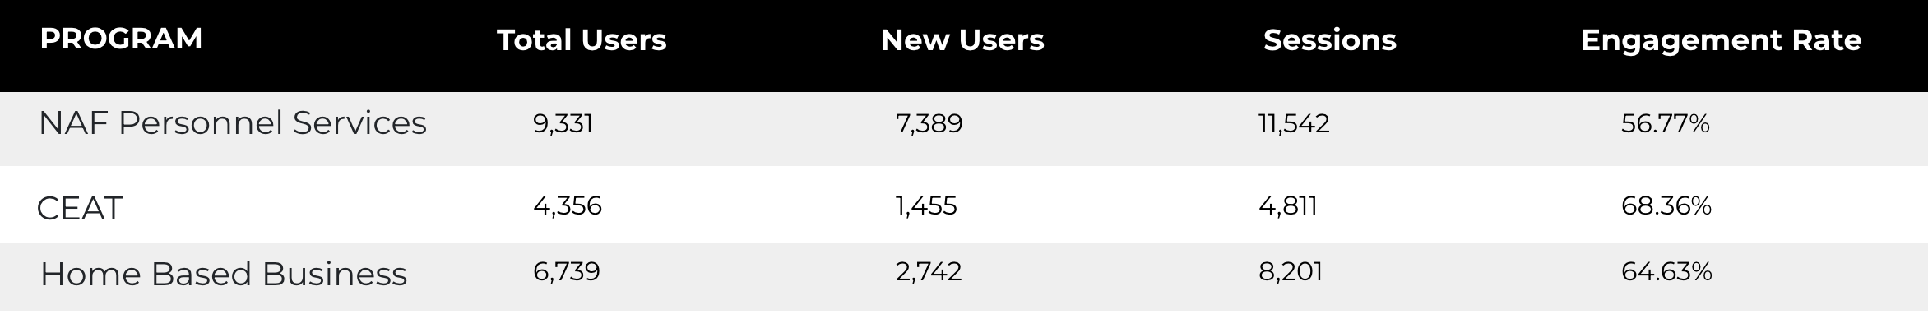
Web Analytics Summary
Program Roll-up

Slide 3
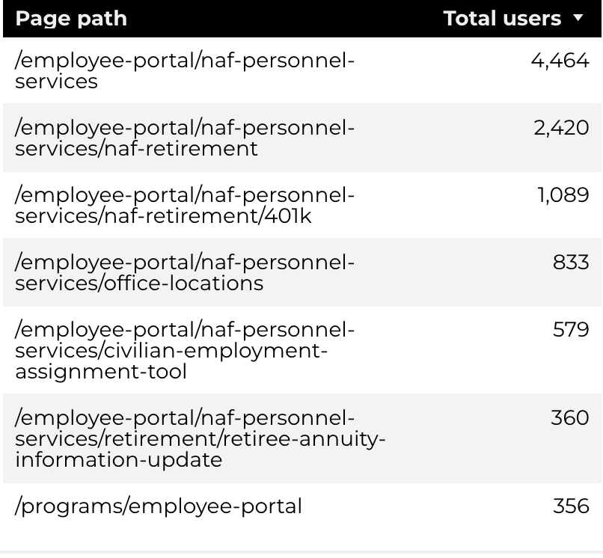
Traffic Highlights
Top Pages NAF Personnel Services
The program received 17,104 views and 11,542 sessions.
The engagement rate was at 57%.
There were a total of 9,331 users.
NAF Personnel Services

Slide 4
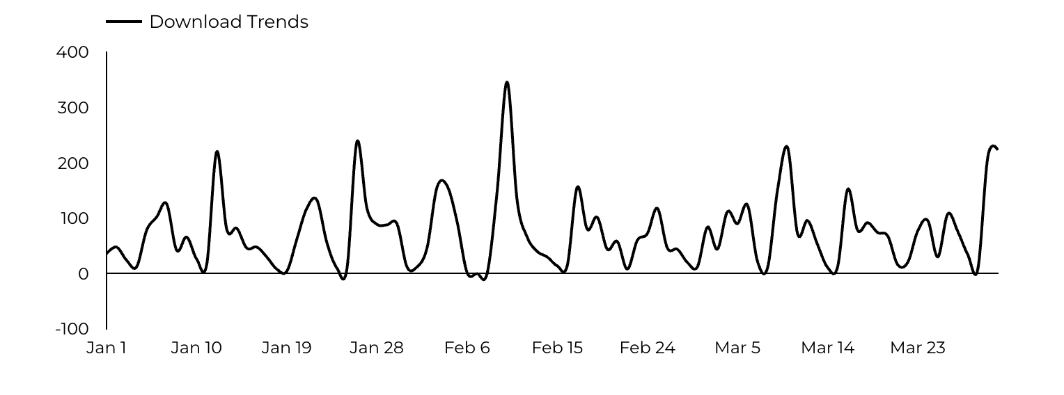
Engagement Insights & Highlights
6,666 people downloaded a PDF or a form.
79 people clicked on a link to another website to get more information.
NAF Personnel Services

Slide 5
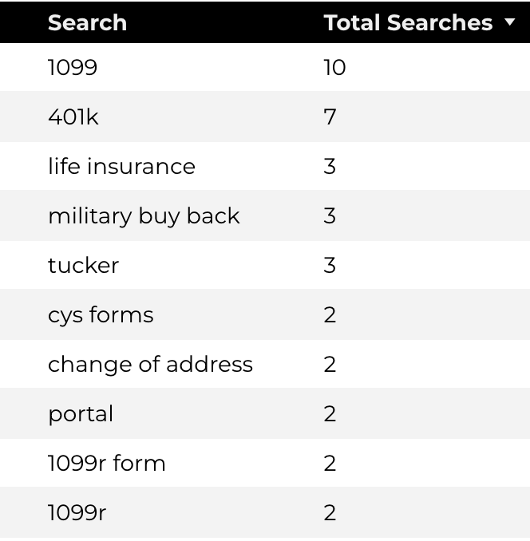
Search Insights & Highlights
Top Searches
There were 176 total on-site searches on NAF Personnel Services pages to find more information.
NAF Personnel Services

Slide 6
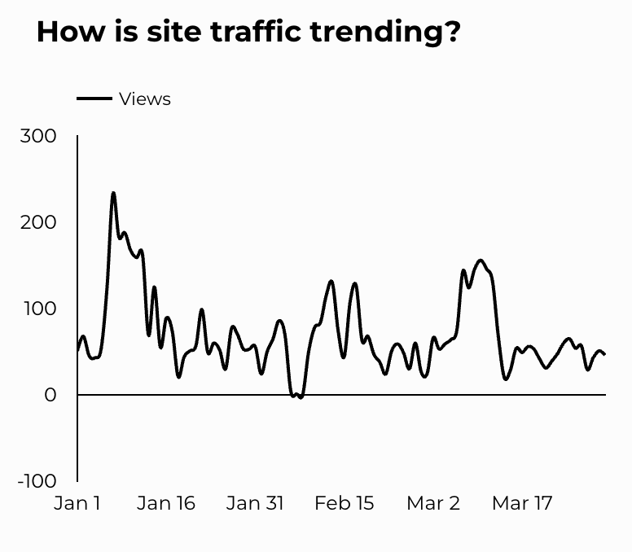
Traffic Highlights
The website received 6,365 views and 4,811 sessions.
The engagement rate was at 68%.
CEAT

Slide 7
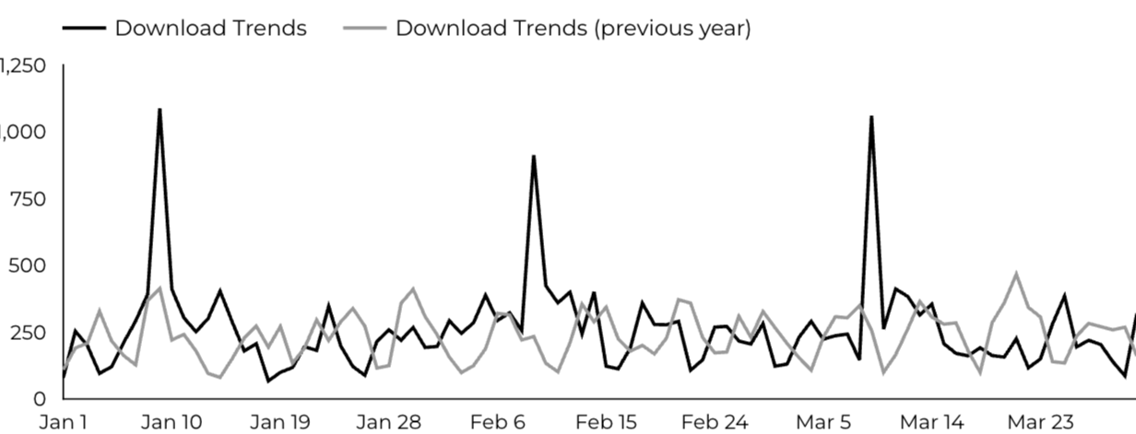
Engagement Insights & Highlights
CEAT Transfer Guide: Achieved 789 Downloads.
CEAT Transfer Guide Download Trends
CEAT

Slide 8
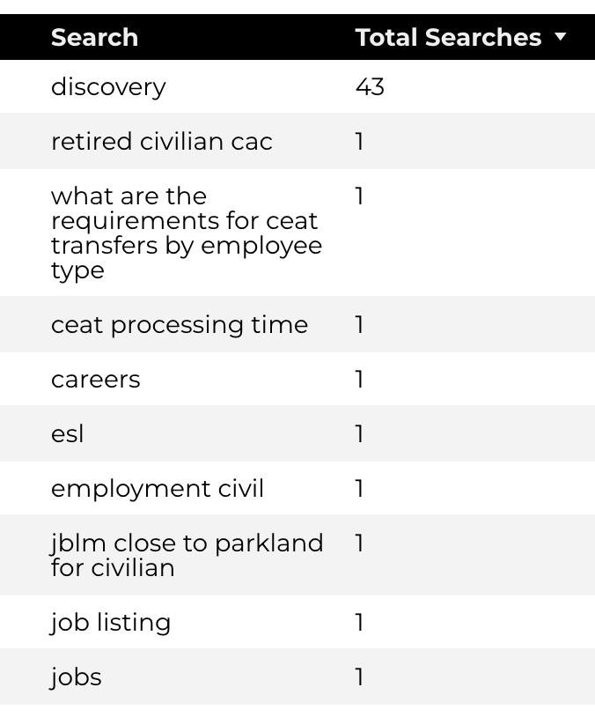
Search Insights & Highlights
Top Searches
70 total on-site searches on CEAT pages to find more information.
CEAT

Slide 9
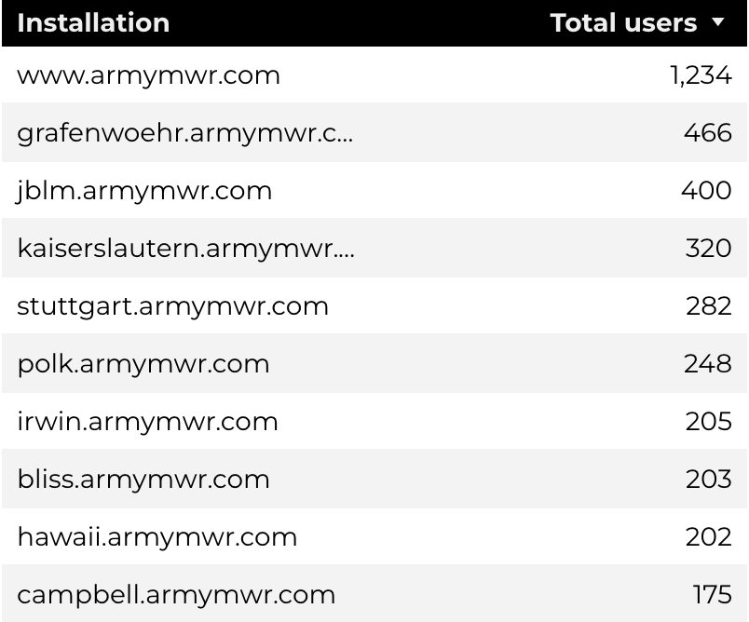
Traffic Highlights
Top Installations
HBB pages received 10,234 views and 8,201 sessions.
The engagement rate was at 65%.
The total number of users was 6,739 and there were 2,742 new users.
Home Based Business (HBB)

Slide 10
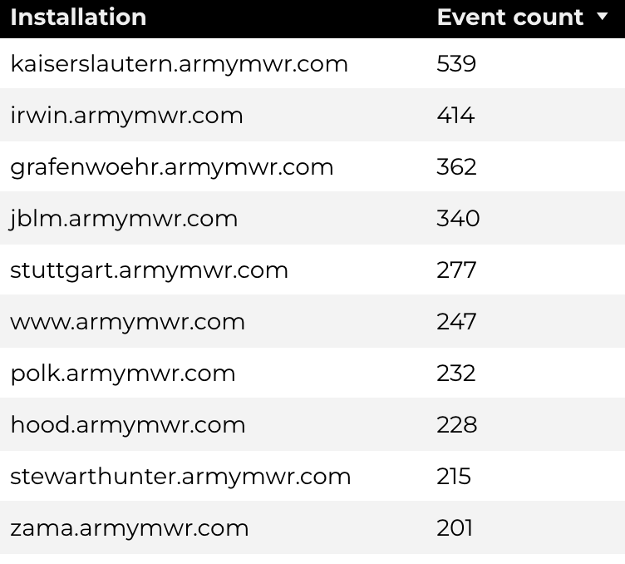
Engagement Insights & Highlights
There were 211 clicks to other websites to find more information.
4,054 people downloaded a PDF or a form.
181 people needed to talk to a real person.
Top Installations
(Downloads, Email, Phone Numbers, Outbound Links)
Home Based Business (HBB)

Slide 11
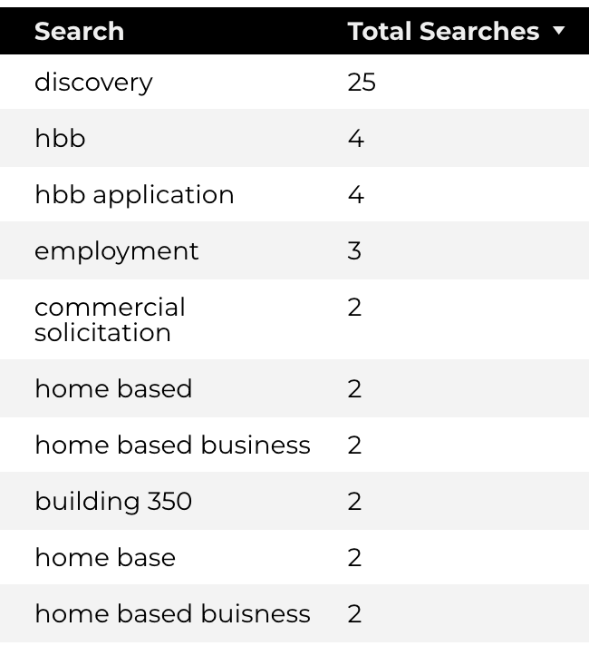
Search Insights & Highlights
99 total on-site searches on HBB pages to find more information.
1.37% of users left the site after performing a search.
Top Searches
Home Based Business (HBB)

