Slide 1
CYS Third Quarter FY25 Insights

Slide 2
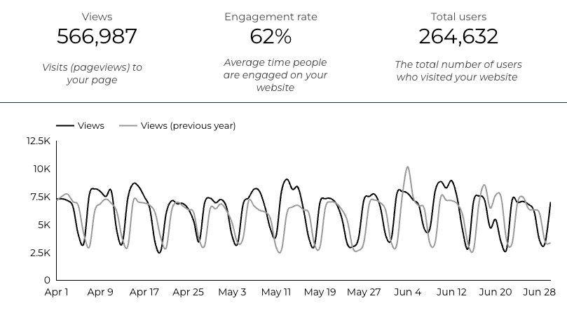
Overview

Slide 3
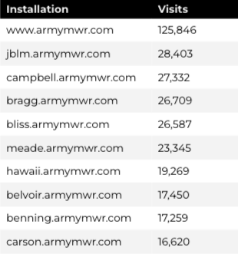
Traffic Highlights
There were a total of 264,632 users, to Child and Youth Services (CYS) web pages.
On average, each user viewed 2.18 pages.
62% of users engaged with a CYS page
Top US Army Installations

Slide 4
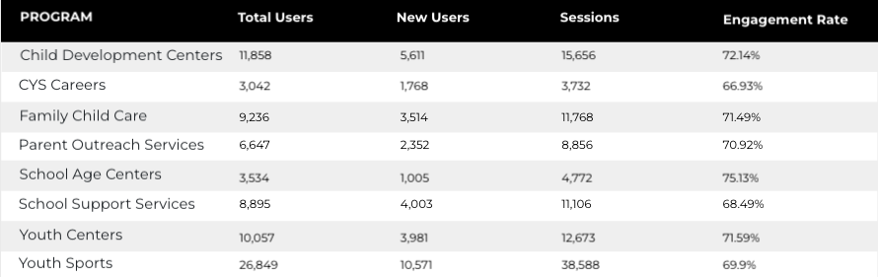
Visitor Highlights
Program Roll-Up

Slide 5
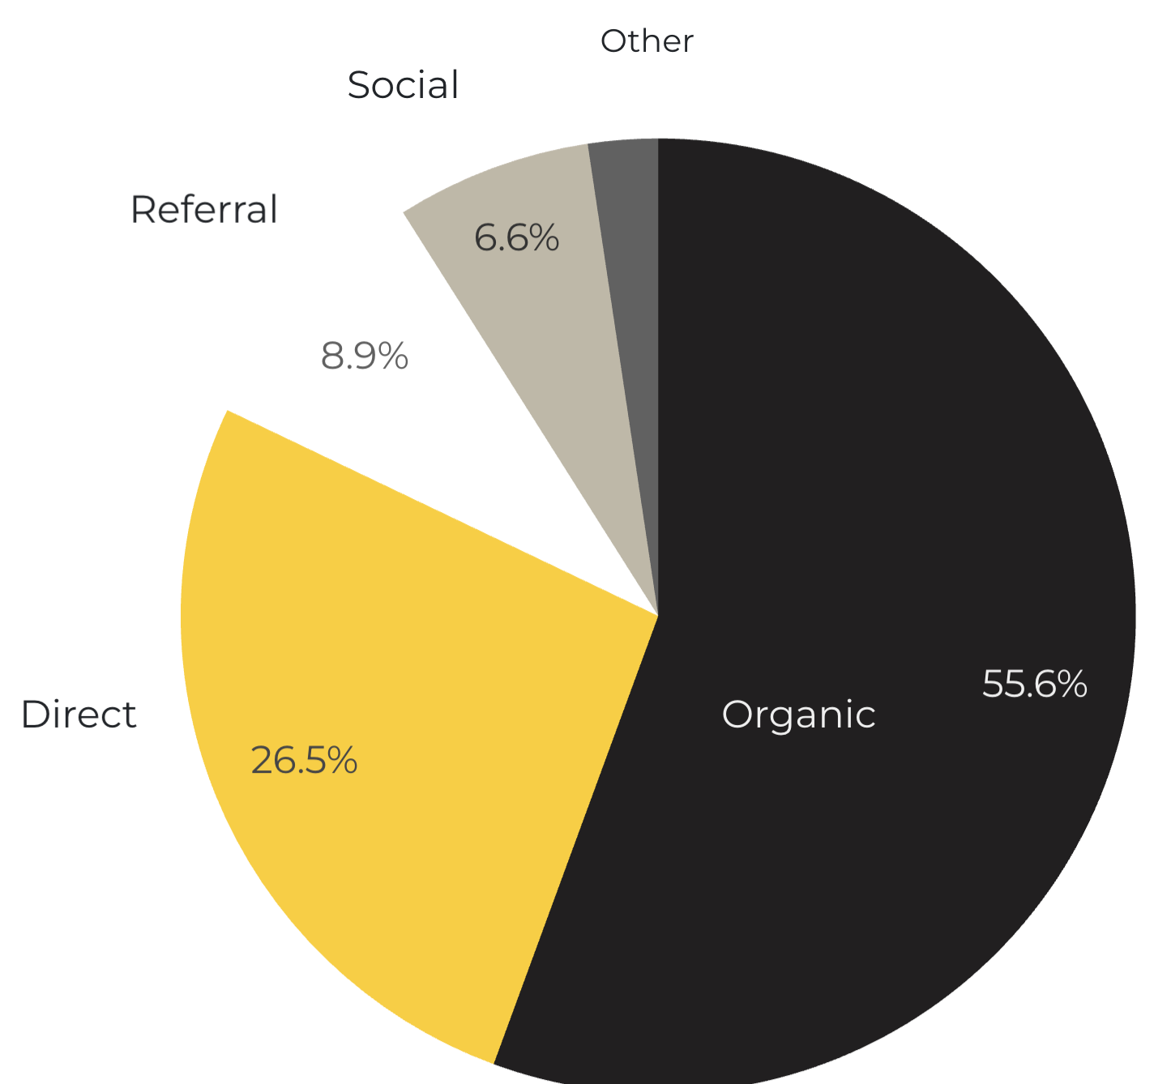
Marketing Reach
55.6% of visitors came from online search engines.
26.5% came directly to the site (by typing in the address, using bookmarks, or email links).
8.9% of visitors came from referrals.
6.6% of visitors came from social media.
2.4% Other (traffic that has an acquisition source Google doesn’t know how to classify).
9.2%
63.8%

Slide 6
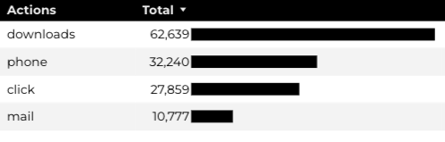
Engagement Insights & Highlights
Last quarter there were a total of 133,515 interactions on the CYS pages, which included downloads, email clicks, phone number clicks, and outbound links.

Slide 7
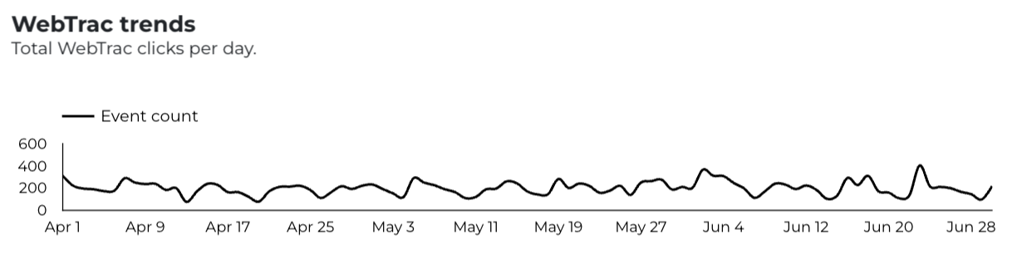
WebTrac Insights & Highlights
A total of 18,355 parents clicked on a WebTrac link from a program page to register or make a payment for a CYS program.

Slide 8
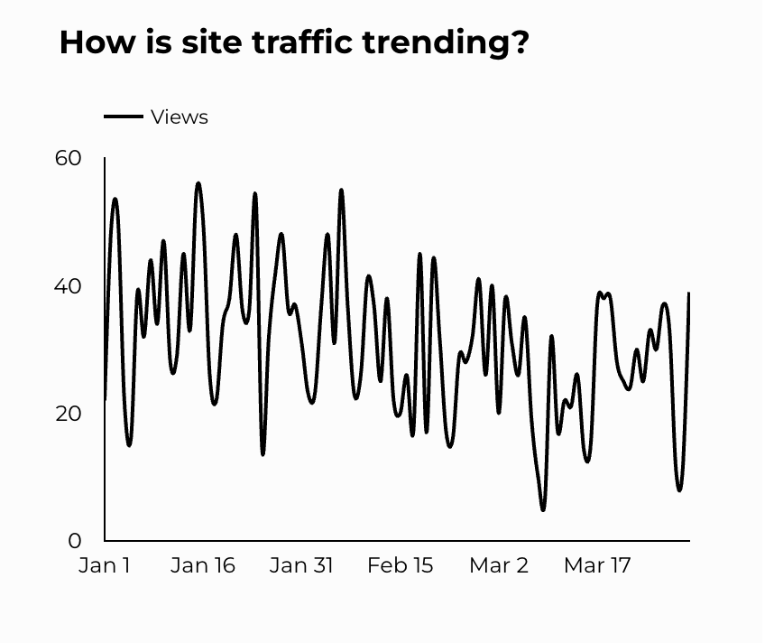
CYS Careers
CYS Career Traffic Trends
1,477 people looking for employment acted and clicked on USAJOBS.gov.
434 downloads of the CYS Career Guide.
54 Rack Card downloads.

Slide 9
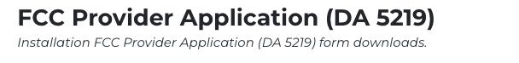
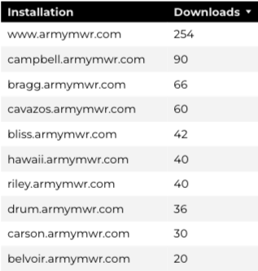
Family Child Care
15,595 visits to program pages.
9,236 users to FCC program pages.
818 downloads of DA 5219 form!

Slide 10
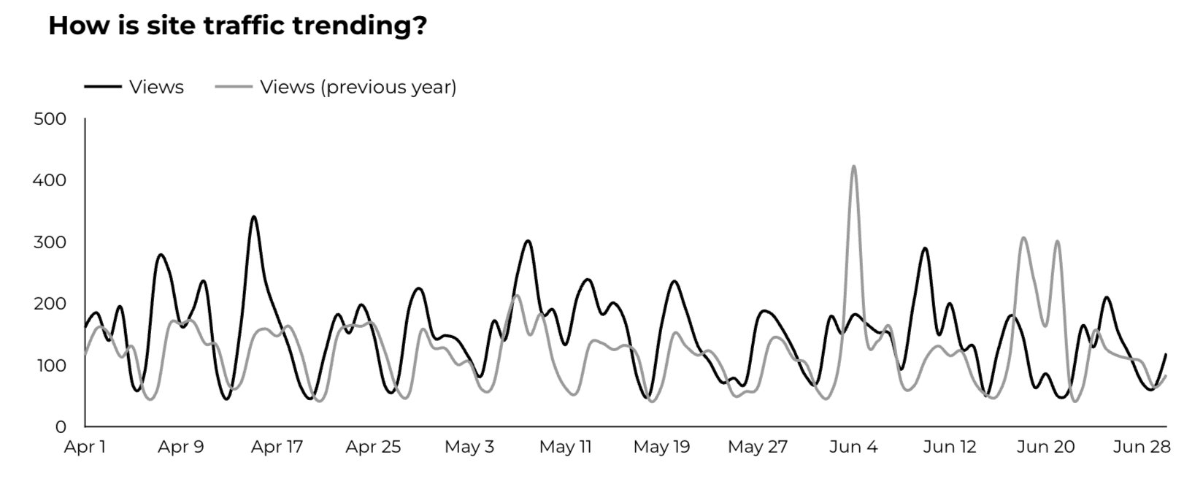
School Support Services
8,895 users made a visit to School Support Services pages.
111 people clicked to watch the 'What Is An SLO Anyway’ video.

Slide 11
Search Intent
41% Searches looking to investigate brands or services and intending to complete an action or purchase.
46% Searches looking for an answer to a specific question or general information.
13% Searches intending to find a specific program, page using the onsite search.
Search intent is defined as being the purpose behind an online query.

Slide 12
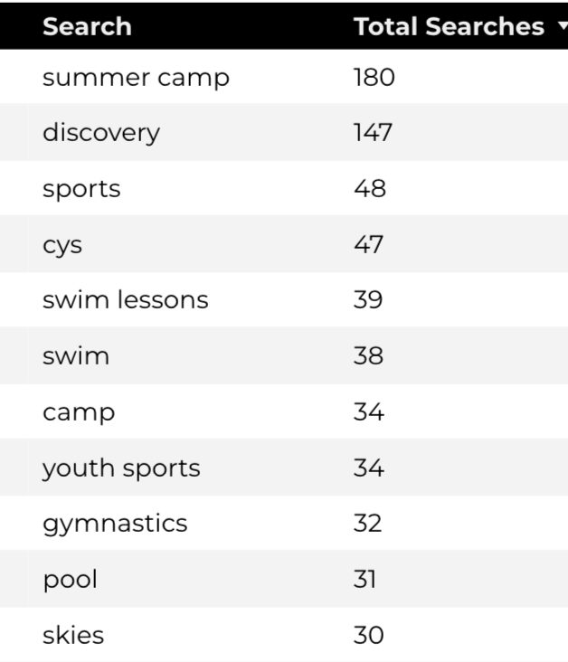
Search Insights
Top Searches
3,933Total on-site searches on CYS pages to find more information.
3.19% of users left the site after performing a search.

Slide 13
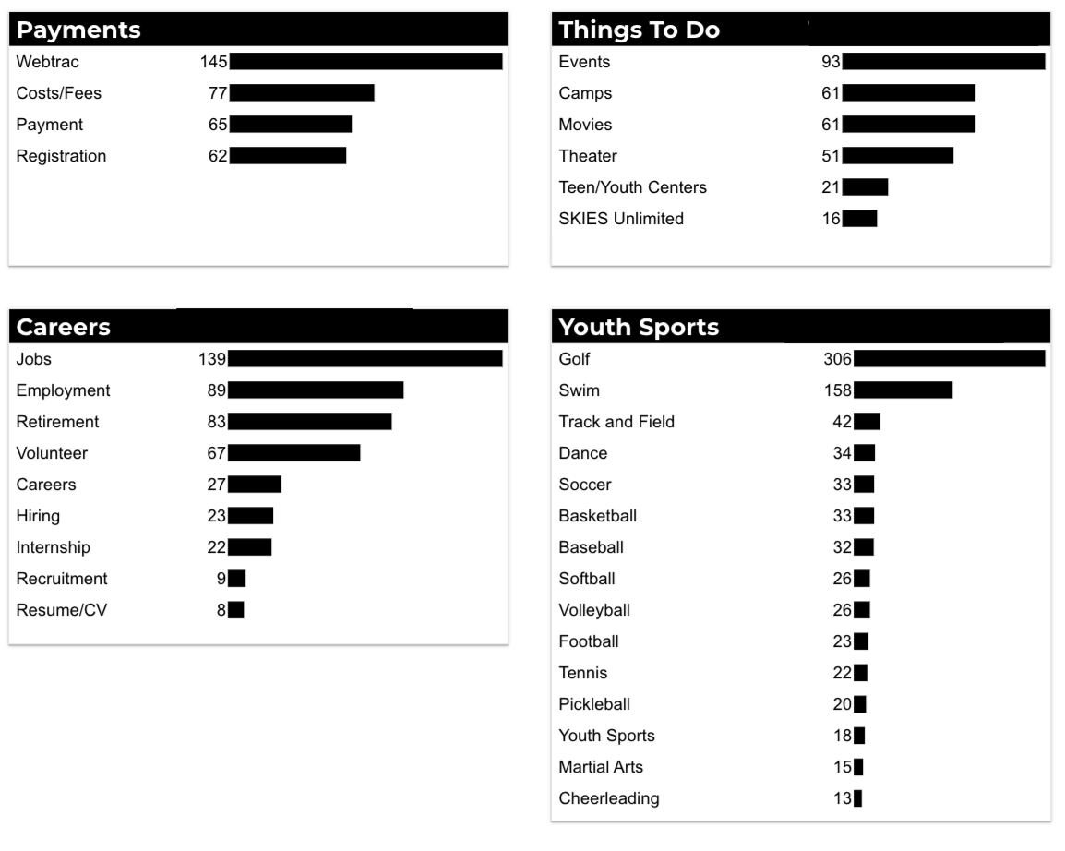
What Are The Top Search Sub-Topics?
The most popular search categories and terms within CYS

