Slide 1
CYS First Quarter FY25 Insights

Slide 2
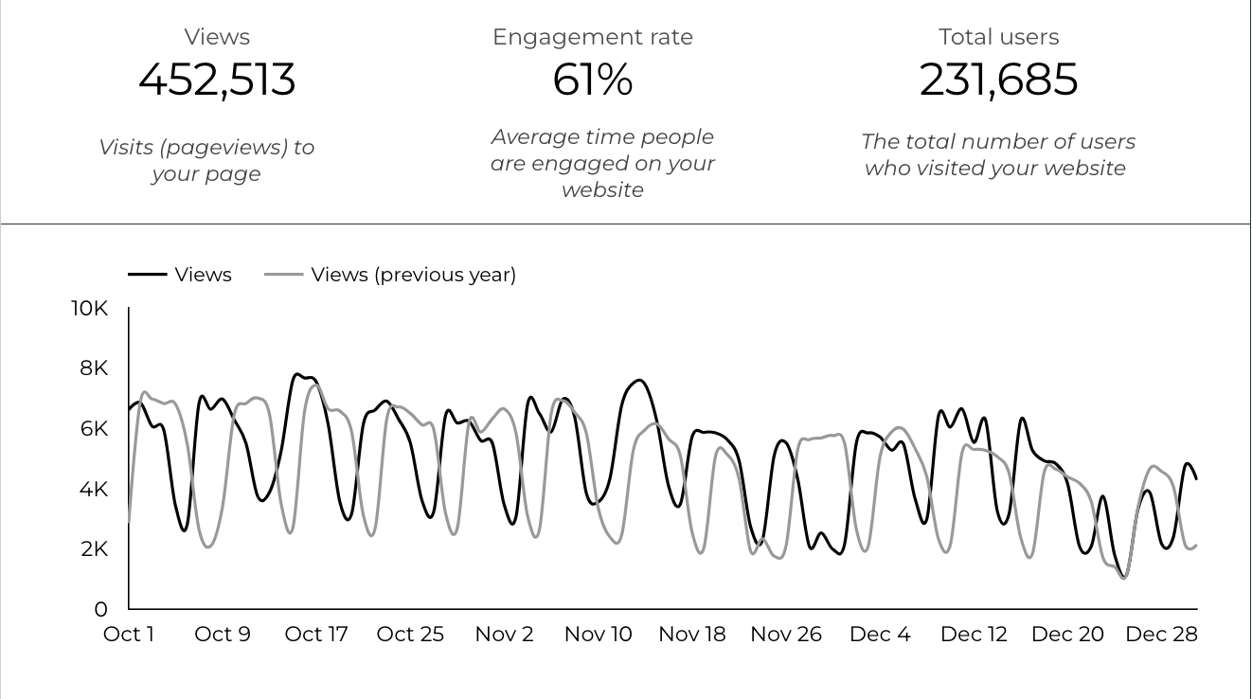
Overview

Slide 3
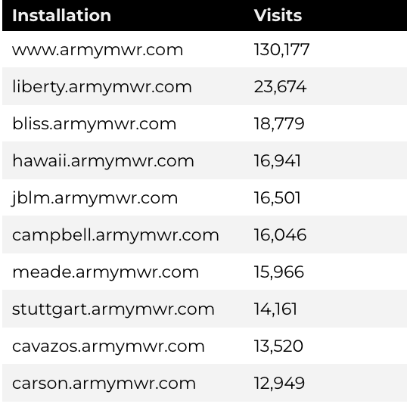
Traffic Highlights
There were a total of 231,685 users, to Child and Youth Services (CYS) web pages.
On average, each user viewed 2 pages.
61% of users engaged with a CYS page
Top US Army Installations

Slide 4
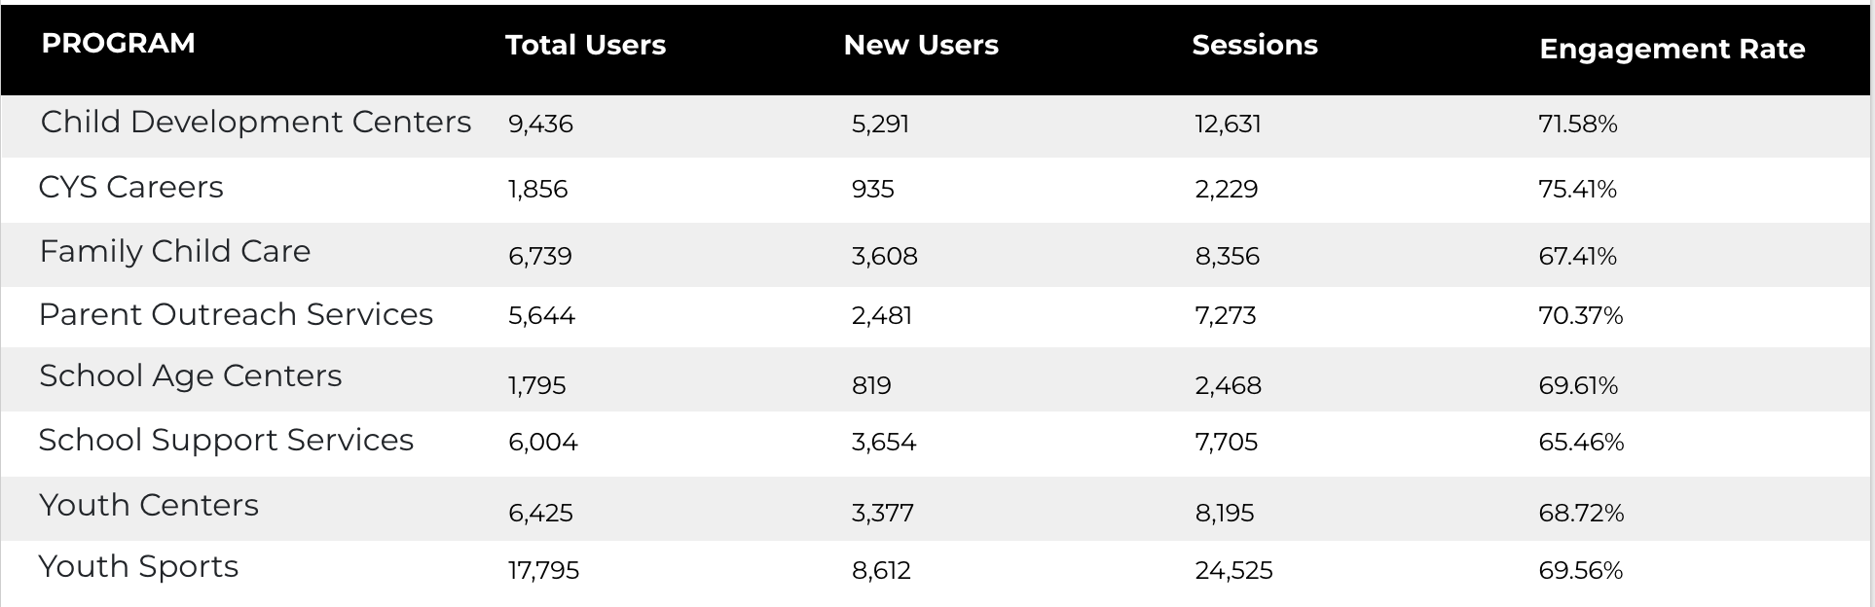
Visitor Highlights
Program Roll-Up

Slide 5
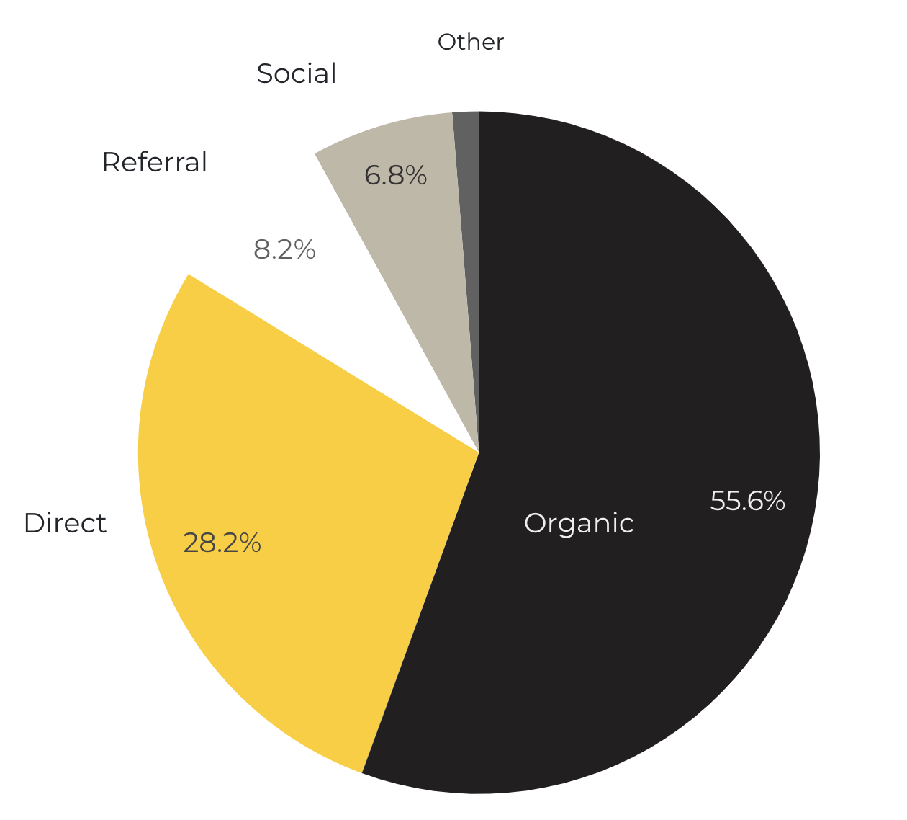
Marketing Reach
55.6% of visitors came from online search engines.
28.2% came directly to the site (by typing in the address, using bookmarks, or email links).
8.2% of visitors came from referrals.
6.8% of visitors came from social media.
1.3% Other (traffic that has an acquisition source Google doesn’t know how to classify).
9.2%
63.8%

Slide 6
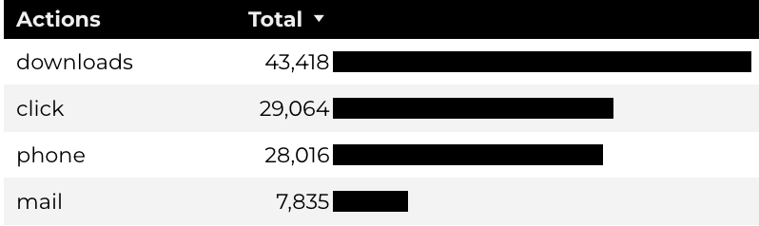
Engagement Insights & Highlights
Last quarter there were a total of 108,333 interactions on the CYS pages, which included downloads, email clicks, phone number clicks, and outbound links.

Slide 7
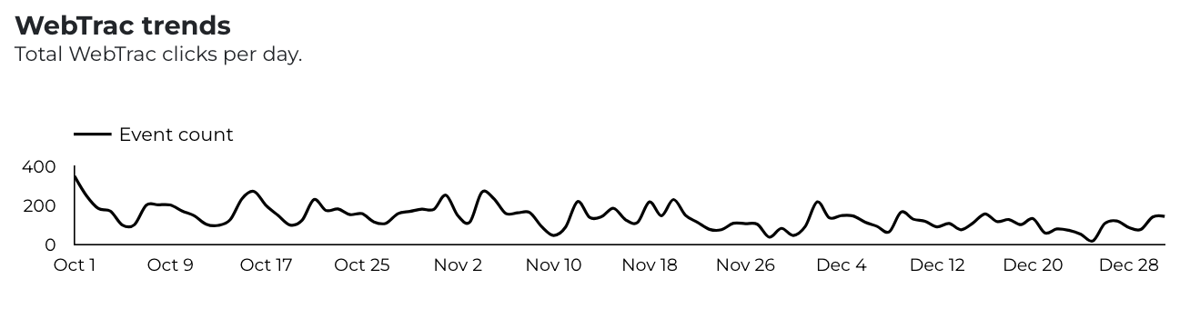
WebTrac Insights & Highlights
A total of 12,872 parents clicked on a WebTrac link from a program page to register or make a payment for a CYS program.

Slide 8
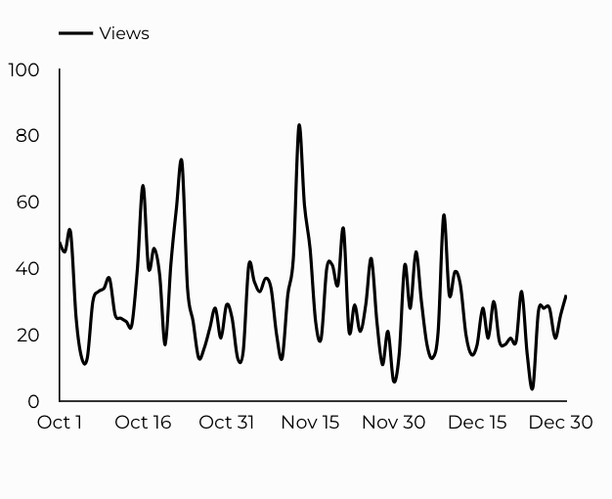
CYS Careers
CYS Career Traffic Trends
864 people looking for employment acted and clicked on USAJOBS.gov.
364 downloads of the CYS Career Guide.
42 Rack Card downloads.

Slide 9
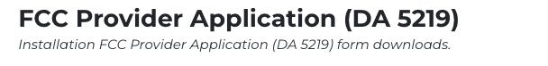
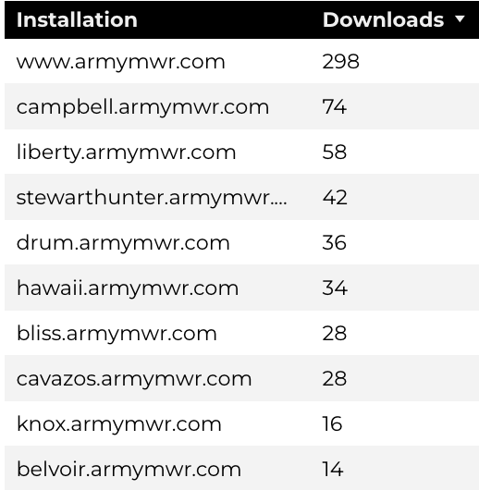
Family Child Care
12,911 visits to program pages.
3,608 users to FCC program pages.
744 downloads of DA 5219 form!

Slide 10
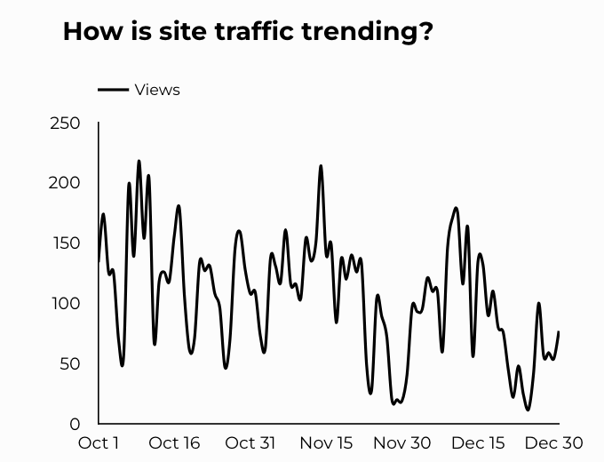
School Support Services
9,761 users made a visit to School Support Services pages.
92 people clicked to watch the 'What Is An SLO Anyway’ video.

Slide 11
Search Intent
41% Searches looking to investigate brands or services and intending to complete an action or purchase.
46% Searches looking for an answer to a specific question or general information.
13% Searches intending to find a specific program, page using the onsite search.
Search intent is defined as being the purpose behind an online query.

Slide 12
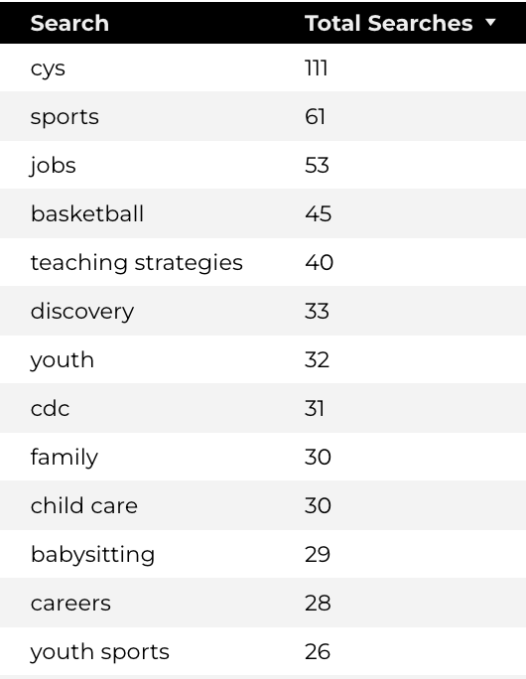
Search Insights
Top Searches
3,715 Total on-site searches on CYS pages to find more information.
2.26% of users left the site after performing a search.

Slide 13
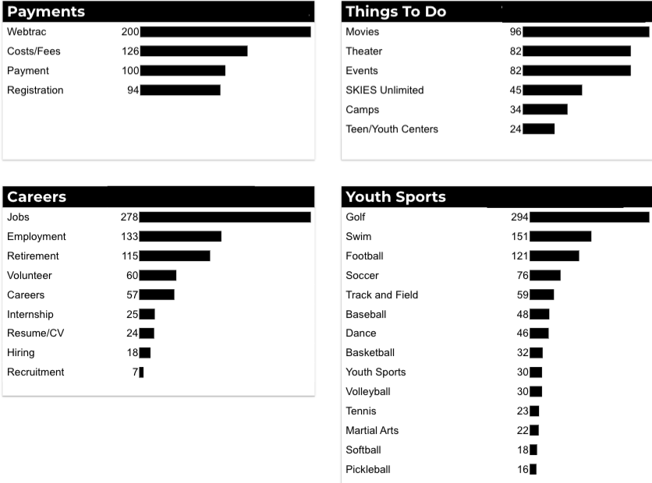
What Are The Top Search Sub-Topics?
The most popular search categories and terms within CYS

