Slide 1
ACS Third Quarter FY26 Insights
​

Slide 2
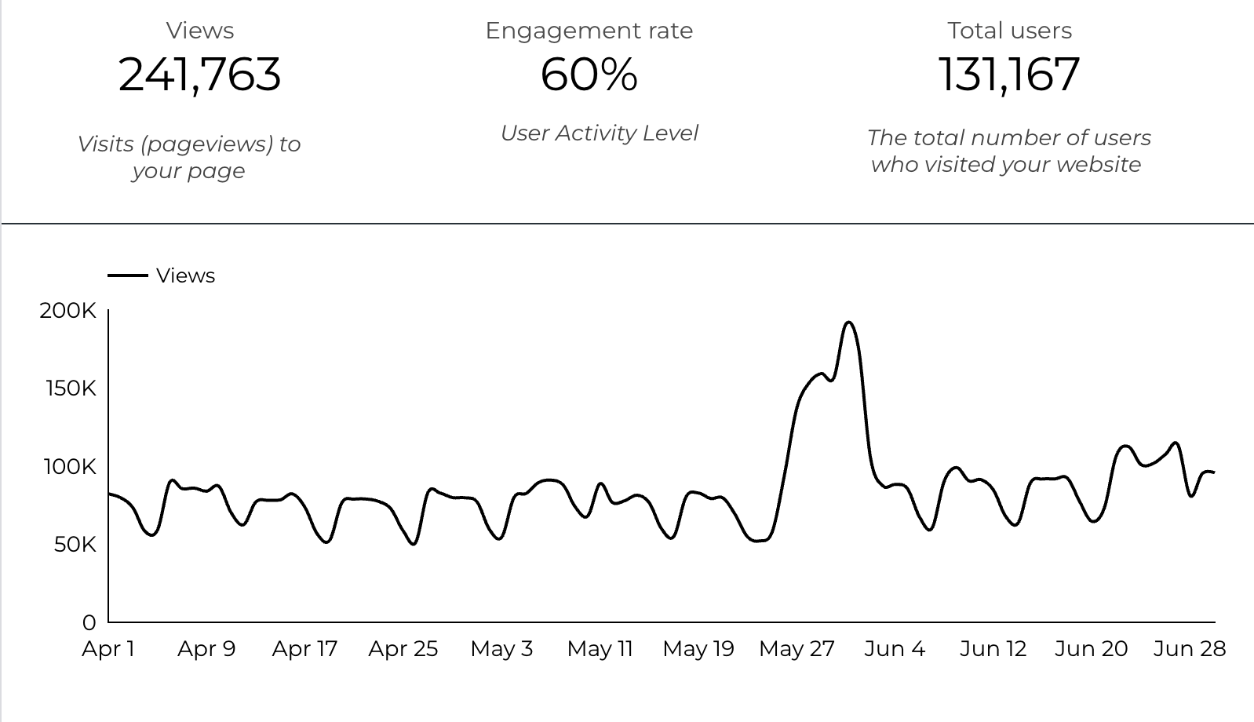
Web Analytics Summary

Slide 3
Traffic Highlights
  ACS pages received 241,763 visits last quarter.
    +15% YoY
  Engagement on ACS pages was 60%.
  There were 131,167 total users who made a visit to ACS.
  3,658 visits were directed from social media platforms.
  Most of the social traffic came from Facebook.

Slide 4
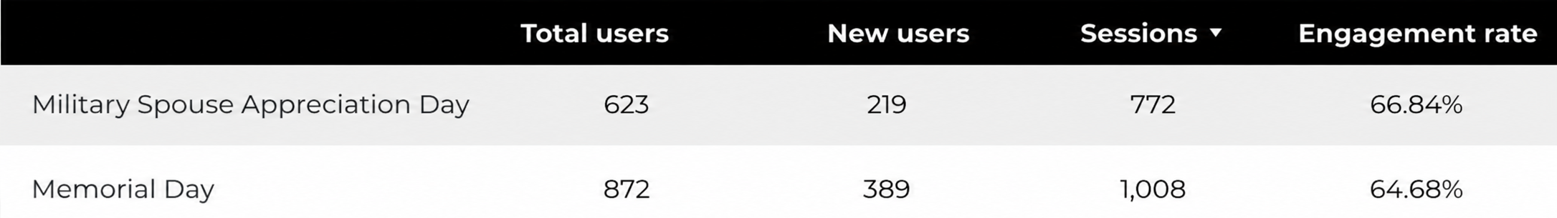
Happenings

Slide 5
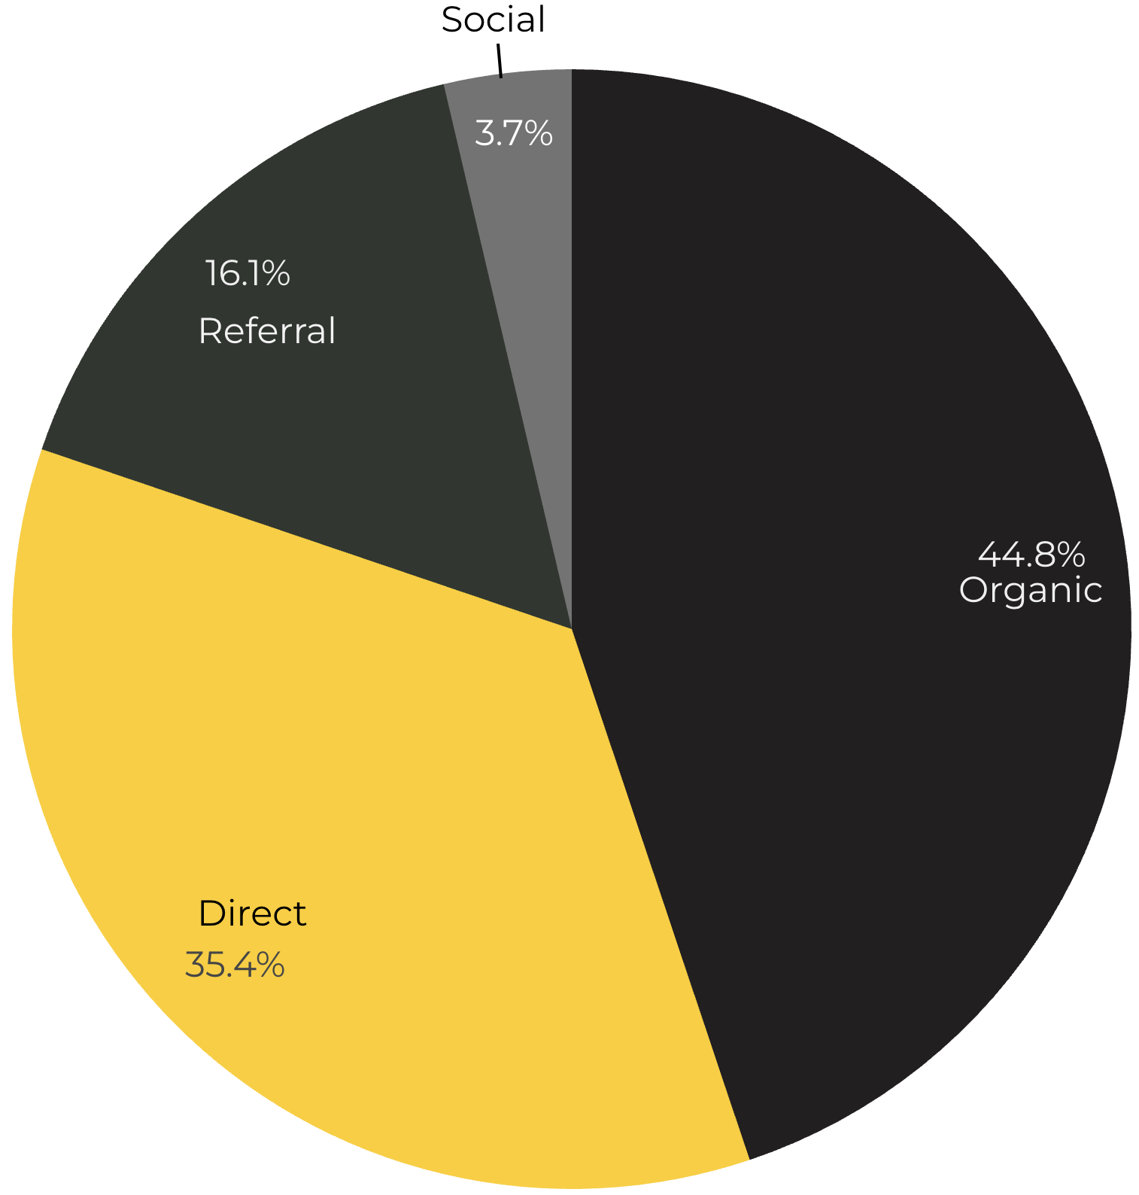
Marketing Reach
44.8% of visitors came from Organic Search engine queries.
35.4% of visitors came directly to the site (by typing in the address, using bookmarks, or email links).
16.1% of visitors came from Referral links on 3rd party web sites.
3.7% of visitors came from Social Media.

Slide 6
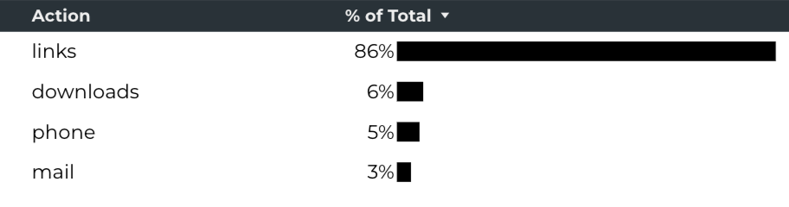
Engagement Insights & Highlights
Last quarter had a total of 192,601 interactions on the ACS pages (interactions are downloads, email clicks, phone number clicks, and outbound links).
Phone
Outbound Clicks

Slide 7
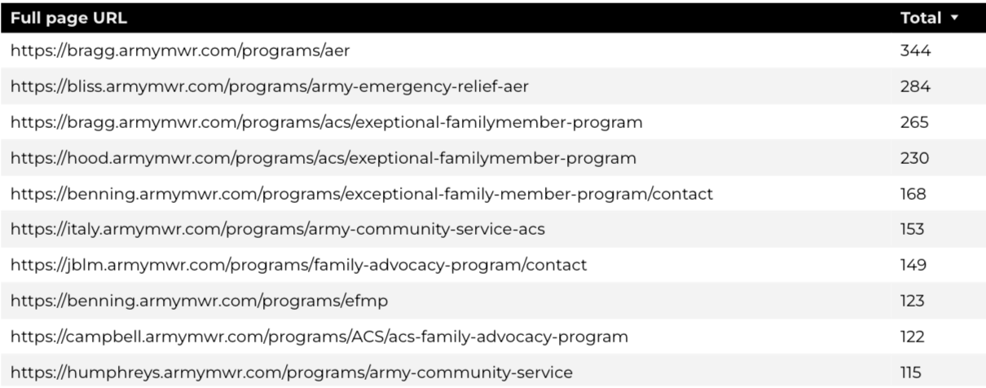
Insights & Highlights
Last quarter,9,805 people required assistance from a live person.
Top ACS programs that received phone calls from the web.

Slide 8
Search Intent
Search intent is defined as being the underlying purpose behind an online query.
42% of searches were aimed at finding an answer to a specific question or acquiring general information.
45% of searches were conducted to explore brands or services with the intention of completing an action or making a purchase.
13% of searches were intended to locate a specific program page using the on-site search.

Slide 9
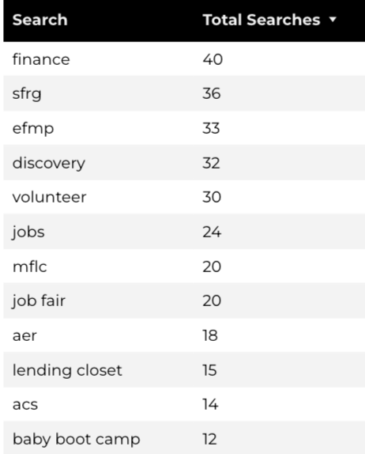
Search Insights
Top Search Terms
2019 Total on-site searches on ACS pages to find more information.
2.36% of users left the site after performing a search.
Notes:
.

Slide 10
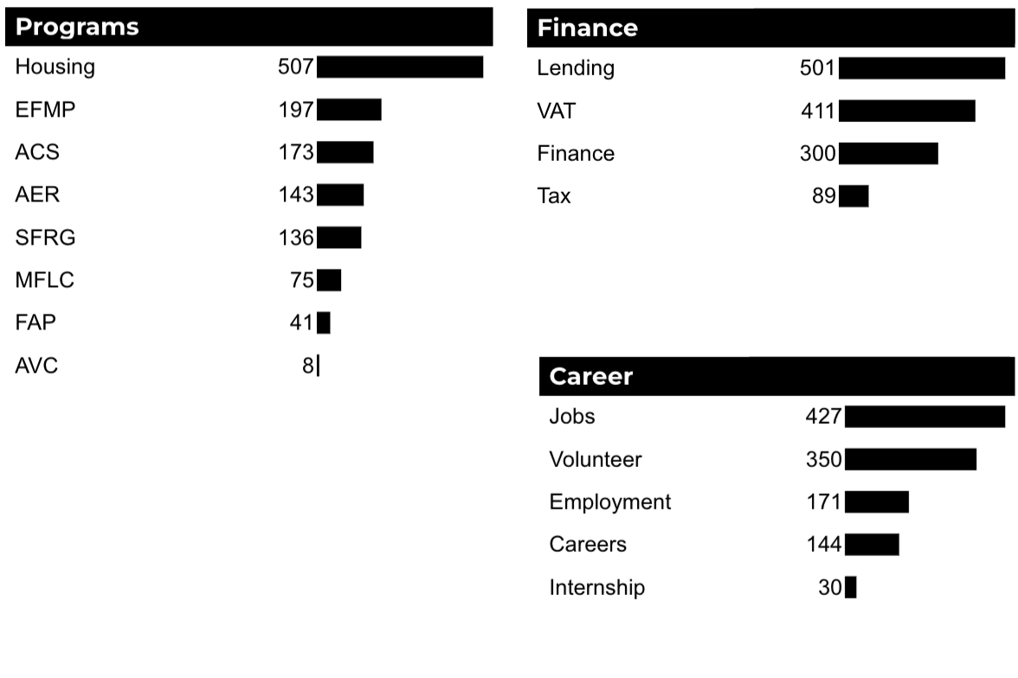
What Are The Top Search Sub-Topics?
The most popular search categories and terms within ACS.

