Slide 1
CYS Fourth Quarter FY25 Insights

Slide 2
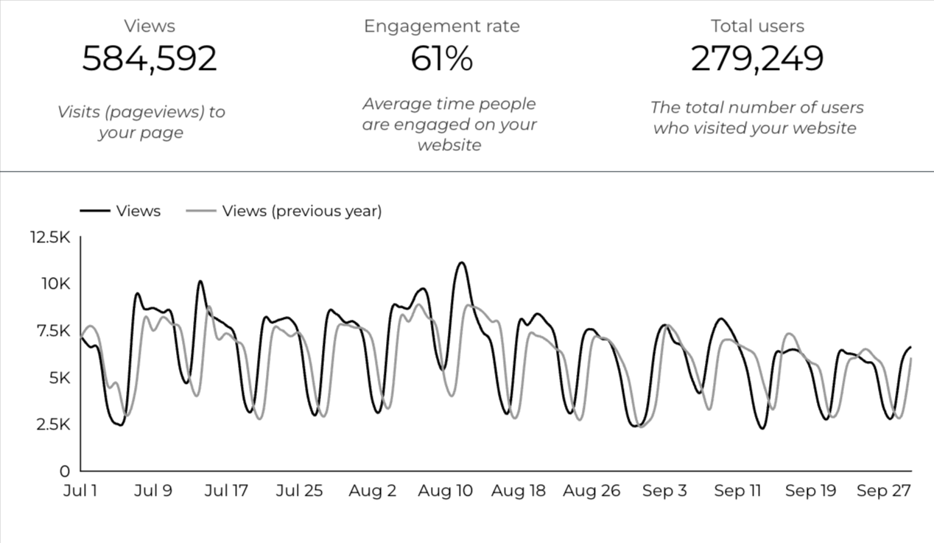
Overview

Slide 3
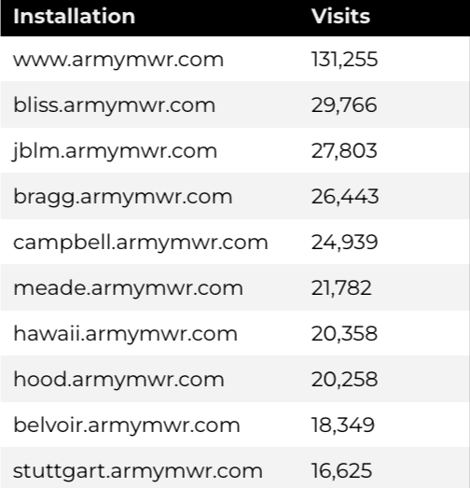
Traffic Highlights
There were a total of 279,249 users, to Child and Youth Services (CYS) web pages.
On average, each user viewed 2.12 pages.
61% of users engaged with a CYS page
Top US Army Installations

Slide 4
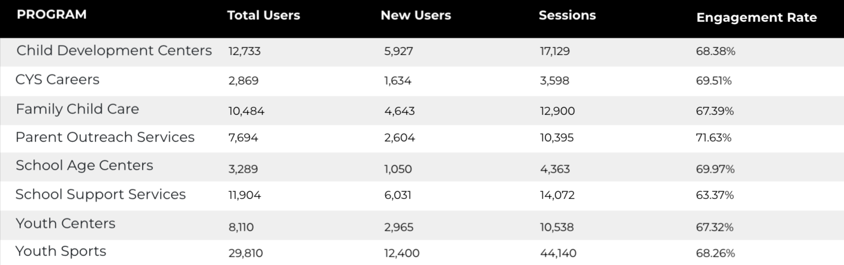
Visitor Highlights
Program Roll-Up

Slide 5
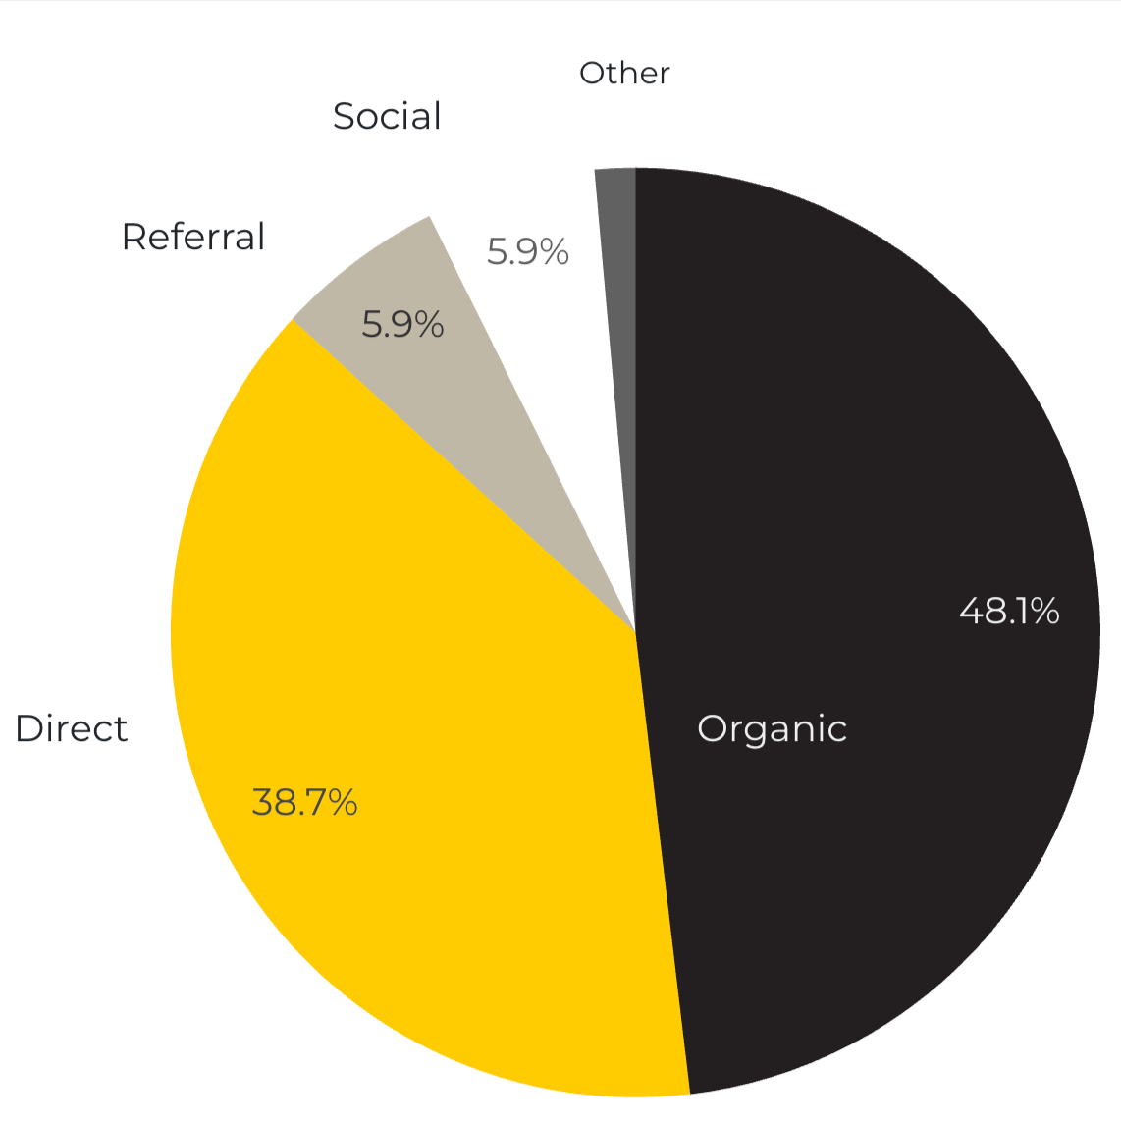
Marketing Reach
55.6% of visitors came from online search engines.
38.7% came directly to the site (by typing in the address, using bookmarks, or email links).
5.9% of visitors came from referrals.
5.9% of visitors came from social media.
1.4% Other (traffic that has an acquisition source Google doesn’t know how to classify).
9.2%
63.8%

Slide 6
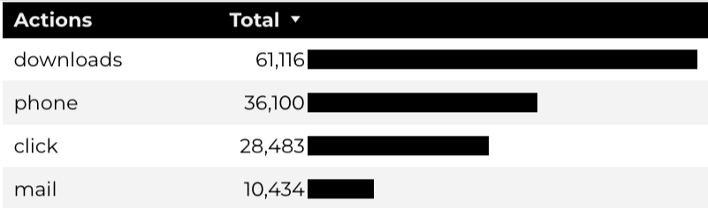
Engagement Insights & Highlights
Last quarter there were a total of 136,133 interactions on the CYS pages, which included downloads, email clicks, phone number clicks, and outbound links.

Slide 7
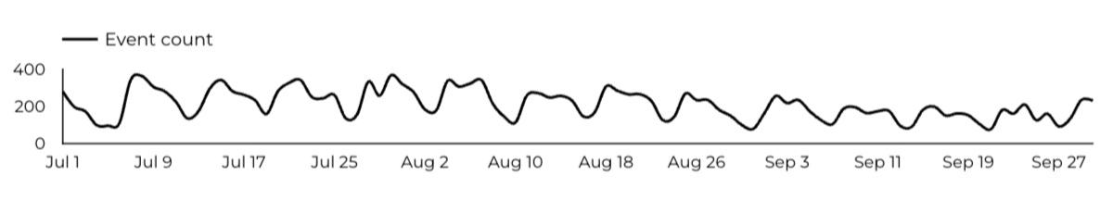
WebTrac Insights & Highlights
A total of 19,446 parents clicked on a WebTrac link from a program page to register or make a payment for a CYS program.

Slide 8
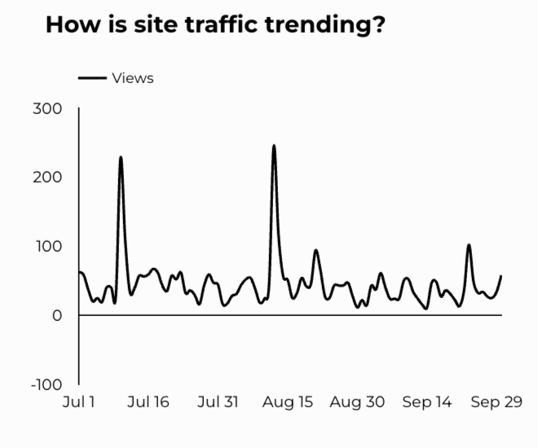
CYS Careers
CYS Career Traffic Trends
1,740 people looking for employment acted and clicked on USAJOBS.gov.
432 downloads of the CYS Career Guide.
78 Rack Card downloads.

Slide 9
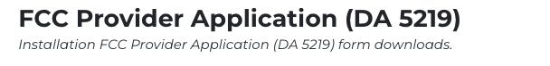
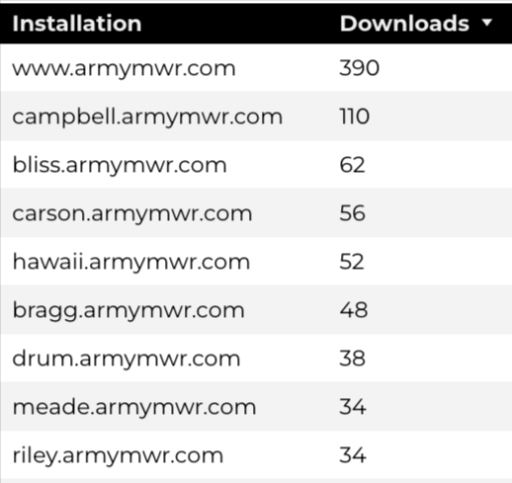
Family Child Care
18,263 visits to program pages.
10,484 users to FCC program pages.
1,004 downloads of DA 5219 form!

Slide 10
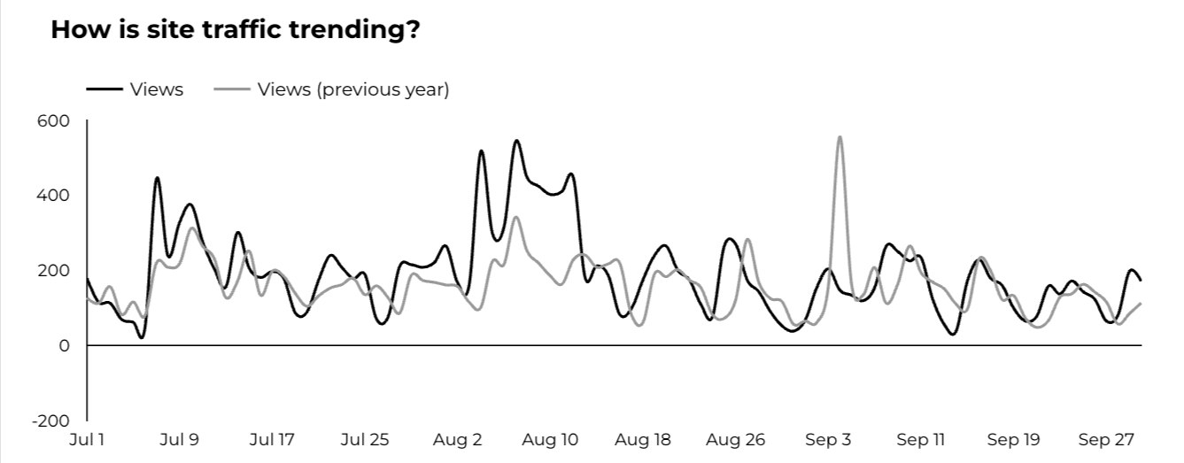
School Support Services
11,904 users made a visit to School Support Services pages.
122 people clicked to watch the 'What Is An SLO Anyway’ video.

Slide 11
Search Intent
42% Searches looking to investigate brands or services and intending to complete an action or purchase.
46% Searches looking for an answer to a specific question or general information.
14% Searches intending to find a specific program, page using the onsite search.
Search intent is defined as being the purpose behind an online query.

Slide 12
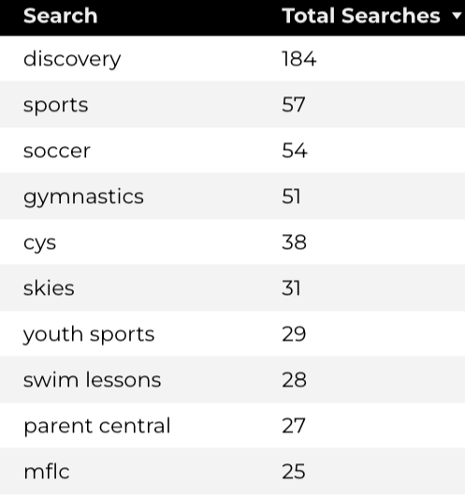
Search Insights
Top Searches
3,819 Total on-site searches on CYS pages to find more information.
2.43% of users left the site after performing a search.

Slide 13
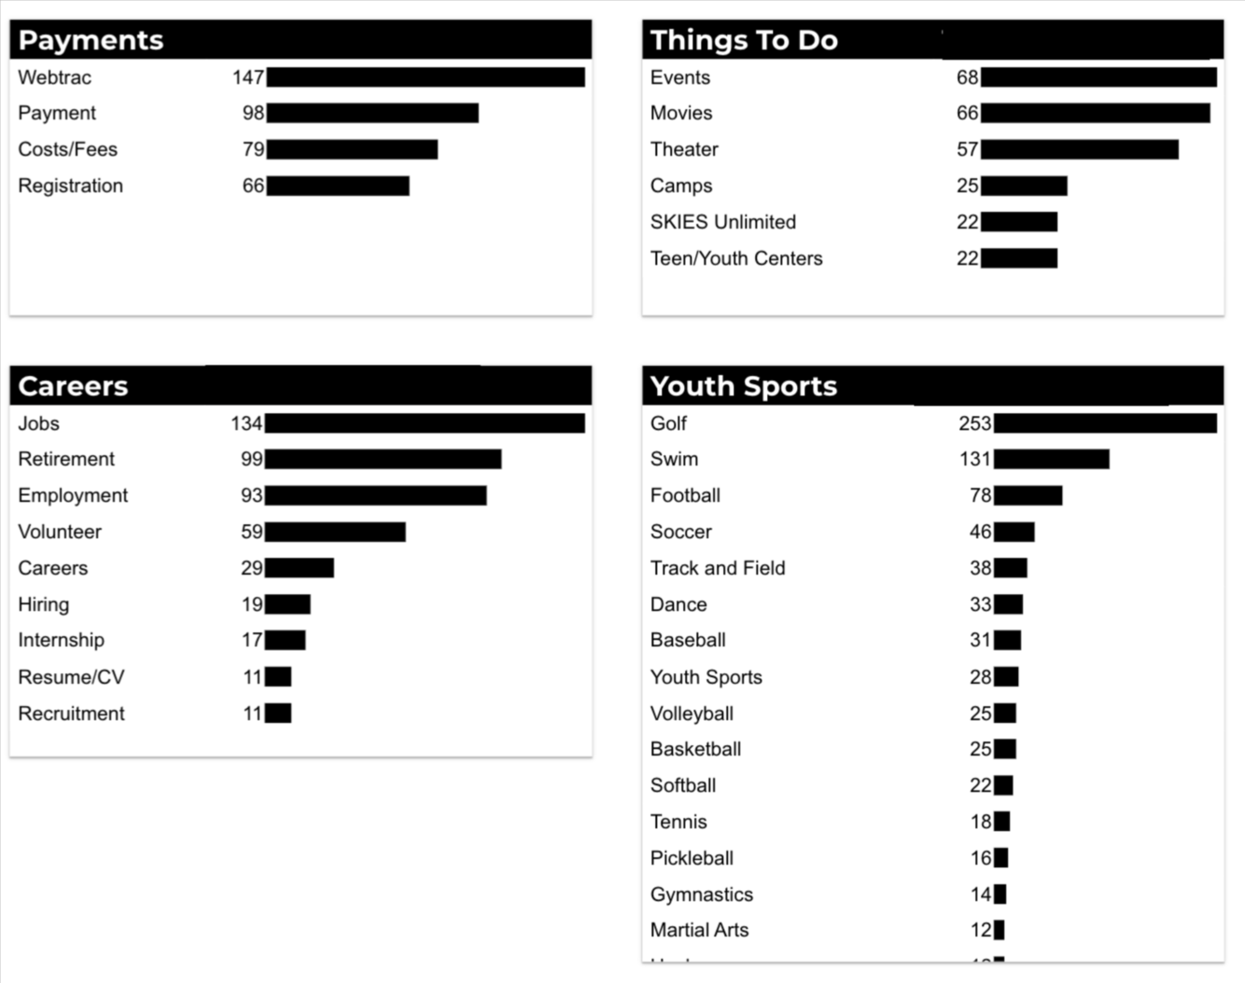
What Are The Top Search Sub-Topics?
The most popular search categories and terms within CYS

