Slide 1
Support Services Third Quarter FY26 Insights

Slide 2
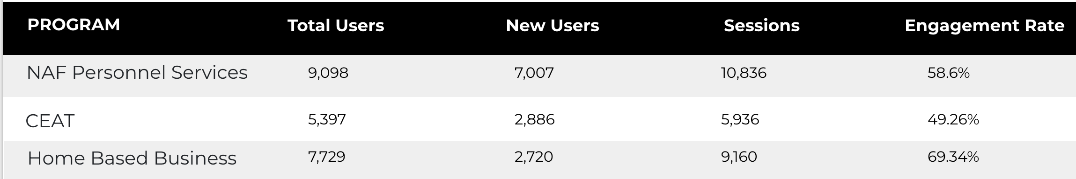
Web Analytics Summary
Program Roll-up

Slide 3
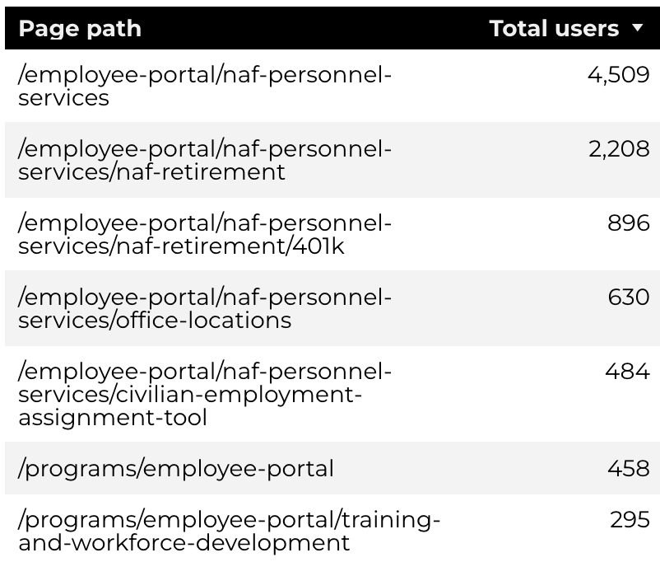
Traffic Highlights
Top Pages NAF Personnel Services
The program received 15,998 views and 10,836 sessions.
The engagement rate was at 59%.
There were a total of 9,098 users.
NAF Personnel Services

Slide 4
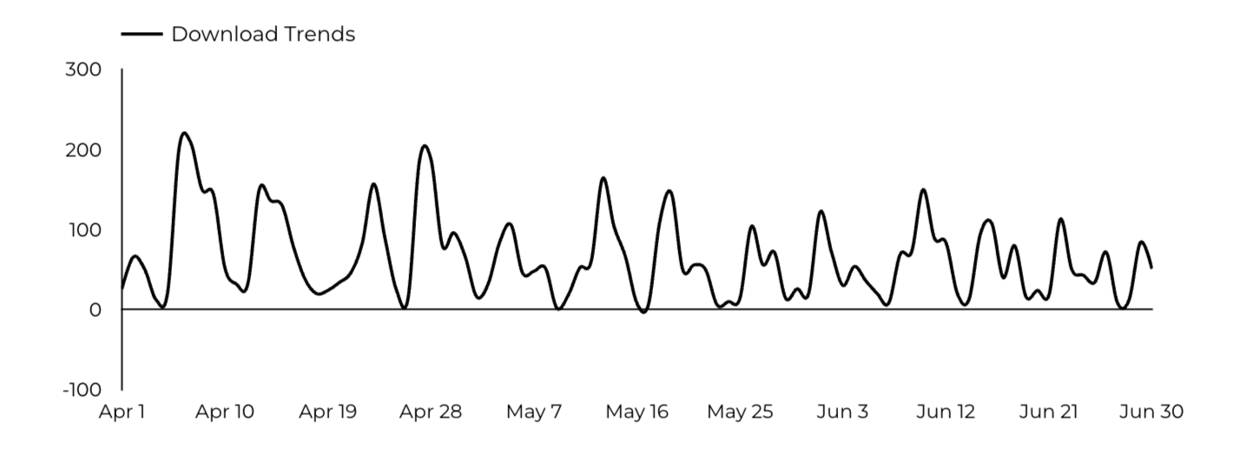
Engagement Insights & Highlights
5,918 people downloaded a PDF or a form.
126 people clicked on a link to another website to get more information.
NAF Personnel Services

Slide 5
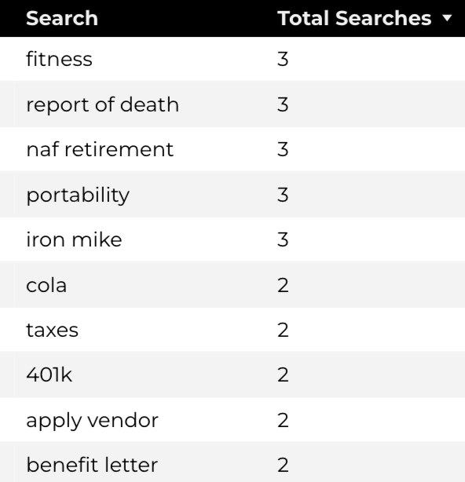
Search Insights & Highlights
Top Searches
There were 138 total on-site searches on NAF Personnel Services pages to find more information.
NAF Personnel Services

Slide 6
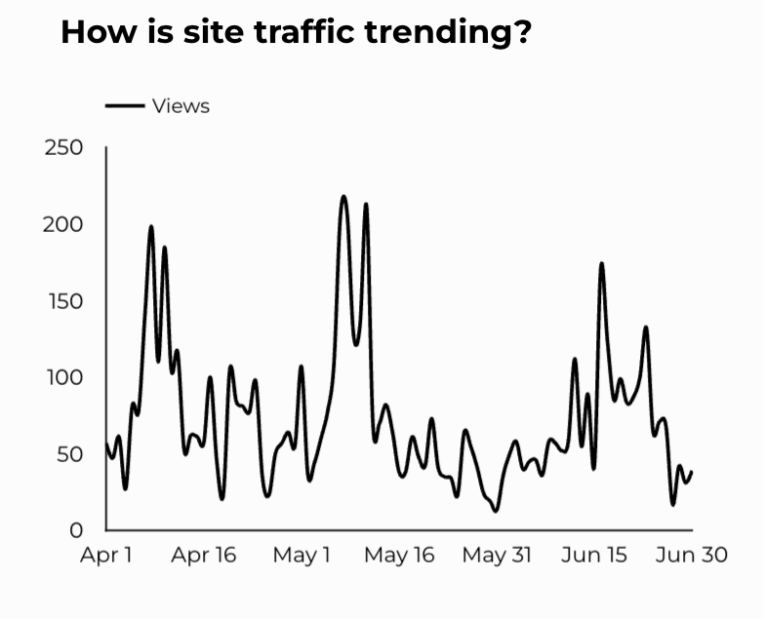
Traffic Highlights
The website received 6,639 views and 5,936 sessions.
The engagement rate was at 49%.
CEAT

Slide 7
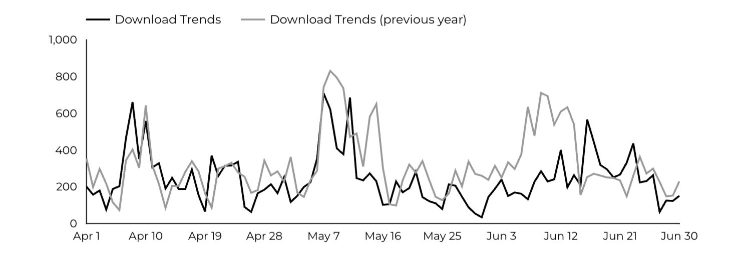
Engagement Insights & Highlights
CEAT Transfer Guide: Achieved 786 Downloads.
CEAT Transfer Guide Download Trends
CEAT

Slide 8
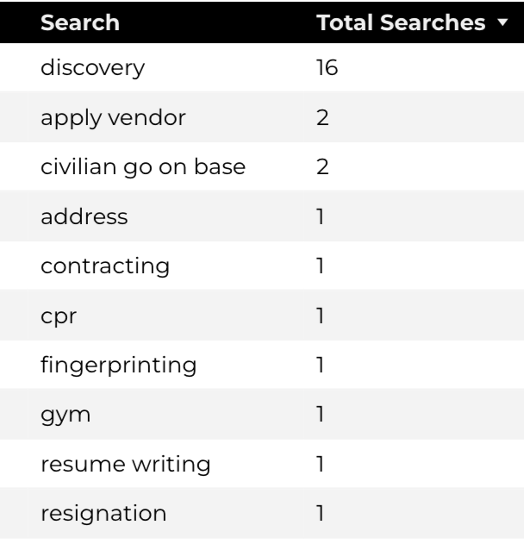
Search Insights & Highlights
Top Searches
40 total on-site searches on CEAT pages to find more information.
CEAT

Slide 9
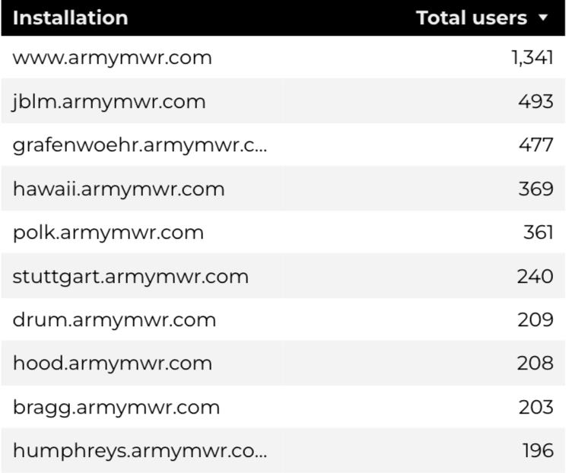
Traffic Highlights
Top Installations
HBB pages received 11,196 views and 9,160 sessions.
The engagement rate was at 69%.
The total number of users was 7,729 and there were 2,720 new users.
Home Based Business (HBB)

Slide 10
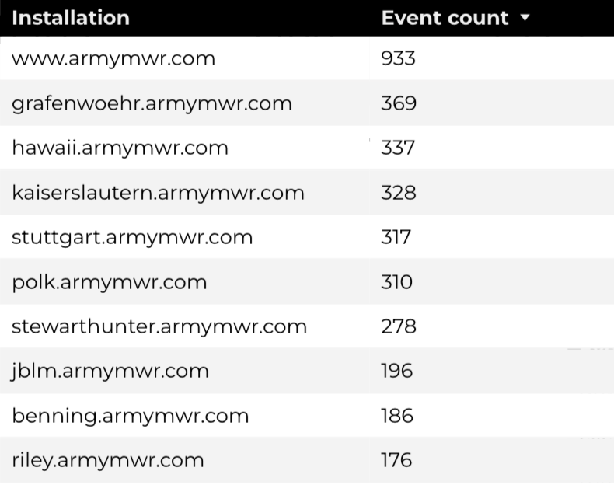
Engagement Insights & Highlights
There were 324 clicks to other websites to find more information.
4,295 people downloaded a PDF or a form.
178 people needed to talk to a real person.
Top Installations
(Downloads, Email, Phone Numbers, Outbound Links)
Home Based Business (HBB)

Slide 11
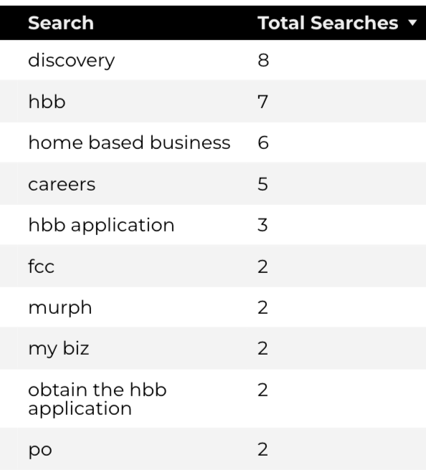
Search Insights & Highlights
95 total on-site searches on HBB pages to find more information.
0 users left the site after performing a search.
Top Searches
Home Based Business (HBB)

