Slide 1
Support Services Fourth Quarter FY25 Insights

Slide 2
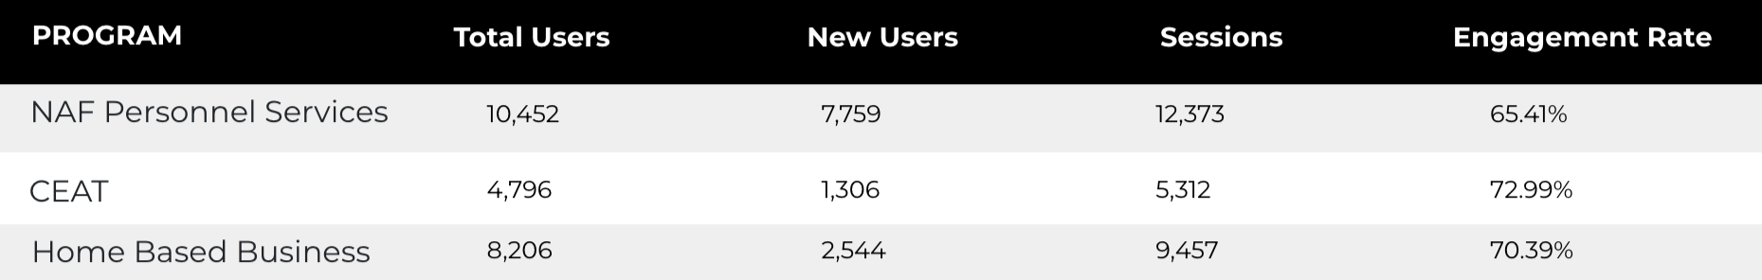
Web Analytics Summary
Program Roll-up

Slide 3
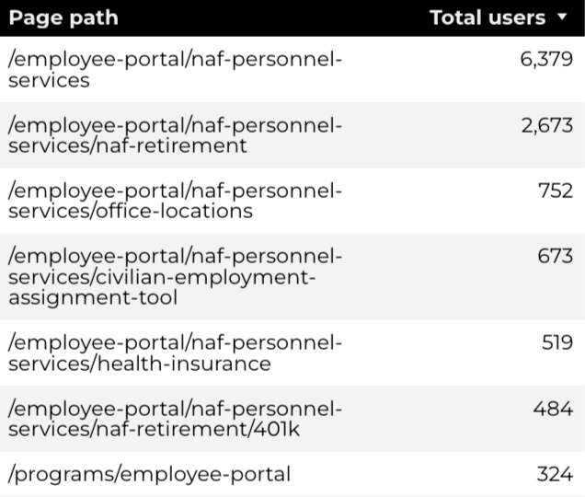
Traffic Highlights
Top Pages NAF Personnel Services
The program received 17,360 views and 12,373 sessions.
The engagement rate was at 65%.
There were a total of 10,452 users.
NAF Personnel Services

Slide 4
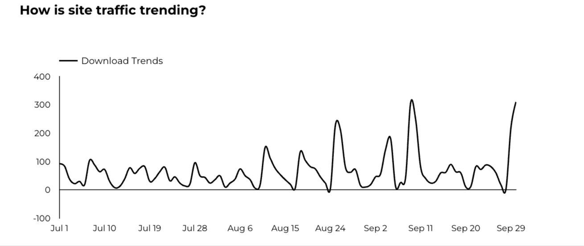
Engagement Insights & Highlights
6,050 people downloaded a PDF or a form.
56 people clicked on a link to another website to get more information.
NAF Personnel Services

Slide 5
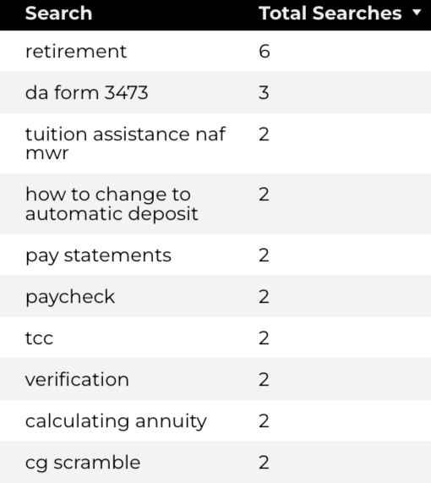
Search Insights & Highlights
Top Searches
There were 115 total on-site searches on NAF Personnel Services pages to find more information.
NAF Personnel Services

Slide 6
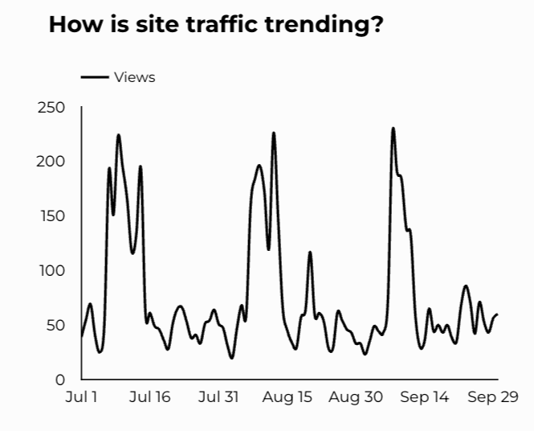
Traffic Highlights
The website received 7,023 views and 5,312 sessions.
The engagement rate was at 73%.
CEAT

Slide 7
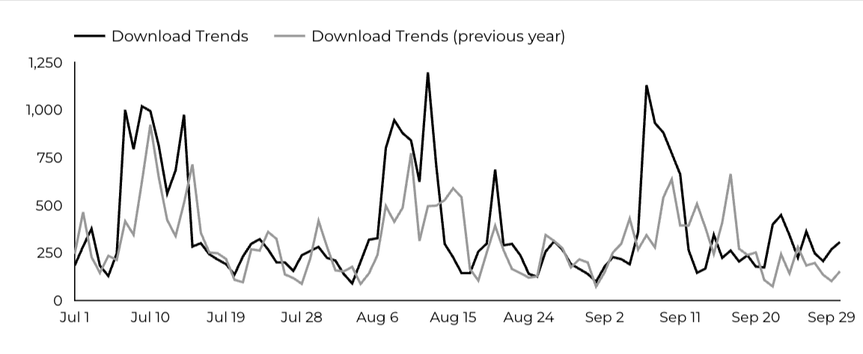
Engagement Insights & Highlights
CEAT Transfer Guide: Achieved 817 Downloads.
CEAT Transfer Guide Download Trends
CEAT

Slide 8
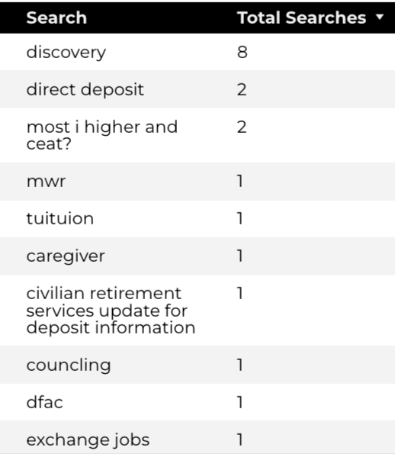
Search Insights & Highlights
Top Searches
37 total on-site searches on CEAT pages to find more information.
CEAT

Slide 9
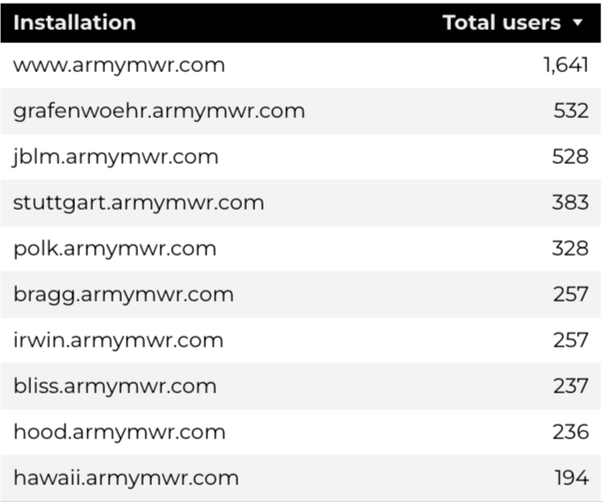
Traffic Highlights
Top Installations
HBB pages received 11,489 views and 9,457 sessions.
The engagement rate was at 70%.
The total number of users was 8,206 and there were 2,544 new users.
Home Based Business (HBB)

Slide 10
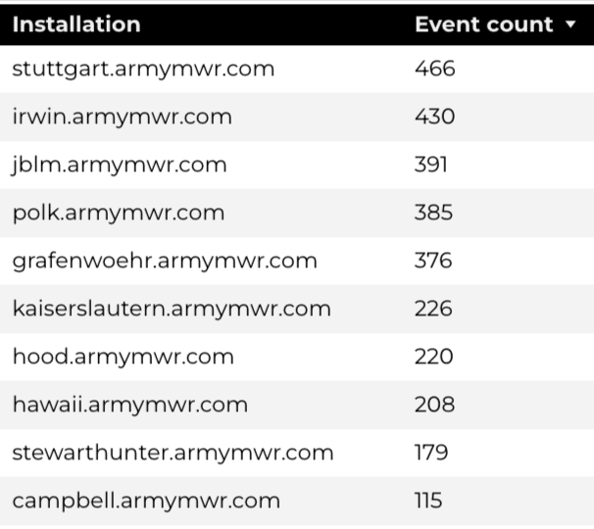
Engagement Insights & Highlights
There were 149 clicks to other websites to find more information.
3,562 people downloaded a PDF or a form.
188 people needed to talk to a real person.
Top Installations
(Downloads, Email, Phone Numbers, Outbound Links)
Home Based Business (HBB)

Slide 11
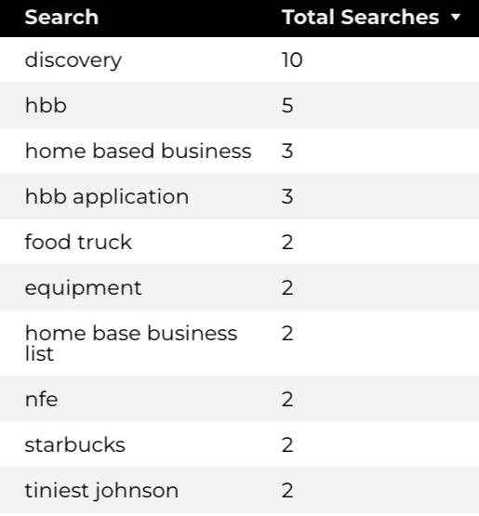
Search Insights & Highlights
98 total on-site searches on HBB pages to find more information.
6.1% of users left the site after performing a search.
Top Searches
Home Based Business (HBB)

