Slide 1
Support Services Fourth Quarter FY26 Insights

Slide 2
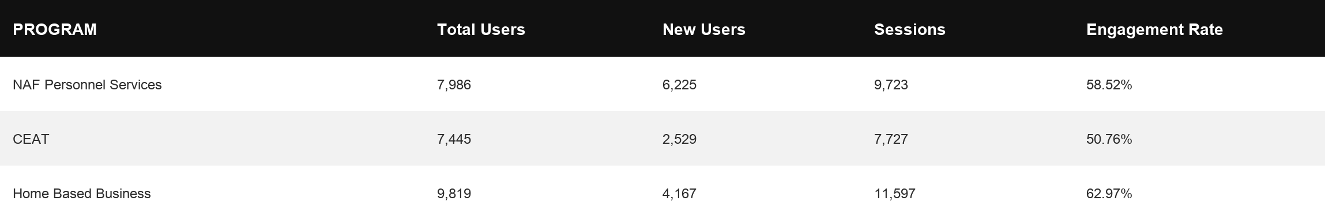
Web Analytics Summary
Program Roll-up

Slide 3
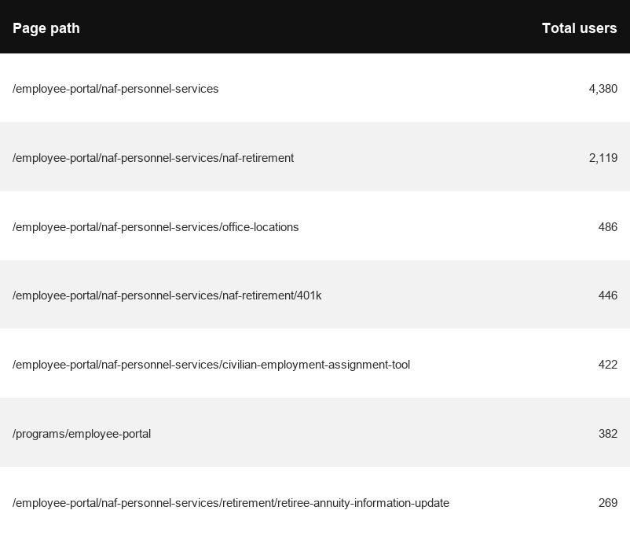
Traffic Highlights
Top Pages NAF Personnel Services
The program received 14,399 views and 9,723 sessions.
The engagement rate was at 59%.
There were a total of 7,986 users.
NAF Personnel Services

Slide 4
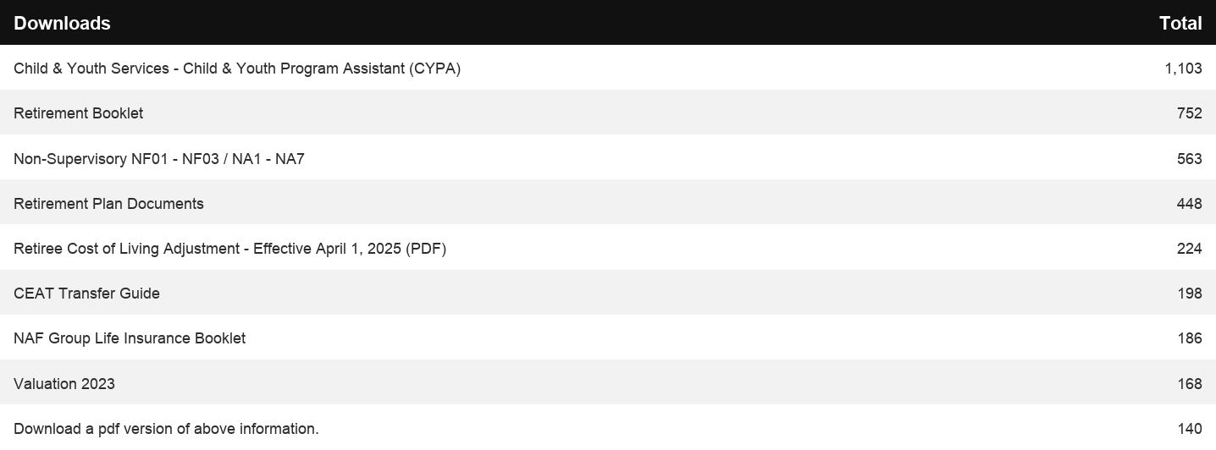
Engagement Insights & Highlights
5,602 people downloaded a PDF or a form.
418 people called to speak with someone for more information.
NAF Personnel Services

Slide 5
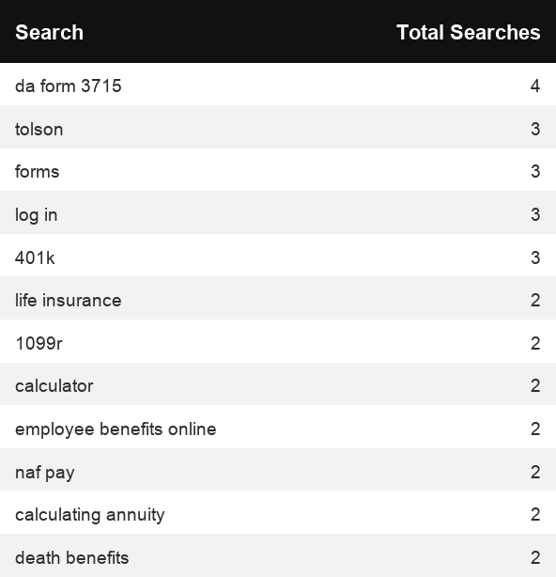
Search Insights & Highlights
Top Searches
There were 122 total on-site searches on NAF Personnel Services pages to find more information.
NAF Personnel Services

Slide 6
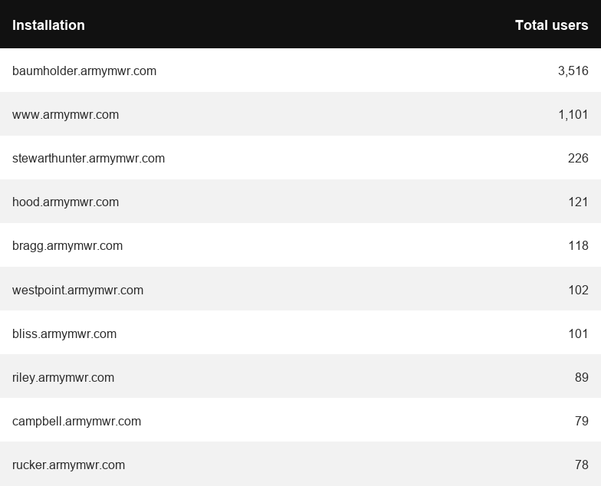
Traffic Highlights
The website received 5,191 views and 7,727 sessions.
The engagement rate was at 51%.
CEAT

Slide 7
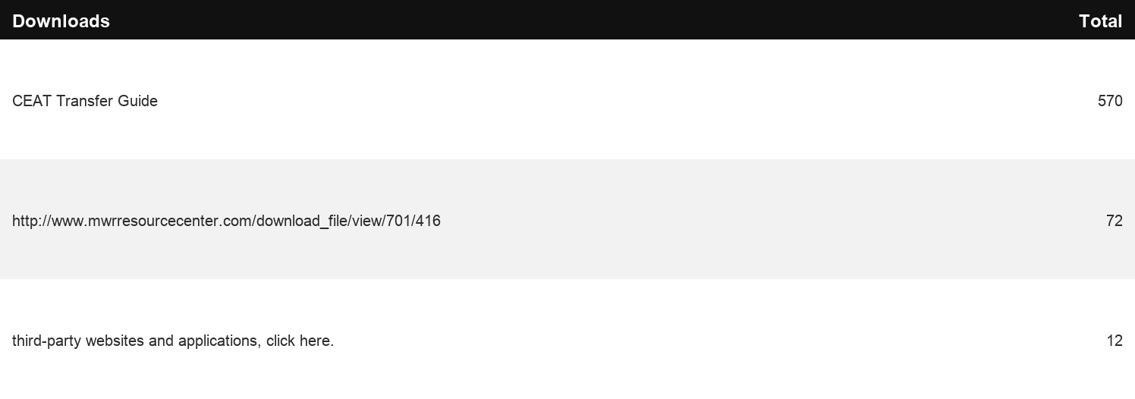
Engagement Insights & Highlights
CEAT Transfer Guide: Achieved 570 Downloads.
CEAT Transfer Guide Download Trends
CEAT

Slide 8
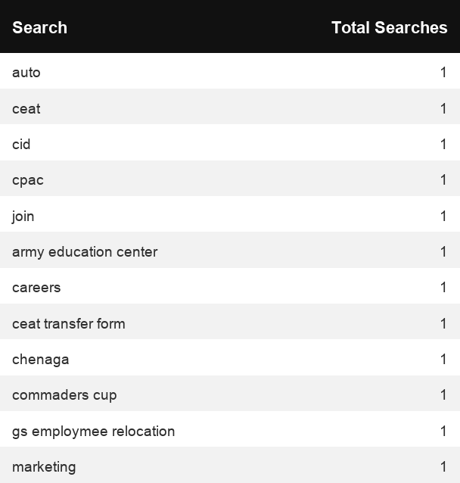
Search Insights & Highlights
Top Searches
17 total on-site searches on CEAT pages to find more information.
CEAT

Slide 9
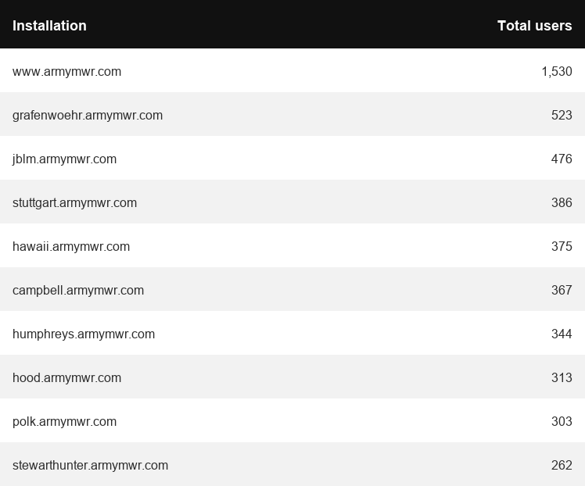
Traffic Highlights
Top Installations
HBB pages received 12,409 views and 11,597 sessions.
The engagement rate was at 63%.
The total number of users was 9,819 and there were 4,167 new users.
Home Based Business (HBB)

Slide 10
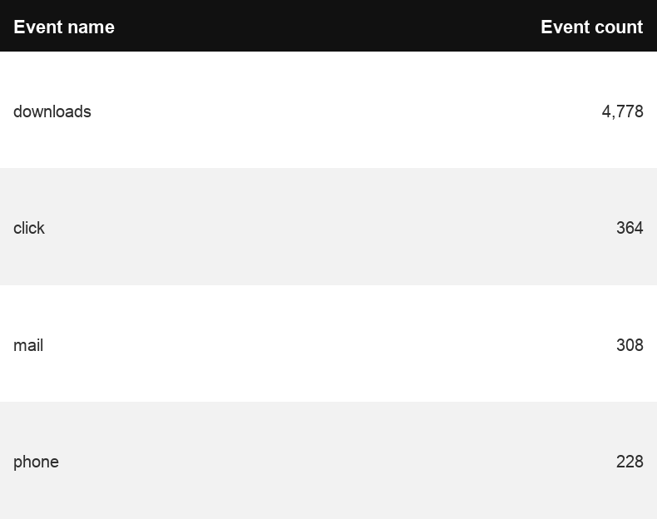
Engagement Insights & Highlights
There were 364 clicks to other websites to find more information.
4,778 people downloaded a PDF or a form.
228 people needed to talk to a real person.
Top Installations
(Downloads, Email, Phone Numbers, Outbound Links)
Home Based Business (HBB)

Slide 11
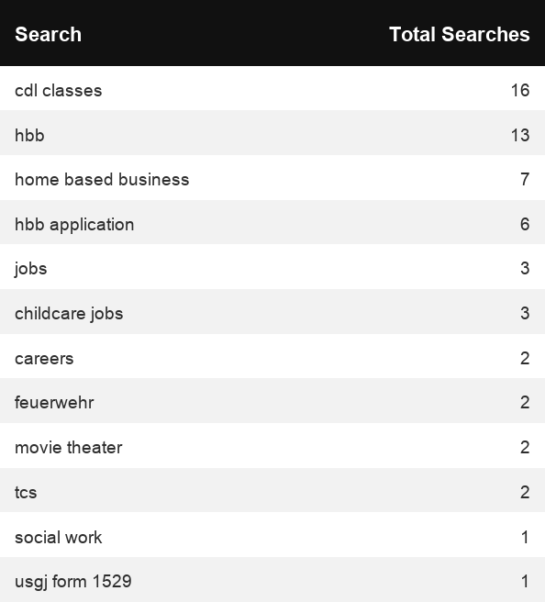
Search Insights & Highlights
106 total on-site searches on HBB pages to find more information.
0 users left the site after performing a search.
Top Searches
Home Based Business (HBB)

