Slide 1
Support Services Third Quarter FY25 Insights

Slide 2
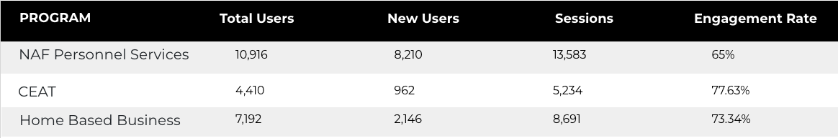
Web Analytics Summary
Program Roll-up

Slide 3
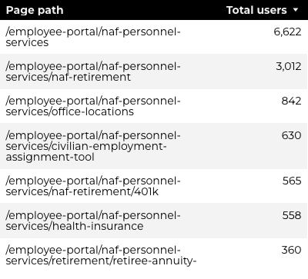
Traffic Highlights
Top Pages NAF Personnel Services
The program received 19,770 views and 13,583 sessions.
The engagement rate was at 65%.
There were a total of 10,916 users.
NAF Personnel Services

Slide 4
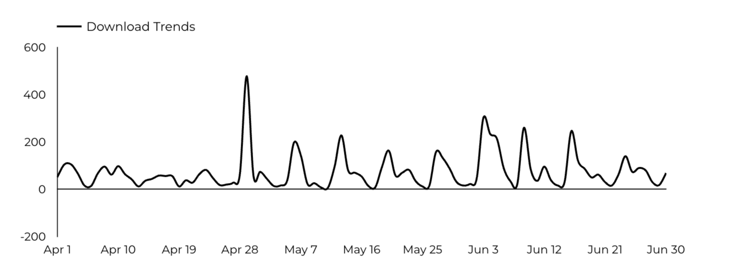
Engagement Insights & Highlights
6,795 people downloaded a PDF or a form.
81 people clicked on a link to another website to get more information.
NAF Personnel Services

Slide 5
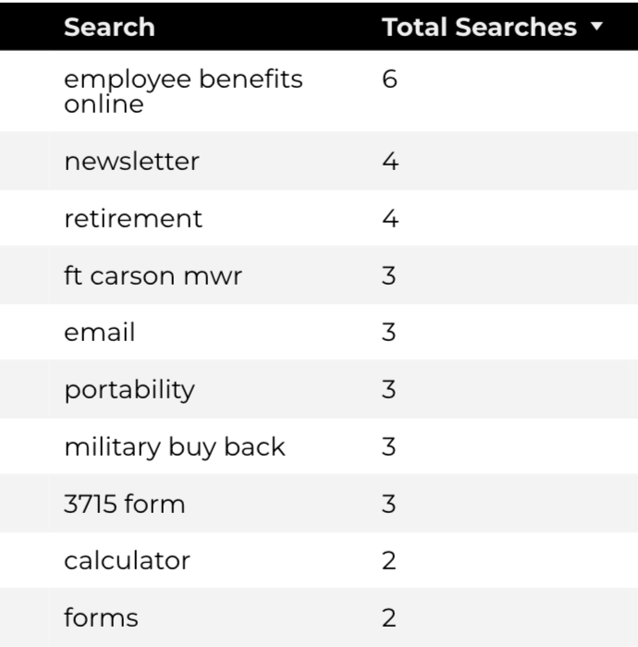
Search Insights & Highlights
Top Searches
There were 171 total on-site searches on NAF Personnel Services pages to find more information.
NAF Personnel Services

Slide 6
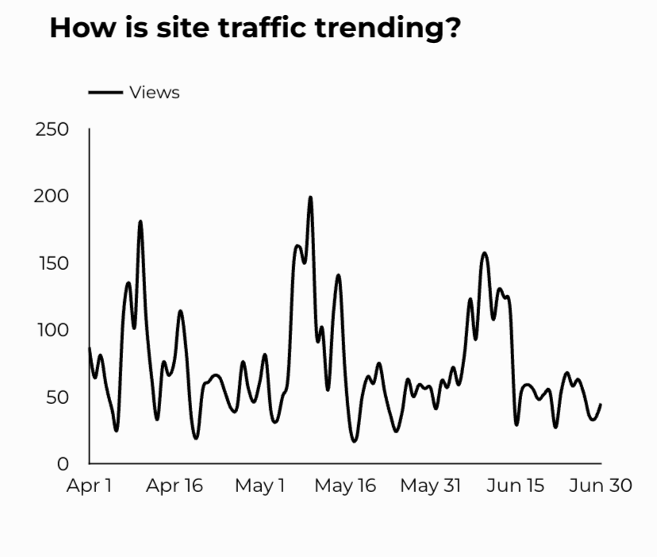
Traffic Highlights
The website received 6,581 views and 5,224 sessions.
The engagement rate was at 78%.
CEAT

Slide 7
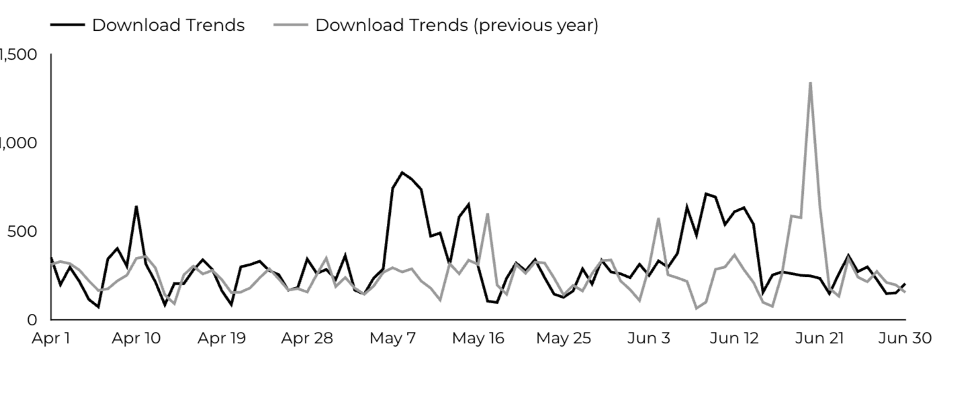
Engagement Insights & Highlights
CEAT Transfer Guide: Achieved 822 Downloads.
CEAT Transfer Guide Download Trends
CEAT

Slide 8
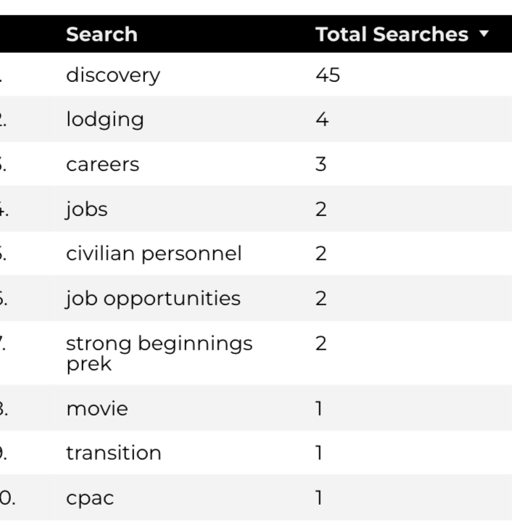
Search Insights & Highlights
Top Searches
86 total on-site searches on CEAT pages to find more information.
CEAT

Slide 9
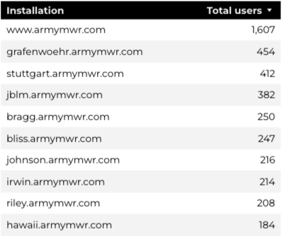
Traffic Highlights
Top Installations
HBB pages received 10,189 views and 8,691 sessions.
The engagement rate was at 73%.
The total number of users was 7,192 and there were 2,146 new users.
Home Based Business (HBB)

Slide 10
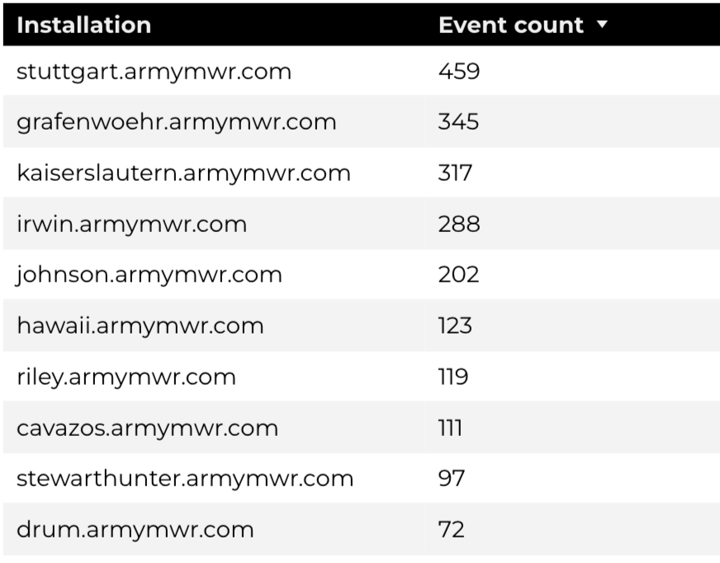
Engagement Insights & Highlights
There were 149 clicks to other websites to find more information.
2,511 people downloaded a PDF or a form.
137 people needed to talk to a real person.
Top Installations
(Downloads, Email, Phone Numbers, Outbound Links)
Home Based Business (HBB)

Slide 11
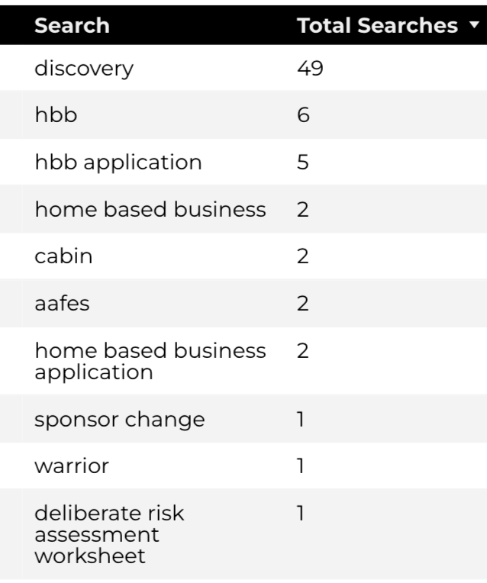
Search Insights & Highlights
111 total on-site searches on HBB pages to find more information.
3.9% of users left the site after performing a search.
Top Searches
Home Based Business (HBB)

