Slide 1
BRD Fourth Quarter FY25 Insights

Slide 2
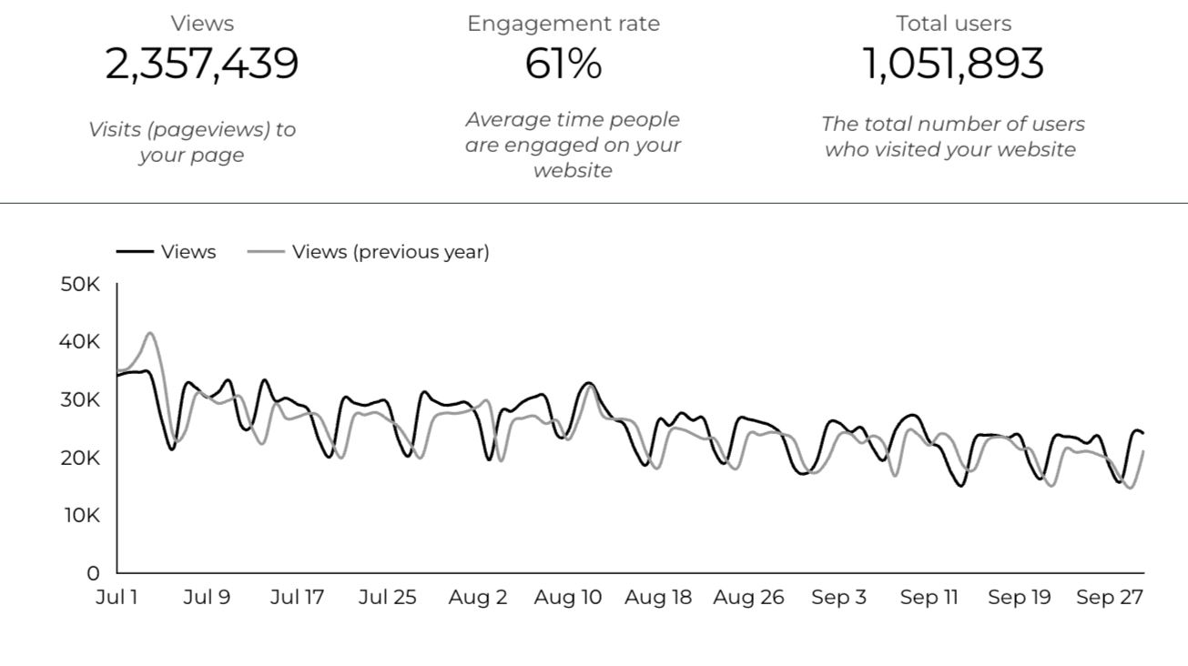
Web Analytics Summary

Slide 3
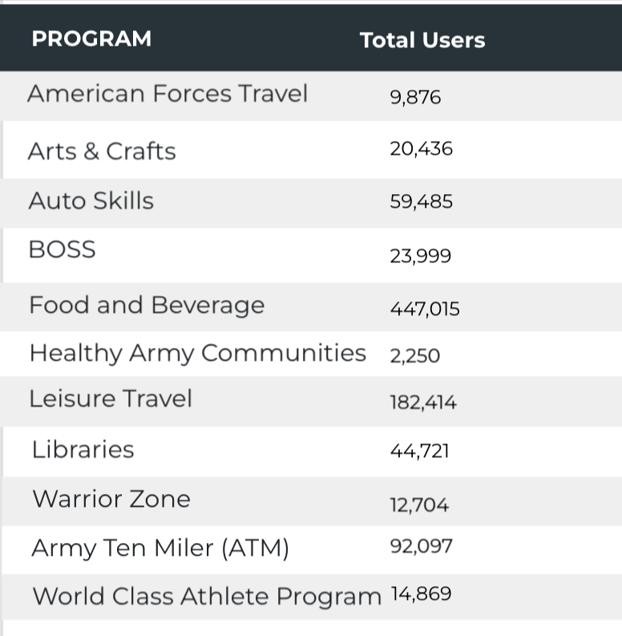

Visitor Highlights
15,950 People clicked on the Chow Now button to start an order.

Slide 4
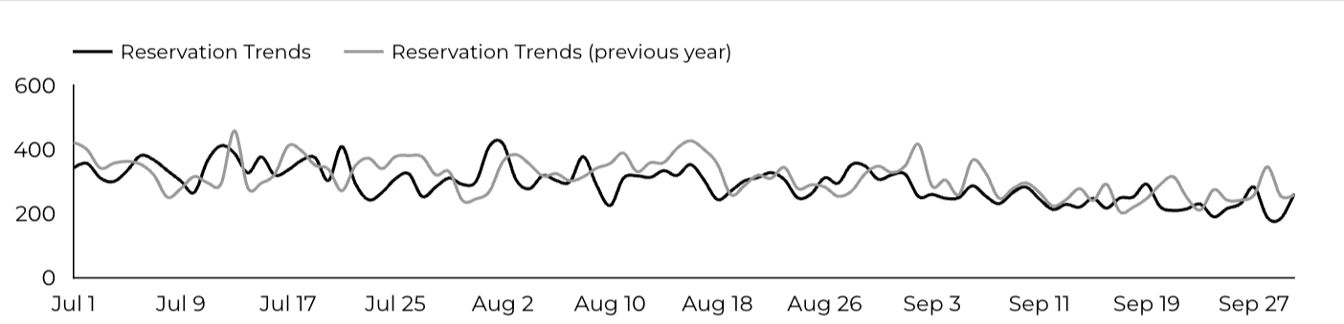
Sports and Fitness
27,088 People clicked to schedule a tee time or register for a golf clinic.

Slide 5
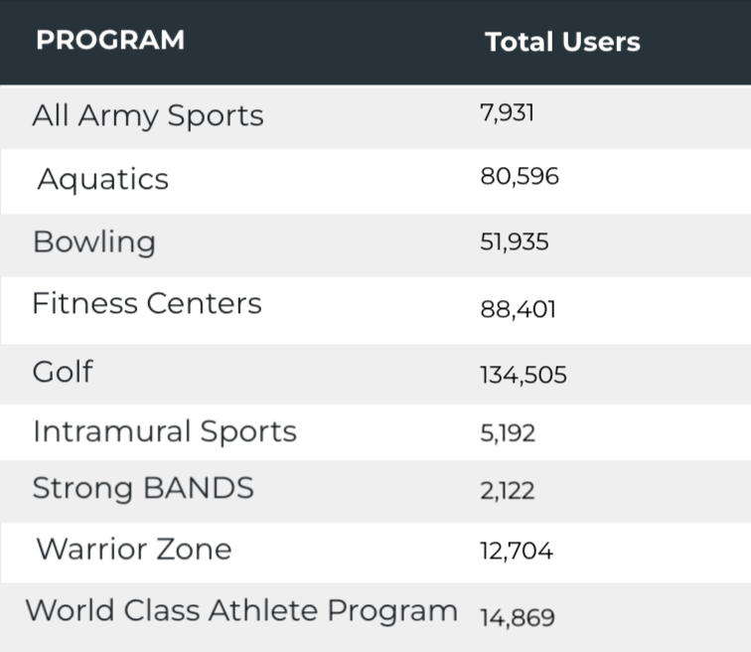
Sports and Fitness
Sports and Fitness

Slide 6
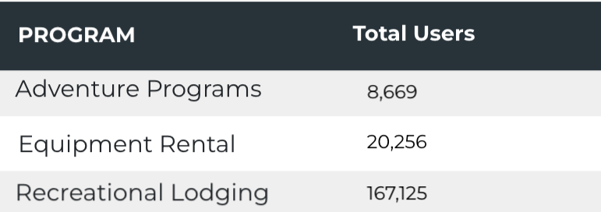
Outdoor Rec Programs
Outdoor Rec

Slide 7
Visitor Highlights
How engaged were these visitors within the website?
On average, users visited 2.26 pages per visit.
On average, users stayed on the site for 3 minutes and 07 seconds per visit.
766,925 visitors were new to the website.
61% of visitors took action on a page!

Slide 8
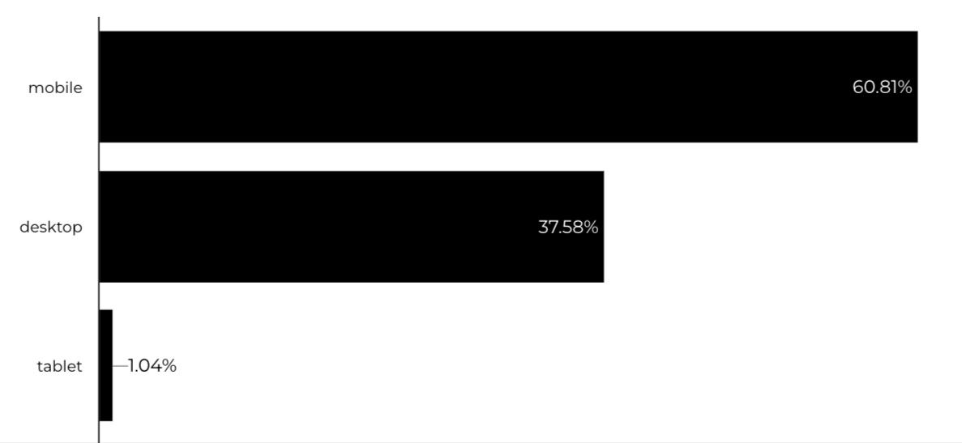
Traffic Highlights
  BRD pages received 2,357,439 visits last quarter.
  The total number of visits from social media is 49,154
  Most of the social traffic came from Facebook.
  Users by Device Category

Slide 9
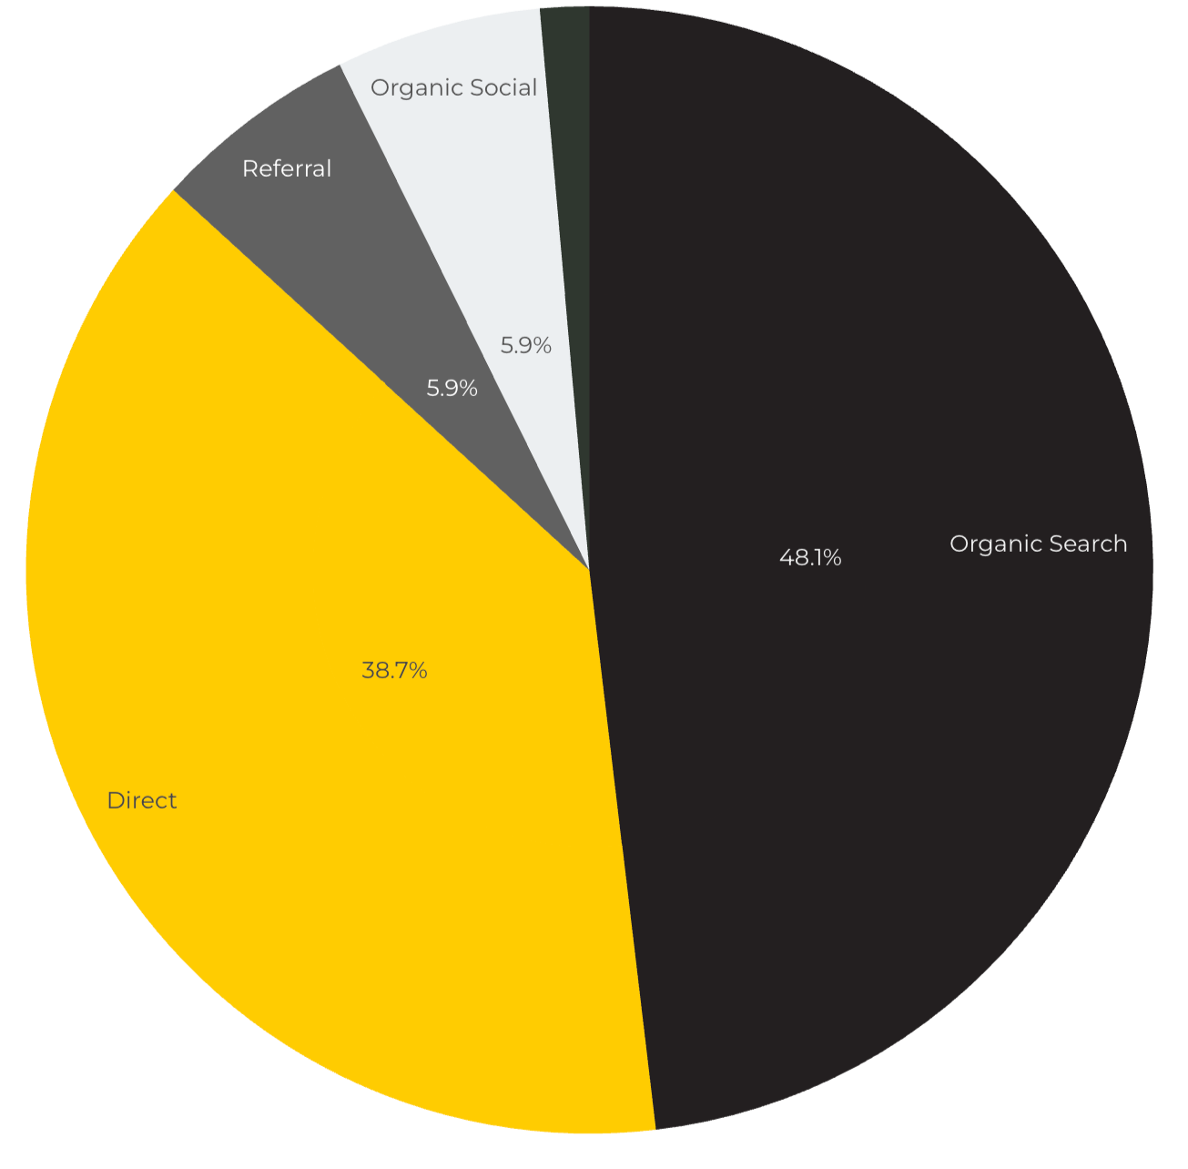
Marketing Reach
Other
|
48.1% of visitors came from online search engines.
38.7% came directly to the site (by typing in the address, using bookmarks, or email links).
5.9% of visitors came from social media.
5.9% of visitors came from referrals.
1.4% Other (traffic that has an acquisition source Google doesn't know how to classify).

Slide 10
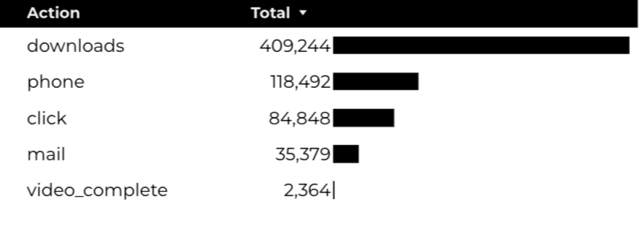
Engagement Insights & Highlights
Last quarter had a total of 735,202 interactions on the pages (including downloads, email clicks, phone number clicks, outbound links, and videos).

Slide 11
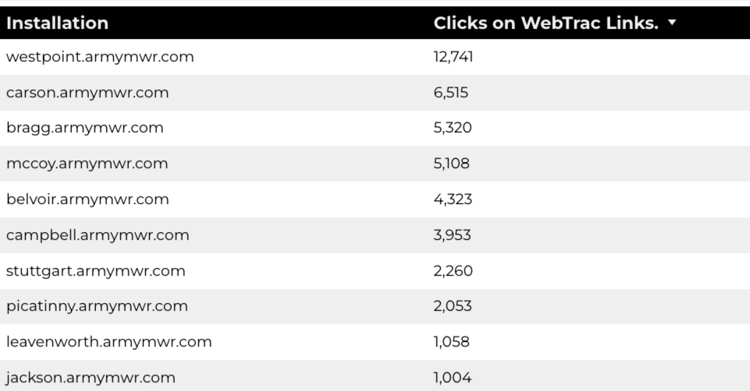
WebTrac Insights & Highlights
A total of 55,690 individuals clicked on a WebTrac link from a program page.
Top installations with the highest number of WebTrac link clicks on pages.

Slide 12

Happenings
American Forces Travel
9,876 users made a visit to an AFT page.
3,721 Users are new
78% Engagement Rate

Slide 13
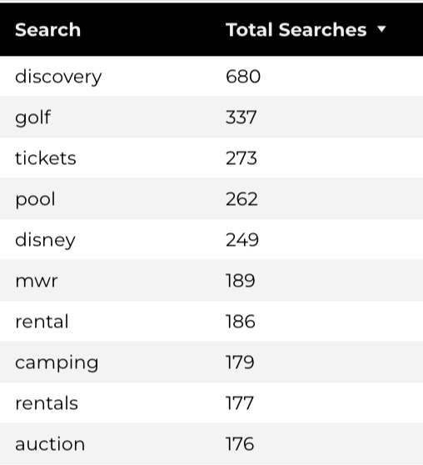
Search Insights
23,565 Total on-site searches on BRD pages to find more information.

Slide 14
Search Intent
Search intent is defined as being the underlying purpose behind an online query.
45% of searches were looking for an answer to a specific question or general information.
43% of searches were looking to investigate brands or services and intending to complete an action or purchase.
12% of searches were intending to find a specific program page using the on-site search.

Slide 15
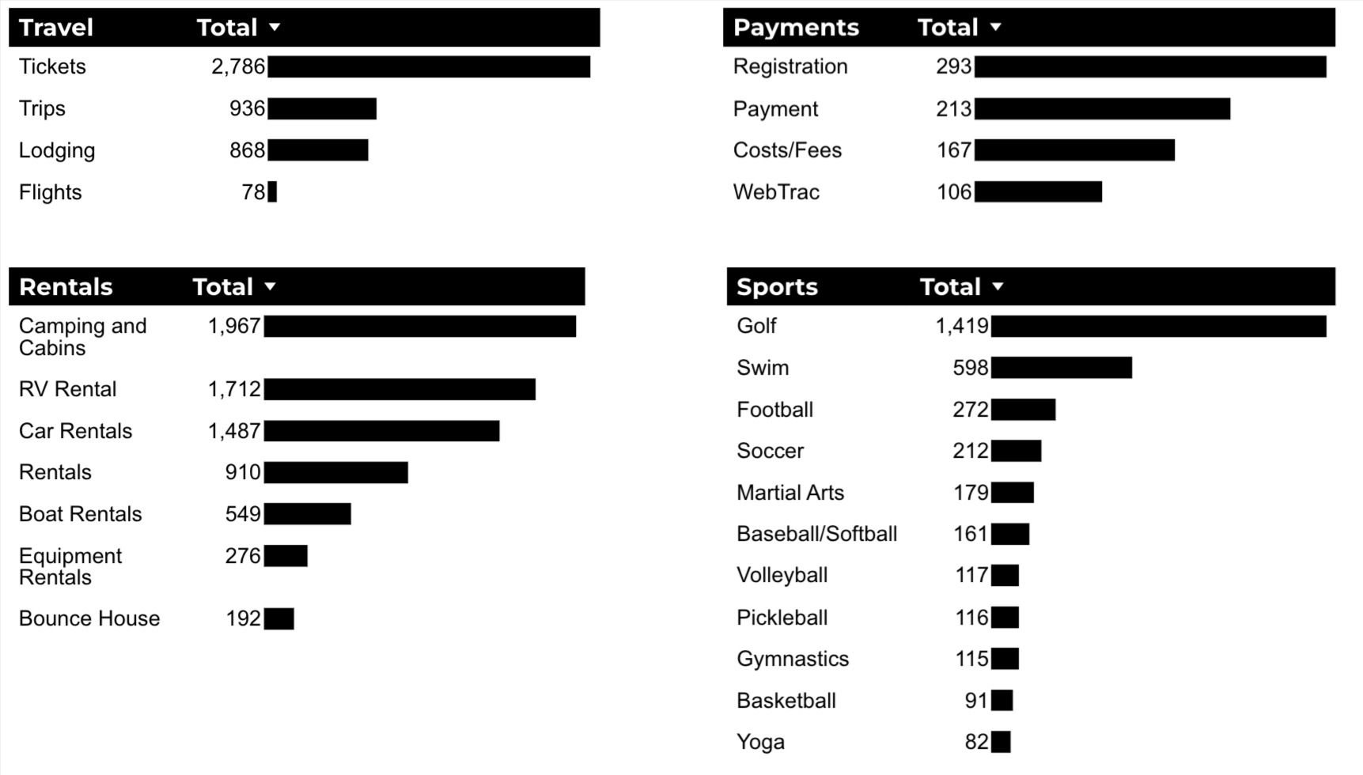
What Are The Top Search Sub-Topics?
The most popular search categories and terms within BRD

