Slide 1
Support Services Second Quarter FY25 Insights

Slide 2
Web Analytics Summary
Program Roll-up

Slide 3
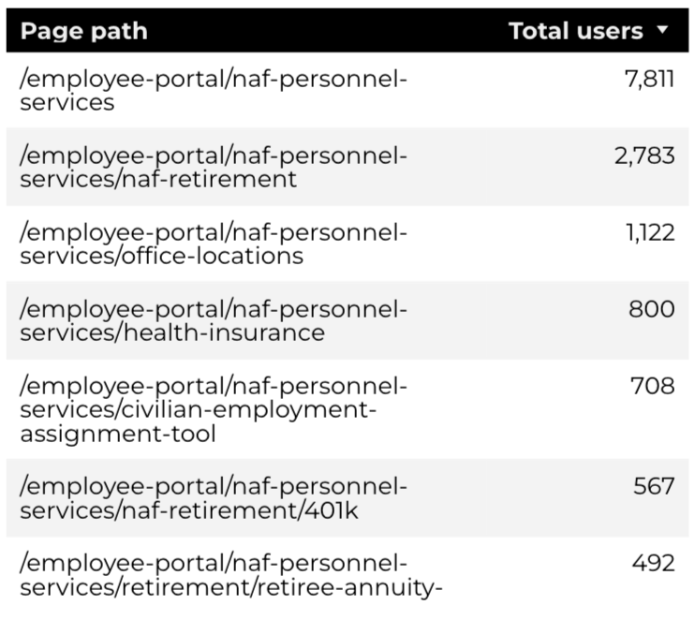
Traffic Highlights
Top Pages NAF Personnel Services
The program received 23,122 views and 14,888 sessions.
The engagement rate was at 65%.
There were a total of 9,275 users.
NAF Personnel Services

Slide 4
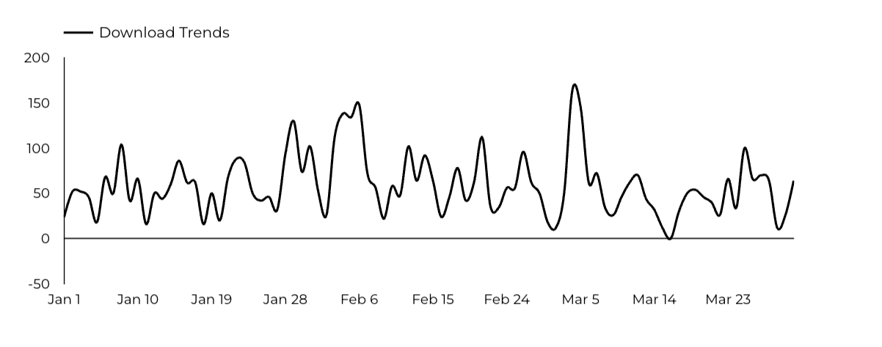
Engagement Insights & Highlights
5,338 people downloaded a PDF or a form.
71 people clicked on a link to another website to get more information.
NAF Personnel Services

Slide 5
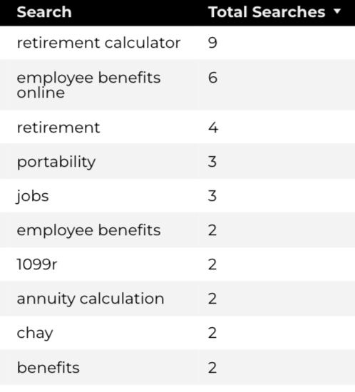
Search Insights & Highlights
Top Searches
There were 148 total on-site searches on NAF Personnel Services pages to find more information.
NAF Personnel Services

Slide 6
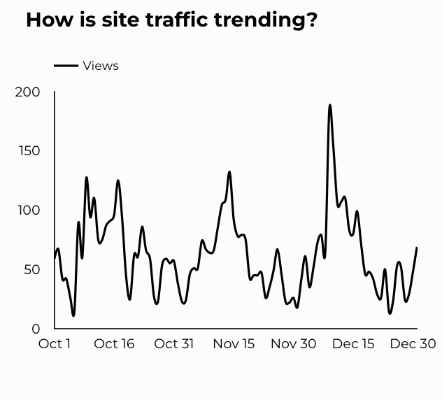
Traffic Highlights
The website received 6,949 views and 5,202 sessions.
The engagement rate was at 76%.
CEAT

Slide 7
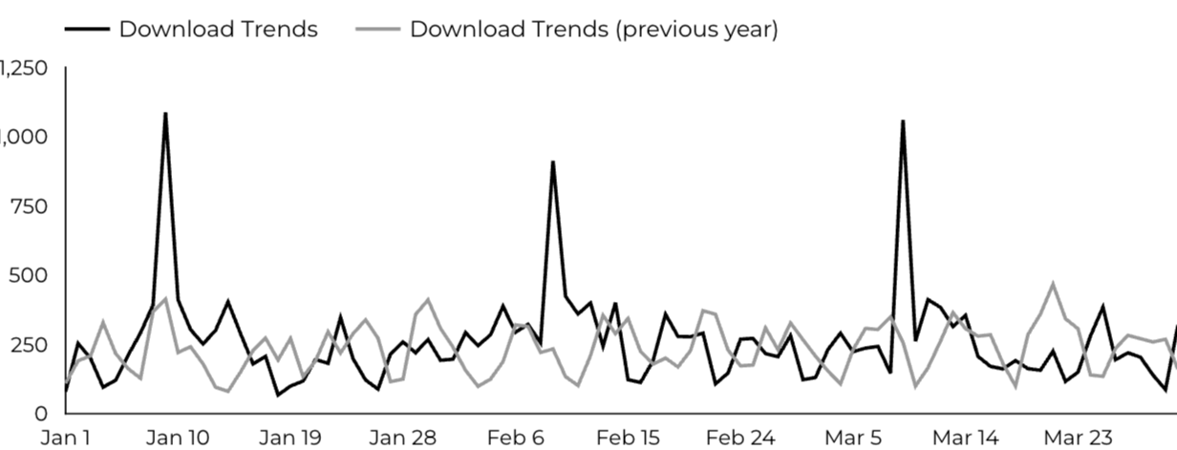
Engagement Insights & Highlights
CEAT Transfer Guide: Achieved 908 Downloads.
CEAT Transfer Guide Download Trends
CEAT

Slide 8
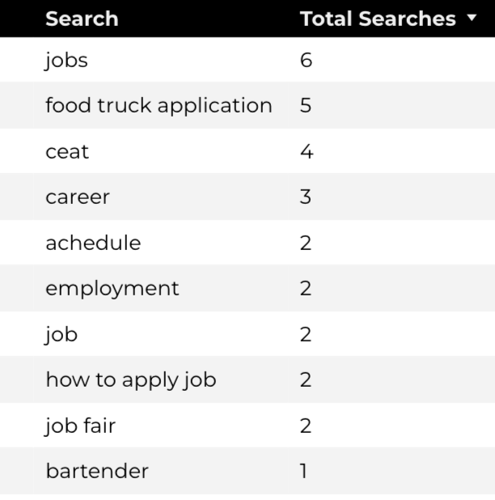
Search Insights & Highlights
Top Searches
70 total on-site searches on CEAT pages to find more information.
CEAT

Slide 9
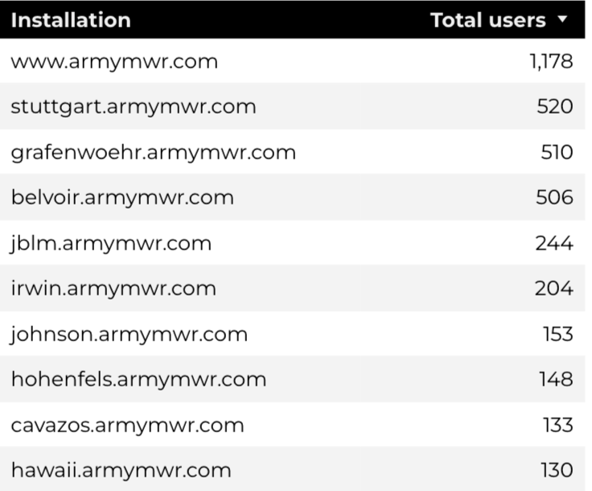
Traffic Highlights
Top Installations
HBB pages received 8,451 views and 6,991 sessions.
The engagement rate was at 65%.
The total number of users was 5,677and there were 2,765 new users.
Home Based Business (HBB)

Slide 10
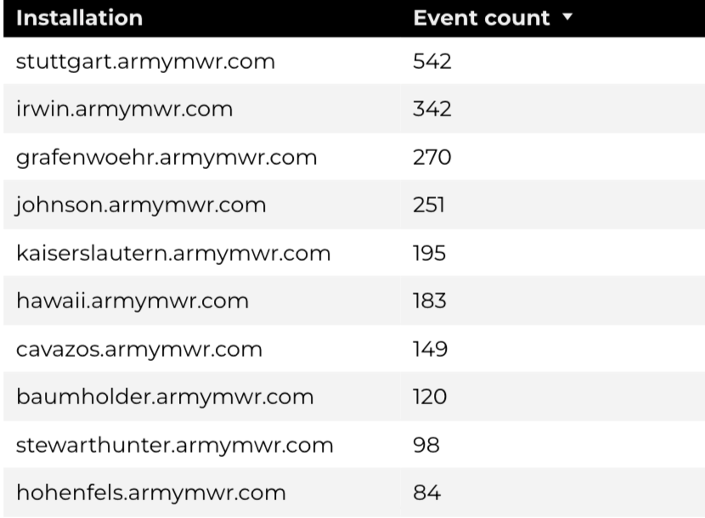
Engagement Insights & Highlights
There were 161 clicks to other websites to find more information.
2,526 people downloaded a PDF or a form.
109 people needed to talk to a real person.
Top Installations
(Downloads, Email, Phone Numbers, Outbound Links)
Home Based Business (HBB)

Slide 11
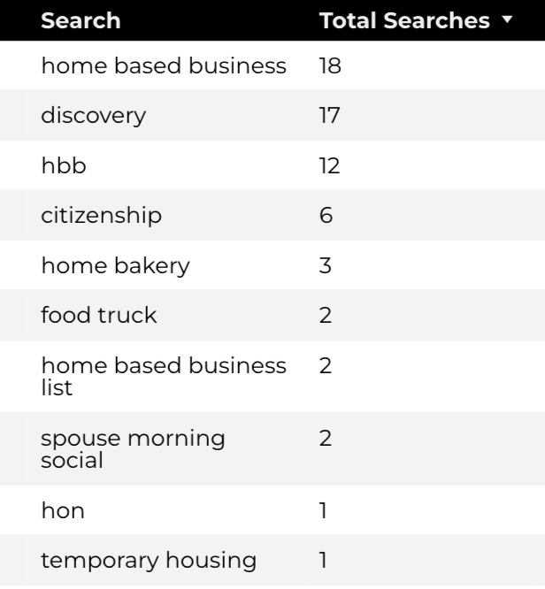
Search Insights & Highlights
104 total on-site searches on HBB pages to find more information.
1.18% of users left the site after performing a search.
Top Searches
Home Based Business (HBB)

