Slide 1
ACS Third Quarter FY25 Insights
​

Slide 2
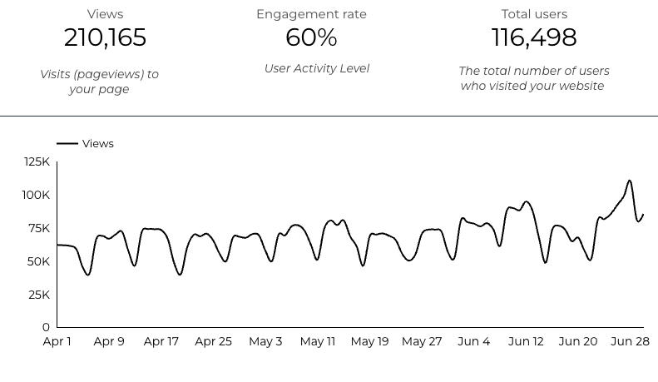
Web Analytics Summary

Slide 3
Traffic Highlights
  ACS pages received 210,165 visits last quarter.
  Engagement on ACS pages was 60%.
  There were 116,498 total users who made a visit to ACS.
  3,094 visits were directed from social media platforms.
  Most of the social traffic came from Facebook.

Slide 4
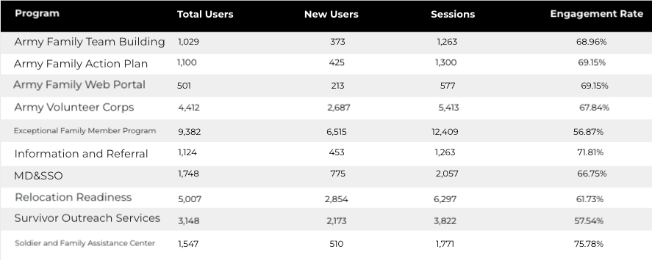
Program Roll-Up

Slide 5
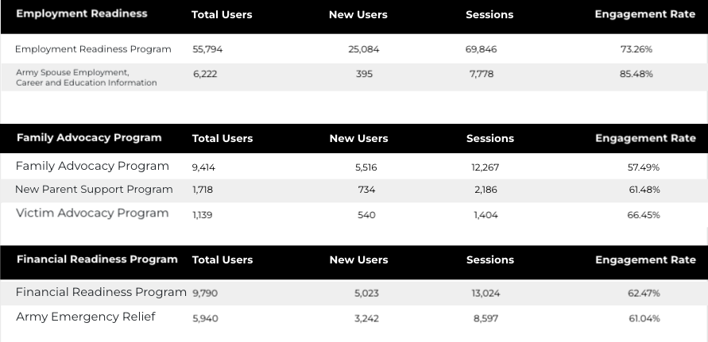
Program Roll-Up

Slide 6
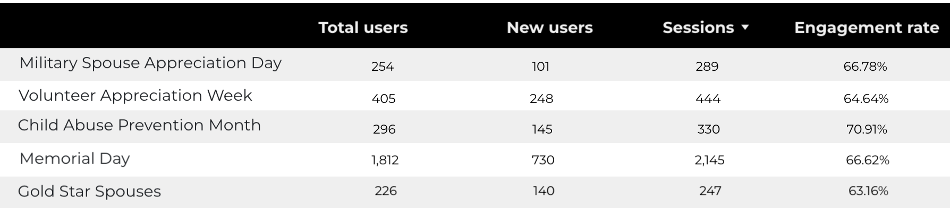
Happenings

Slide 7
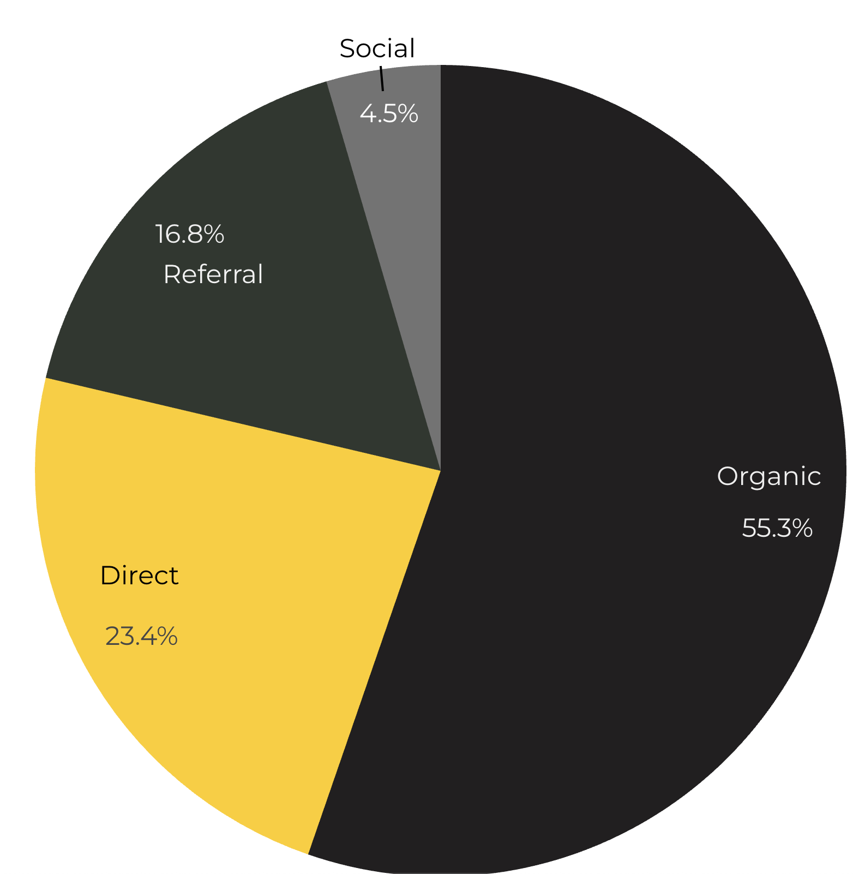
Marketing Reach
55.3% of visitors came from Organic Search engine queries.
23.4% of visitors came directly to the site (by typing in the address, using bookmarks, or email links).
16.8% of visitors came from Referral links on 3rd party web sites.
4.5% of visitors came from Social Media.

Slide 8
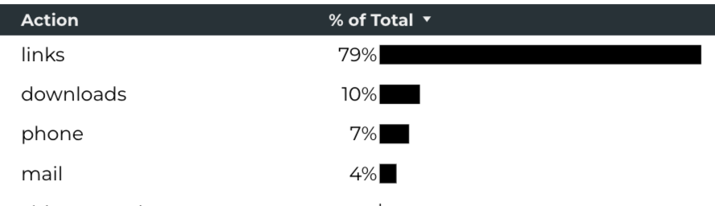
Engagement Insights & Highlights
Last quarter had a total of 158,956 interactions on the ACS pages (interactions are downloads, email clicks, phone number clicks, and outbound links).
Phone
Outbound Clicks

Slide 9
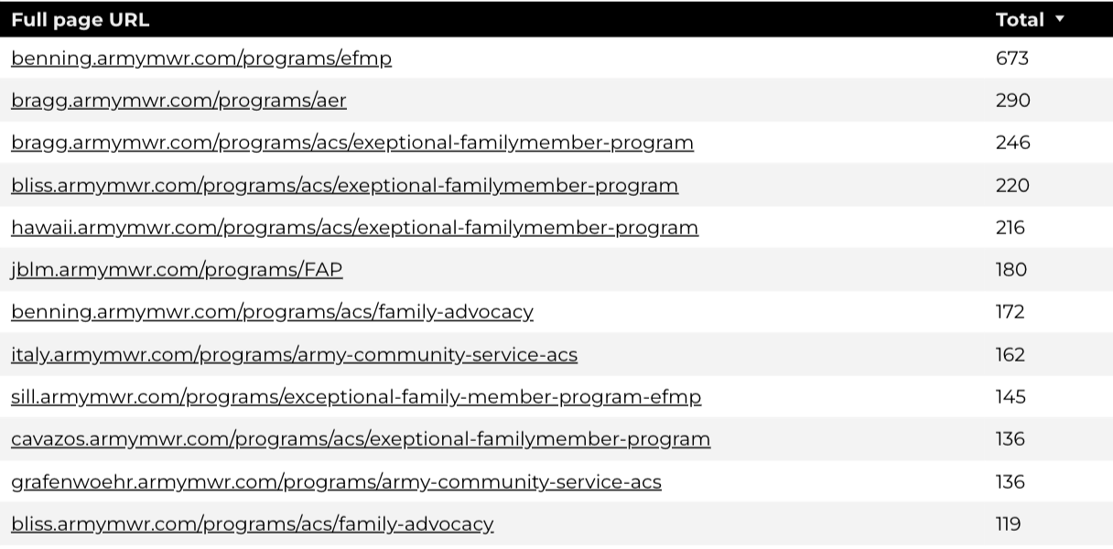
Insights & Highlights
Last quarter,11,393 people required assistance from a live person.
Top ACS programs that received phone calls from the web.

Slide 10
Search Intent
Search intent is defined as being the underlying purpose behind an online query.
41% of searches were aimed at finding an answer to a specific question or acquiring general information.
43% of searches were conducted to explore brands or services with the intention of completing an action or making a purchase.
16% of searches were intended to locate a specific program page using the on-site search.

Slide 11
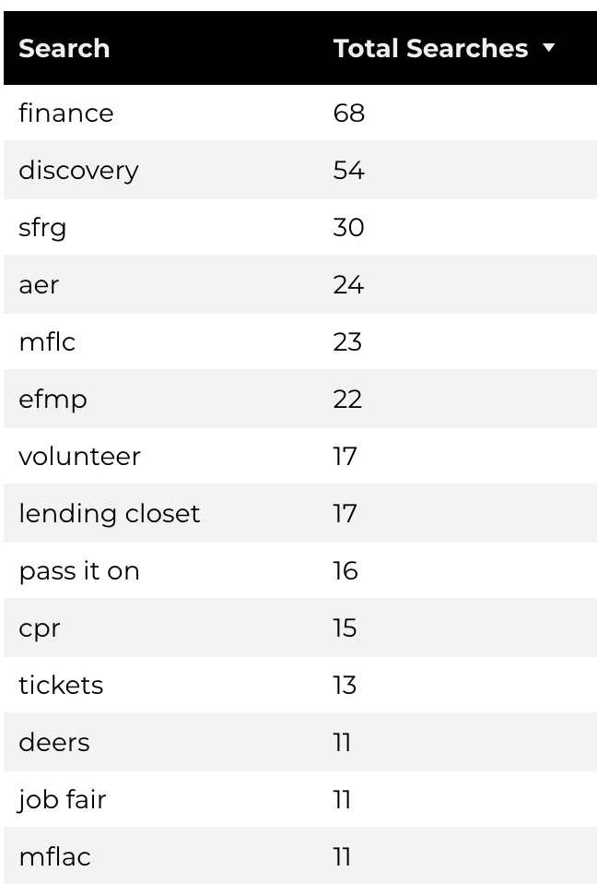
Search Insights
Top Search Terms
2111 Total on-site searches on ACS pages to find more information.
2.63% of users left the site after performing a search.
Notes:
.

Slide 12
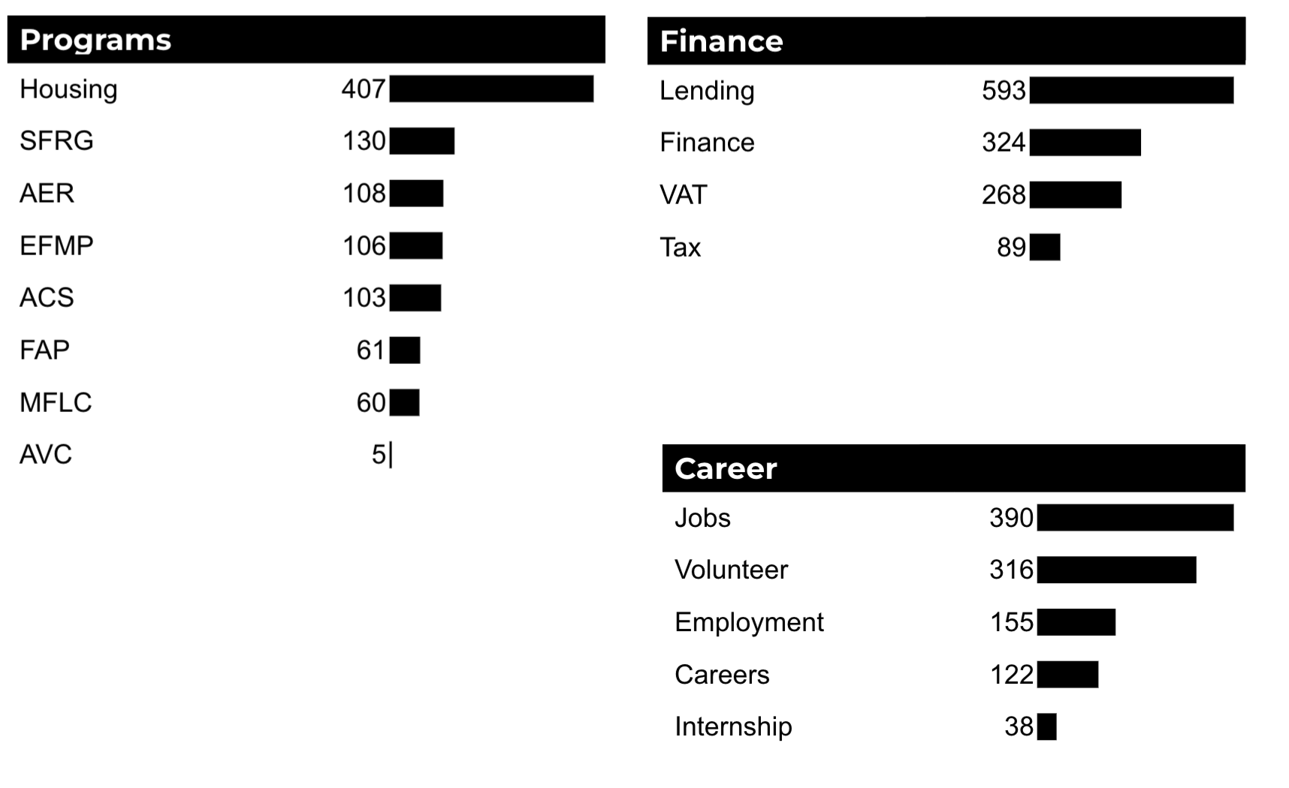
What Are The Top Search Sub-Topics?
The most popular search categories and terms within ACS.

