Slide 1
ACS Annual FY25 Insights
​

Slide 2
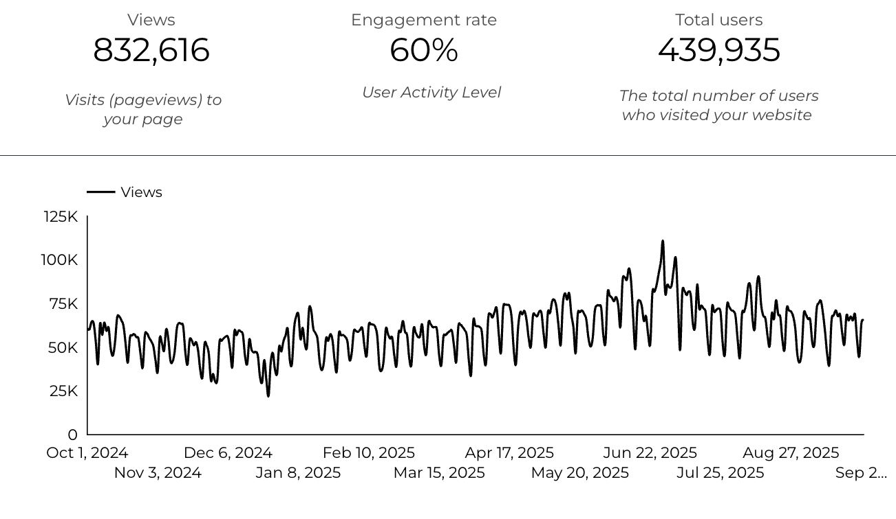
Web Analytics Summary

Slide 3
Traffic Highlights
  ACS pages received 832,616 visits last FY.
  Engagement on ACS pages was 60%.
  There were 582,058 Sessions who made a visit to ACS.
  There were 439,935 total users.
  15,727 visits were directed from social media platforms.
  Most of the social traffic came from Facebook.

Slide 4
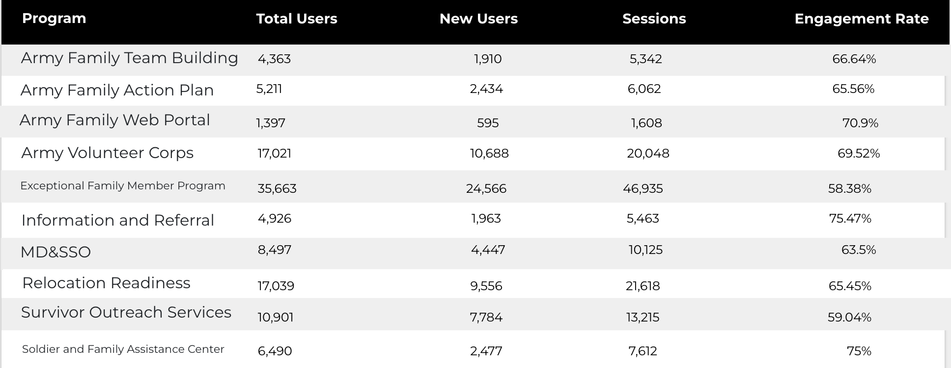
Program Roll-Up

Slide 5
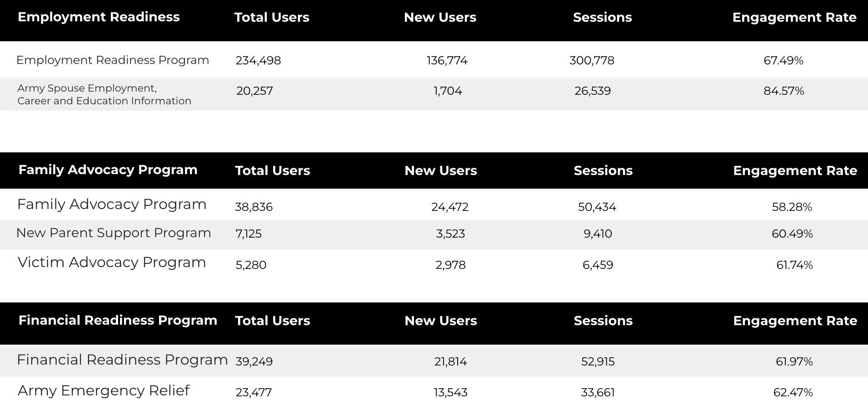
Program Roll-Up

Slide 6
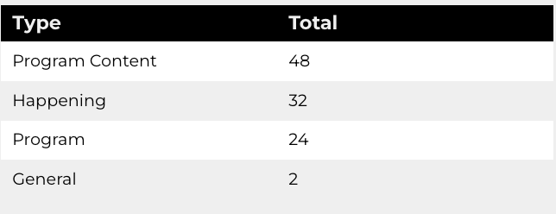
New Pages
Web managers created 106 new ACS pages, program pages, and happenings on EPW last year. (Data from EPW Page Report)
Total page types

Slide 7
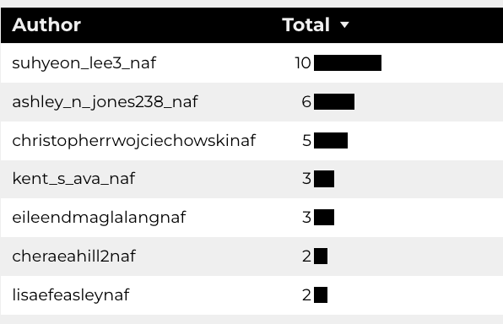
Top Content Creators

Slide 8
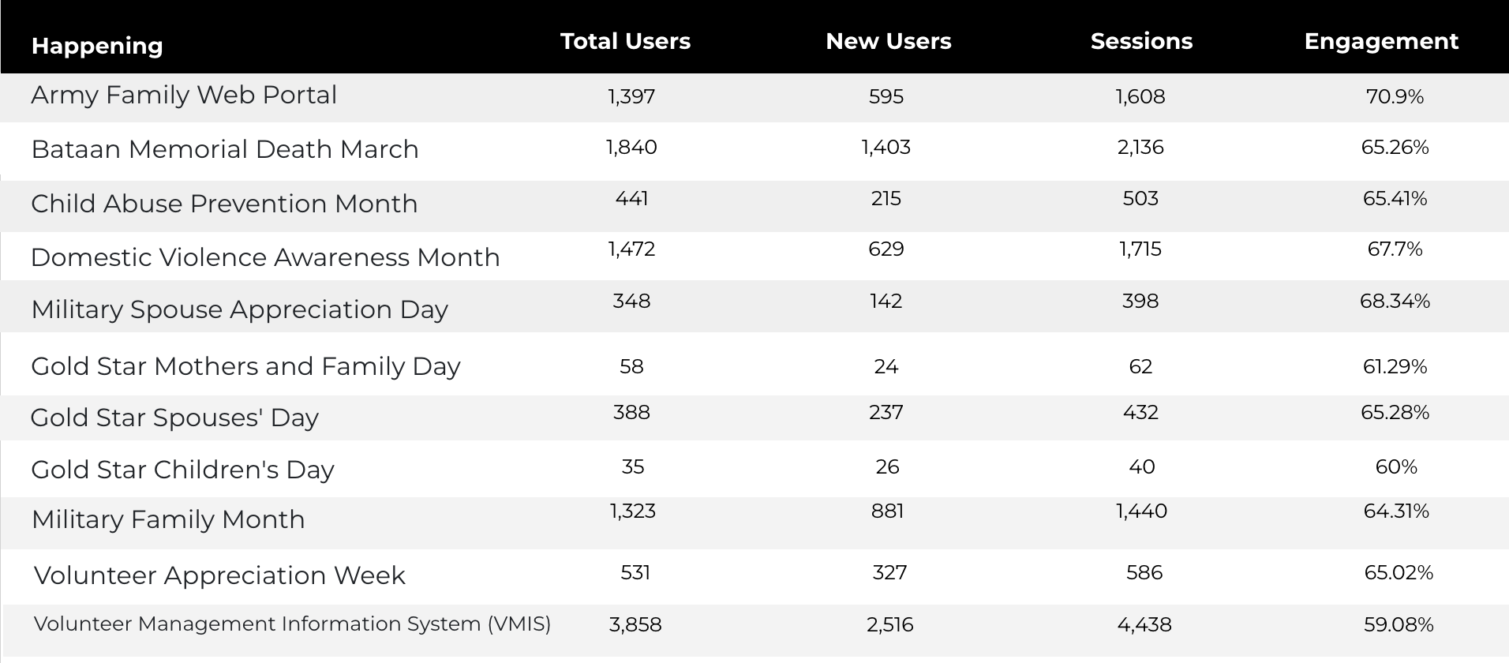
Happenings

Slide 9
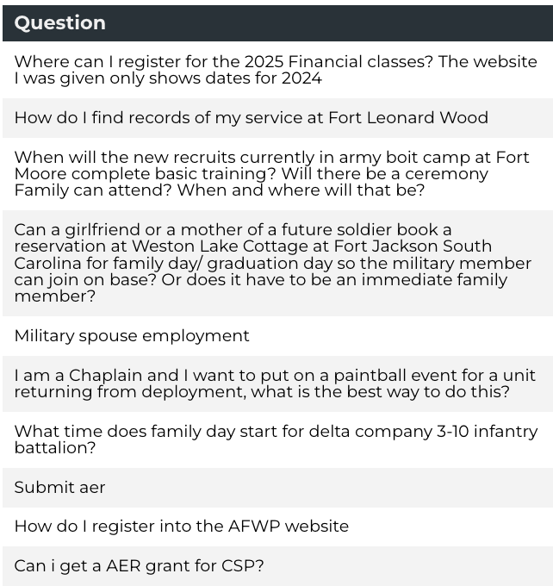
Army Answers
40 new questions added to Army Answers.

Slide 10
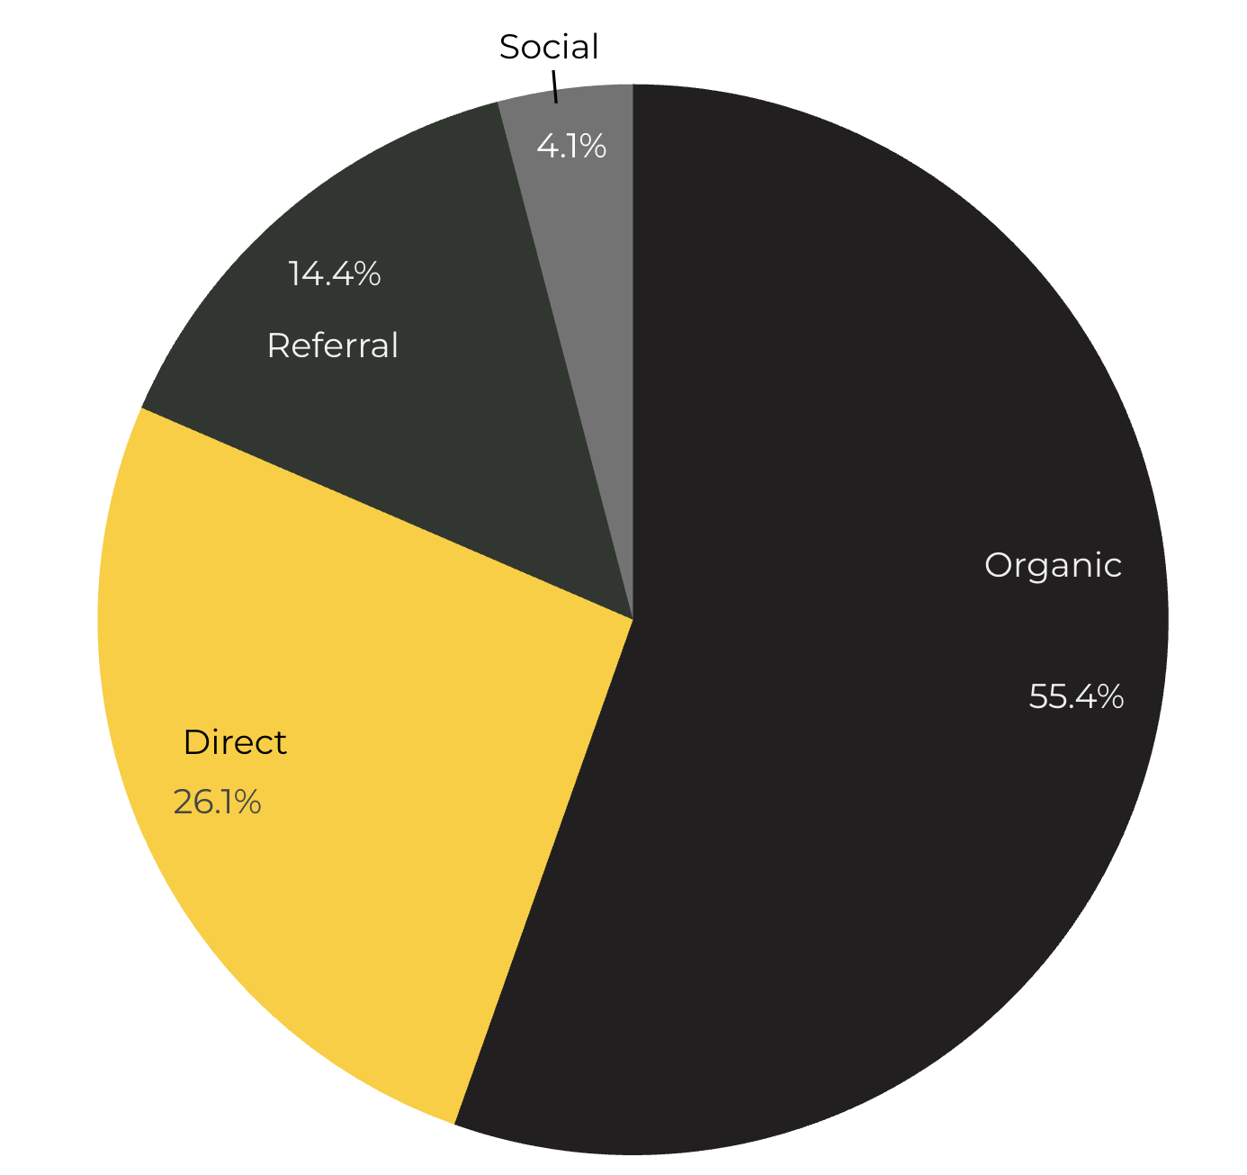
Marketing Reach
55.4% of visitors came from Organic Search engine queries.
26.1% of visitors came directly to the site (by typing in the address, using bookmarks, or email links).
14.4% of visitors came from Referral links on 3rd party web sites.
4.1% of visitors came from Social Media.

Slide 11
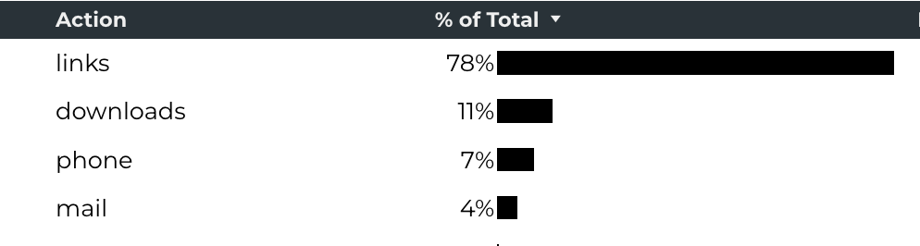
Engagement Insights & Highlights
Last FY had a total of 628,134 interactions on the ACS pages (interactions are downloads, email clicks, phone number clicks, and outbound links).
Phone
Outbound Clicks

Slide 12
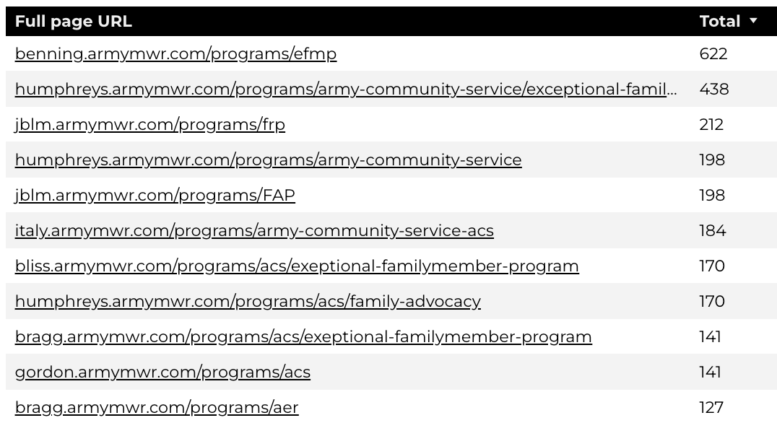
Insights & Highlights
Last FY, 45,614 people required assistance from a live person.
Top ACS programs that received phone calls from the web.

Slide 13
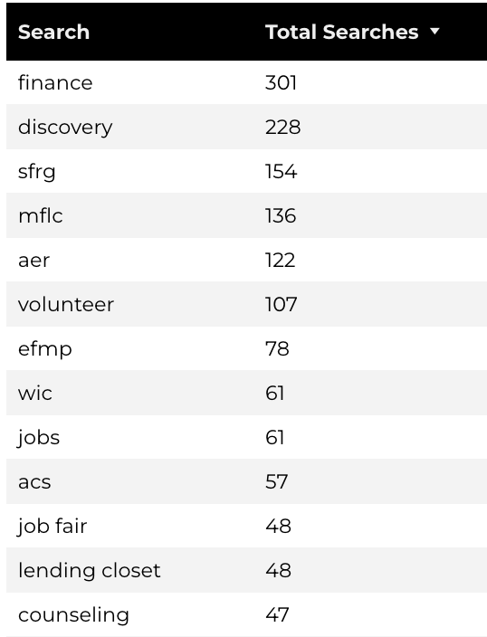
Search Insights
Top Search Terms
8,992 Total on-site searches on ACS pages to find more information.
2.8% of users left the site after performing a search.
Notes:
.

Slide 14
Search Intent
Search intent is defined as being the underlying purpose behind an online query.
44% of searches were aimed at finding an answer to a specific question or acquiring general information.
45% of searches were conducted to explore brands or services with the intention of completing an action or making a purchase.
11% of searches were intended to locate a specific program page using the on-site search.

Slide 15
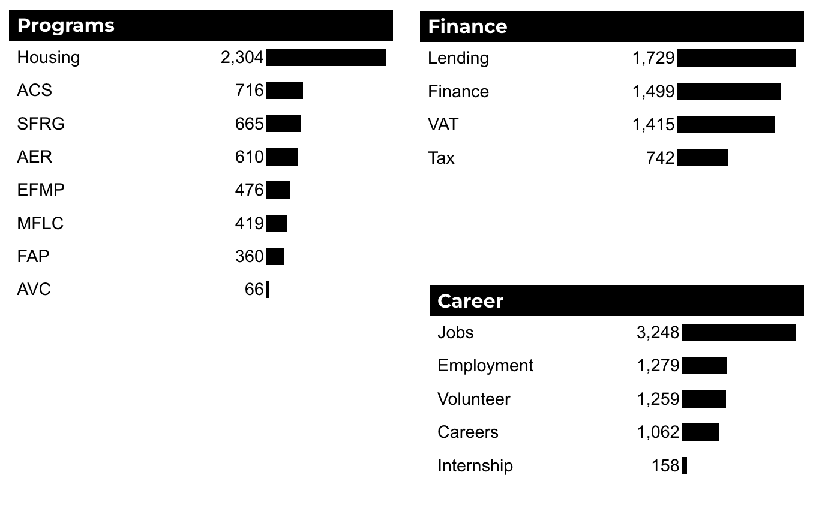
What Are The Top Search Sub-Topics?
The most popular search categories and terms within ACS.

