Slide 1
BRD Annual FY24 Insights

Slide 2
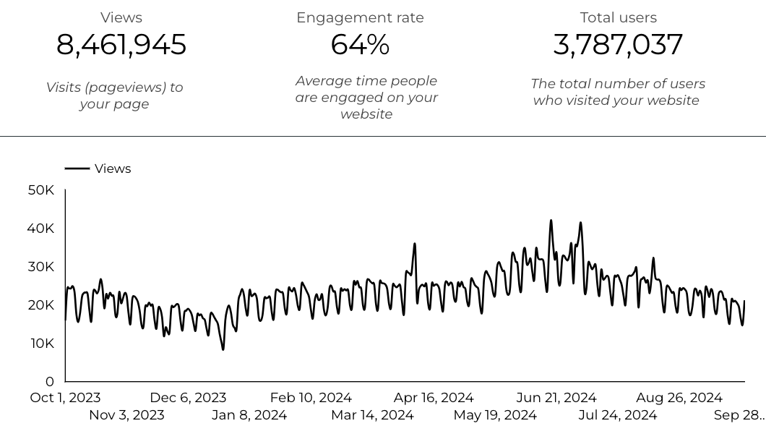
Web Analytics Summary

Slide 3
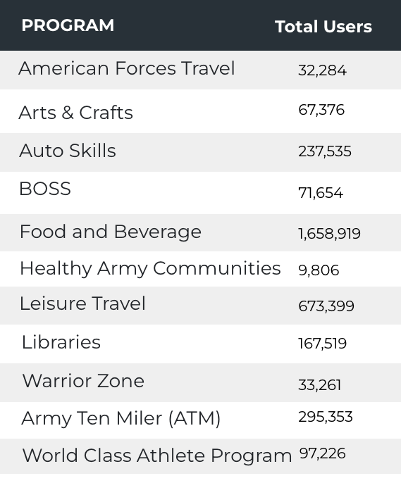

Visitor Highlights
39,911 People clicked on the Chow Now button to start an order.

Slide 4

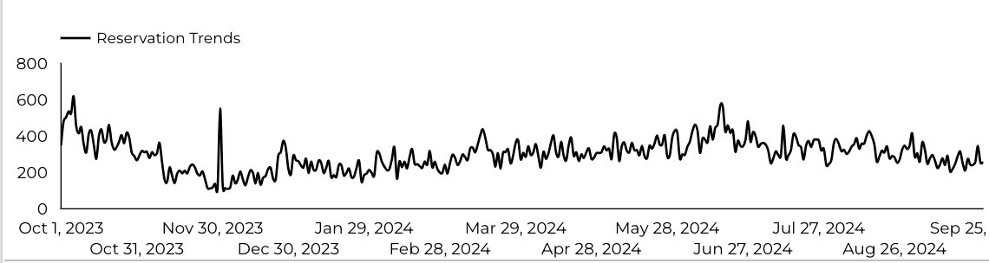
Sports and Fitness
109,378 People clicked to schedule a tee time or register for a golf clinic.

Slide 5
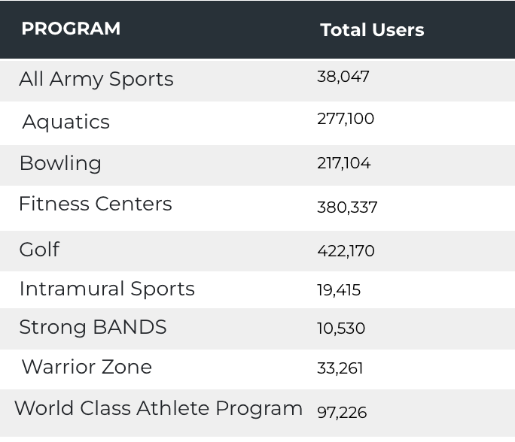
Visitor Highlights
Sports and Fitness

Slide 6
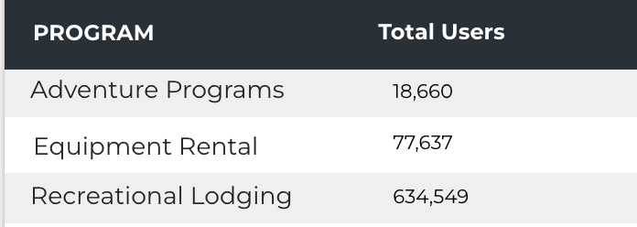
Visitor Highlights
Outdoor Rec

Slide 7
Visitor Highlights
How engaged were these visitors within the website?
On average, users visited 2.24 pages per visit.
On average, users stayed on the site for 2 minutes and 46 seconds per visit.
3,048,146 visitors were new to the website.
64% of visitors took action on a page!

Slide 8
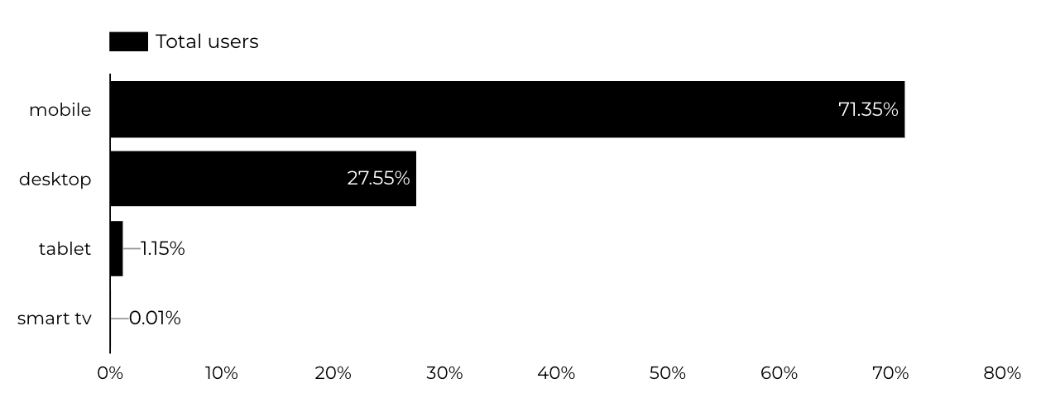
Traffic Highlights
  BRD pages received 8,461,945 visits.
  The majority of social traffic came from Facebook.
  Users by Device Category

Slide 9
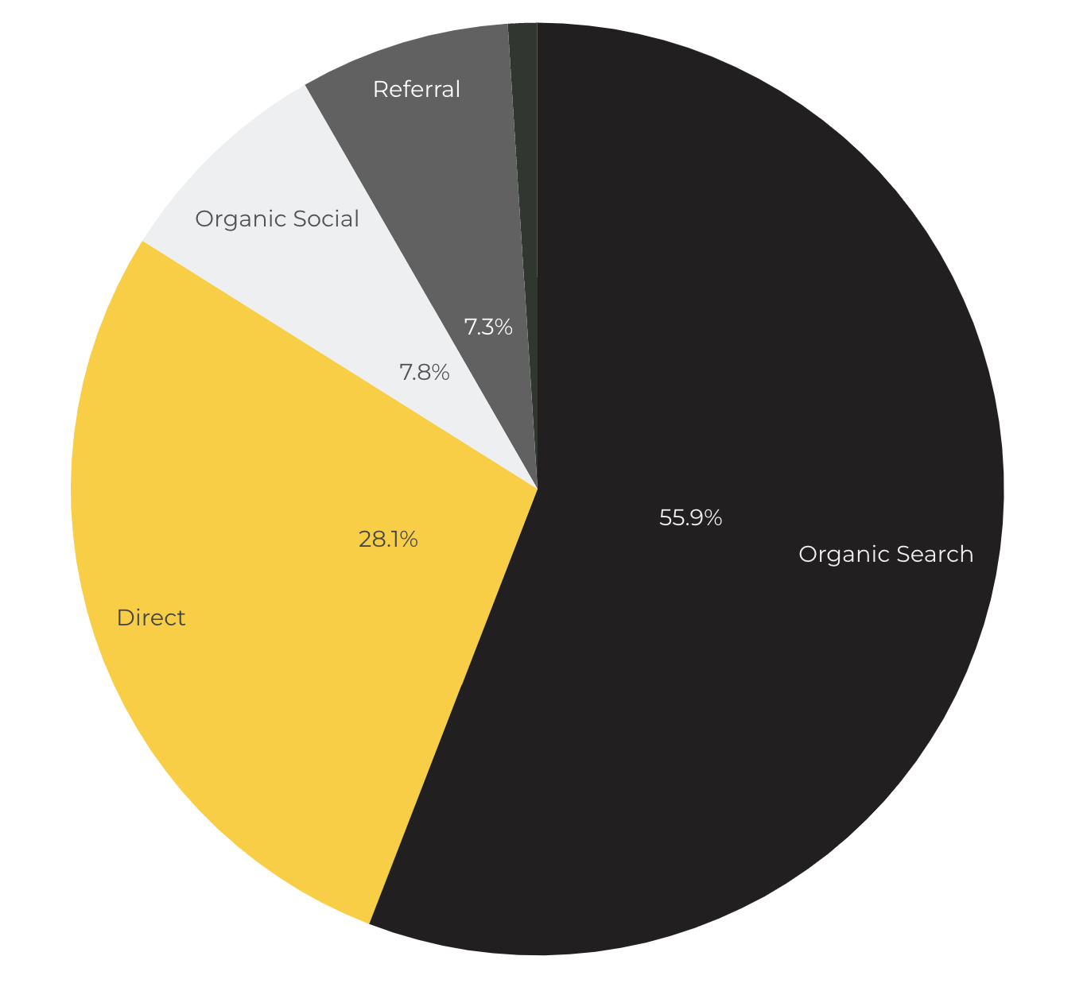
Marketing Reach
Other
|
55.9% of visitors came from online search engines.
28.1% came directly to the site (by typing in the address, using bookmarks, or email links).
7.8% of visitors came from social media.
7.3% of visitors came from referrals.
1% Other (traffic that has an acquisition source Google doesn't know how to classify).

Slide 10
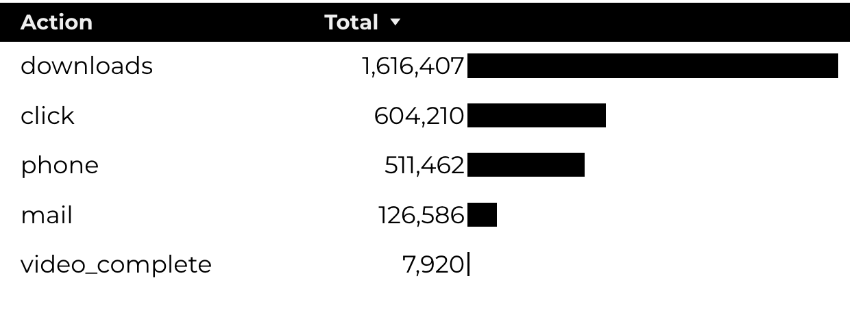
Engagement Insights & Highlights
Last year had a total of 2,866,585 interactions on the pages (including downloads, email clicks, phone number clicks, outbound links, and videos).

Slide 11
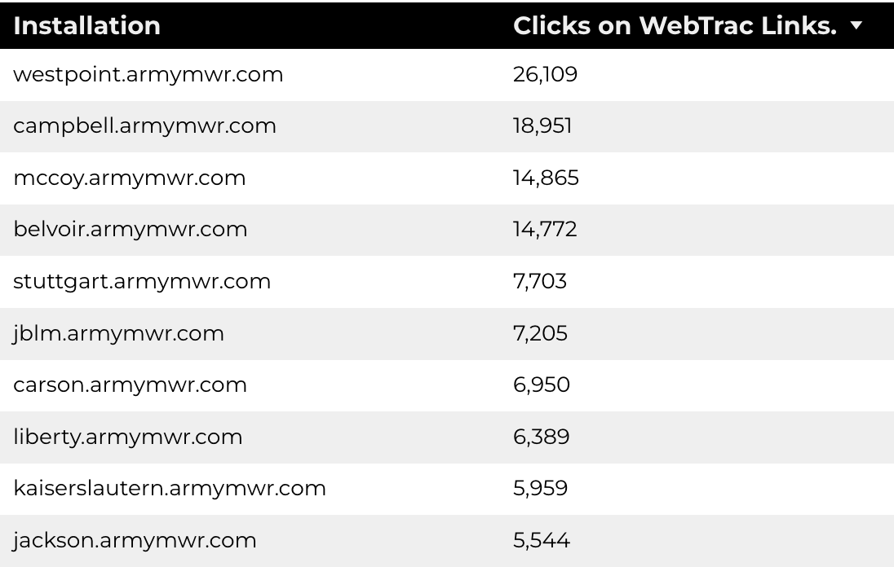
WebTrac Insights & Highlights
A total of 166,982 individuals clicked on a WebTrac link from a program page.
Top installations with the highest number of WebTrac link clicks on pages.

Slide 12

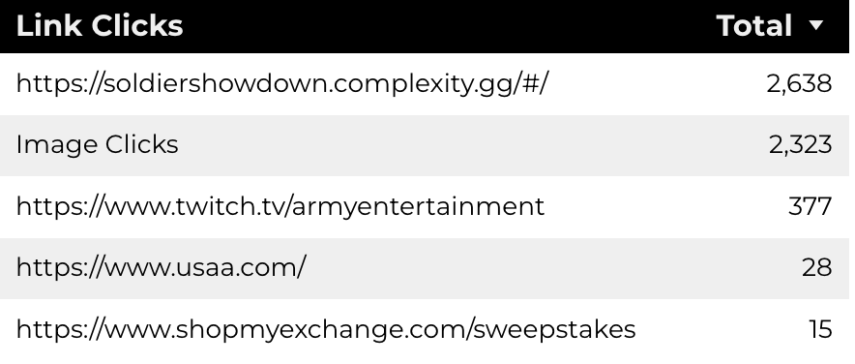
ESPORTS
13,476 Users made a visit.
53% of Visitors Take Action on a Page.
474,444 Stripe Impressions.

Slide 13

Summer Reading Program
27,290 Users made a visit.
67% of Visitors Take Action on a Page.
397,021 Stripe Impressions.
6,180 Clicks on AT&T Sponsor.
7337 Clicks to beanstack

Slide 14

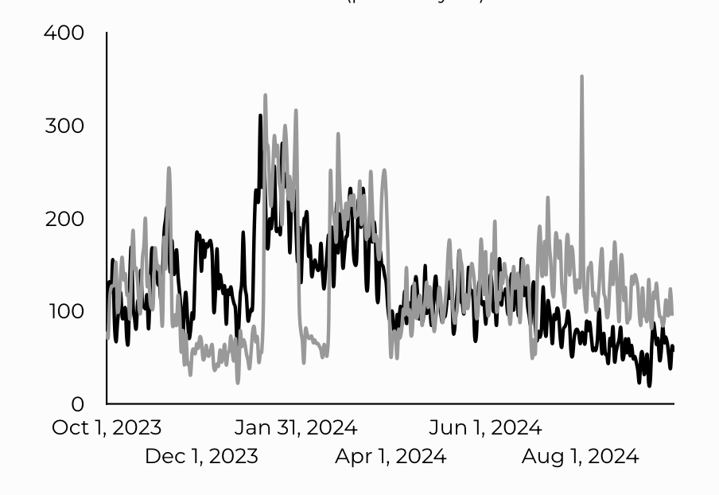
Armed Forces Travel
32,284 Users made a visit.
81% of Visitors Take Action on a Page.
Traffic trends compared y-o-y

Slide 15
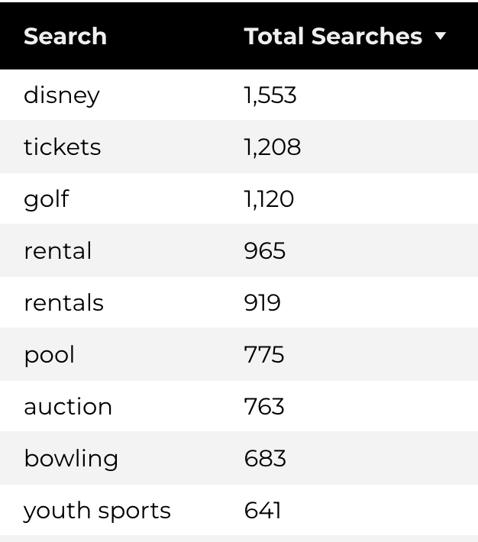
Search Insights
118,822 Total on-site searches on BRD pages to find more information.

Slide 16
Search Intent
Search intent is defined as being the underlying purpose behind an online query.
41% of searches were looking for an answer to a specific question or general information.
45% of searches were looking to investigate brands or services and intending to complete an action or purchase.
14% of searches were intending to find a specific program page using the on-site search.

Slide 17
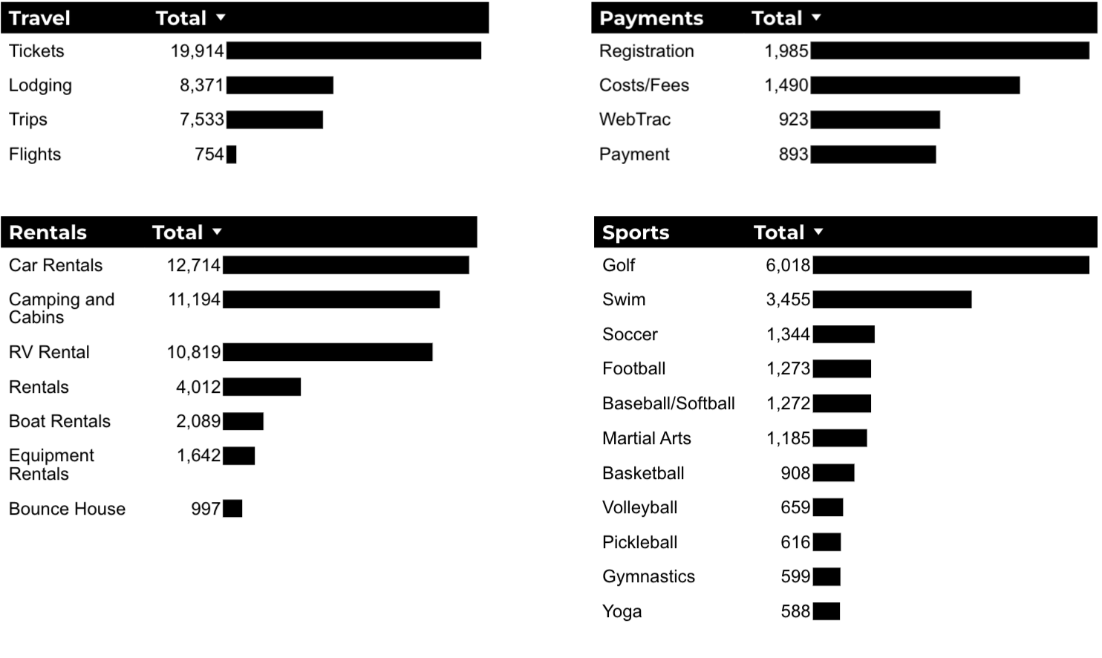
What Are The Top Search Sub-Topics?
The most popular search categories and terms within BRD

