Slide 1
ACS Annual FY24 Insights
​

Slide 2
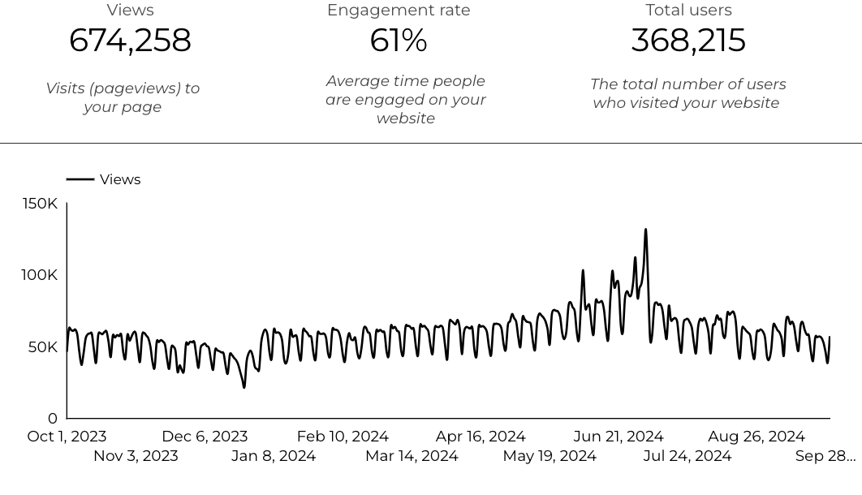
Web Analytics Summary

Slide 3
Traffic Highlights
  ACS pages received 674,258 visits last FY.
  Engagement on ACS pages was 61%.
  There were 368,215 total users who made a visit to ACS.
  15,727 visits were directed from social media platforms.
  Most of the social traffic came from Facebook.

Slide 4
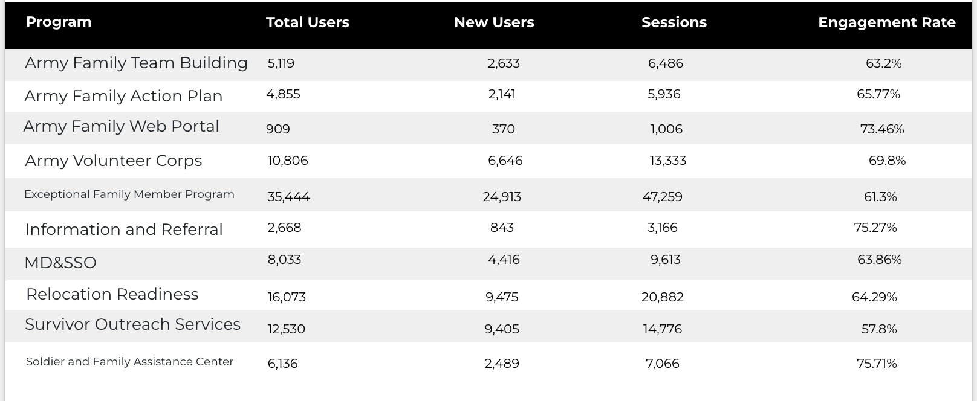
Program Roll-Up

Slide 5
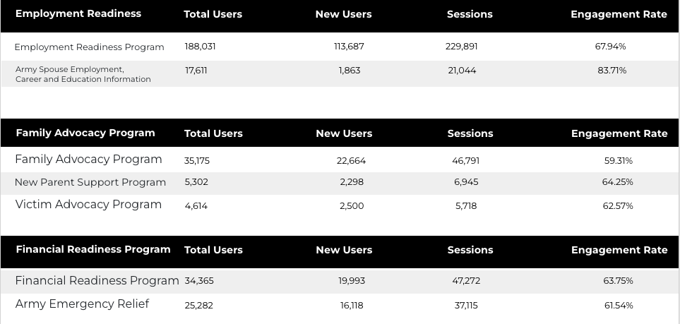
Program Roll-Up

Slide 6
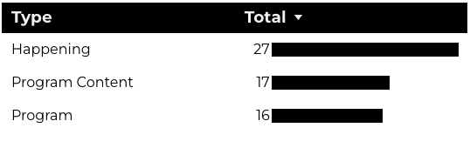
New Pages
Web managers created 60 new ACS pages, program pages, and happenings on EPW last year. (Data from EPW Page Report)
Total page types

Slide 7
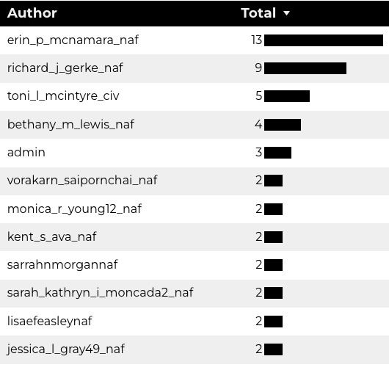
Top Content Creators

Slide 8
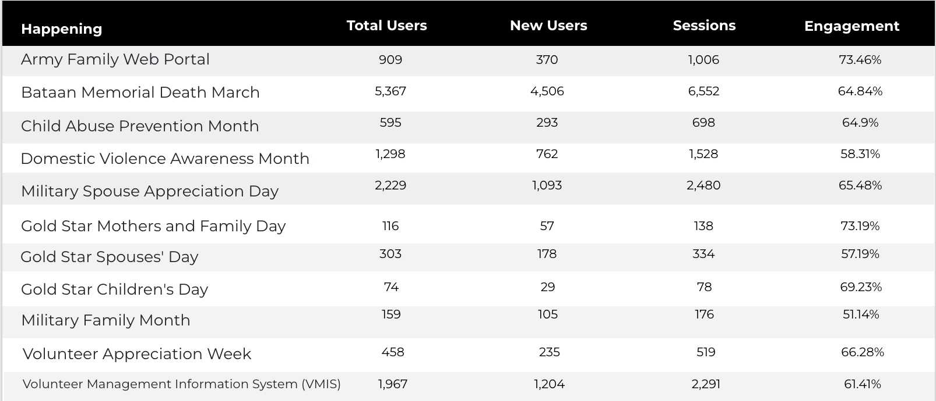
Happenings

Slide 9
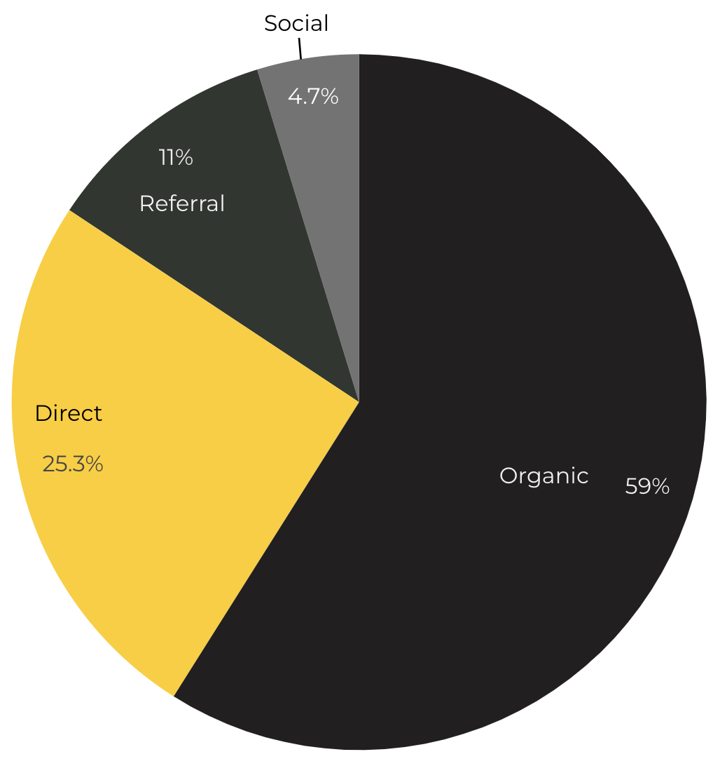
Marketing Reach
59% of visitors came from Organic Search engine queries.
25.3% of visitors came directly to the site (by typing in the address, using bookmarks, or email links).
11% of visitors came from Referral links on 3rd party web sites.
4.7% of visitors came from Social Media.

Slide 10
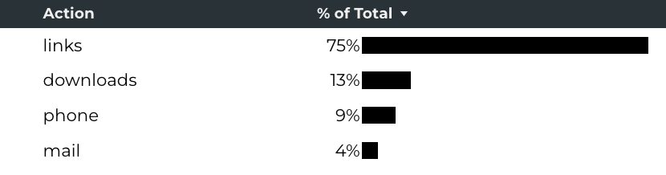
Engagement Insights & Highlights
Last FY had a total of 548,645 interactions on the ACS pages (interactions are downloads, email clicks, phone number clicks, and outbound links).
Phone
Outbound Clicks

Slide 11
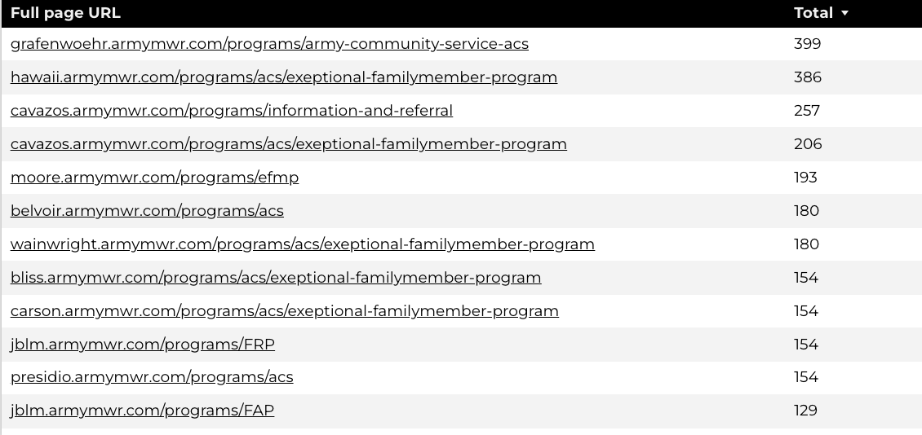
Insights & Highlights
Last FY, 47,574people required assistance from a live person.
Top ACS programs that received phone calls from the web.

Slide 12
Search Intent
Search intent is defined as being the underlying purpose behind an online query.
44% of searches were aimed at finding an answer to a specific question or acquiring general information.
45% of searches were conducted to explore brands or services with the intention of completing an action or making a purchase.
11% of searches were intended to locate a specific program page using the on-site search.

Slide 13
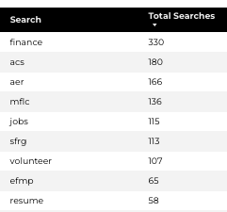
Search Insights
Top Search Terms
8431 Total on-site searches on ACS pages to find more information.
2.54% of users left the site after performing a search.
Notes:
.

Slide 14
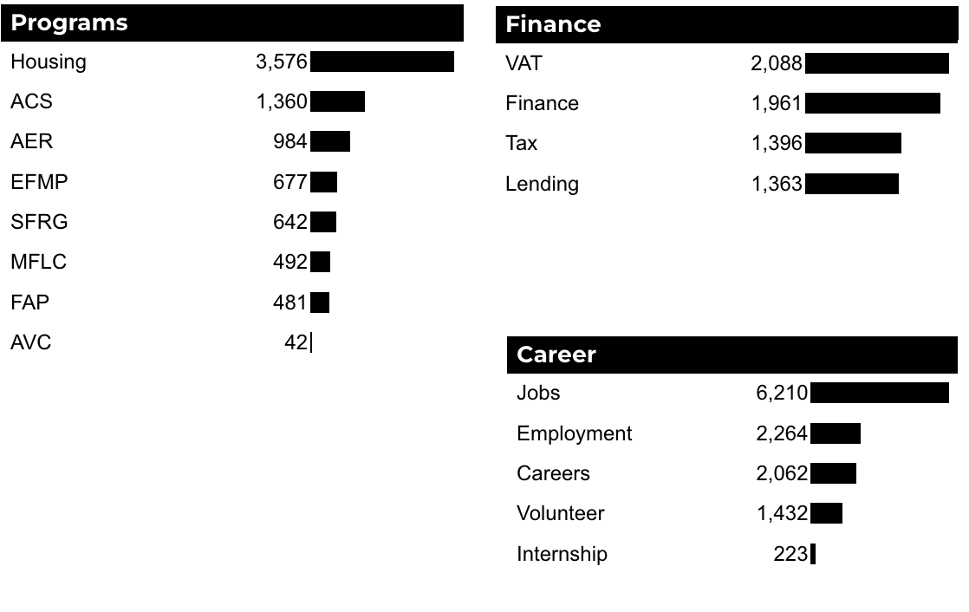
What Are The Top Search Sub-Topics?
The most popular search categories and terms within ACS.

